Slide 1



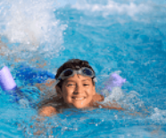
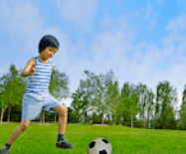
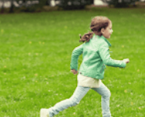

5
My hobbies
LESSON 2
Period 3

Slide 2

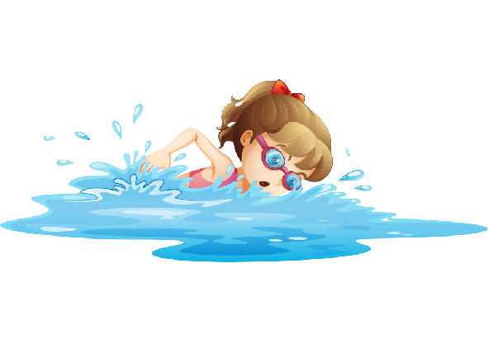
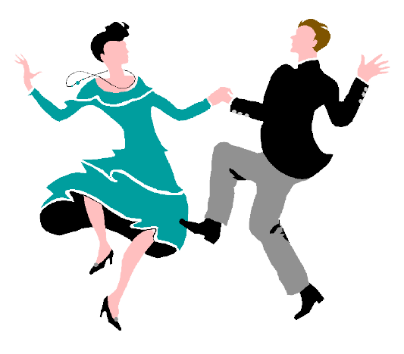

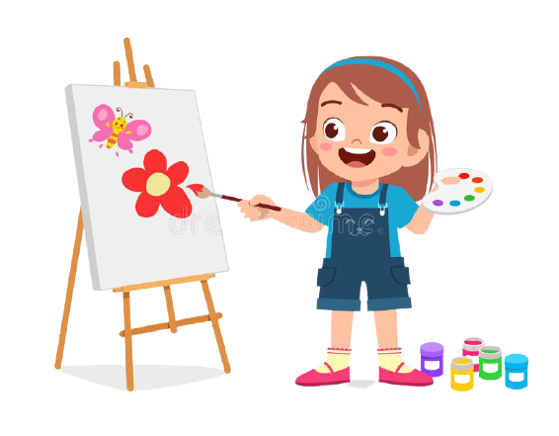


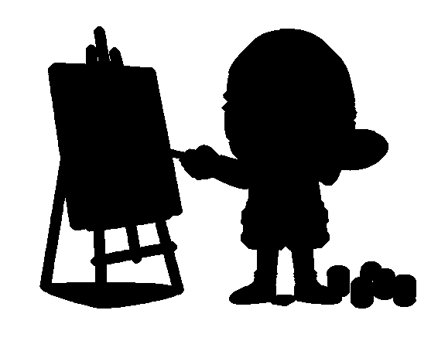
Warm – up: Game
1
2
3
4
5
6
7
8
Notes:
- T divides class into 2 teams (Boys and Girls).
- Pupils in 2 teams take turn to open the boxes to match the shadows and their original pictures (open: click the numbers-close: click the red signs).
- Pupils of each team will get points if their matching is correct.
- Review hobbies: singing, drawing, dancing, swimming.

Slide 3
singing
Notes:
T shows the shadows with their pictures and say the words and gives sentences: “They are _____.”, “She is _____.”, “He is _____.”.

Slide 4
drawing
Notes:
T shows the shadows with their pictures and say the words and gives sentences: “They are _____.”, “She is _____.”, “He is _____.”.

Slide 5
swimming
Notes:
T shows the shadows with their pictures and say the words and gives sentences: “They are _____.”, “She is_____.”, “He is _____.”.

Slide 6
dancing
Notes:
T shows the shadows with their pictures and say the words and gives sentences: “They are _____.”, “She is _____.”, “He is _____.”.

Slide 7
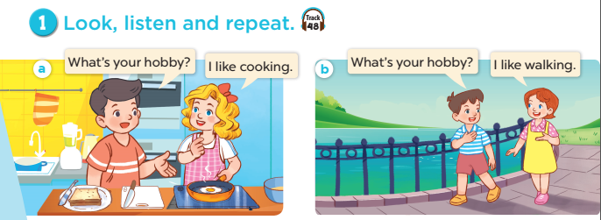

Notes:
Step 1: Have pupils look at Pictures a and b and identify the characters in the pictures.
Step 2: Ask pupils to look at Picture a. Play the recording for them to listen. Play the recording
again, sentence by sentence, for pupils to listen and repeat. Follow the same procedure with
Picture b. Correct their pronunciation where necessary.
Step 3: Play the recording again for pupils to listen and repeat in chorus sentence by sentence.
Step 4: Invite a few pairs to the front of the classroom to listen and repeat the sentences in the
recording.
Step 5: Draw their attention to the question What’s your hobby? and the answers I like cooking.
and I like walking. Tell pupils that they are a question and answers about hobbies.

Slide 8
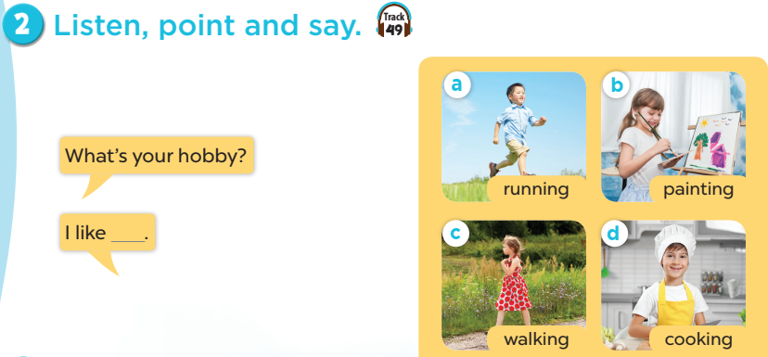
Notes:
Step 1: Have pupils look at the pictures and elicit the names of the hobbies.
Step 2: Have pupils point at Picture a (a boy running), listen to the recording and repeat the
word (running). Follow the same procedure with the other three pictures. Have the class
repeat the words a few times.
Step 3: Point at the bubble and have pupils listen and repeat after the recording (What’s your
hobby?). Point at Picture a and have pupils listen and repeat after the recording (I like
running.). Follow the same procedure with the other three pictures.
Step 4: Have pairs practise asking and answering the question What’s your hobby? – I like
_____.
Step 5: Invite a few pairs to point at the pictures and say the questions and answers in front of
the class.

Slide 9
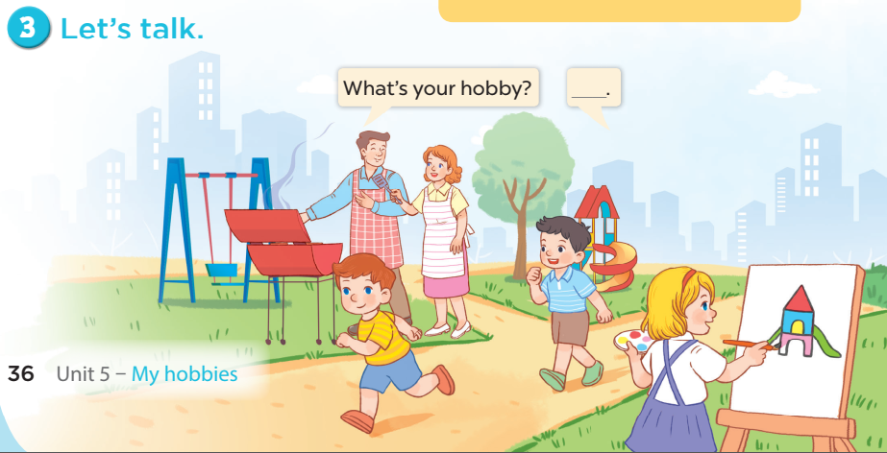
3. Let’s talk
Notes:
Step 1: Draw pupils’ attention to the picture. Tell them about the activity. Ask questions to help
them understand the context (see Input).
Step 2: Put pupils into pairs and encourage them to ask and answer questions using the target
sentence patterns. Go around the classroom to offer support where necessary.
Step 3: Invite some pairs to stand up to perform their exchanges.

