Slide 1





















Unit 4
My house
Lesson 1 – Task 1,2,3
Notes:
Để nguyên trang bìa như này, chỉ thay đổi tên bài trong quá trình làm. Logo của sách Wonderful World

Slide 2




Warm up

Slide 3




Movement Game: Hip hip hooray
Hands up!
Hands down!
Hip hip hooray
Go to Wonderful World!
Notes:
+ Hands up: raise 2 hands up
+ Hands down: Put to hands down
+ Hip hip hooray (2 times): smack 2 hands on hips then put hands to mouth when saying hooray (2 times)
+ Go to Wonderful World: join 2 hands and make waves then raise both hands up and wave.

Slide 4


Slide 5
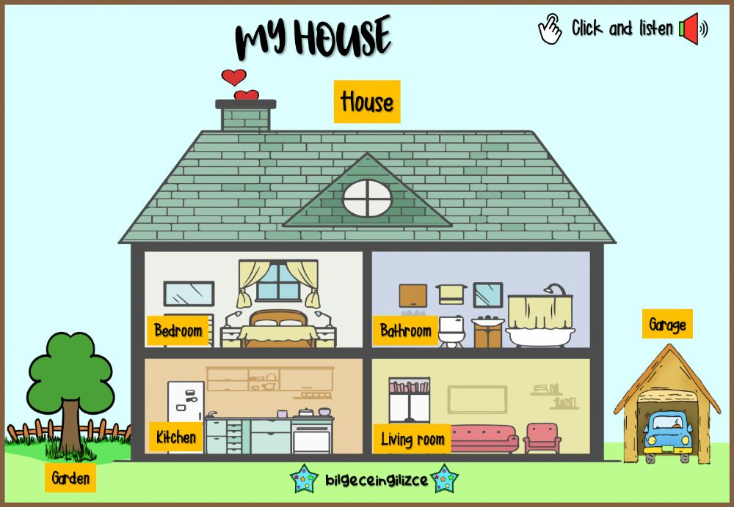
LEAD IN
Notes:
Lead in: Teacher introduces your house

Slide 6

Presentation

Slide 7
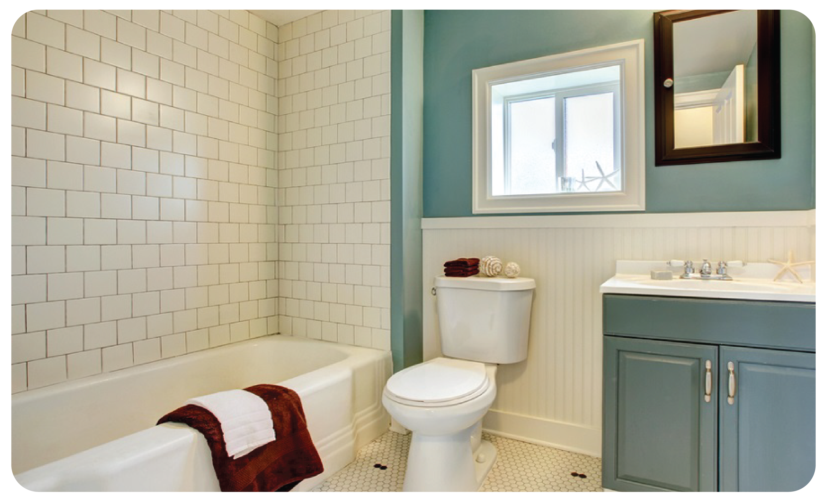
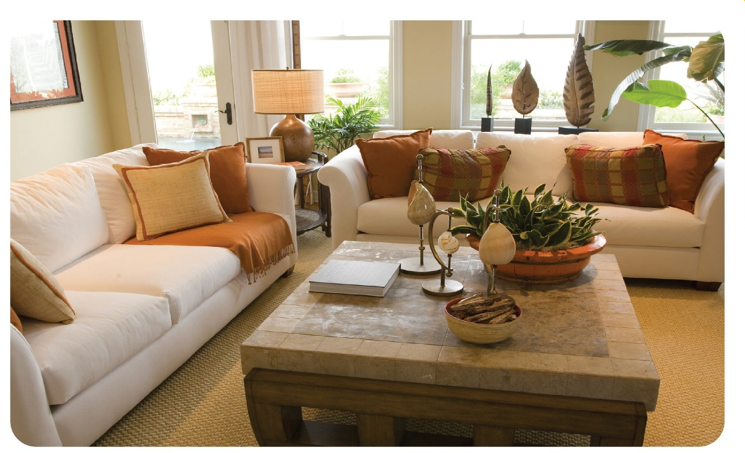
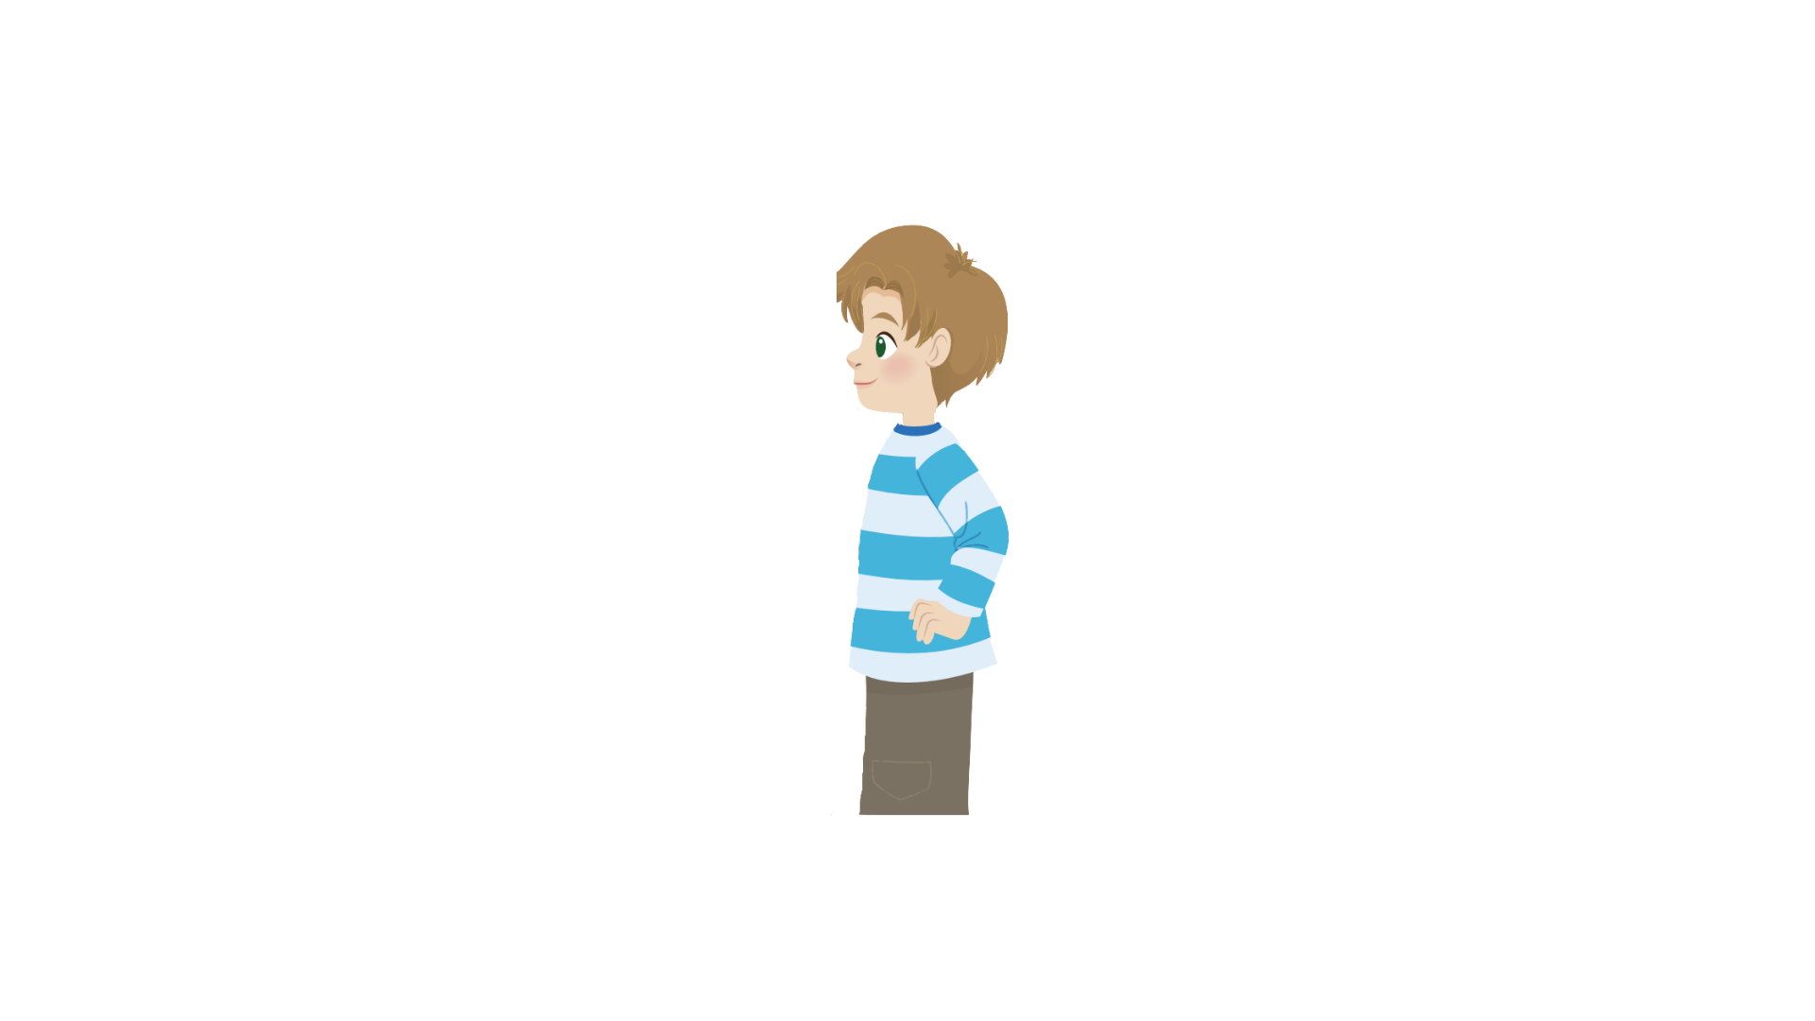

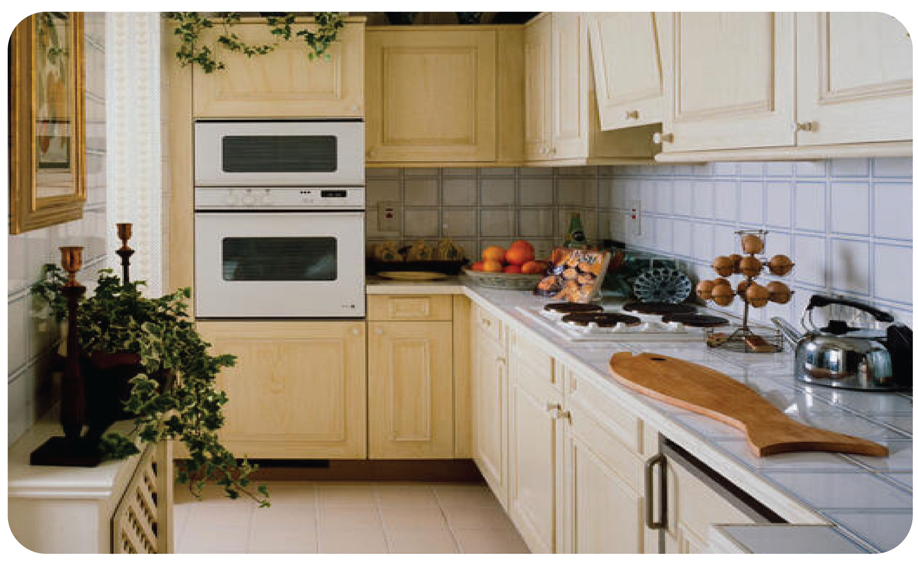
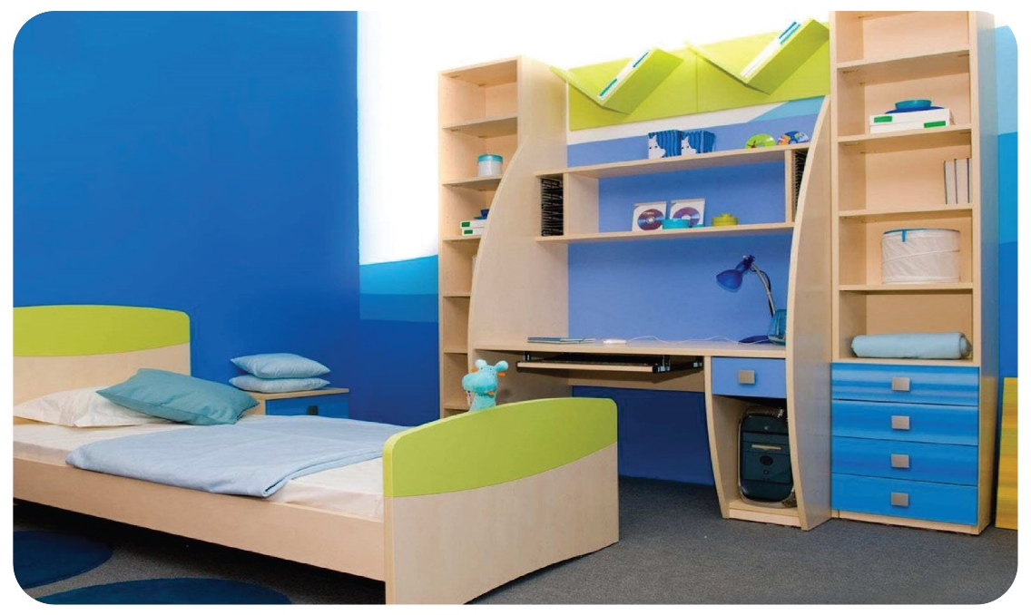
1 Listen and point. Repeat.
bathroom
living room
kitchen
bedroom

Slide 8
1
Listen and repeat.
bathroom

Slide 9

living room

Slide 10
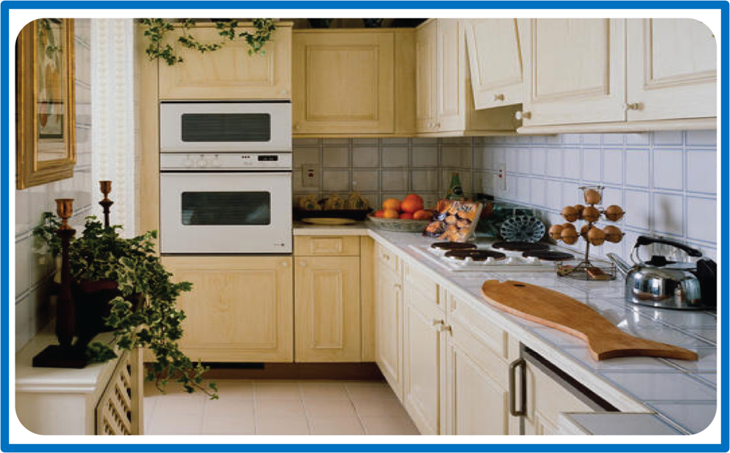
kitchen

Slide 11

bedroom

Slide 12
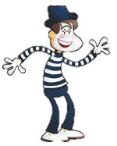
MIMING GAME
bathroom
living room
kitchen
bedroom

Slide 13

Practice

Slide 14

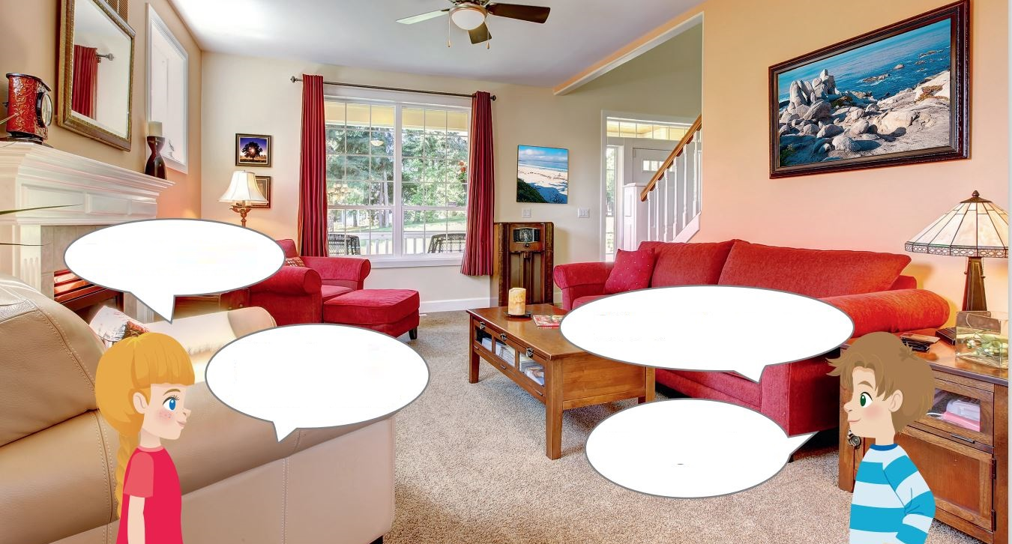
2
Listen and tick.
What’s this?
It’s a living room.
It’s nice.
What’s that?
It’s a garden.
The living room garden is nice.
✓
Notes:
HOẠT ĐỘNG TƯƠNG TÁC: chèn file nghe
Listen and tick:
The ______ is nice.
living room
garden

Slide 15
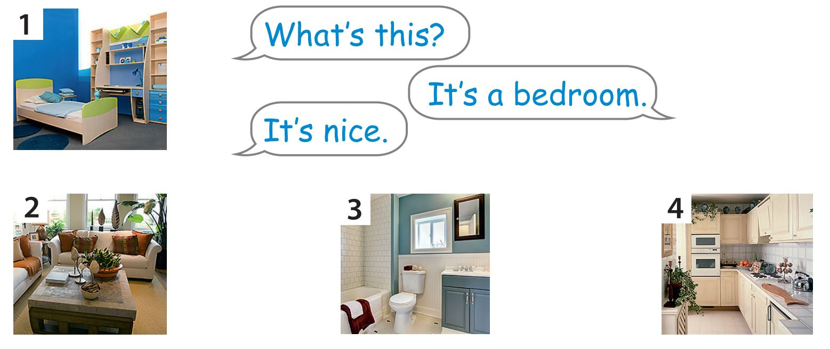
3
Look. Ask and answer.

Slide 16





What’s this?
It’s a bedroom.
It’s nice.
bedroom

Slide 17
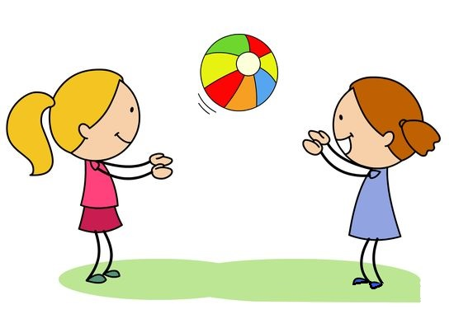
Pass the ball Game
Start

Slide 18

1
2
3
Next

Slide 19


What’s this?
It’s a bathroom.
It’s nice.
1

Slide 20
What’s this?
It’s a living room.
It’s nice.
2

Slide 21
What’s this?
It’s a kitchen.
It’s nice.
3

Slide 22

Production

Slide 23

Miming Game
Notes:
Work in groups. A student mimes one of the activities in the room and the others try to guess the name of the room. Then swap.
What’s this?
It’s…….

Slide 24

Assessment

Slide 25
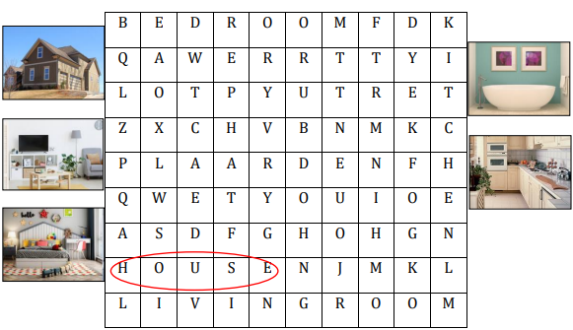
Notes:
HOẠT ĐỘNG TƯƠNG TÁC

Slide 26



Slide 27




Good bye.
See you again!

