Slide 1





















Unit 4
My house
Lesson 2 – Task 1,2,3
Notes:
Để nguyên trang bìa như này, chỉ thay đổi tên bài trong quá trình làm. Logo của sách Wonderful World

Slide 2




Warm up

Slide 3
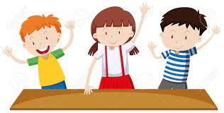



Movement Game: Hip hip hooray
Hands up!
Hands down!
Hip hip hooray
Go to Wonderful World!
Notes:
+ Hands up: raise 2 hands up
+ Hands down: Put to hands down
+ Hip hip hooray (2 times): smack 2 hands on hips then put hands to mouth when saying hooray (2 times)
+ Go to Wonderful World: join 2 hands and make waves then raise both hands up and wave.

Slide 4

Presentation

Slide 5


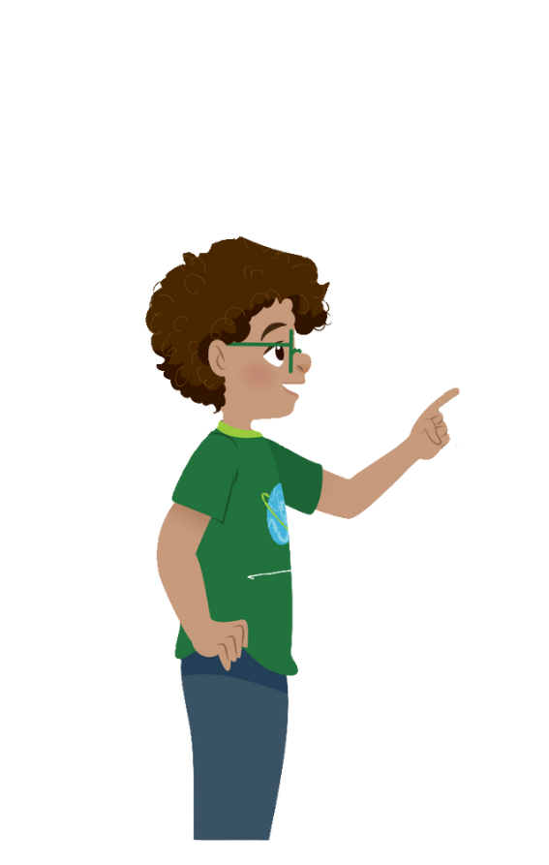
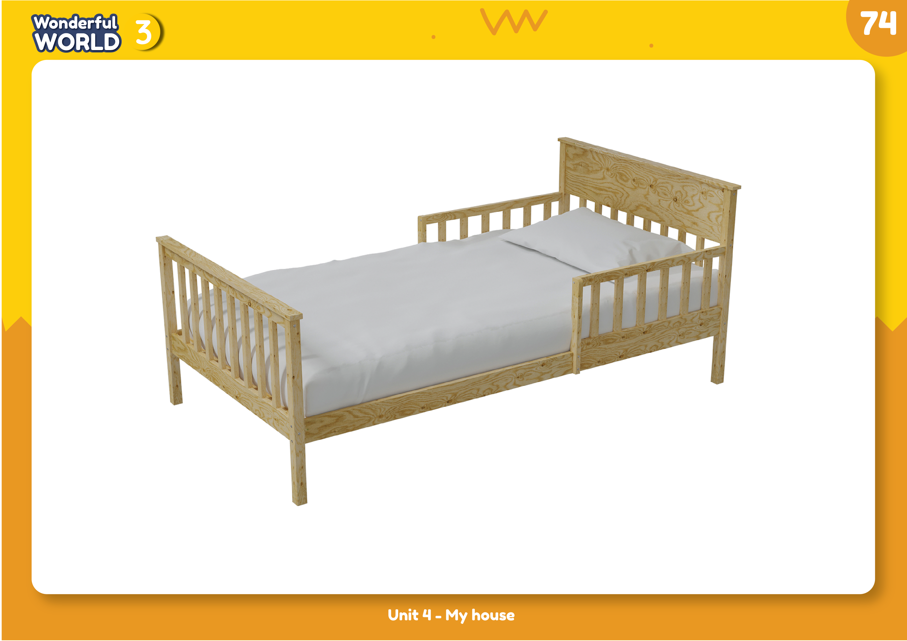
1
Listen and point. Repeat.
bed

Slide 6
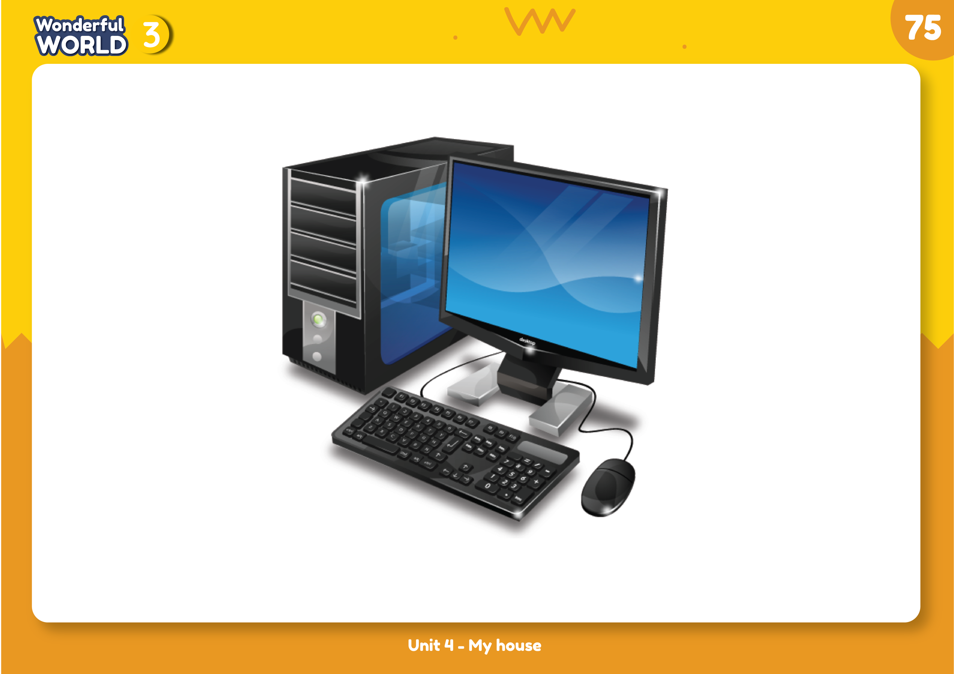
computer

Slide 7
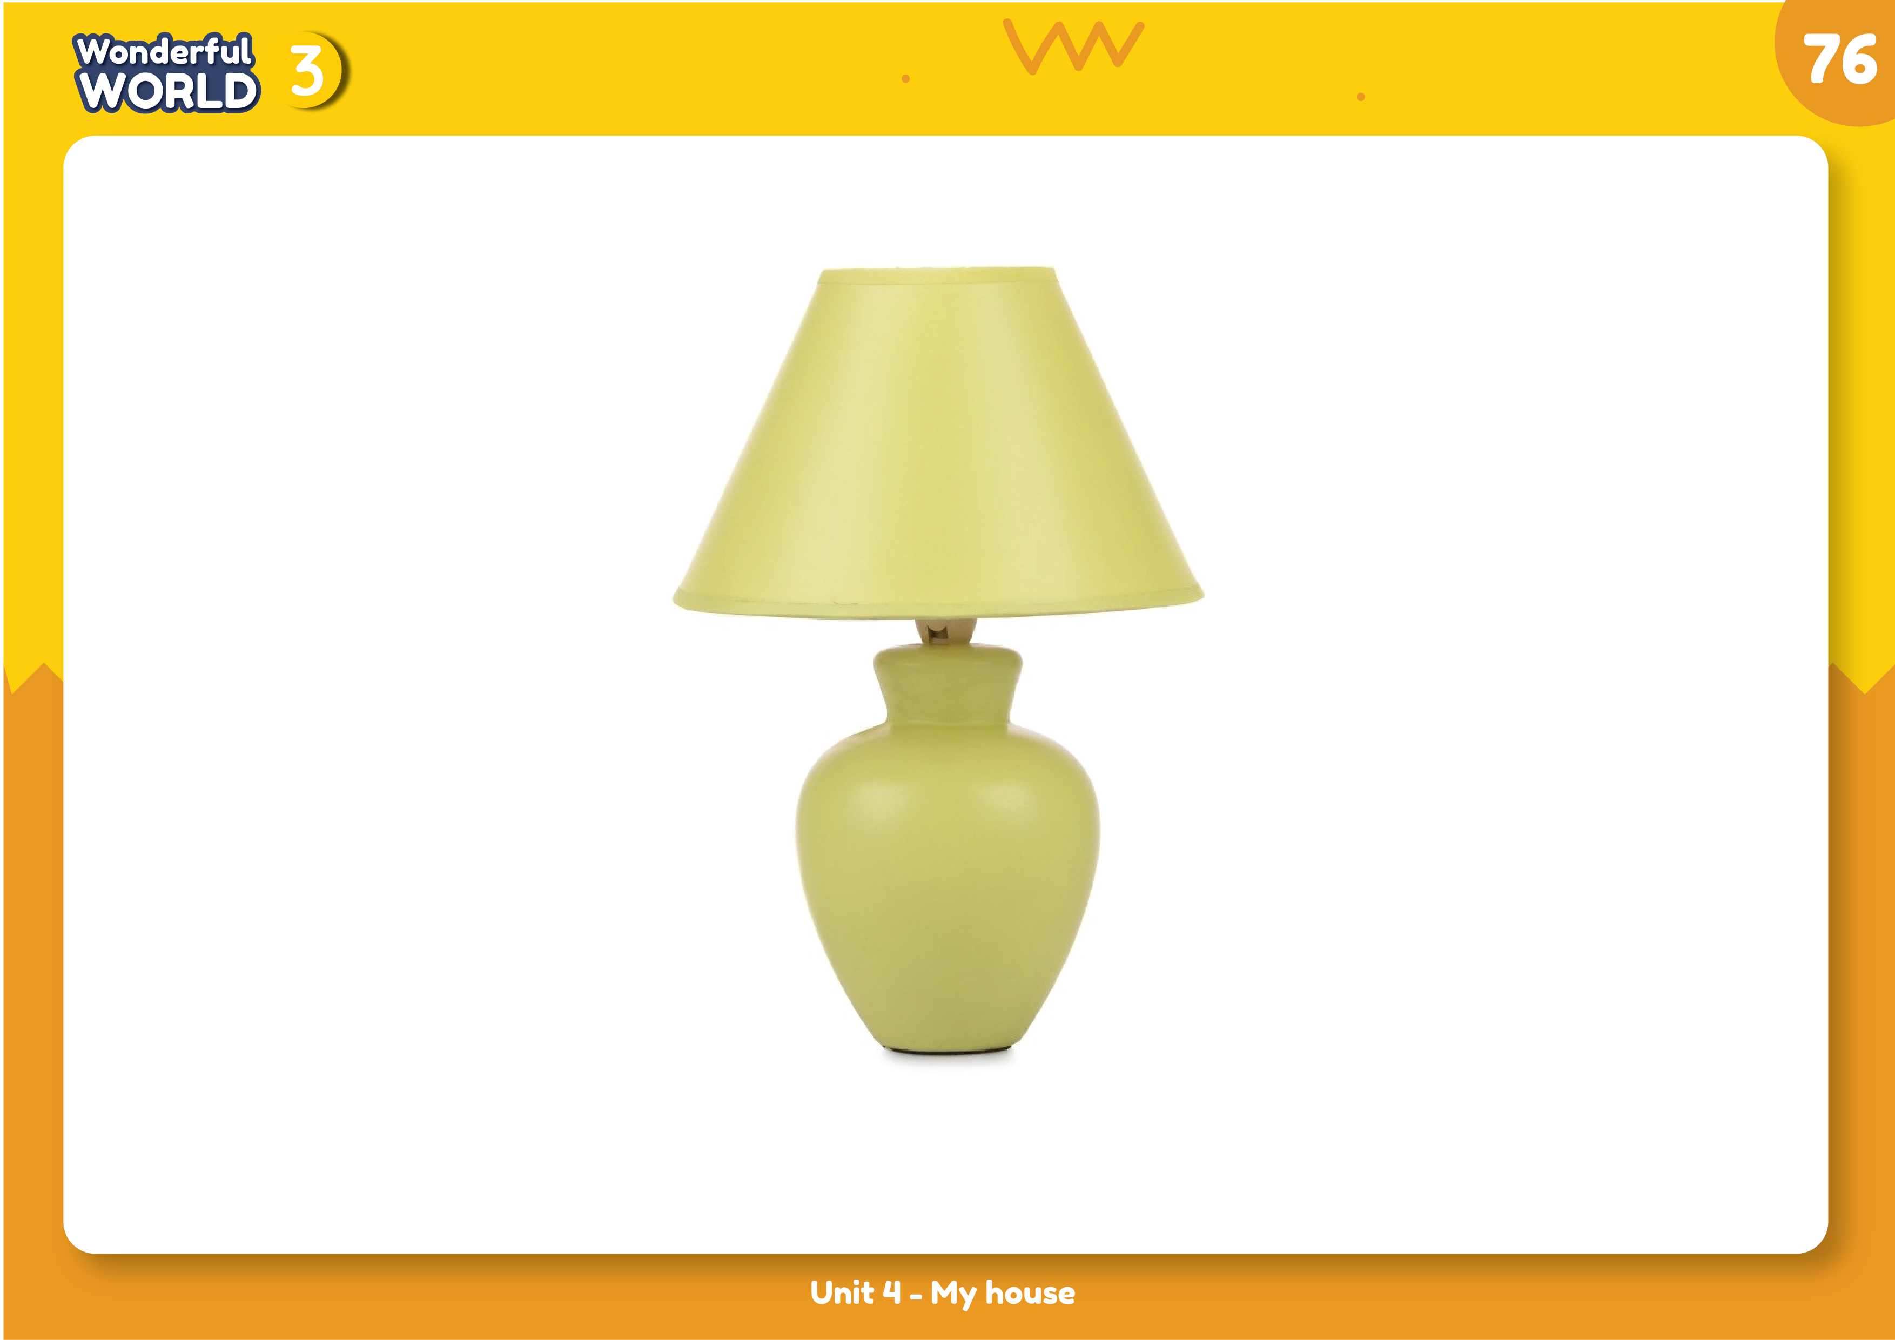
lamp

Slide 8
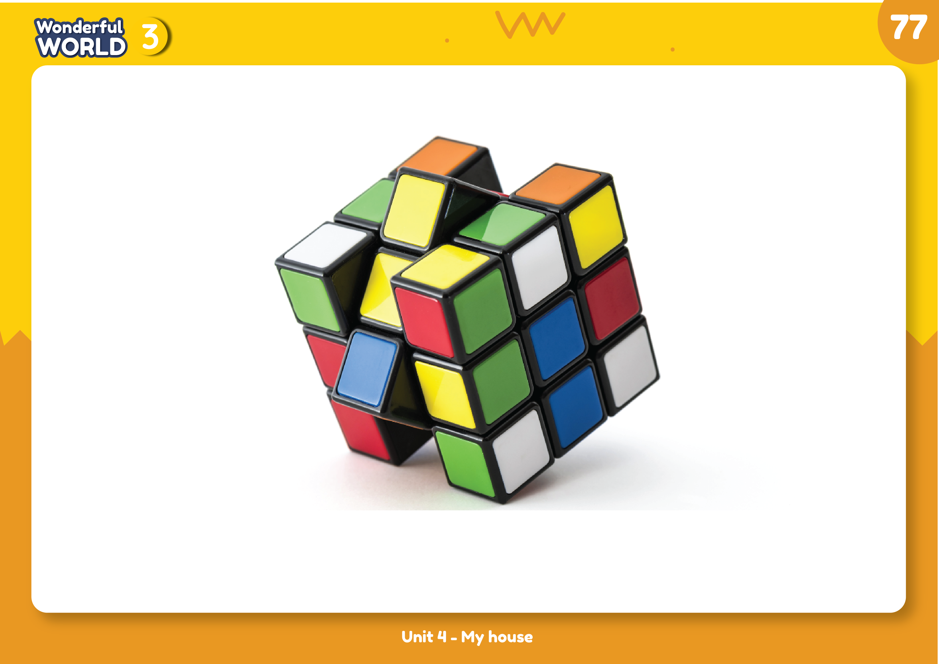
toy

Slide 9
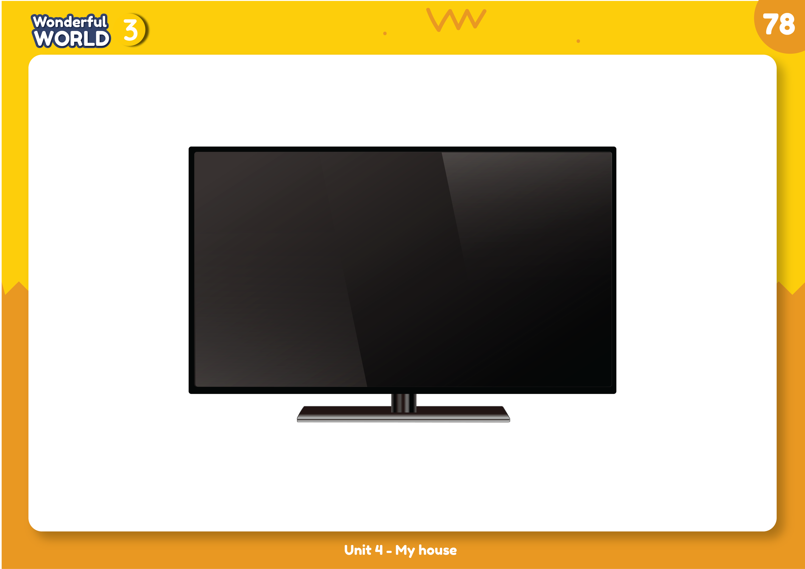
TV

Slide 10





bed
computer
lamp
toy
TV

Slide 11

SPEED SLAP GAME
bed
computer
lamp
toy
TV
Notes:
Phần này GV có thể đọc để hs Slap cho hay hay click chuột cũng đc

Slide 12






Practice
Task 2: Listen and write

Slide 13

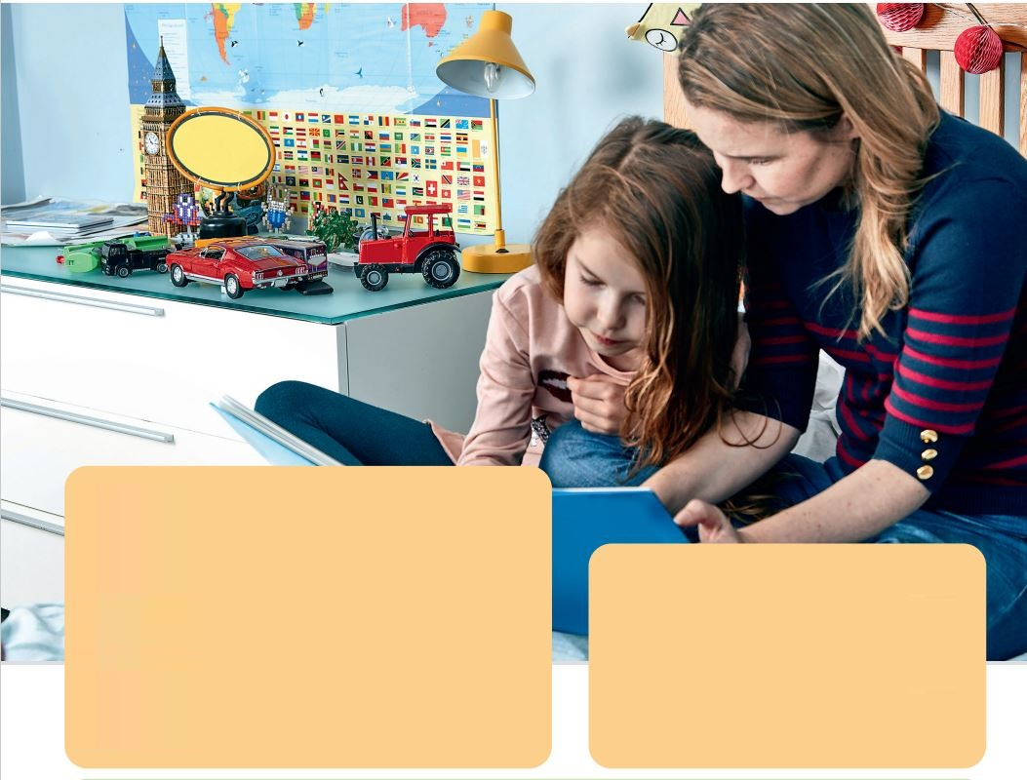
Jane:
Is that your mum, Agata?
Agata:
Yes, it is. We’re in my bedroom.
Jane:
Are there toys?
Agata:
Yes, there are.
Jane:
Is there a bed?
Agata:
Yes, there is. There’s a lamp and there’s a clock, too.
Jane:
Your bedroom is so nice!
Notes:
GV có thể cho hs nghe 2 lần
GV có thể gọi 2 bạn đàm thoại lại mẫu này.

Slide 14

2
Listen and write.
There’s a bed in the _______. There’s a ___ and there’s a clock, too.
bedroom
lamp
Notes:
HOẠT ĐỘNG TƯƠNG TÁC: hs nghe và viết từ còn thiếu vào chỗ trống
bedroom
lamp

Slide 15
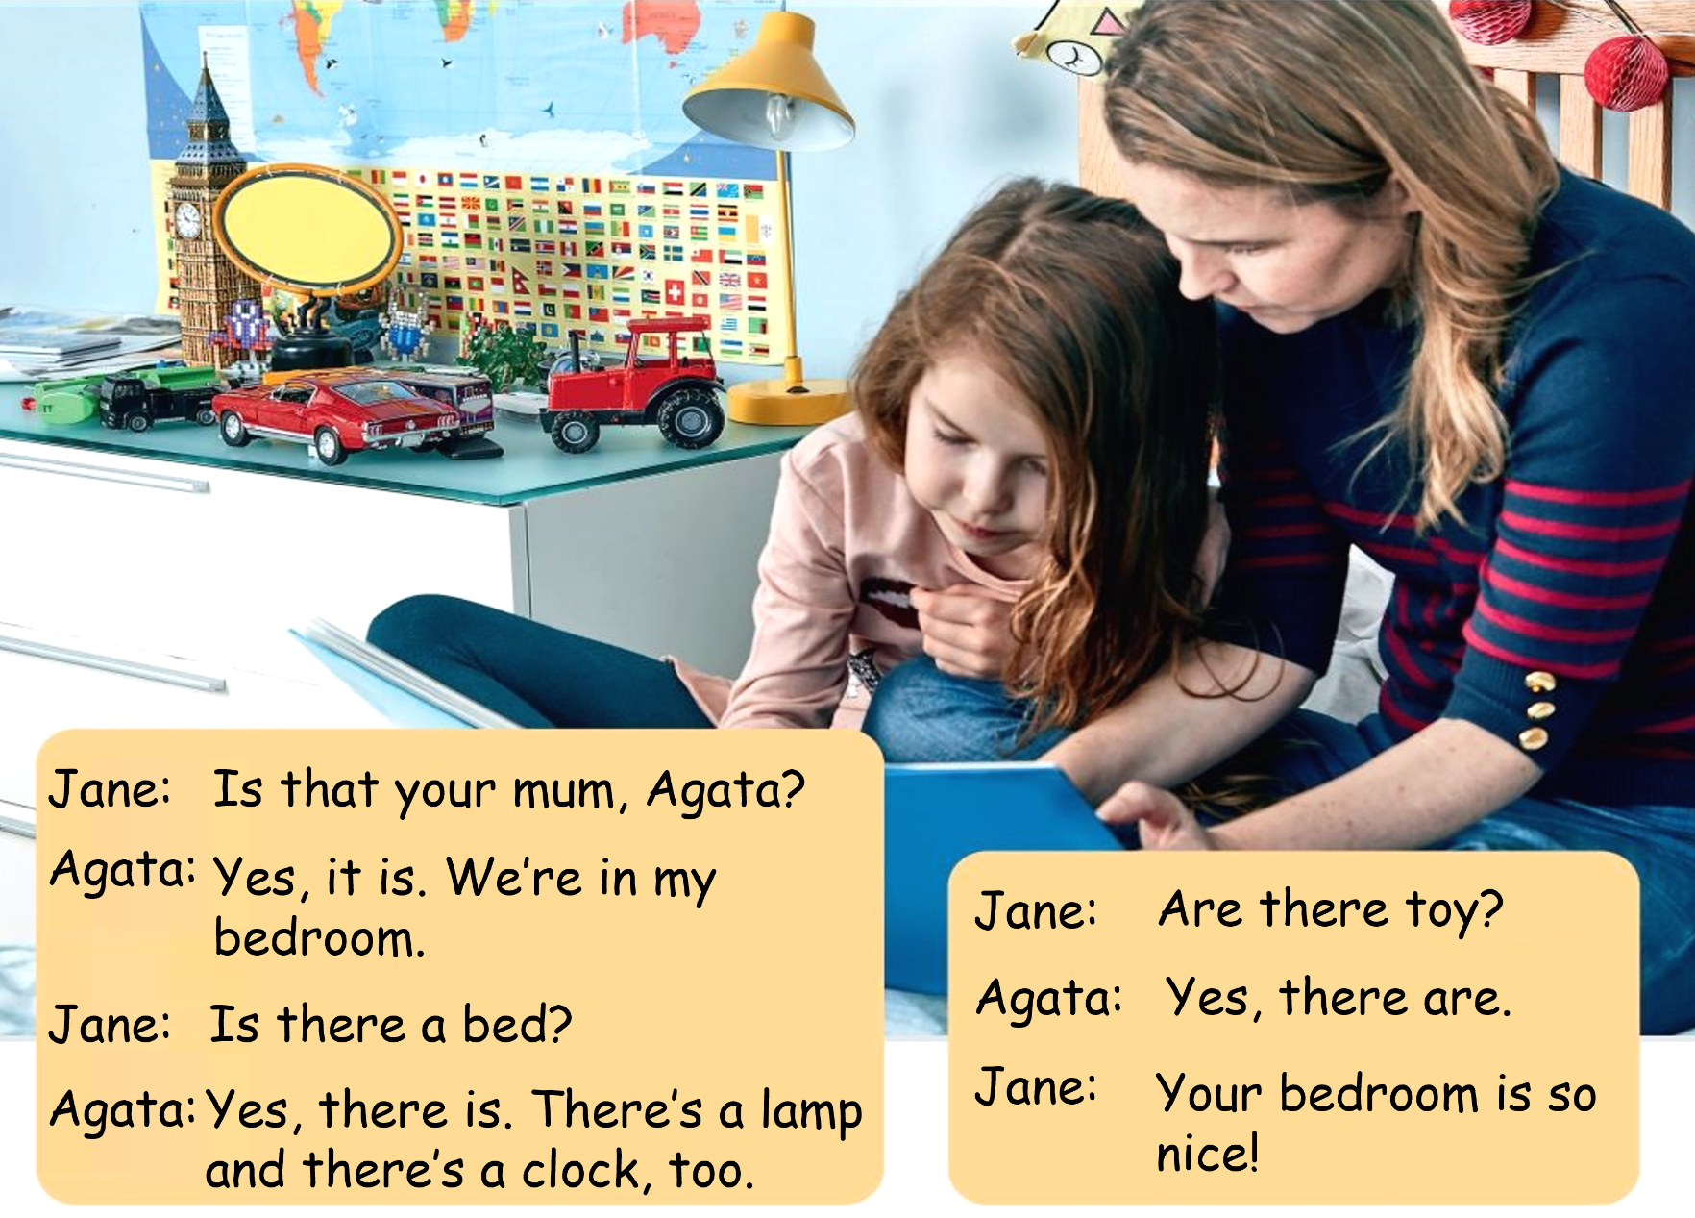

3
Look at the photo 2. Tick and say what you can see.
✓
✓
a girl
a computer
There’s a girl in the bedroom.
There’s a lamp, too.
a TV
✓
a book
✓
a lamp
a bed
✓
toys

Slide 16

Production

Slide 17
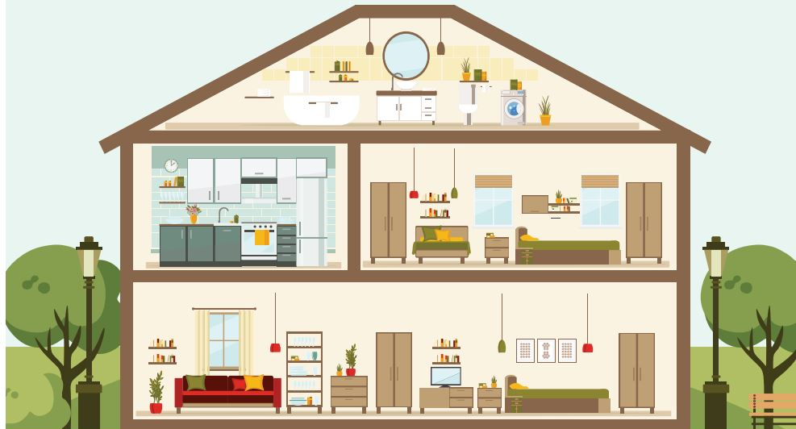

Slide 18

Assessment

Slide 19
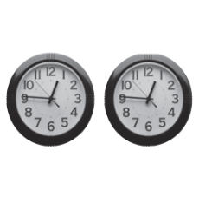

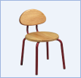

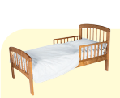




Look and read. Put tick (✓) or cross (✗) in the box.
There are two pens.
Ex:
This is a chair
1.
This is a bed.
4.
There is a lamp.
2.
This is a TV.
3.
5.
There are two toys.
This is a board.
Notes:
HOẠT ĐỘNG TƯƠNG TÁC

Slide 20



Slide 21




Good bye.
See you again!

