Slide 1





















Unit 4 My house Lesson 2 – Task 7,8,9
Notes:
Để nguyên trang bìa như này, chỉ thay đổi tên bài trong quá trình làm. Logo của sách Wonderful World

Slide 2







Warm up
Game: Simon say

Slide 3

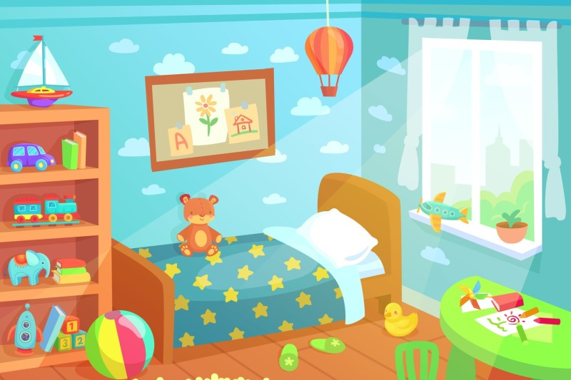
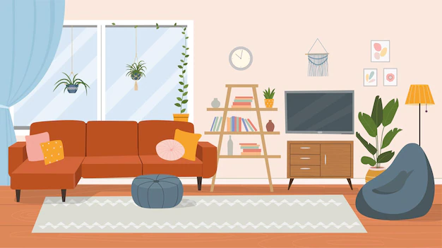
Simon says
BOARD RACE
TV
bed
toys
clock
lamp
computer

Slide 4

Presentation
Task 7: Listen and tick

Slide 5


7
Listen and tick.
In the bedroom:
1
Is there a computer?
Yes
✓
No
2
Are there books?
✓
Yes
No
3
Is there a lamp?
✓
Yes
No
4
Is there a TV?
Yes
✓
No
Notes:
HOẠT ĐỘNG TƯƠNG TÁC: HS NGHE CẢ ĐOẠN VÀ LÀM CẢ 4 CÂU, KHÔNG TÁCH RIÊNG TỪNG CÂU.

Slide 6

Practice
Task 8: Look and say

Slide 7




Sentence jumble

Slide 8
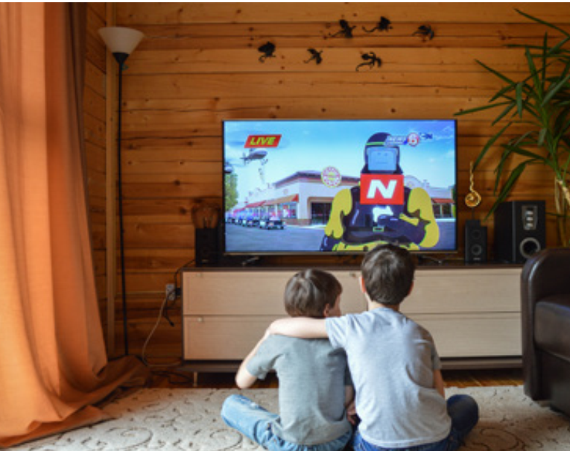
1. TV / There / the / in / living room. / a / is
There is a TV in the living room.

Slide 9
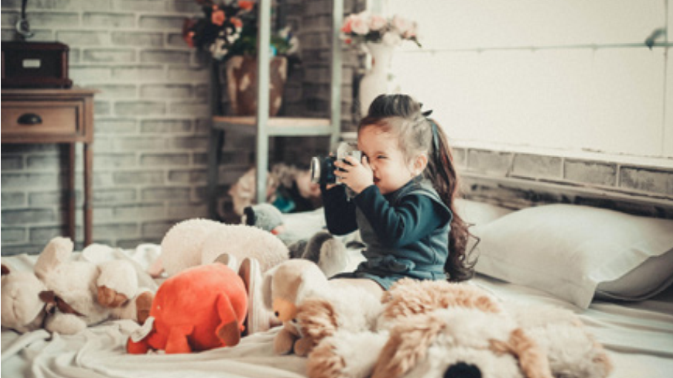
2. bedroom. / isn’t / There / in / a / the / laptop
There isn’t a laptop in the bedroom.

Slide 10
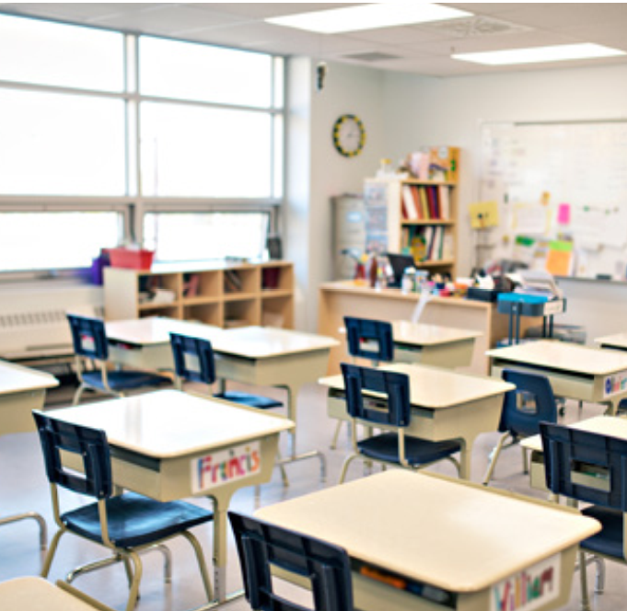
3. chairs /are / classroom. / There / the / in
There are chairs in the classroom.

Slide 11
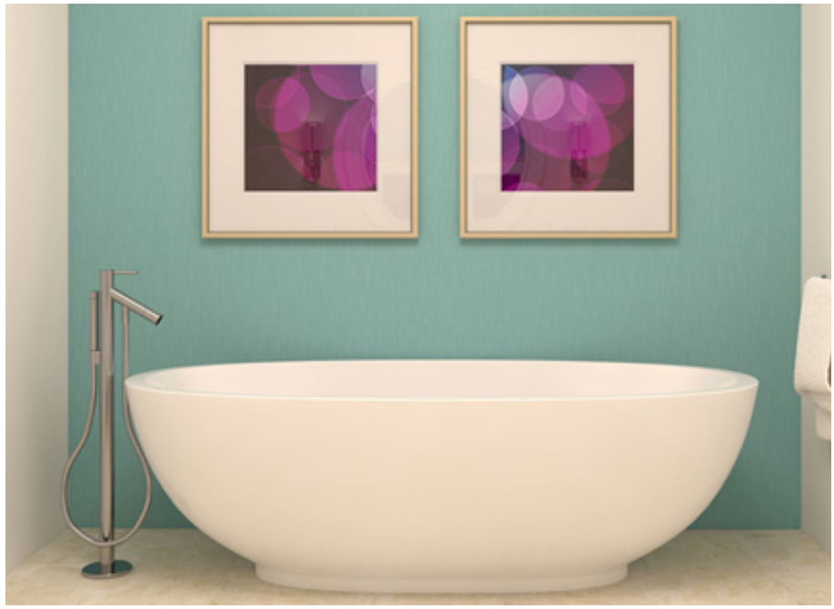
4. in / beds / the / There / bathroom. / aren’t
There aren’t beds in the bathroom.

Slide 12



8
Look and say.
What room is it?

Slide 13
1
There is a TV in the living room.
There isn’t a computer.

Slide 14
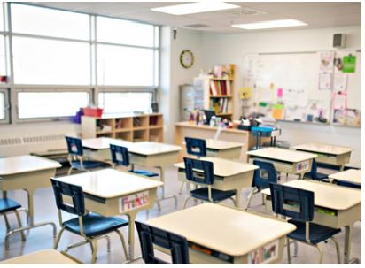
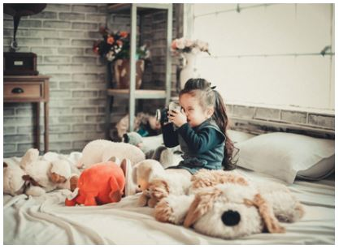
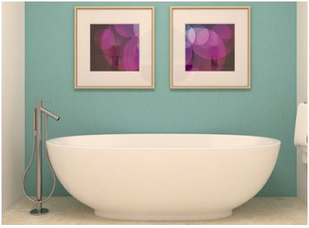

2
3
Speak in groups
4

Slide 15

Production
Task 9: Listen and sing

Slide 16

9
Listen and sing.

Slide 17
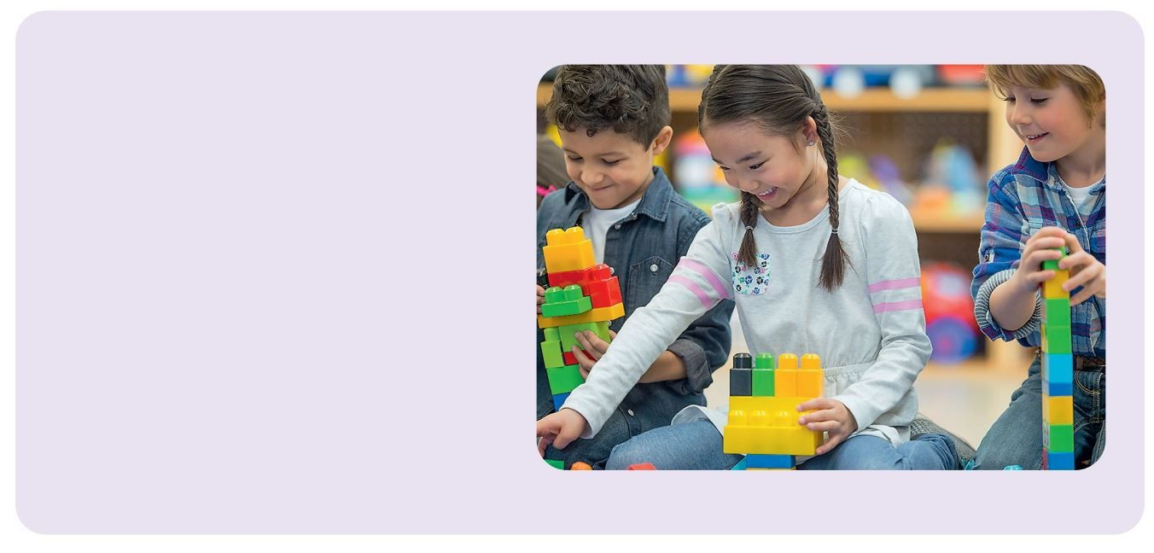
There are toys for you.
There are toys for you.
Are there toys for me?
There’s a book for you.
There’s a book for you.
Is there a book for me?
Yes, there are toys!
Yes, there’s a book!
Hooray! Hooray!
Let’s go home and play!

Slide 18
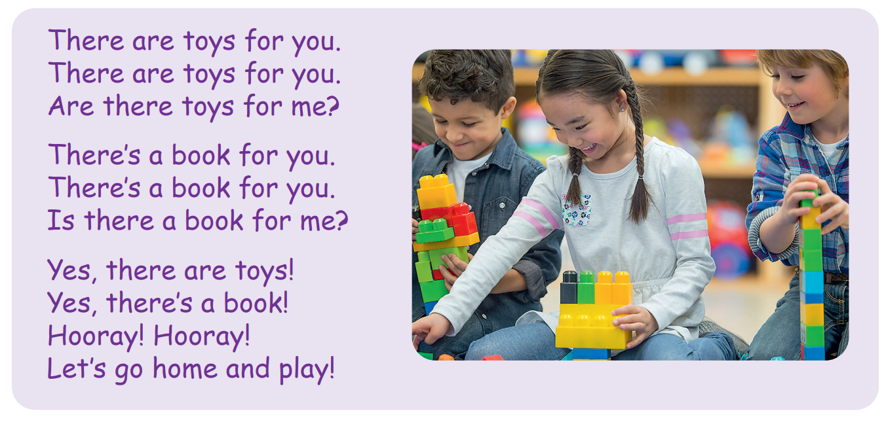

Slide 19

Talented musician

Slide 20

Assessment

Slide 21
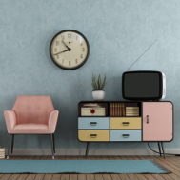
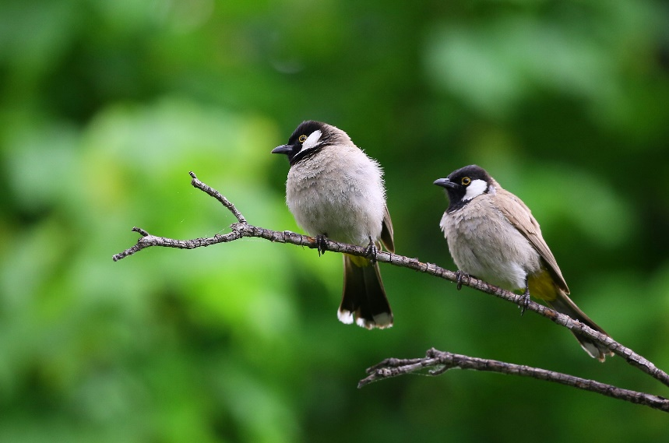
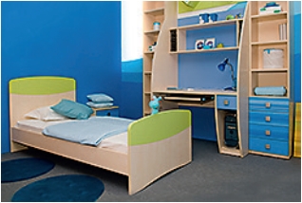
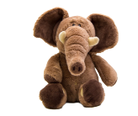

Look at the pictures and draw the lines.
There | is | a bed
 | is | a clock | in the garden.
There |  | a lamp | in the living room.
 | are | toys | in the bedroom.
 |  | a chair
 |  | birds
Notes:
HOẠT ĐỘNG TƯƠNG TÁC

Slide 22
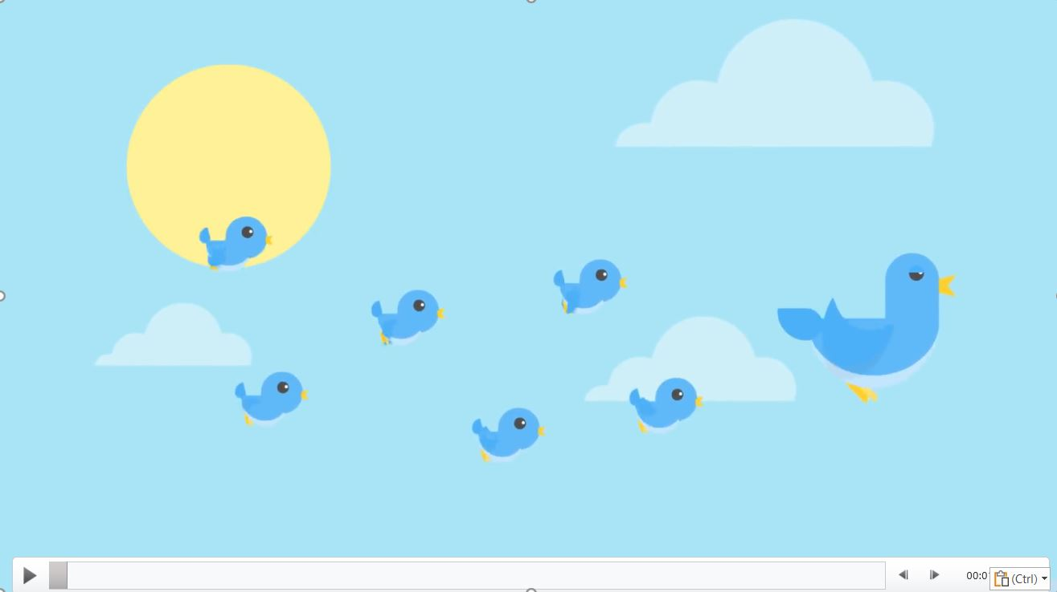


Slide 23




Good bye.
See you again!

