Slide 1





















Unit 4
My house
Lesson 3 – Task 4,5,6
Notes:
Để nguyên trang bìa như này, chỉ thay đổi tên bài trong quá trình làm. Logo của sách Wonderful World

Slide 2







Warm up
Play the brain gym

Slide 3


Slide 4
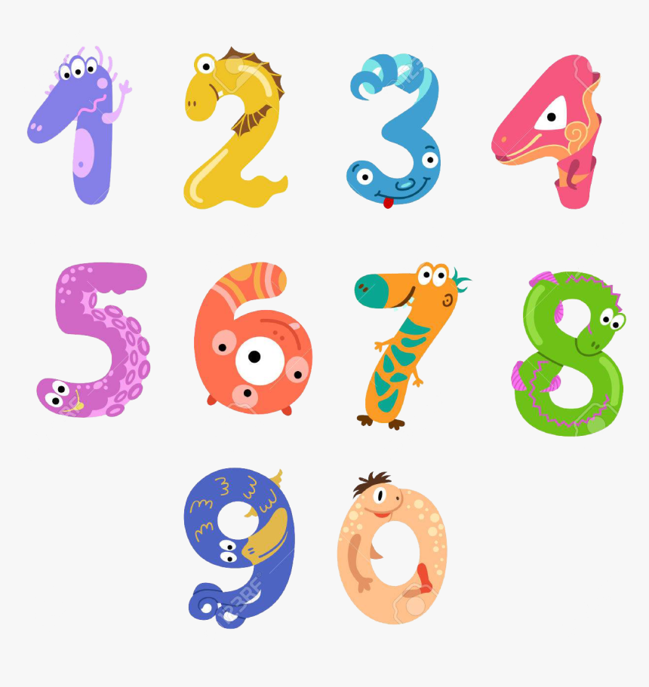
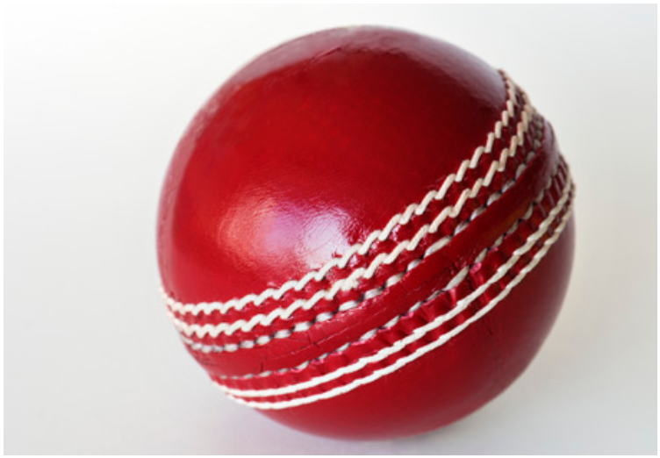
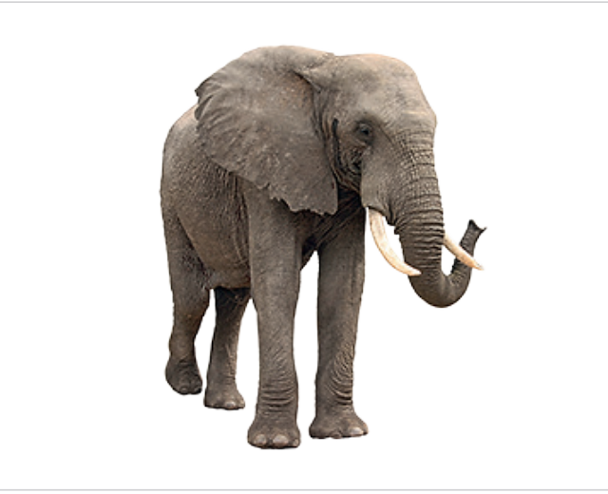
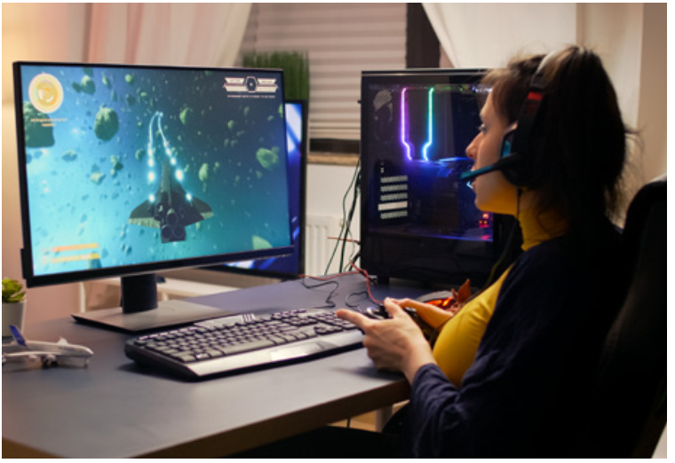
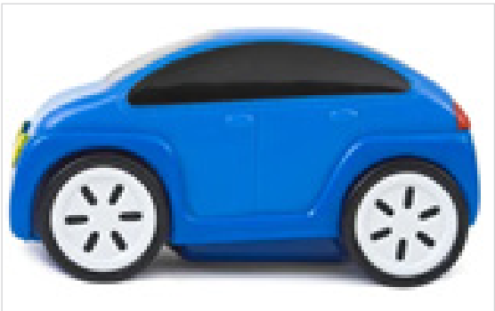
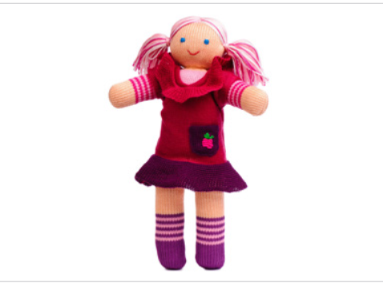
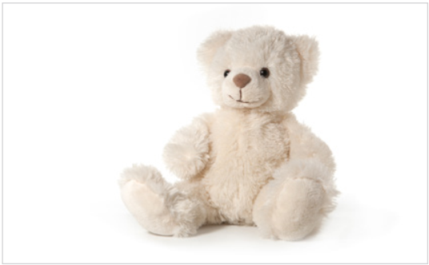
Hidden Treasure Game
Next
a ball
an elephant
a game
a car
a teddy bear
a doll

Slide 5

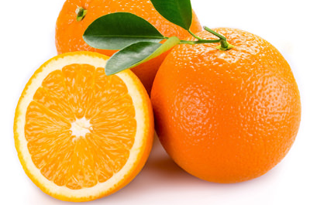
What colour is it?
orange

Slide 6

What colour is it?
red

Slide 7
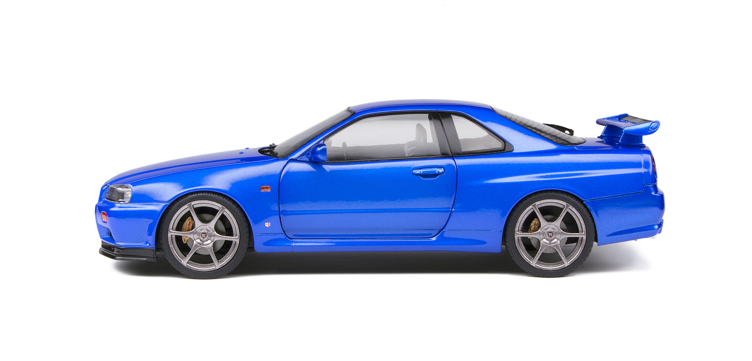
What colour is it?
blue

Slide 8
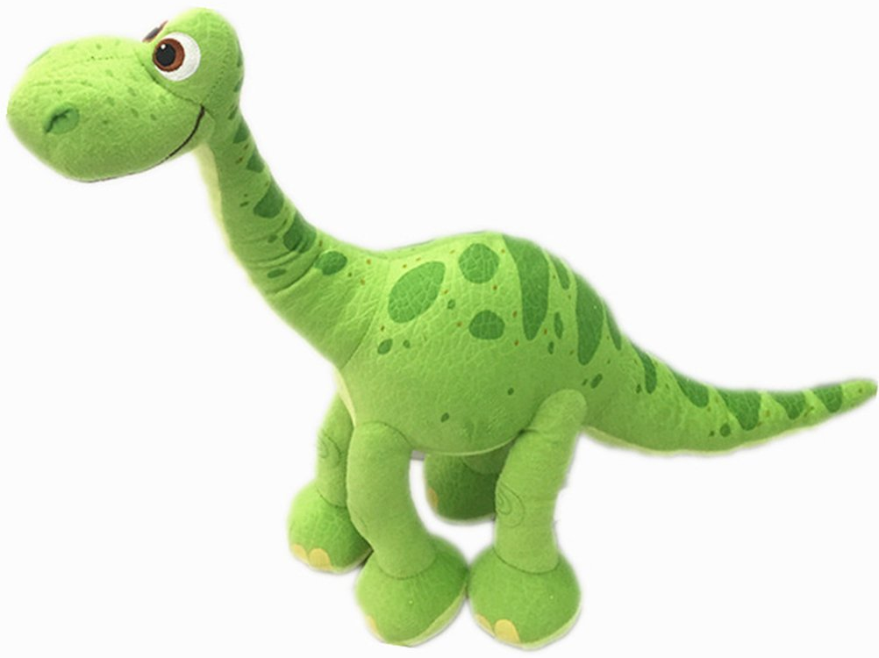
What colour is it?
green

Slide 9
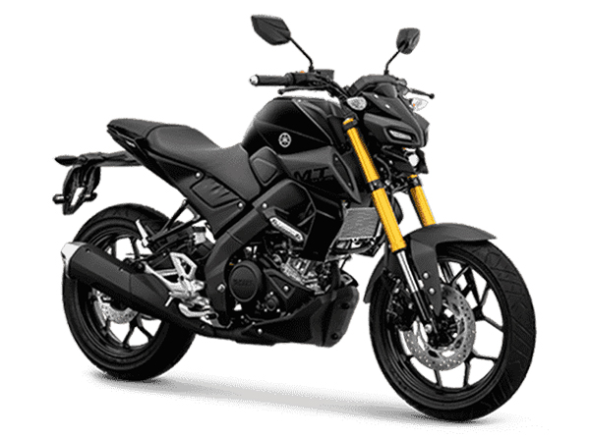
What colour is it?
black

Slide 10
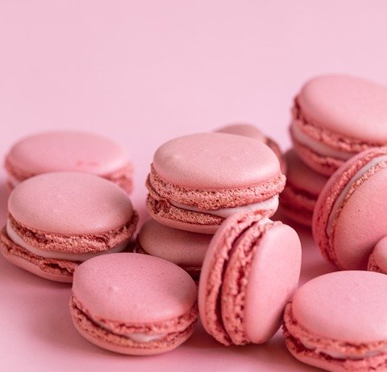
What colour is it?
pink

Slide 11

Presentation
Task 4: Listen and repeat

Slide 12


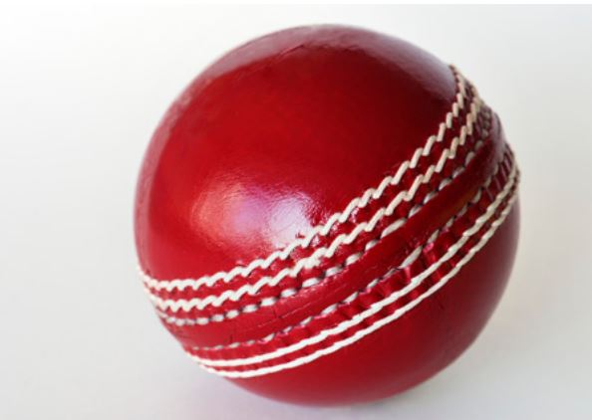
4
Listen and repeat.
1
There’s a ball.
The ball is red.

Slide 13
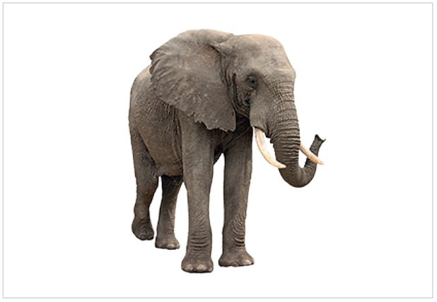
2
There’s an elephant.
The elephant is young.

Slide 14
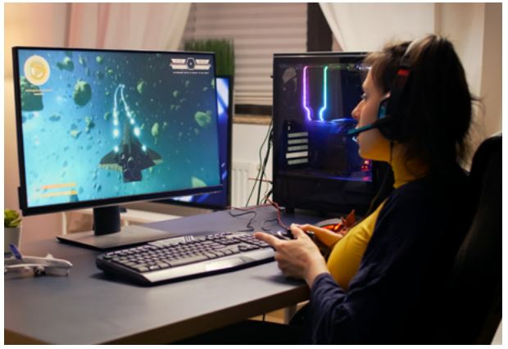
3
There’s a game.
The game is cool.

Slide 15
1
There’s a ball.
2
There’s an elephant.
3
There’s a game.
The ball is red.
The game is cool.
The elephant is young.

Slide 16

Practice
Task 5: Look and say

Slide 17
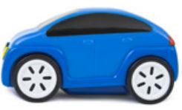
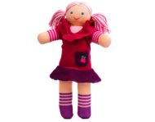
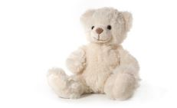
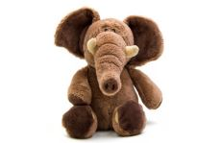

5
Look and say.
There’s a car.
The car is blue.
1
car / blue
2
doll / red
3
teddy bear / white
4
Elephant / nice
5
TV / great

Slide 18
2
doll / red
There’s a doll. The doll is red.

Slide 19
3
teddy bear / white
There’s a teddy bear. The teddy bear is white.

Slide 20
4
Elephant / nice
There’s an elephant. The elephant is nice.

Slide 21
5
TV / great
There’s a TV. The TV is great.

Slide 22


Slide 23

Production
Task 6: Draw and write. Say

Slide 24
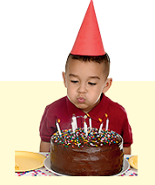

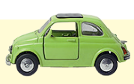


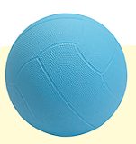
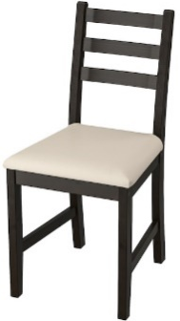
Word maze
Look! | They’re | You | blue | teddy bear | kitchen | birthday
she | my | he | great | white | cool | car
is | toys | There’s | dad | The | orange | computer
ball | lamps | a | beds | isn’t | too | teddy bear
The | TV | doll | and | There’s | a | ball
No | brother | aren’t | kitchen | bathroom | The | chairs
Start
Finish

Slide 25
Word maze
Look! | They’re | You | blue | teddy bear | kitchen | birthday
she | my | he | great | white | cool | car
is | toys. | There’s | dad | The | orange | computer
ball | lamps | a | beds | isn’t | too | teddy bear
The | TV | doll | and | There’s | a | ball
No | brother | aren’t | kitchen | bathroom | The | chairs
Start
Finish

Slide 26


6
Draw and write. Say.

Slide 27
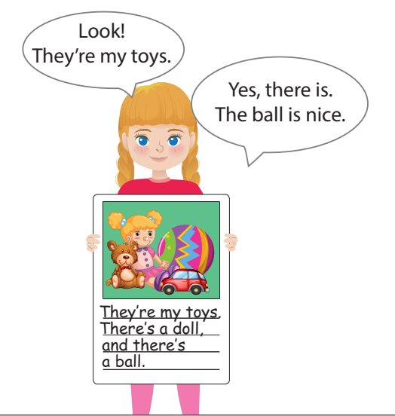

Gallery walk
Look! This is my house.
There’s a living room. There is a ball in the living room. The ball is red.

Slide 28

Assessment
Read and circle the
correct words!

Slide 29

Read and circle the correct word.
Ex: There’s a/ an pencil. The / A pencil is yellow.
1. There’s an / a doll in my bedroom.
2. There is a / the TV in the living room.
3. The / A teddy bear is on the desk. The/ A teddy bear is brown.
4. Is there a chair in the bathroom? No, there isn’t.
The / A chair is in the living room.
5. There’s an/ the elephant. The / An elephant is young.
Notes:
Gv giải thích thêm cho hs hiểu & biết cách dùng mạo từ “A, An, The”

Slide 30




Good bye.
See you again!

