Slide 1





















Notes:
Để nguyên trang bìa như này, chỉ thay đổi tên bài trong quá trình làm. Logo của sách Wonderful World

Slide 2
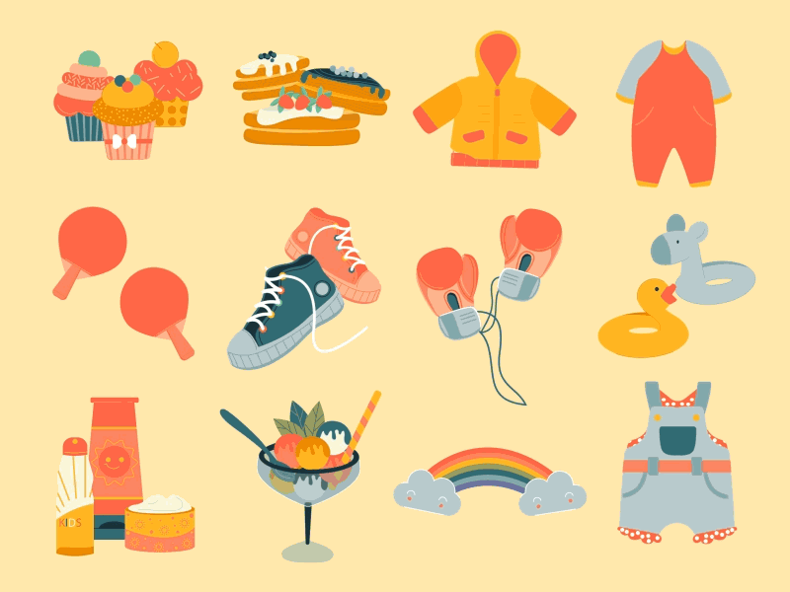



Unit 5
My clothes
Lesson 1 – Task 1,2,3

Slide 3


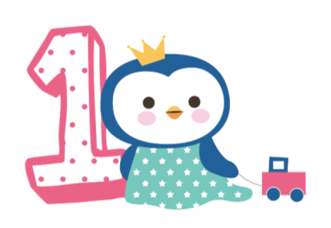



Warm up
Song: Hello song

Slide 4
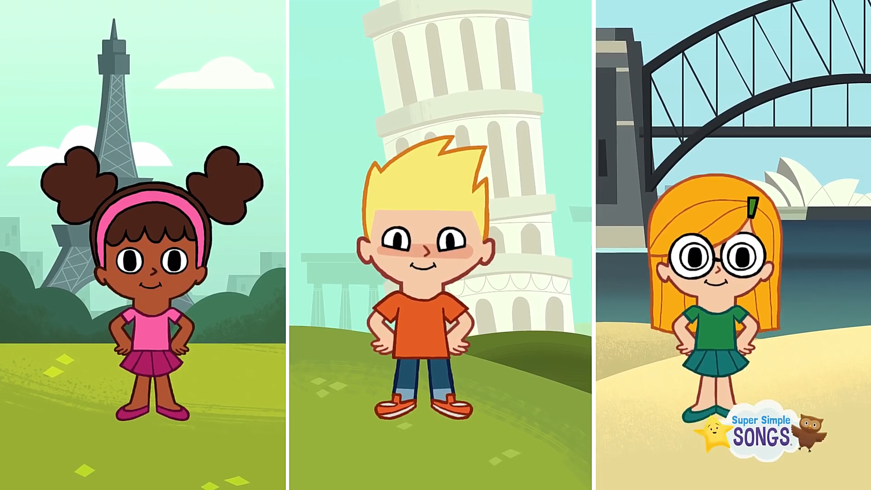

Slide 5
1
2
3
GUESSING GAME
4
5
6

Slide 6
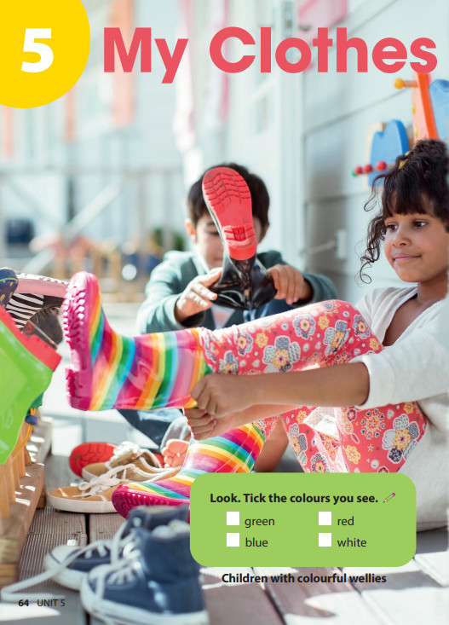
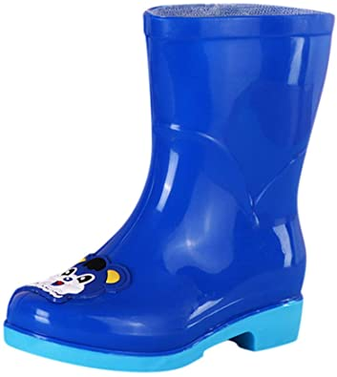
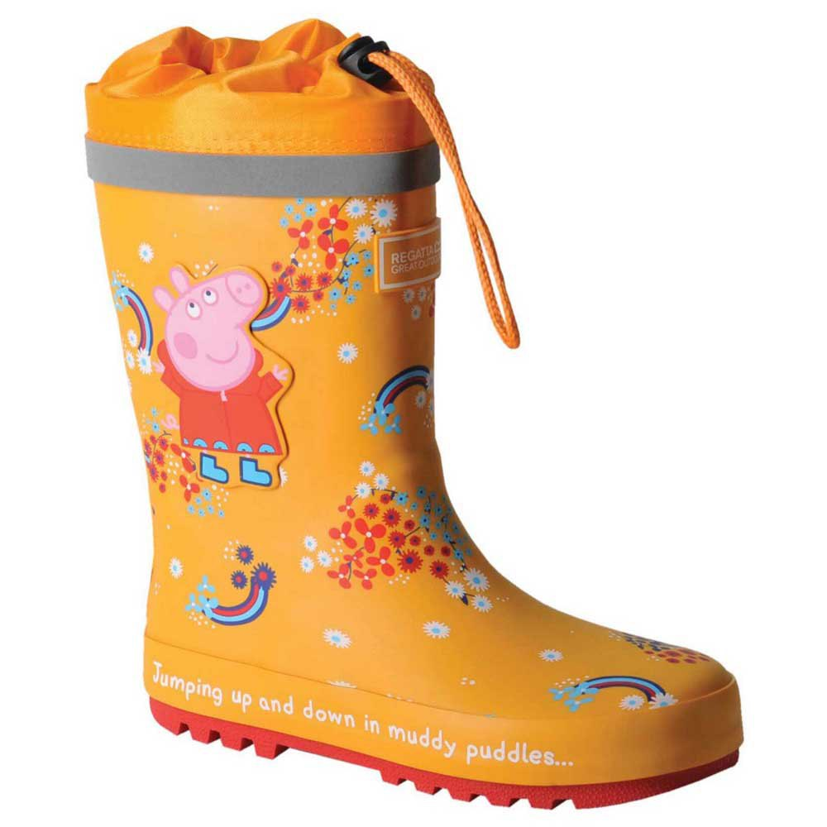
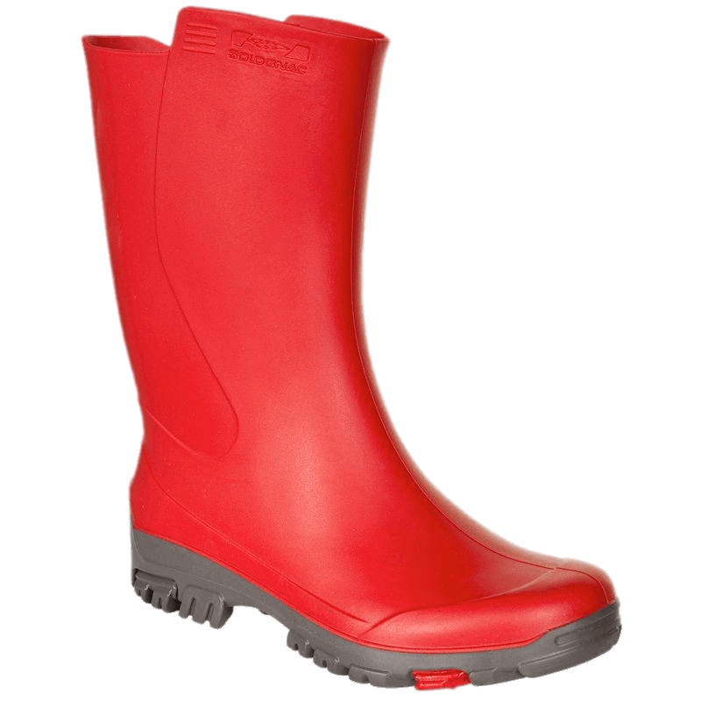
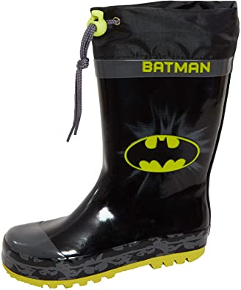
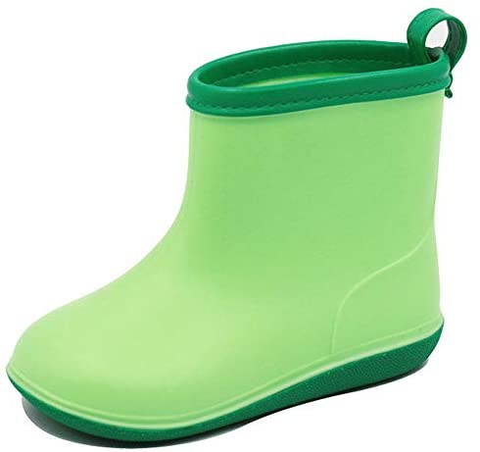
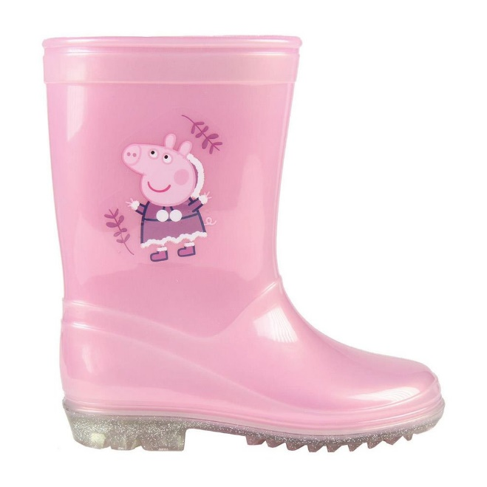
1
2
3
What colour is it?
What colour is it?
What colour is it?
4
5
6
What colour is it?
What colour is it?
What colour is it?
Notes:
Lead in: Use the opener picture to lead in the topic (My clothes) then teacher introduces the new unit “My chothes”

Slide 7

Presentation
Task 1: Listen and point. Repeat.

Slide 8

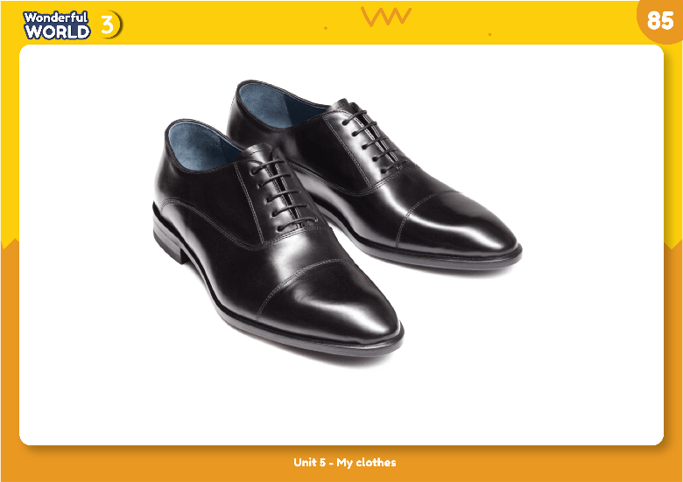
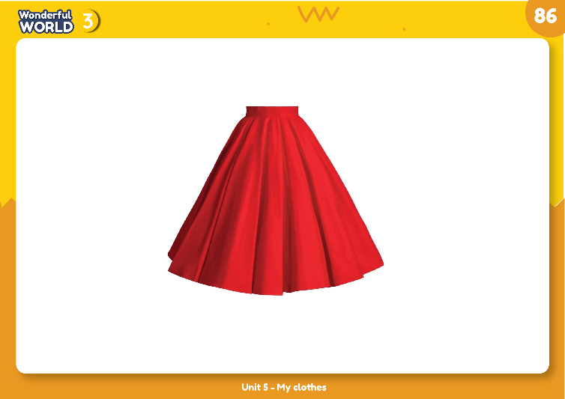
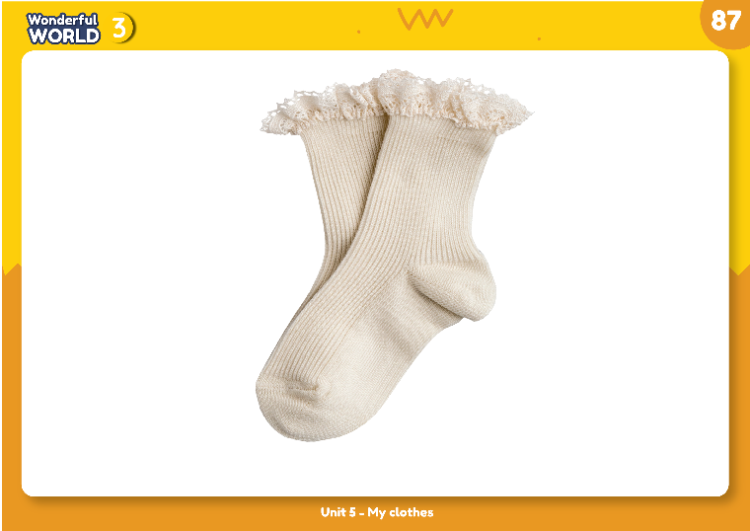
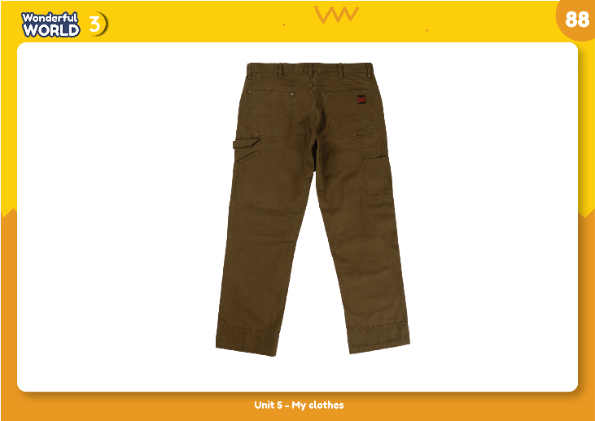
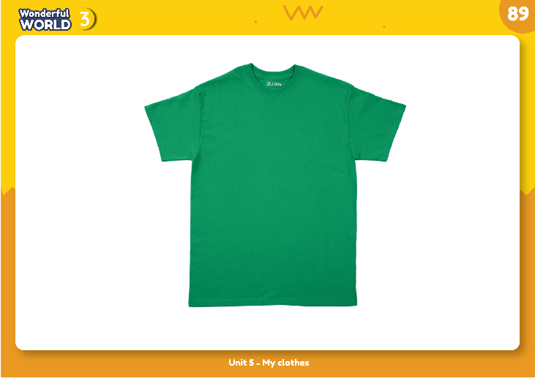
Listen and point. Repeat.

Slide 9


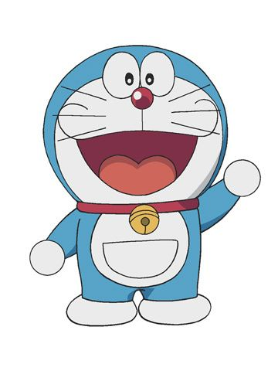
Hi! I’m Doraemon. I’m in Japan.
This is my magic bag.
What’s in my bag?

Slide 10
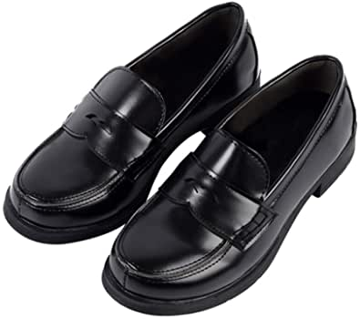
What’s in my bag?
shoes

Slide 11
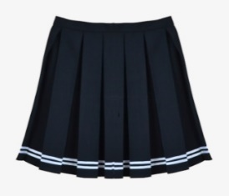
What’s in my bag?
skirt

Slide 12
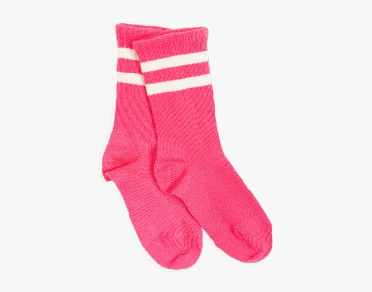
What’s in my bag?
socks

Slide 13
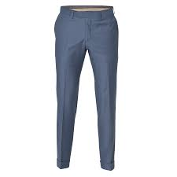
What’s in my bag?
trousers

Slide 14
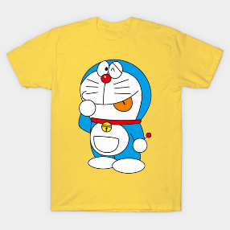
What’s in my bag?
T-shirt

Slide 15

Practice
Task 2: Listen and match

Slide 16
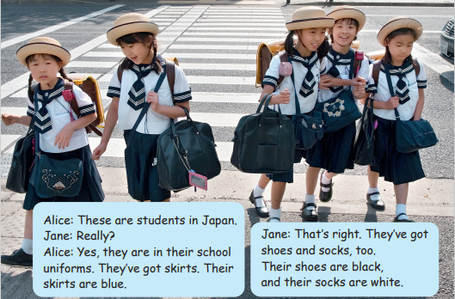
skirt a black
shoes b white
socks c blue

Slide 17



Tasks:Work in group!
Role play with your groups!

Slide 18

Production
Draw your uniform

Slide 19
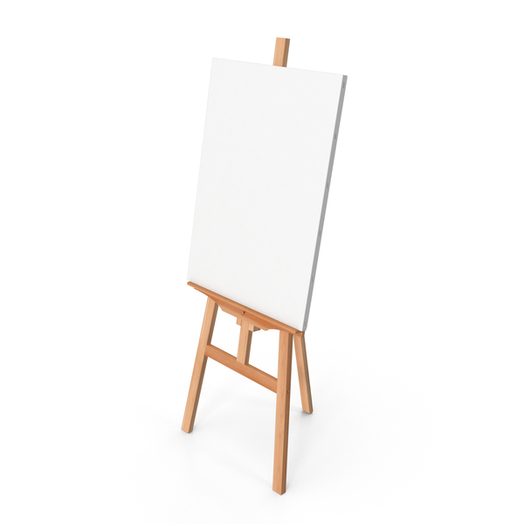









4 PRODUCTION
Draw your uniform.
There are ___.
There aren’t ___.

Slide 20
worksheet

Slide 21

tT
tT
tT
tT
tT
tT
tT
1.
There are
skirts
uniforms.
in
their
blue.
They
are
There are skirts in their uniforms. They are blue.
tT
tT
tT
tT
tT
2.
There aren’t
trousers
uniforms.
in
their
There aren’t trousers in their uniforms.
tT
tT
tT
tT
tT
white.
tT
tT
3.
There are
their
uniforms.
in
socks
They
are
There are socks in their uniforms. They are white.
tT
tT
tT
tT
tT
tT
tT
4.
There are
shoes
uniforms.
are
their
They
black.
in
There are shoes in their uniforms. They are black.
Notes:
THIẾT KẾ HOẠT ĐỘNG TƯƠNG TÁC CHO 4 CÂU NÀY

Slide 22

Assessment

Slide 23
5 ASSESSMENT
1. Which topic do we learn today?
Clothes
2. How many words have we learn?
Five words: shoes, skirt, trousers, T-shirt
3. What’s activity do you like the most?
Notes:
THIẾT KẾ HOẠT ĐỘNG TƯƠNG TÁC CHO 3 CÂU HỎI NÀY. VỚI CÂU HỎI 3 LÀ TRẢ LỜI THEO Ý CỦA HS.

Slide 24




Good bye.
See you again!

