Slide 1


Slide 2

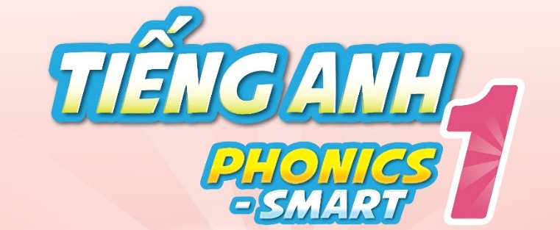

Slide 3

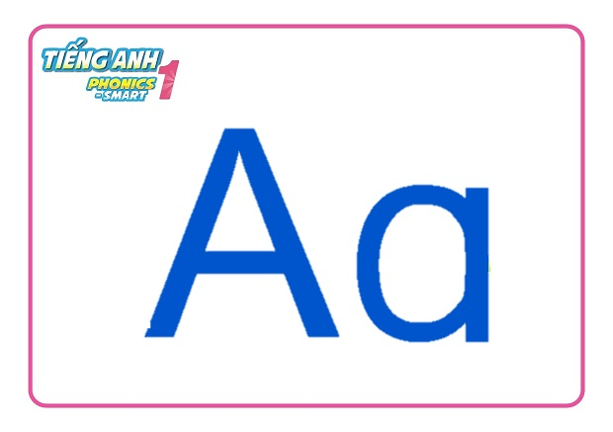
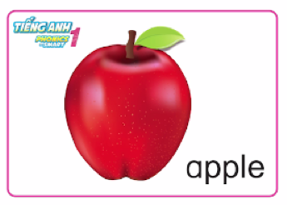
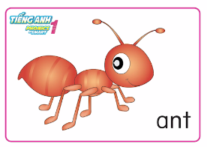
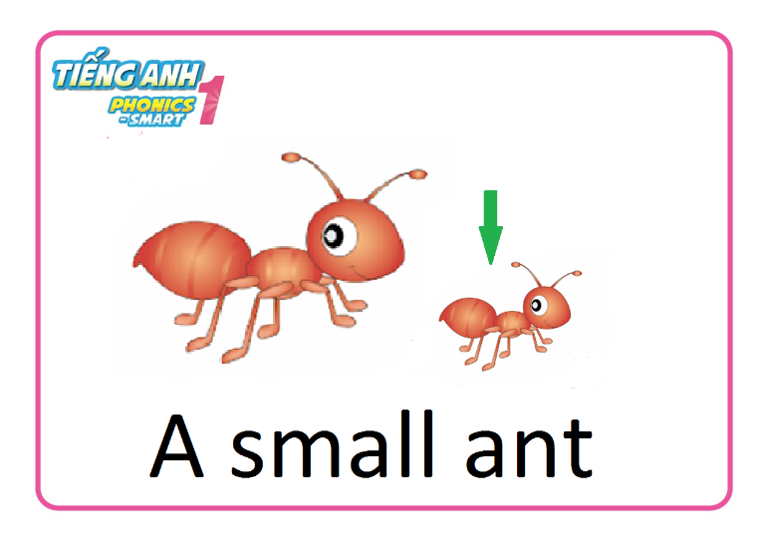
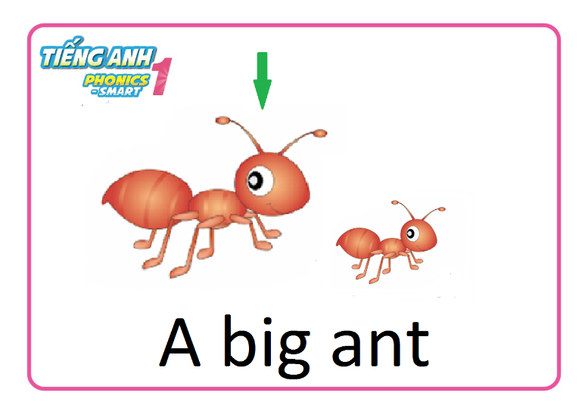
Let’s review
Game
Mime it
Notes:
Review word/phrase: Aa/a/Ant! Apple! A small ant! A big ant!
- First round: Teacher says the words, students do the actions.
- Second round: Teacher does the actions, students says the words.

Slide 4
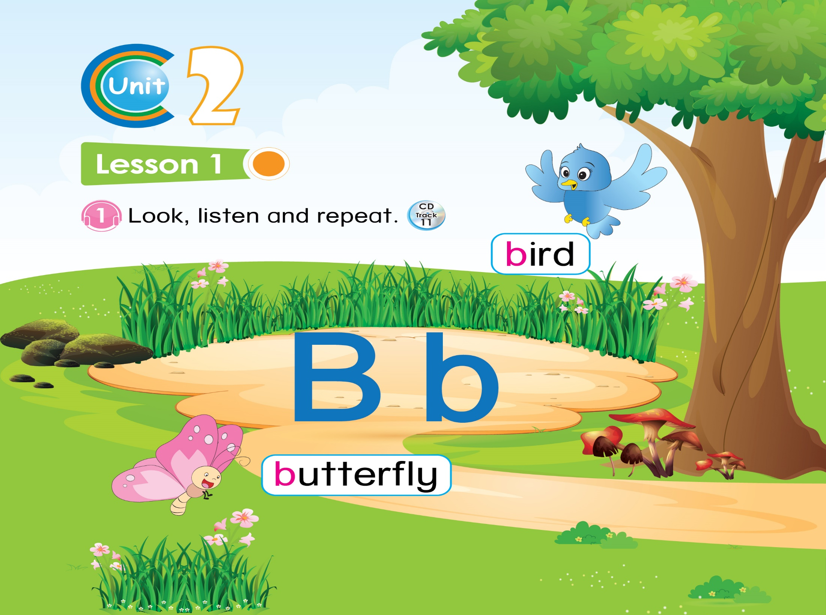


Lesson 1

Slide 5
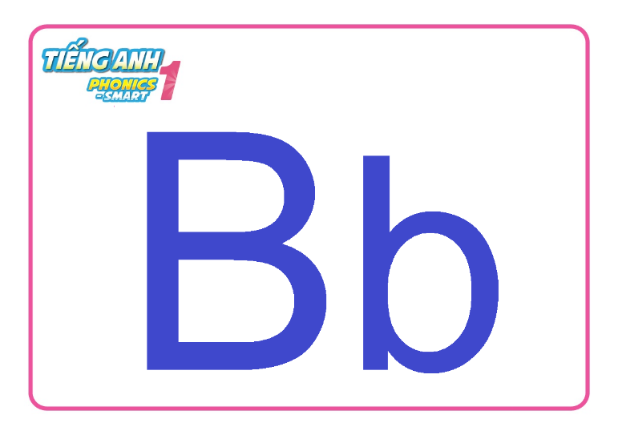

Unit 2:
Lesson 1:
Bb
1. Look, listen and repeat.

Slide 6
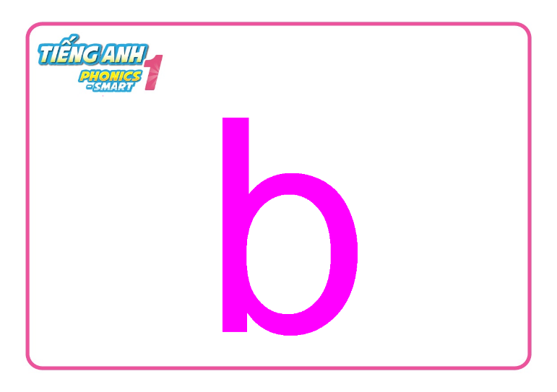
Unit 2:
Lesson 1:
Bb
1. Look, listen and repeat.

Slide 7
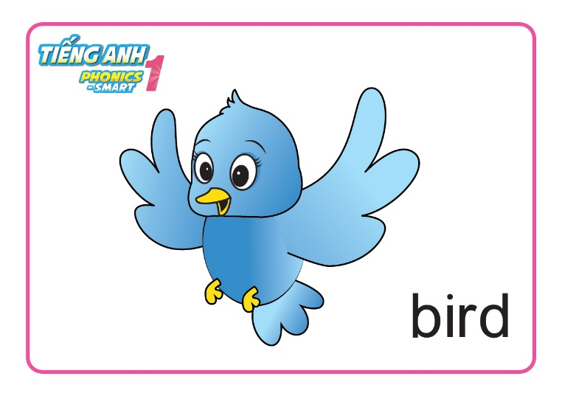
Unit 2:
Lesson 1:
Bb
1. Look, listen and repeat.

Slide 8
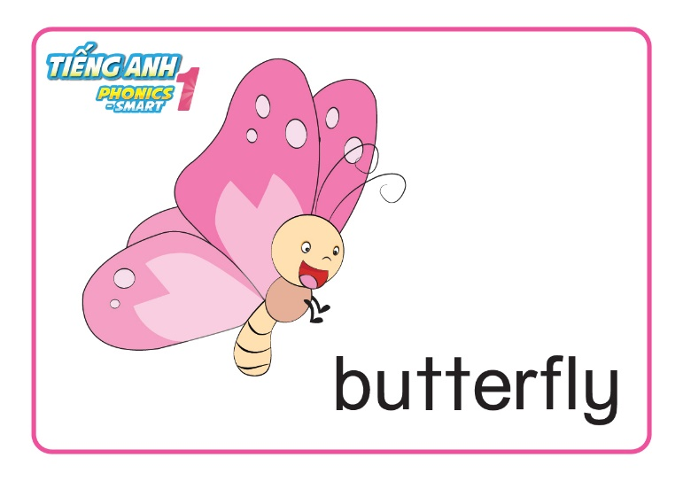
Unit 2:
Lesson 1:
Bb
1. Look, listen and repeat.

Slide 9
Unit 2:
Lesson 1:
Bb
1. Look, listen and repeat.

Slide 10




Unit 2:
Lesson 1:
Bb
1. Look, listen and repeat.
Clapping hands
YOU SAY
YOU SAY
Notes:
- Audio: letter B, /b/. HS nghe âm thanh B: Vỗ tay xuống thấp. HS nghe âm thanh /b/: vỗ tay lên cao.

Slide 11

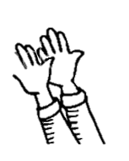


Unit 2:
Lesson 1:
Bb
1. Look, listen and repeat.
Clapping hands
YOU SAY
YOU SAY
Notes:
- Audio: bird, butterfly. Hs nghe thấy bird: vỗ tay xuống thấp 2 lần. HS nghe thấy butterfly: vỗ tay lên cao 2 lần.

Slide 12


Slide 13

Listen repeat and point

Slide 14






Unit 2:
Lesson 1:
Bb
1. Look, listen and repeat.
2. Let’s chant.

Slide 15

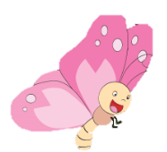

Unit 2:
Lesson 1:
Bb
1. Look, listen and repeat.
2. Let’s chant.
B
b

Slide 16


CÔNG TY CỔ PHẦN PHÁT TRIỂN GIÁO DỤC
VIỆT NAM VPBOX
Hà Nội
Biệt thự G2&G28, Làng Quốc Tế Thăng Long,
Quận Cầu Giấy, Hà Nội.
ĐT: (024) 3 3793 2405
phonics.hanoi@vpbox.edu.vn
Thành Phố Hồ Chí Minh
Số 29 Mai Thị Lựu, Quận 1, TP. HCM.
ĐT: (028) 3 820 5934
phonics.hcm@vpbox.edu.vn
www.vpbox.edu.vn

