Slide 1


Slide 2



Slide 3


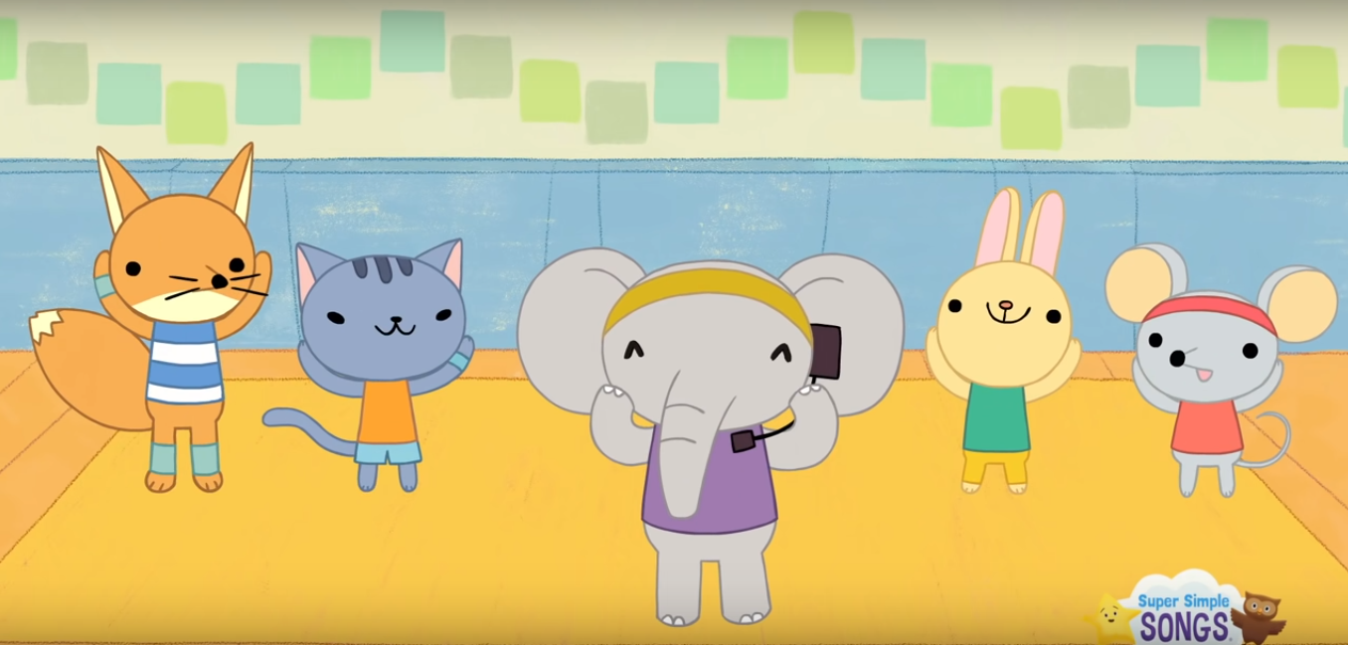
LET’S WARM UP
https://www.youtube.com/watch?v=WX8HmogNyCY
Notes:
Warm-up song: head, shoulder, knees and toes

Slide 4

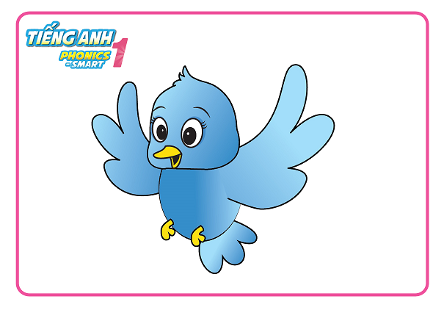
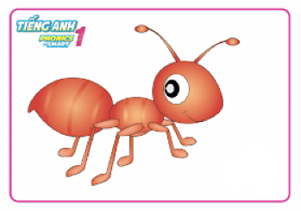
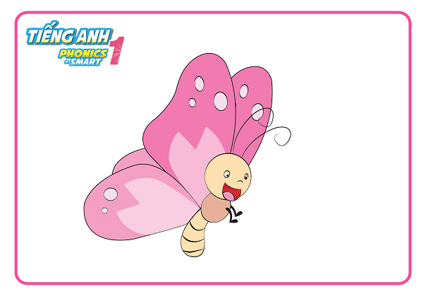
CAN YOU NAME SOME ANIMAL?
ant
butterfly
bird
Notes:
- Review some animals Ss have learnt from previous lessons.
- Asks Ss to name some more animals if they know.

Slide 5




Unit 1
Lesson 4
Notes:
Lead in the new lesson.

Slide 6

Unit 2:
Lesson 4
1. Listen and repeat.

Slide 7

Unit 2:
Lesson 4
1. Listen and repeat.

Slide 8
Unit 2:
Lesson 4
1. Listen and repeat.
Game
Who’s faster?

Slide 9
Game
Who’s faster?
Hide/
Unhide
Next

Slide 10
Game
Who’s faster?
Hide/
Unhide
Next

Slide 11
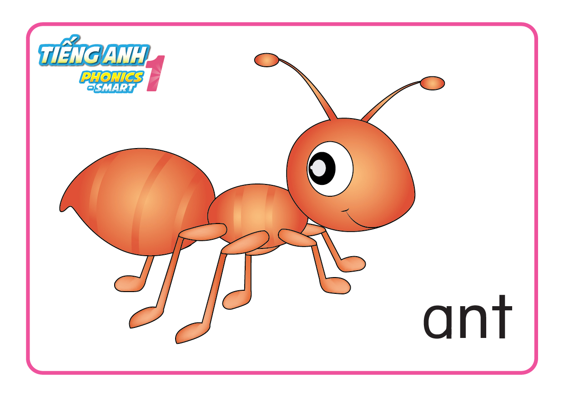
Game
Who’s faster?
Hide/
Unhide
Next

Slide 12

Game
Who’s faster?
Hide/
Unhide
Next

Slide 13
Game
Who’s faster?
Hide/
Unhide
Next

Slide 14

WELL DONE

Slide 15

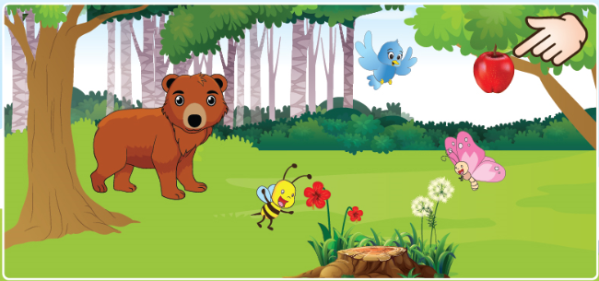

Unit 2:
Lesson 4
1. Listen and repeat.
2. Look, point and say.
apple
It is a _______.
Next

Slide 16

Unit 2:
Lesson 4
1. Listen and repeat.
2. Look, point and say.
It is a bird.
Next
Notes:
Part 2. Look, point and say.
Part 2. Look, point and say.
T checks with whole class one more time.

Slide 17

Unit 2:
Lesson 4
1. Listen and repeat.
2. Look, point and say.
It is a butterfly.
Next
Notes:
Part 2. Look, point and say.

Slide 18
Unit 2:
Lesson 4
1. Listen and repeat.
2. Look, point and say.
It is a bear.
Next
Notes:
Part 2. Look, point and say.

Slide 19
Unit 2:
Lesson 4
1. Listen and repeat.
2. Look, point and say.
It is a bee.
Next
Notes:
Part 2. Look, point and say.

Slide 20

Unit 2:
Lesson 4
1. Listen and repeat.
2. Look, point and say.
3. Draw and say.
Notes:
- Tell Ss that they are going to draw the animal according to their group name ( group bird, butterfly, bee, bear) and then introduce their drawing using structure “ It is a..”
- Give Ss some time to finish
- Call each team to show and tell about their picture
- Give mark for the team that perform best

Slide 21



Unit 2:
Lesson 4
1. Listen and repeat.
2. Look, point and say.
3. Draw and say.
Notes:
- Tell Ss that they are going to draw the animal according to their group name ( group bird, butterfly, bee, bear) and then introduce their drawing using structure “ It is a..”
- Give Ss some time to finish
- Call each team to show and tell about their picture
- Give mark for the team that perform best

Slide 22


CÔNG TY CỔ PHẦN PHÁT TRIỂN GIÁO DỤC
VIỆT NAM VPBOX
Hà Nội
Biệt thự G2&G28, Làng Quốc Tế Thăng Long,
Quận Cầu Giấy, Hà Nội.
ĐT: (024) 3 3793 2405
phonics.hanoi@vpbox.edu.vn
Thành Phố Hồ Chí Minh
Số 29 Mai Thị Lựu, Quận 1, TP. HCM.
ĐT: (028) 3 820 5934
phonics.hcm@vpbox.edu.vn
www.vpbox.edu.vn

