Slide 1


Slide 2



Slide 3
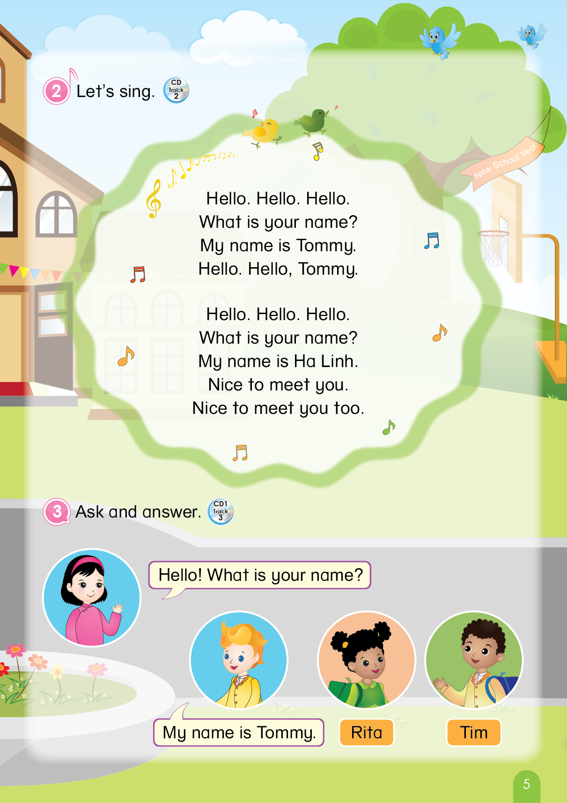

Notes:
T says “ Hello, everyone. How are you? How’s the weather? Is it sunny? Great! Now, let’s sing a song with me.”
Warm up: Sing “Hello song” – “Excellent! You sing very well.”
Divide class into 2 groups (optional) – “Today, we will have 2 groups – Group 1 and Group 2. You are Group 1, you are Group 2.”

Slide 4




Let’s Review!
Game: Raise your hands
A bird
A cow
✗
Notes:
- Teacher gives instructions of this activity:
+ ask students to raise hands if the picture matches with the word.
+ ask students not to raise hands if the picture does not match the word.
“ Class, look at the picture and raise your hand with the correct picture.”
“First, a bird. OK! A cow, OK! Now, let’s see. Yeah, A bird.”

Slide 5
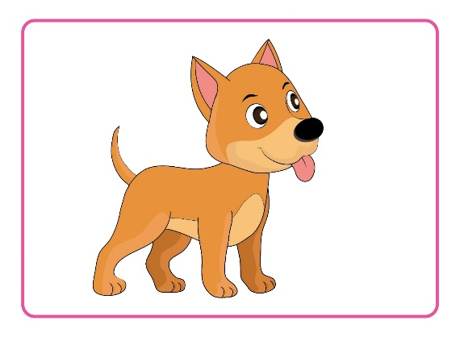

Game: Raise your hands
A dog
Notes:
“Class, a dog? Yes.”

Slide 6

Game: Raise your hands
A donkey
✗
Notes:
“A donkey? No. Good job”

Slide 7
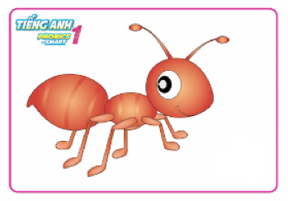
Game: Raise your hands
A cat
✗
Notes:
“A cat? No. Great.”

Slide 8
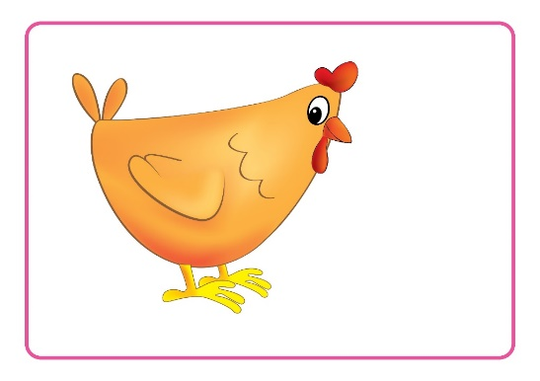
Game: Raise your hands
A chicken
Notes:
“A chicken? Yes, good.”

Slide 9
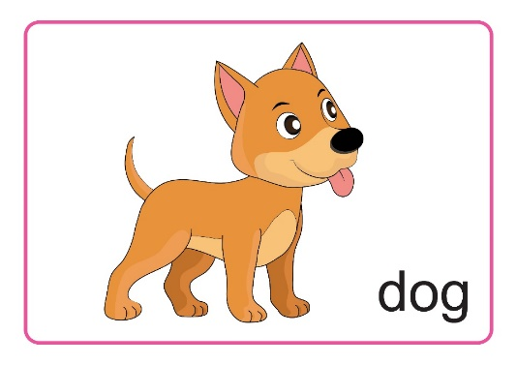

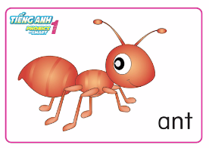


Notes:
- Teacher gives praises to the whole class. – “Great”

Slide 10


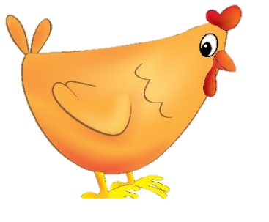

Unit 5
Lesson 2
Notes:
Teacher introduces the new lesson with some following questions:
“Class, what is it?”
“What is the color of the tree?”
“ What do you see in the picture?”
- “Great. Now let move to next part.”

Slide 11
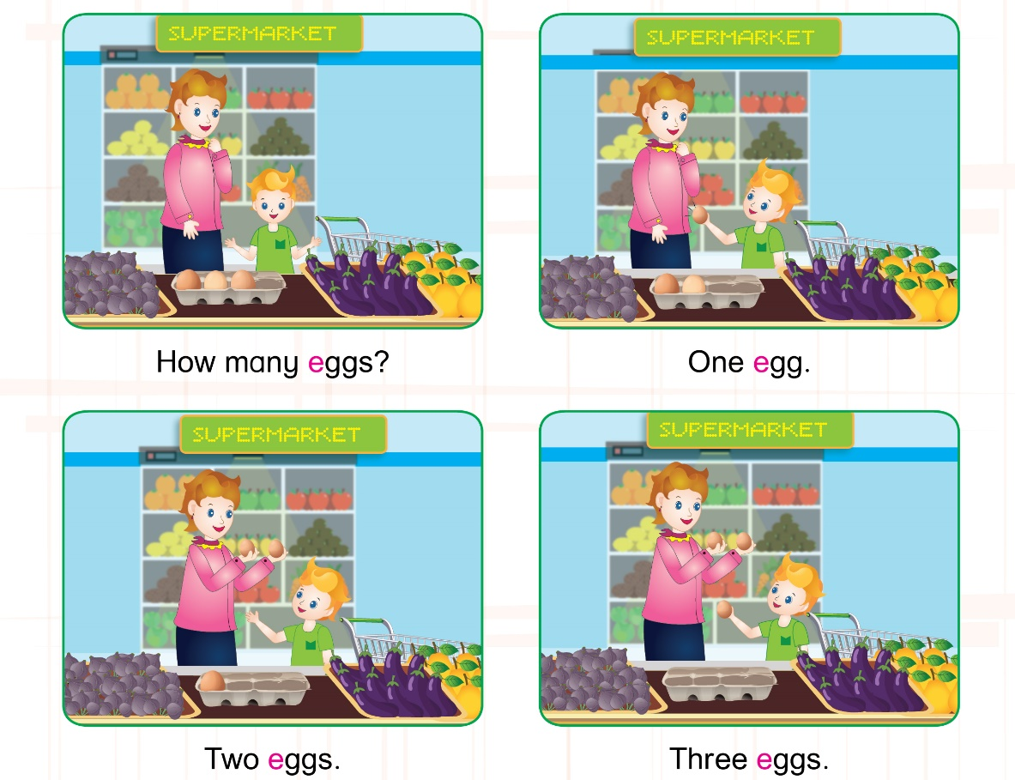
Unit 5:
Lesson 2:
E e
1. Listen and repeat.
Where
are
they?
What are they talking?
Notes:
- Teacher introduces the contexts by asking – “Class, look and answer my questions”
+ What is it?
+ How many people are there?
+ Where are they?
Teacher asks students to listen twice.
Teacher asks students to repeat once.

Slide 12


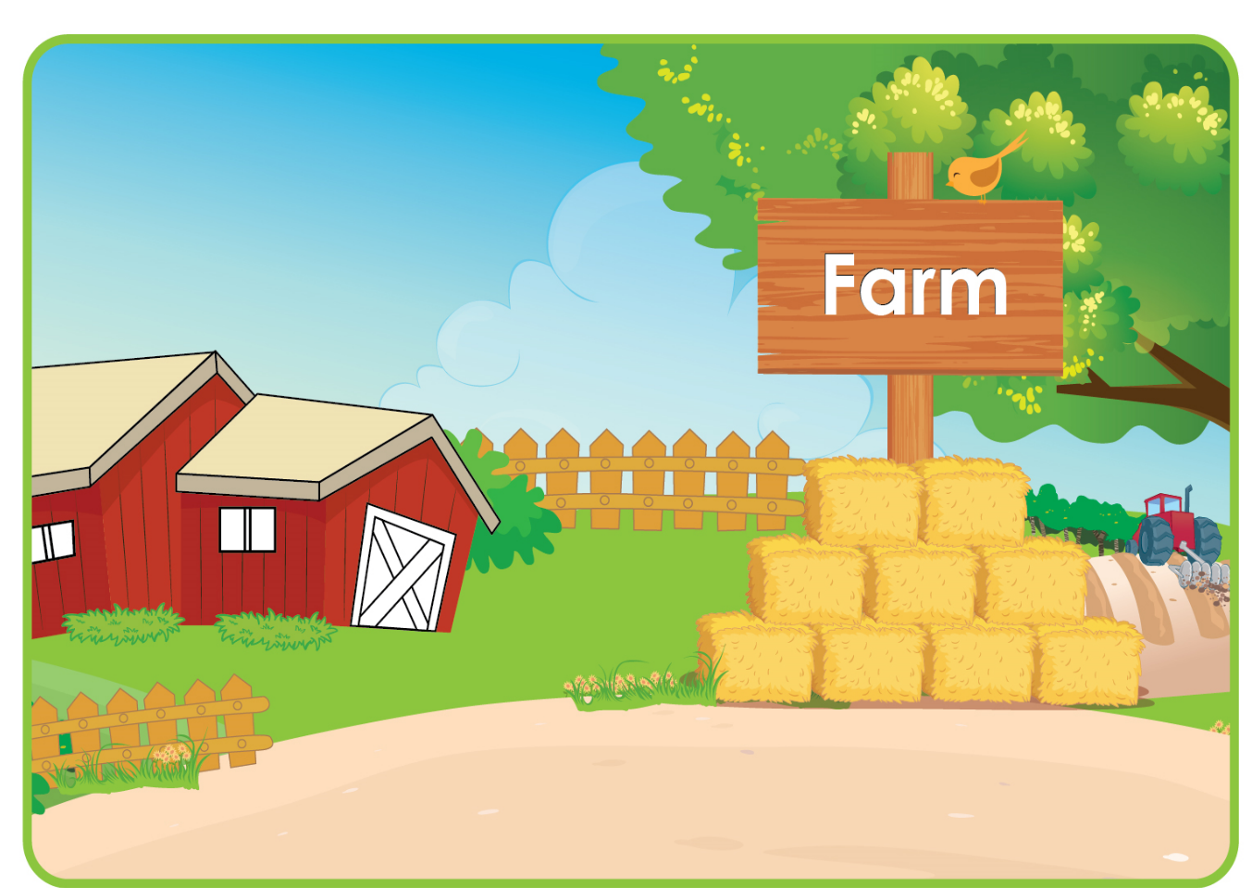
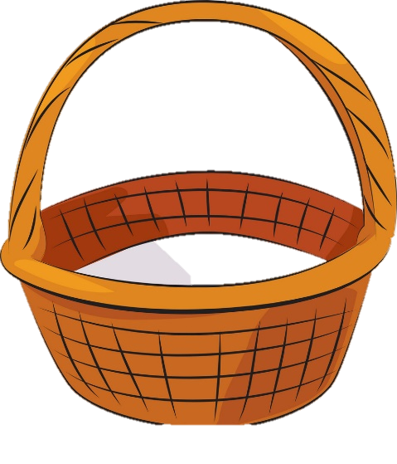


Unit 5:
Lesson 2:
E e
1. Listen and repeat.
Game: Let’s collect eggs!
Notes:
Teachers introduces the game:
+ choose 3 students of each group and have them come to board.
+ one student asks, one student answers, one student puts the egg into the basket following the received information.
+ the game ends when all groups’ turns are done.
“Now, let’ collect eggs. 3 people from each group will come here. One asks, one answers and one puts the egg into the basket.”

Slide 13



Game: Let’s collect eggs!
What can you see?
I can see TWO eggs.
Notes:
“Now, you please.”

Slide 14


Two eggs.
Notes:
“Well done”

Slide 15


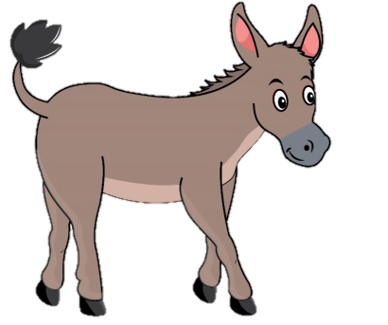
Game: Let’s collect eggs!
I can see FOUR eggs.
What can you see?
Notes:
“Next, you please.”

Slide 16

Four eggs.
Notes:
“Good job.”

Slide 17
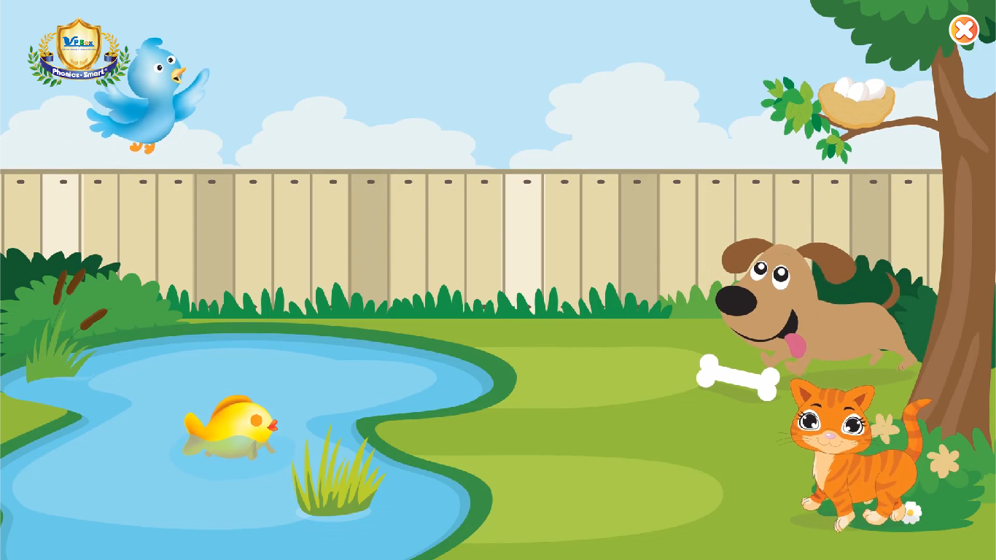
Game: Let’s collect eggs!
I can see THREE eggs.
What can you see?
Notes:
“You, please.”

Slide 18
Three eggs.
Notes:
“well done”

Slide 19
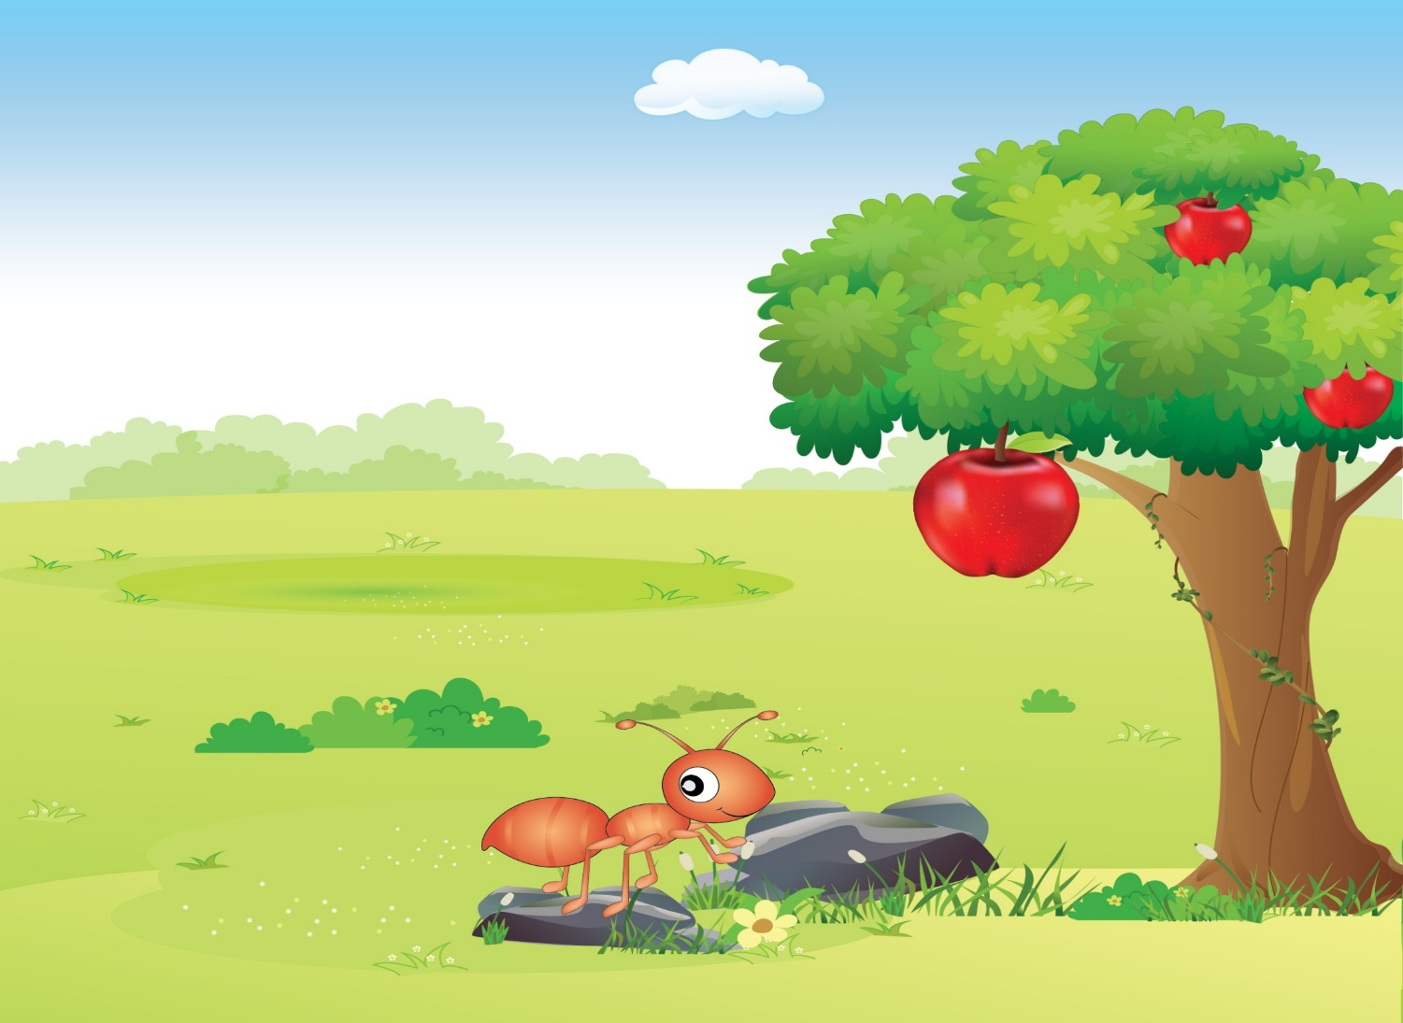



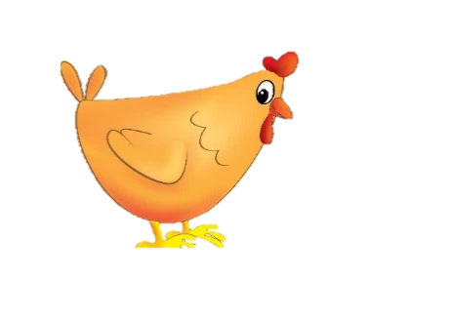
Game: Let’s collect eggs!
What can you see?
I can see
ONE egg.
Notes:
“You, please.”

Slide 20
One egg.
Notes:
“Great”

Slide 21
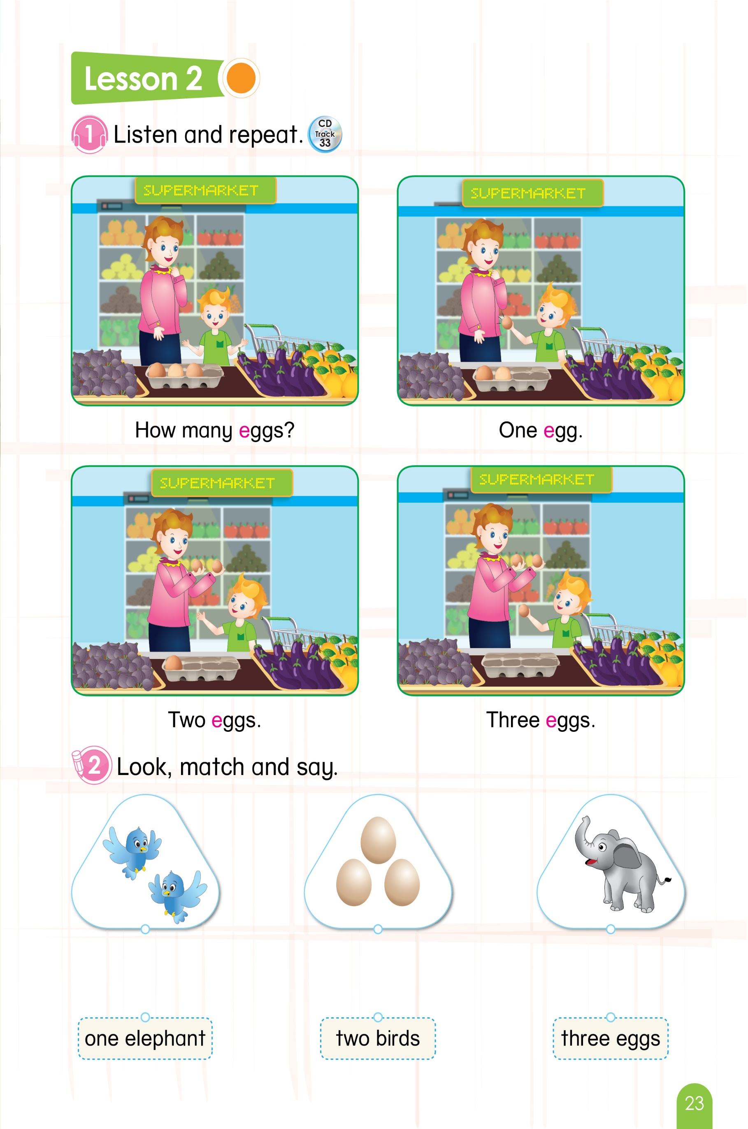
Unit 5:
Lesson 2:
E e
2. Look, match and say.
LOOK AT YOUR BOOK!
WORK IN PAIRS.
Notes:
Teacher gives instructions of the task. – “Let’s look, match and say.”
Teacher asks students to look at their books and work in pairs in 3 minutes. – “Look at your book page 23”. “You will look the picture and match it with the correct word. Let’s work with your friends.”

Slide 22

Unit 5:
Lesson 2:
E e
2. Look, match and say.
Notes:
After 3 minutes, teacher does the task with students, while showing the answer one by one.
“Have you finished? Let’s check your answer.”

Slide 23
Unit 5:
Lesson 2:
E e
2. Look, match and say.
Notes:
Teacher gives praises. – “Well done”

Slide 24





Unit 5:
Lesson 2:
E e
What have we learned?
How many elephants?
How many birds?
How many eggs?
One elephant
Two birds
Three eggs
Notes:
Teacher reviews the lesson by asking students “How many’’, following the picture one by one.
“Class, how many elephants? Yes!”
“How many birds? Great!”
“How many eggs? Good”

Slide 25
Unit 5:
Lesson 2:
E e
What have we learned?
Notes:
Teacher gives praises: “Good job.”

Slide 26

Unit 5:
Lesson 2:
E e
1. Listen and repeat.
2. Look, match and say.
Notes:
Teacher asks students to ask and answer again: “So class, how many eggs? Good. And how many eggs? Well done.”
Teacher gives comments of the class’s performance: “Class, you did so well today.”

Slide 27

Unit 5:
Lesson 2:
E e
Notes:
Teacher says Goodbye. – “It’s time to say Goodbye. Goodbye, and see you.”

Slide 28


CÔNG TY CỔ PHẦN PHÁT TRIỂN GIÁO DỤC
VIỆT NAM VPBOX
Hà Nội
Biệt thự G2&G28, Làng Quốc Tế Thăng Long,
Quận Cầu Giấy, Hà Nội.
ĐT: (024) 3 3793 2405
phonics.hanoi@vpbox.edu.vn
Thành Phố Hồ Chí Minh
Số 29 Mai Thị Lựu, Quận 1, TP. HCM.
ĐT: (028) 3 820 5934
phonics.hcm@vpbox.edu.vn
www.vpbox.edu.vn

