Slide 1


Slide 2

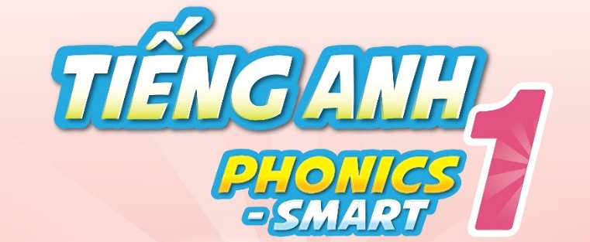

Slide 3
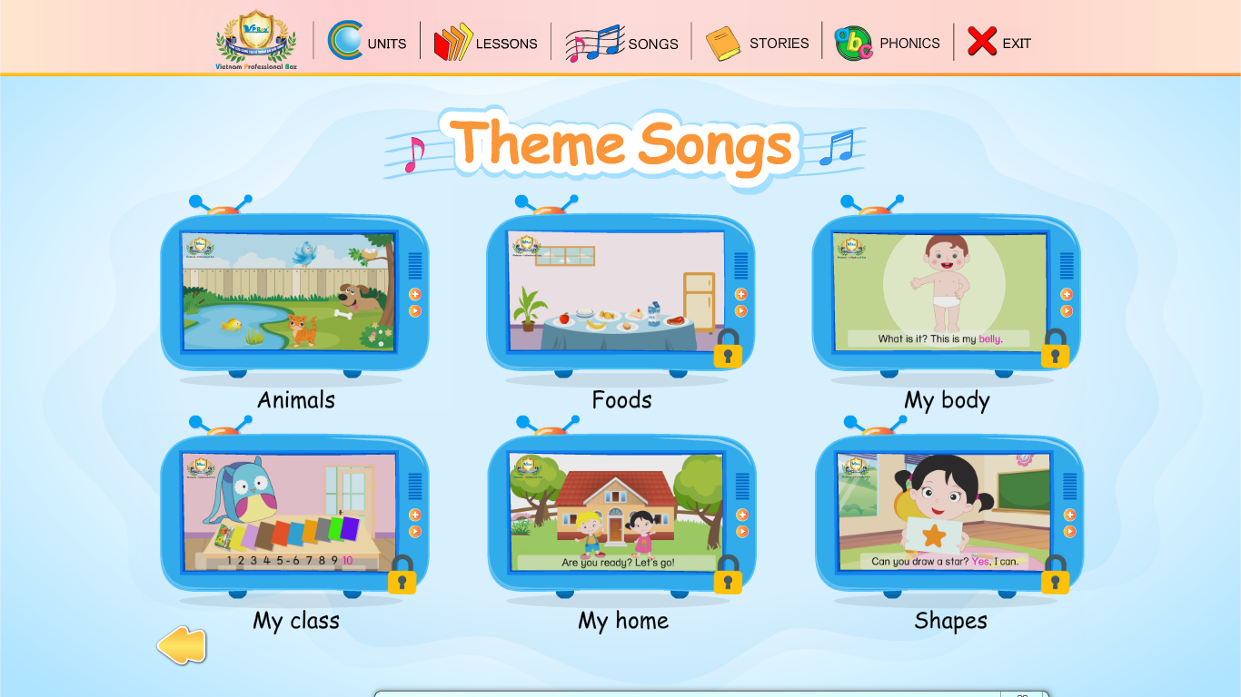
Warm up
Alphabet song
Notes:
Hello children, How are you?
I hope you are good.
Let’s sing The alphabet song. You sing very well.
Today, we will have 2 groups – group 1 and group 2. You are group 1, you are Group 2.
Chèn bài hát Alphabet song

Slide 4
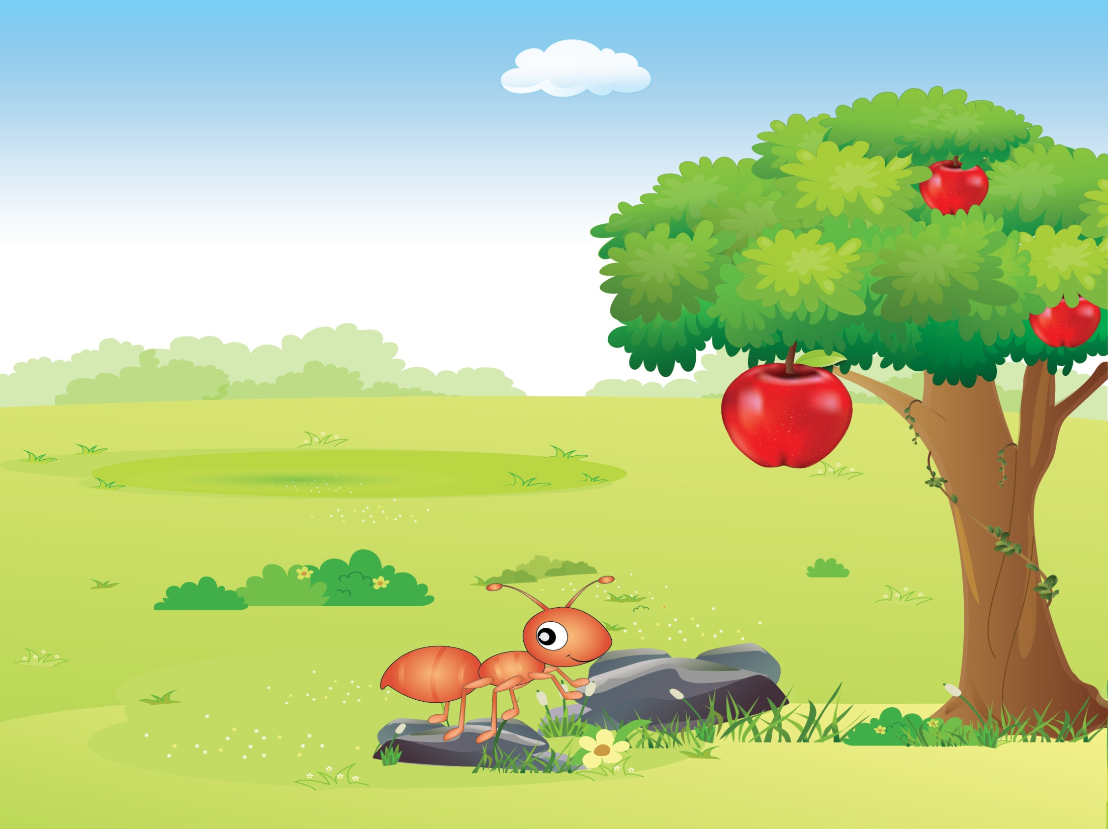


Unit 5
Lesson 3
E e
Notes:
Welcome to Unit 5 – Letter E
- Today we will continue with Lesson 3.

Slide 5

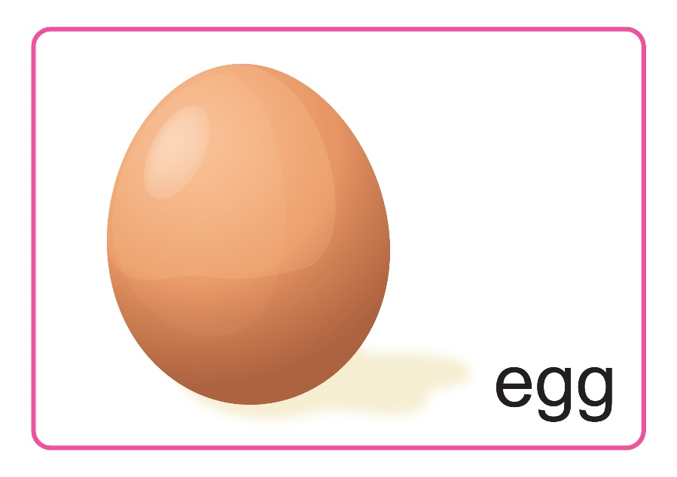

Let’s say
E e
Notes:
- Do you remember these cards?
- Let’s say together.
“ Letter E”, “egg”, “elephant”
- Very good!

Slide 6


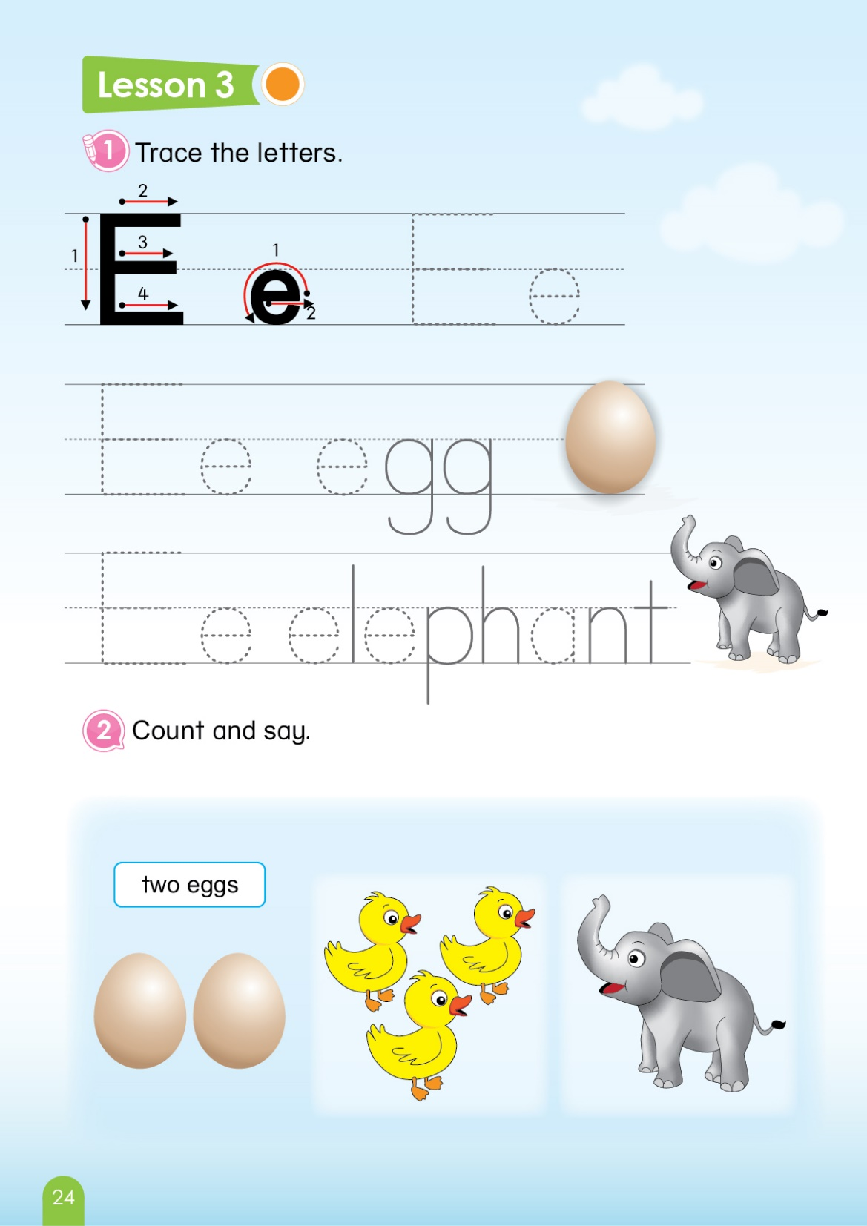

Unit 5 Lesson 3
1.Trace the letters
Notes:
-Today, We learn how to trace Letter E. Unit 5 – Lesson 3, part 1- Trace the letters
-Now, let’s look.
-With big E: We have four strokes, like this One, Two, Three and Four.
-With small e: How do we start? Let’s see. One – Two, Just Two steps.
-Now, let’s rise your fingers and follow ( back to tracing E and e)
-Ask SS to trace in their book E, e, egg, elephant.

Slide 7
Unit 5 Lesson 3
1. Trace the letters
2. Count and say
Two eggs
1
2
Notes:
- Now, we come to Part 2 – Count and say
- Look at this picture, count with me One, Two, “Two eggs”

Slide 8
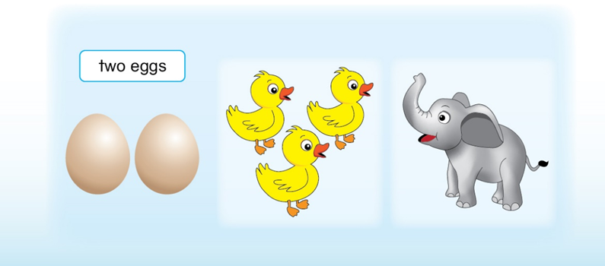
Unit 5 Lesson 3
1. Trace the letters
Three ducks
2. Count and say



Notes:
How about this one?
Click – One, Two, Three –” Three ducks”. Very good!

Slide 9
Unit 5 Lesson 3
1. Trace the letters
2. Count and say
One elephant
Notes:
- Let’s count elephant. One – “One elephant” – Well done

Slide 10
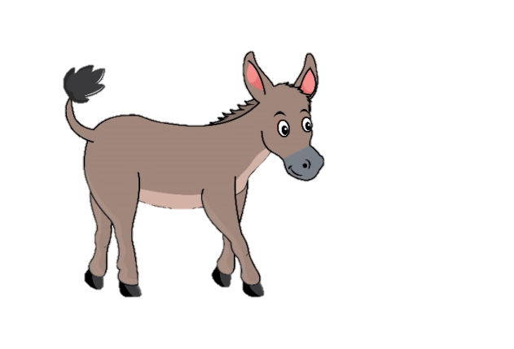


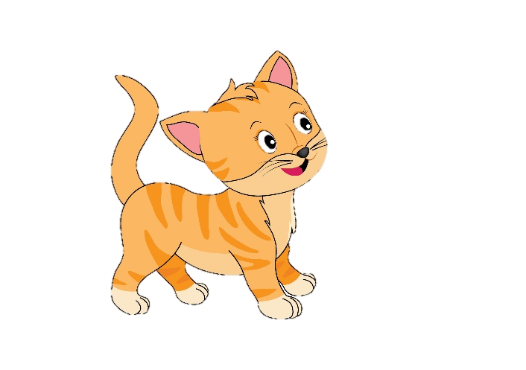
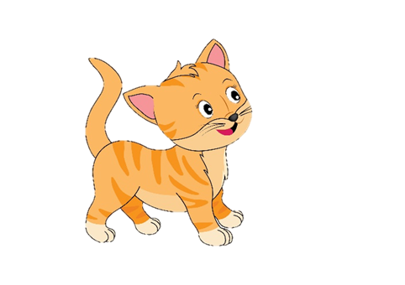
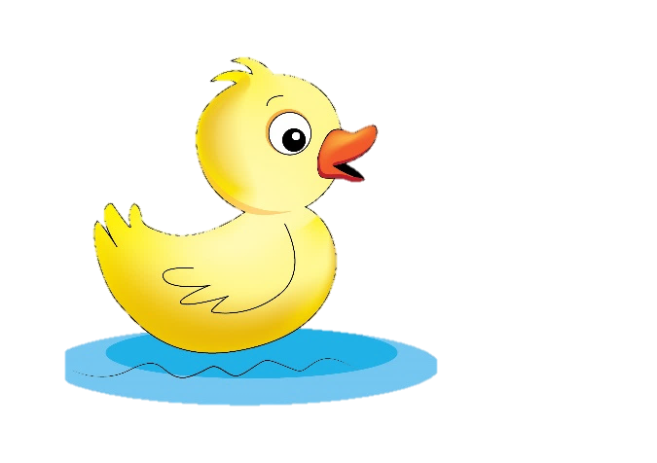

Unit 5 Lesson 3
How many
Game
Who can count?
Notes:
Let’s play the game “ Who can count?”
You look and count how many animals are.

Slide 11
Unit 5 Lesson 3
Game: Who can count?
How many cats?
Three cats.
Notes:
Let’s start. How many cats?
Can you count?
Yes! Three cats.
With the correct answer, your group will have 1 point.
Great job.

Slide 12
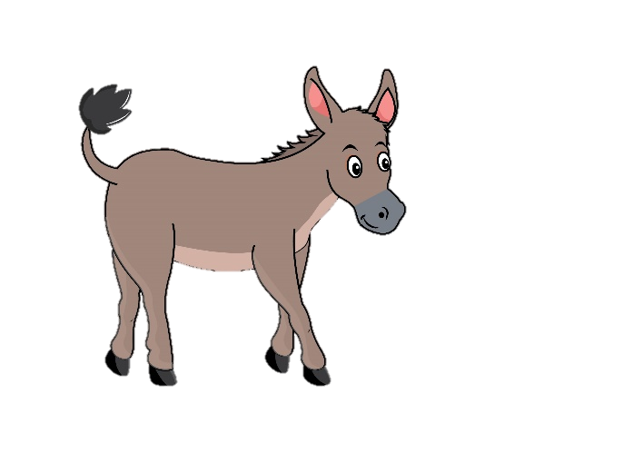
Unit 5 Lesson 3
Game: Who can count?
How many donkeys?
One donkey.
Notes:
How many donkeys?
That’s right! – One donkey.
With the correct answer, your group will have 1 point. Well done.

Slide 13
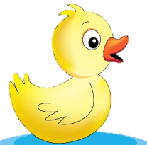
Unit 5 Lesson 3
Game: Who can count?
How many ducks?
Four ducks.
Notes:
Let’s count. How many ducks?
Exactly! Four ducks.
-With the correct answer, your group will have 1 point. Well done.

Slide 14
Unit 5 Lesson 3
Game: Who can count?
How many elephants?
Two elephants.
Notes:
How many elephants?
That’s it! – Two elephants.
1 more point for your group. Great.

Slide 15
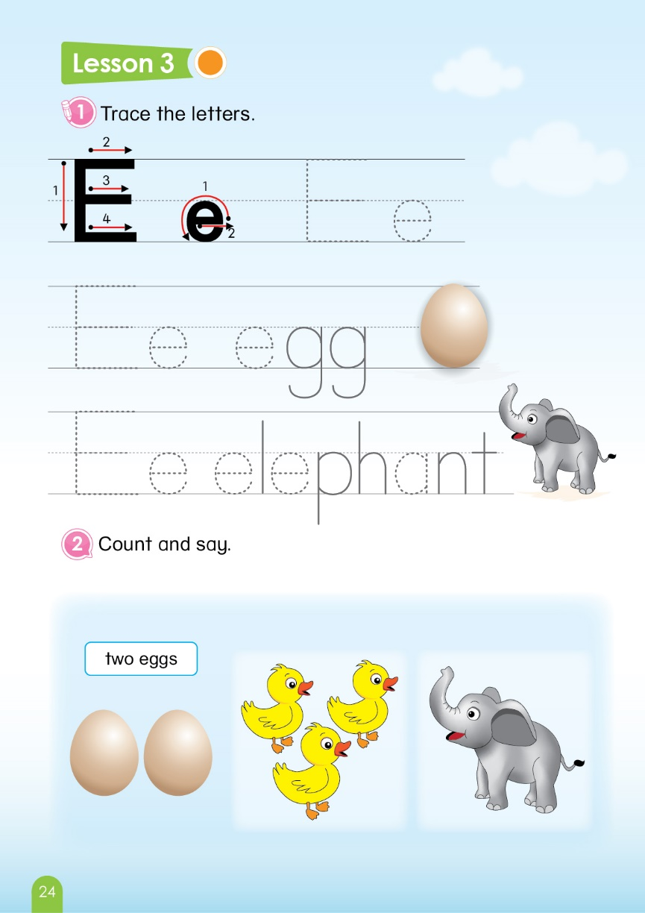

Unit 5
Sum up
Notes:
- Now, You look at your book page 24 again.
- Do you finish tracing E, e, egg, and elephant? – Very good.
- Can you count and say these animals? – It’s easy right?
- Well. It’s the end of our lesson today.
- Let’s count your points.
So the winner is group …. Group …, you also good, too.
Goodbye class

Slide 16


CÔNG TY CỔ PHẦN PHÁT TRIỂN GIÁO DỤC
VIỆT NAM VPBOX
Hà Nội
Biệt thự G2&G28, Làng Quốc Tế Thăng Long,
Quận Cầu Giấy, Hà Nội.
ĐT: (024) 3 3793 2405
phonics.hanoi@vpbox.edu.vn
Thành Phố Hồ Chí Minh
Số 29 Mai Thị Lựu, Quận 1, TP. HCM.
ĐT: (028) 3 820 5934
phonics.hcm@vpbox.edu.vn
www.vpbox.edu.vn

