Slide 1


Slide 2



Slide 3

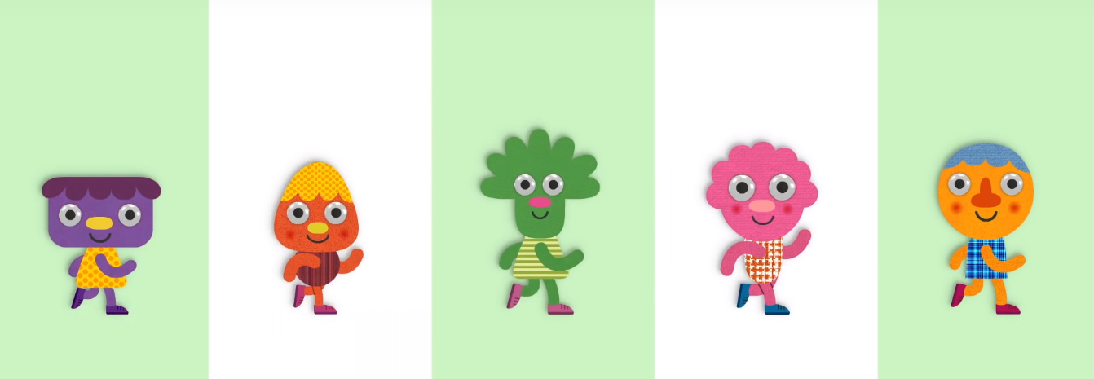

Warm up with me
https://www.youtube.com/watch?v=fPMjnlTEZwU
Notes:
Warm-up: Walking walking: https://www.youtube.com/watch?v=fPMjnlTEZwU

Slide 4


Unit 6
Lesson 4

Slide 5

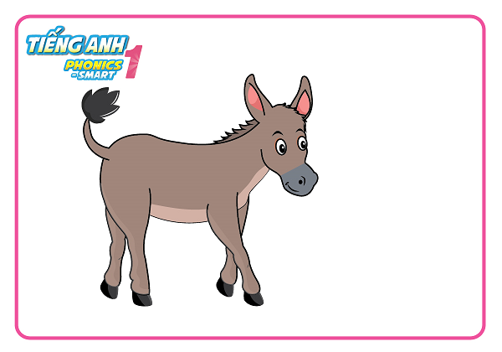
Unit 6:
Lesson 4
What animal is this?

Slide 6

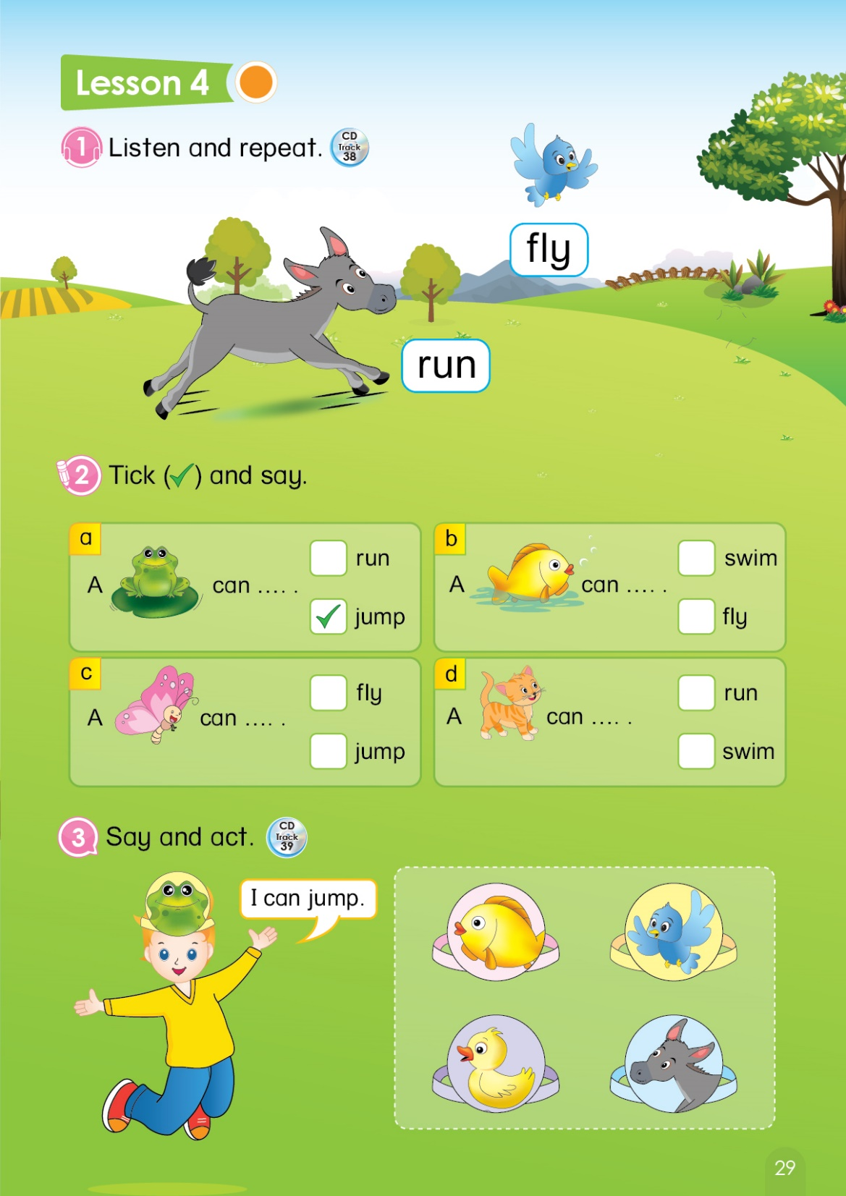
Unit 6:
Lesson 4
1. Listen and repeat.

Slide 7
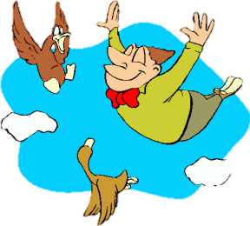

Unit 6:
Lesson 4
Game
I say You do
Fly
You say
& do
You say
& do
Run
Notes:
When teacher says bird -> Ss say “Fly” and act out
When teacher says donkey -> Ss say “Run” and act out.

Slide 8
Unit 6:
Lesson 4
1. Listen and repeat.
Listen, point and say

Slide 9

Unit 6:
Lesson 4
1. Listen and repeat.
2. Tick and say
Notes:
Review: frog, fish, butterfly, cat, run, jump, swim, fly by the game lucky number

Slide 10
Lucky Numer
A
B
1
2
3
2
5
4
1
3
1
2
3
4
5
C
4
5
6
D
4
3
2
1
1
5
5
3
2
4
7
8
9
Notes:
Devide class up to 4 teams.
Has each team choose a number and answer the picture:
+If the answer correct, each teach will get 1 point.
+ If the answer is incorrect, the score will be remained.
(GV cho điểm các đội bằng cách nhấn vào chính biểu tượng của mỗi đội, mỗi lần nhấn +1 điểm ( tối đa 5đ/đội)
Nếu chọn vào lucky number, đội đó đc tang 1đ mà k cần trl câu hỏi.

Slide 11

WHAT IS IT?

Slide 12

WHAT CAN IT DO?

Slide 13

WHAT IS IT?

Slide 14

WHAT CAN IT DO?

Slide 15

WHAT IS IT?

Slide 16

WHAT CAN IT DO?

Slide 17
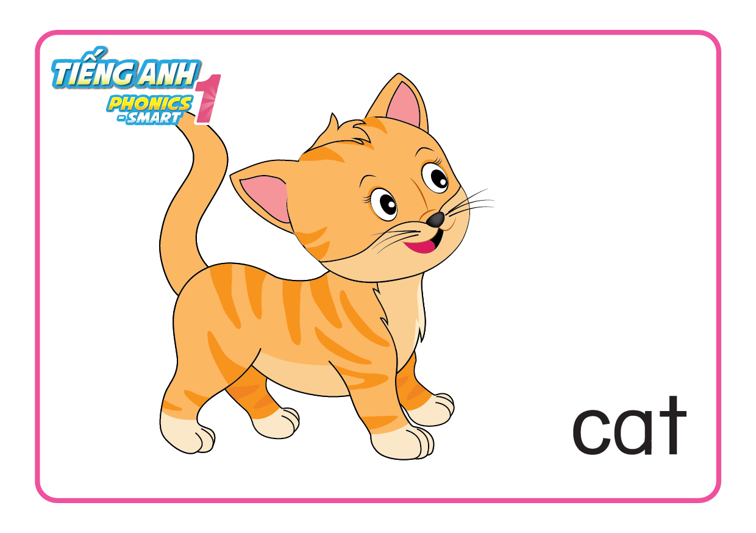
WHAT IS IT?

Slide 18
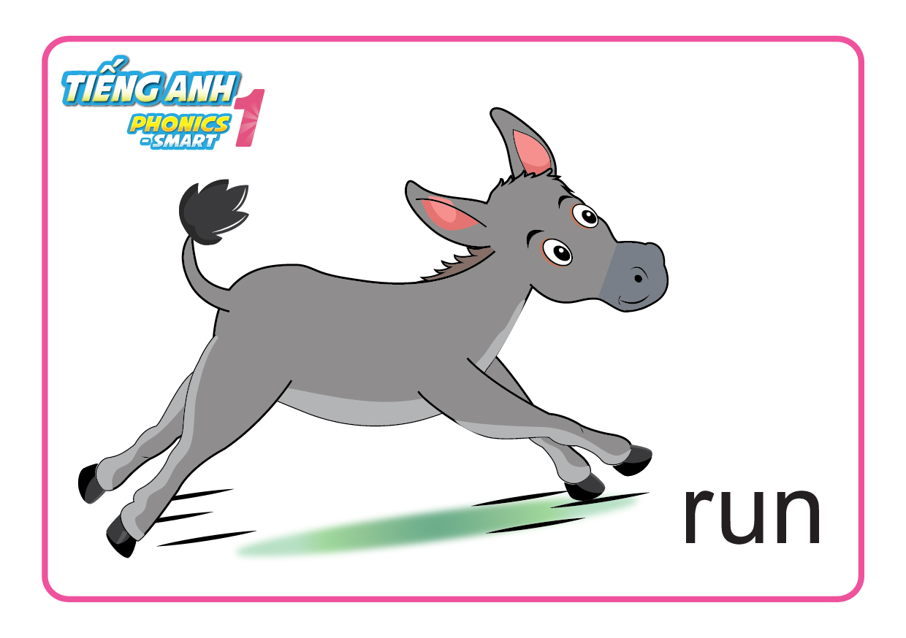
WHAT CAN IT DO?

Slide 19

Lucky Number

Slide 20


Slide 21
Unit 6:
Lesson 4
1. Listen and repeat.
2. Tick and say
Notes:
Asks Ss to open the book page 29 and look at part 2.

Slide 22
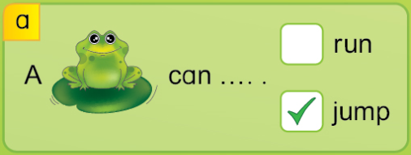

Unit 6:
Lesson 4
1. Listen and repeat.
2. Tick and say

Notes:
T does an example of picture a by clicking into correct answer on the slide.
Before showing the answer, T elicits some answer from Ss by asking “ What is it?” -> “ A frog?” -> “So, A frog can run? Yes or no?” -> “A frog can jump? Yes or no? “ ( GV kết hợp hỏi và đưa tay vào các gợi ý trong sách giúp HS dễ hình dung.
Instructs Ss to put the tick in the correct answer
Gives Ss some time to do the task

Slide 23
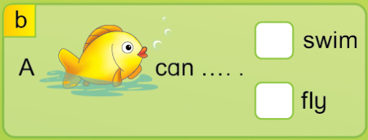
Unit 6:
Lesson 4
1. Listen and repeat.
2. Tick and say



Slide 24
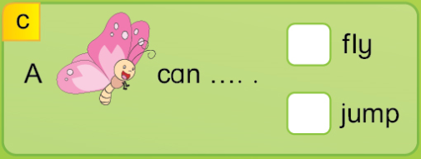
Unit 6:
Lesson 4
1. Listen and repeat.
2. Tick and say



Slide 25
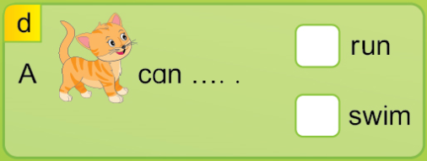
Unit 6:
Lesson 4
1. Listen and repeat.
2. Tick and say



Slide 26




Unit 6:
Lesson 4
1. Listen and repeat.
2. Tick and say



Notes:
T has Ss read all the correct sentence from each picture

Slide 27


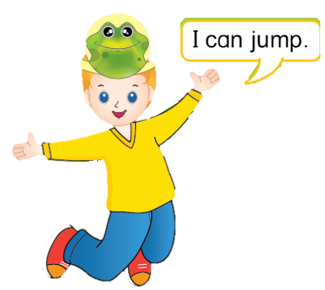
Unit 6:
Lesson 4
1. Listen and repeat.
2. Tick and say
3. Say and act
WHO IS FASTER?
Notes:
T asks Ss what animal is on the boy’s head -> “frog” , then asks “ What can a frog do?”
Checks the answers for Ss by clicking the audio.
Tells Ss that they are going to play a game “ Who is faster?”

Slide 28
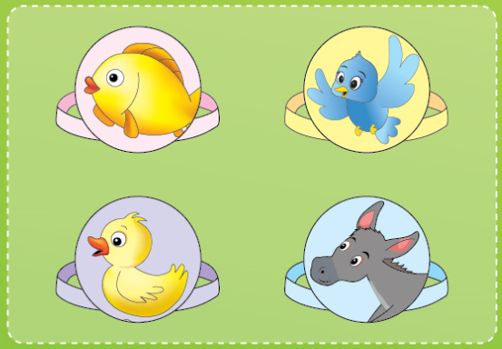


Unit 6:
Lesson 4
3. Say and act
Who is faster?
I can _____.
I can _____.
Notes:
Game: Who is faster?
- Calls 1 student from each team to the board, stand face to the class
- Teacher points to a picture on board.
- Whole class will act the flashcards for their friends on board.
The students on board have to say the answer using “I can____”, who is faster will get 1 point the team.
- The faster will win and get stars/points.
- Keep going in 3-4 rounds.

Slide 29
Unit 6:
Lesson 4
1. Listen and repeat.
2. Tick and say
3. Say and act
Point and say
I can swim.
I can run.
I can swim.
I can fly.
Notes:
T has whole class open the book page 29, part 3. Point in the book and say.
With each sentence, T can have Ss to say and act out the sentence.

Slide 30

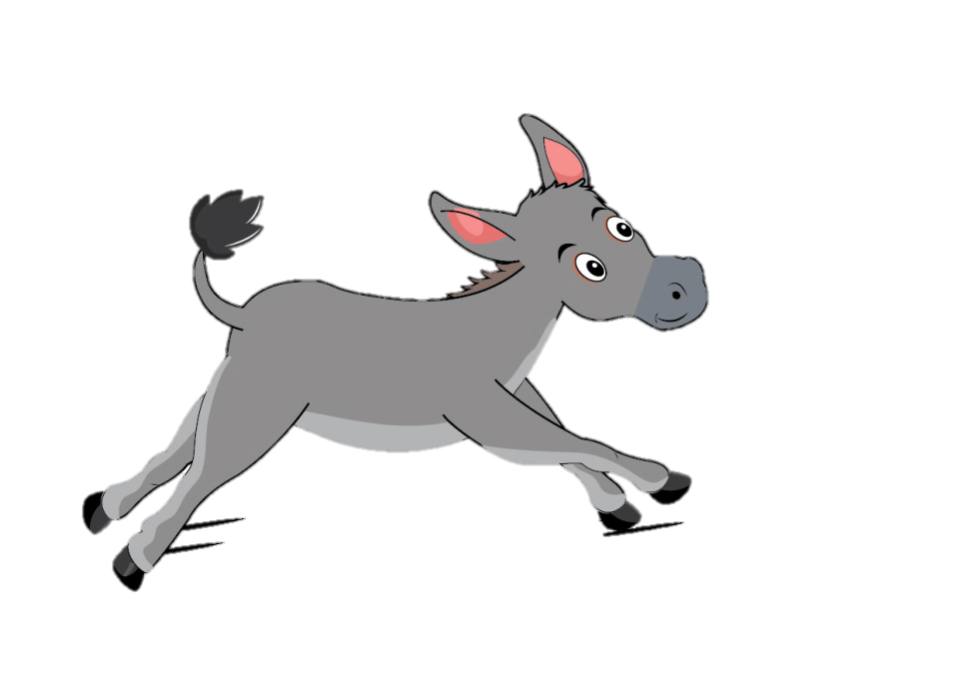
Unit 6:
Lesson 4
1. Listen and repeat.
2. Tick and say
3. Say and act

Slide 31


CÔNG TY CỔ PHẦN PHÁT TRIỂN GIÁO DỤC
VIỆT NAM VPBOX
Hà Nội
Biệt thự G2&G28, Làng Quốc Tế Thăng Long,
Quận Cầu Giấy, Hà Nội.
ĐT: (024) 3 3793 2405
phonics.hanoi@vpbox.edu.vn
Thành Phố Hồ Chí Minh
Số 29 Mai Thị Lựu, Quận 1, TP. HCM.
ĐT: (028) 3 820 5934
phonics.hcm@vpbox.edu.vn
www.vpbox.edu.vn

