Slide 1







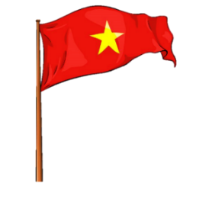


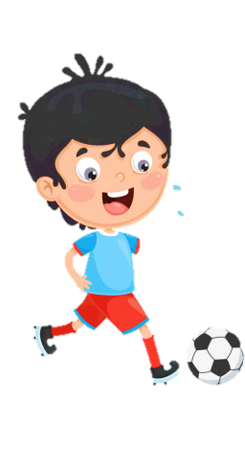
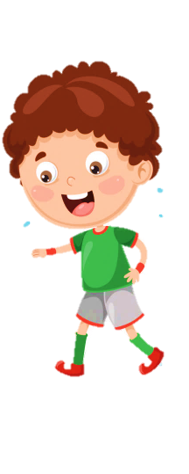
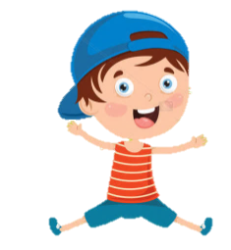
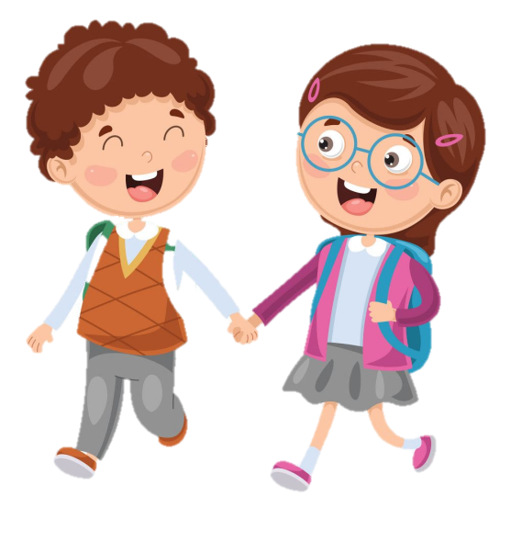



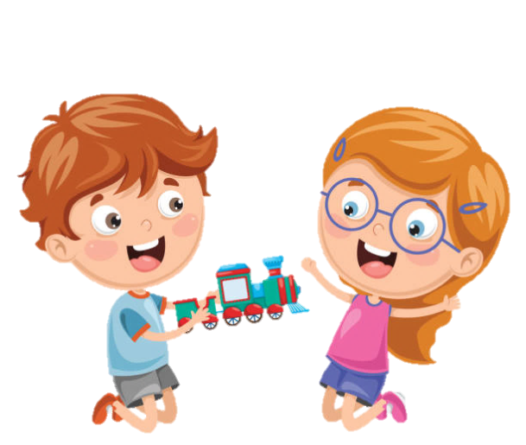
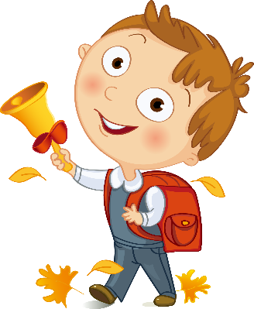



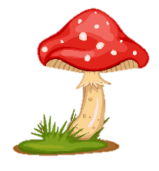
SCHOOL

Slide 2







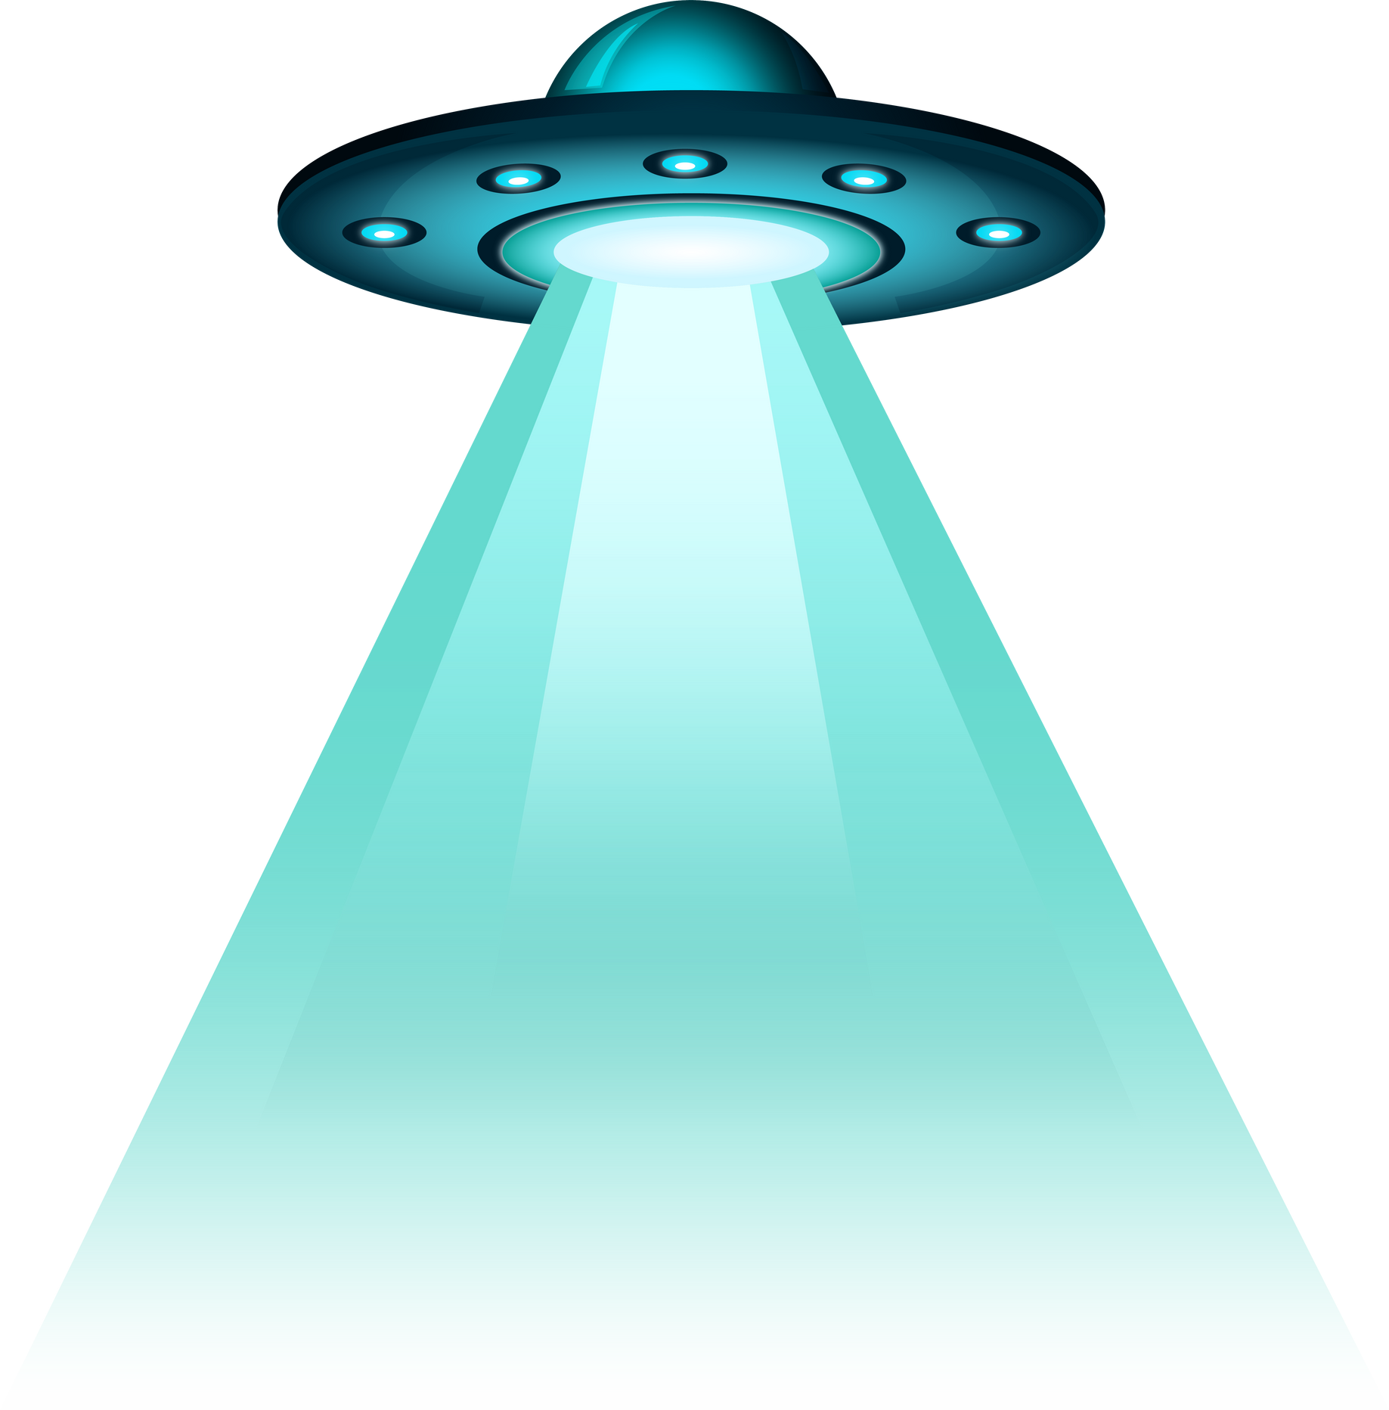





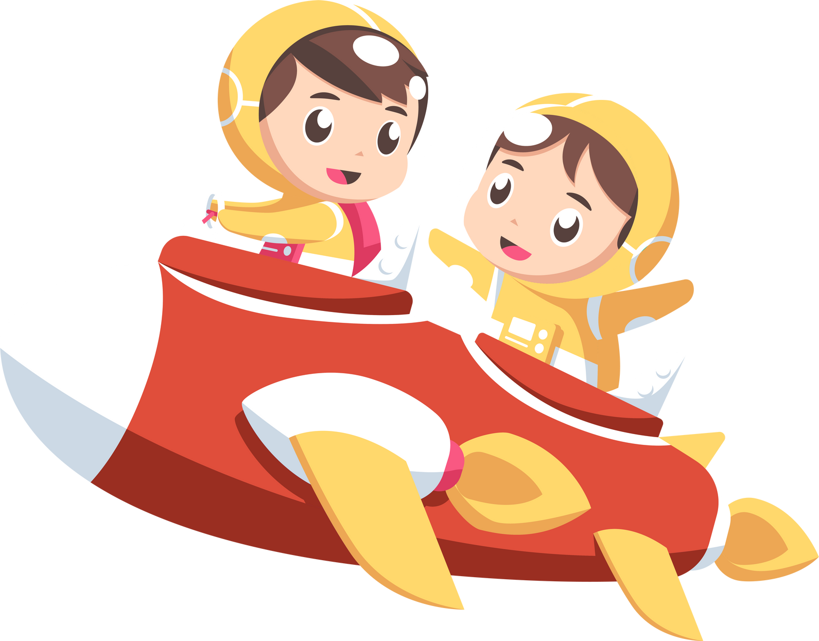
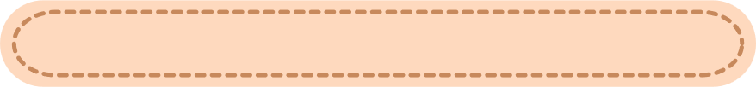
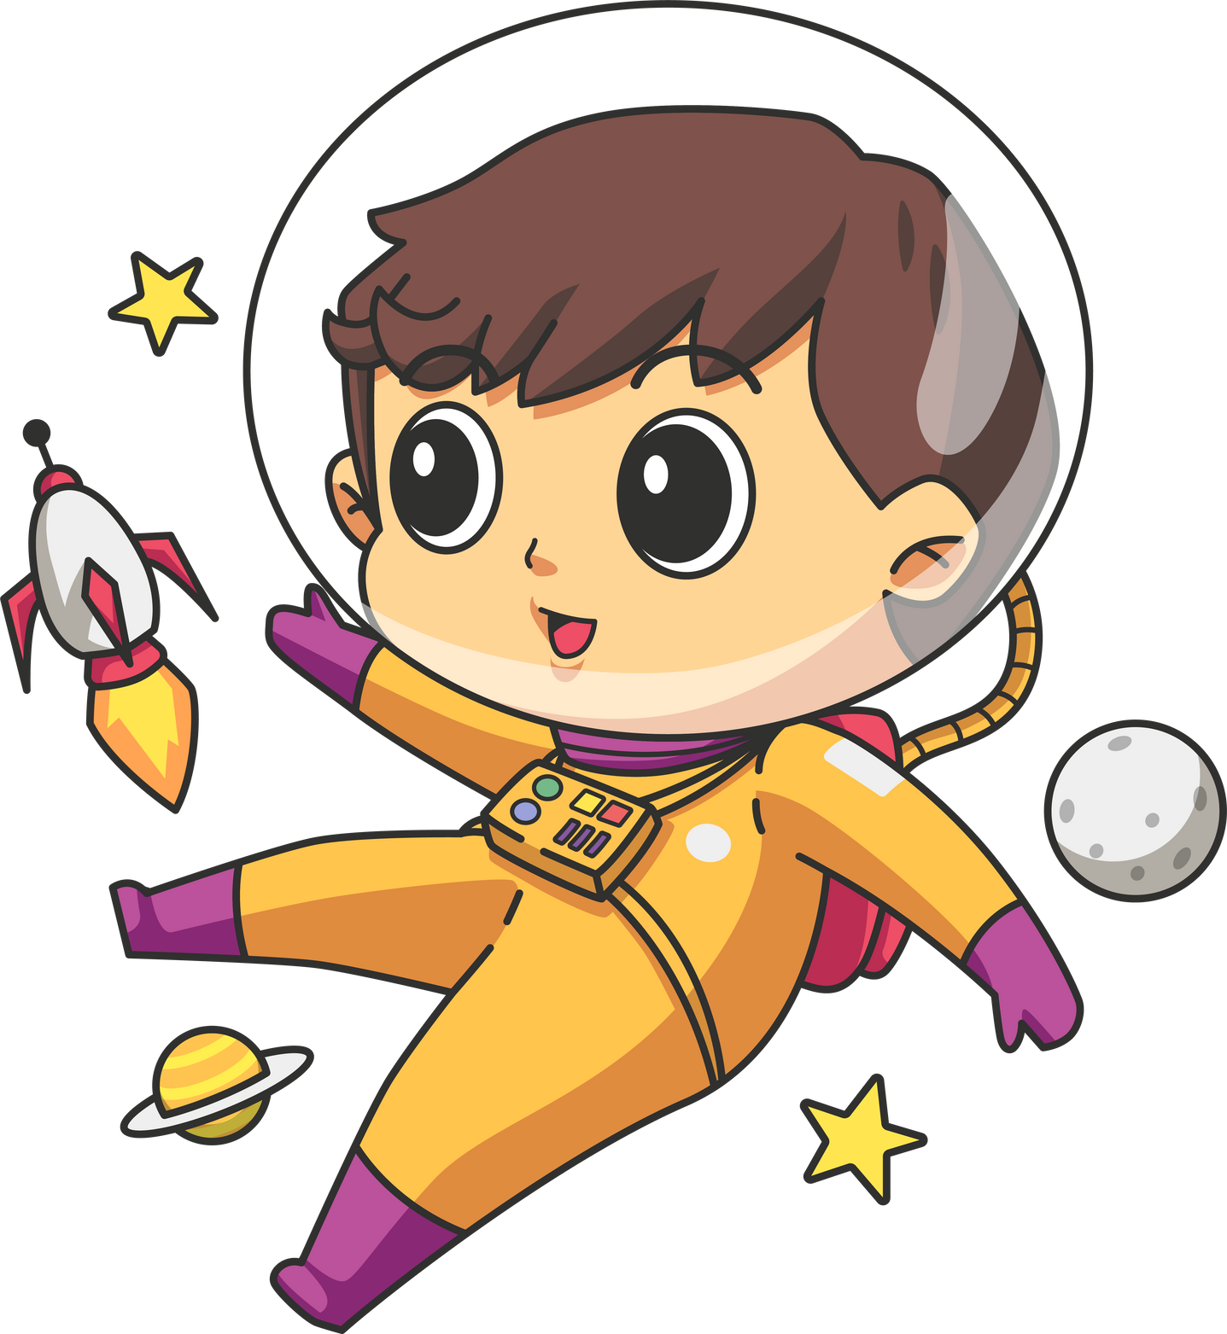



Unit 8
People and Places
LESSON 2 PART 1 2 3
LESSON 2 PART 1 2 3

Slide 3








1
Warm-up

Slide 4
2
Presentation

Slide 5
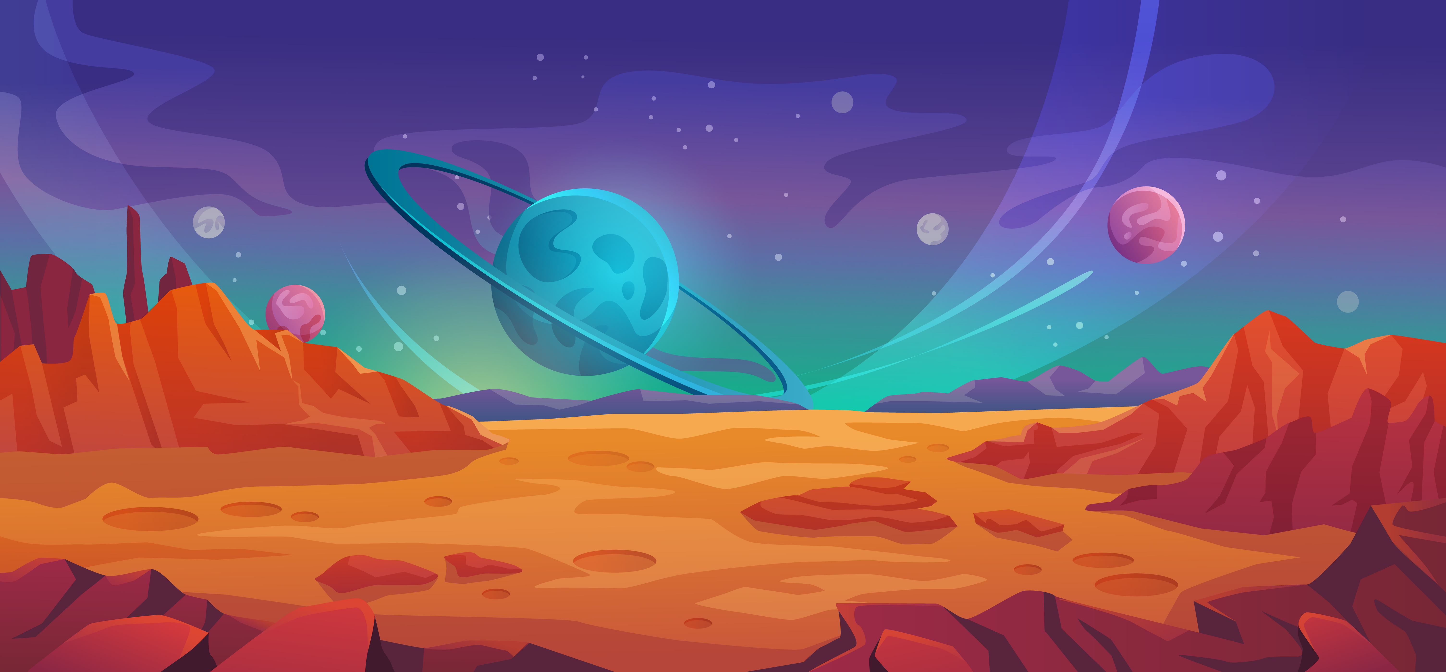
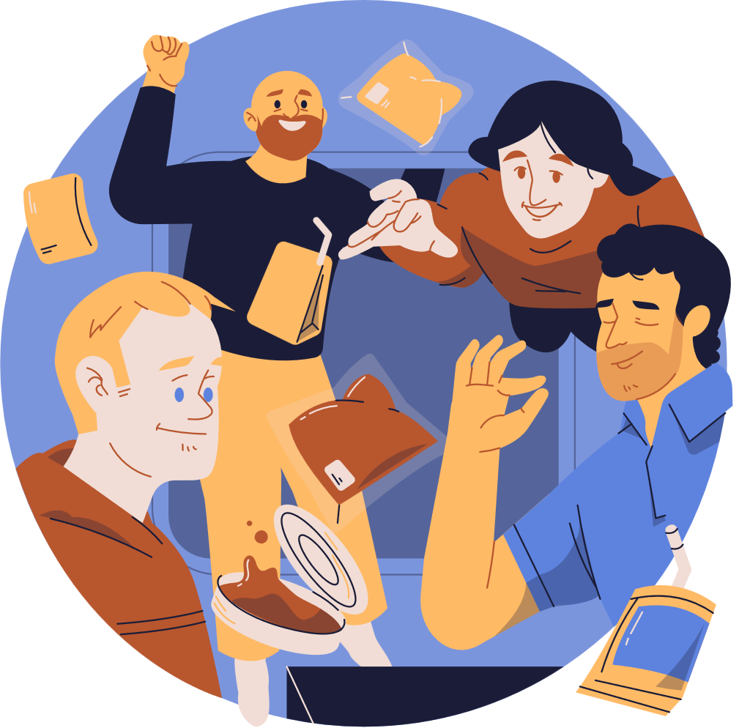
Listen and read about life on the International Space Station
A Day at the International Space Station (ISS)
In the morning, scientists use a towel and special soap to clean their bodies. There’s very little water, so they can’t have a shower or a bath. In space, everything floats. Food doesn’t stay on the plates, so scientists must eat food from packages. There isn’t a fridge on the ISS, so they mustn’t keep fruit and vegetables for long. In their free time, they watch films, read books or exercise. At bedtime, they sleep in special sleeping bags on the wall. They must fasten themselves to the floor or the wall to stay in one place.

Slide 6
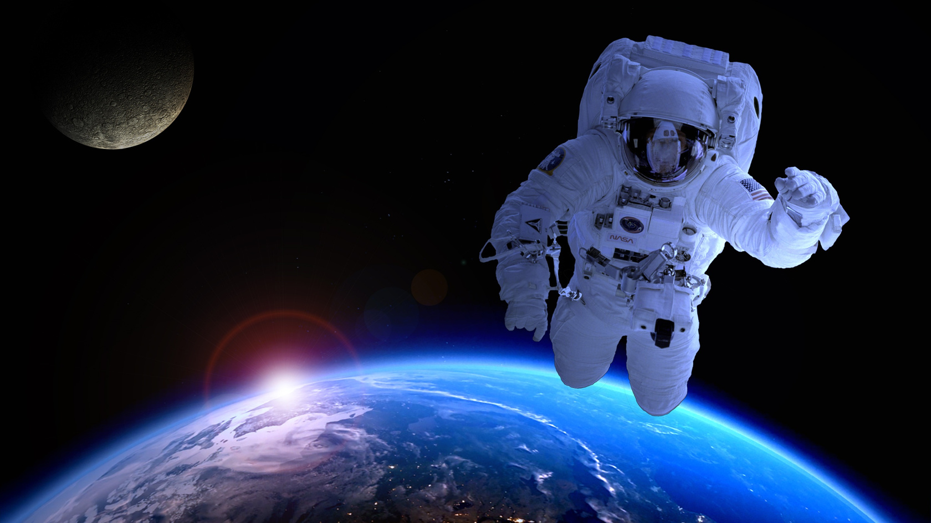
float
/fləʊt/

Slide 7
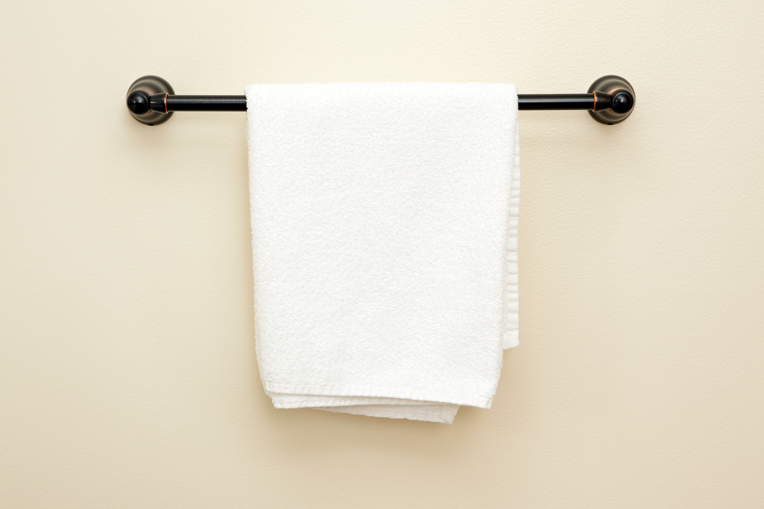
towel
/taʊəl/

Slide 8
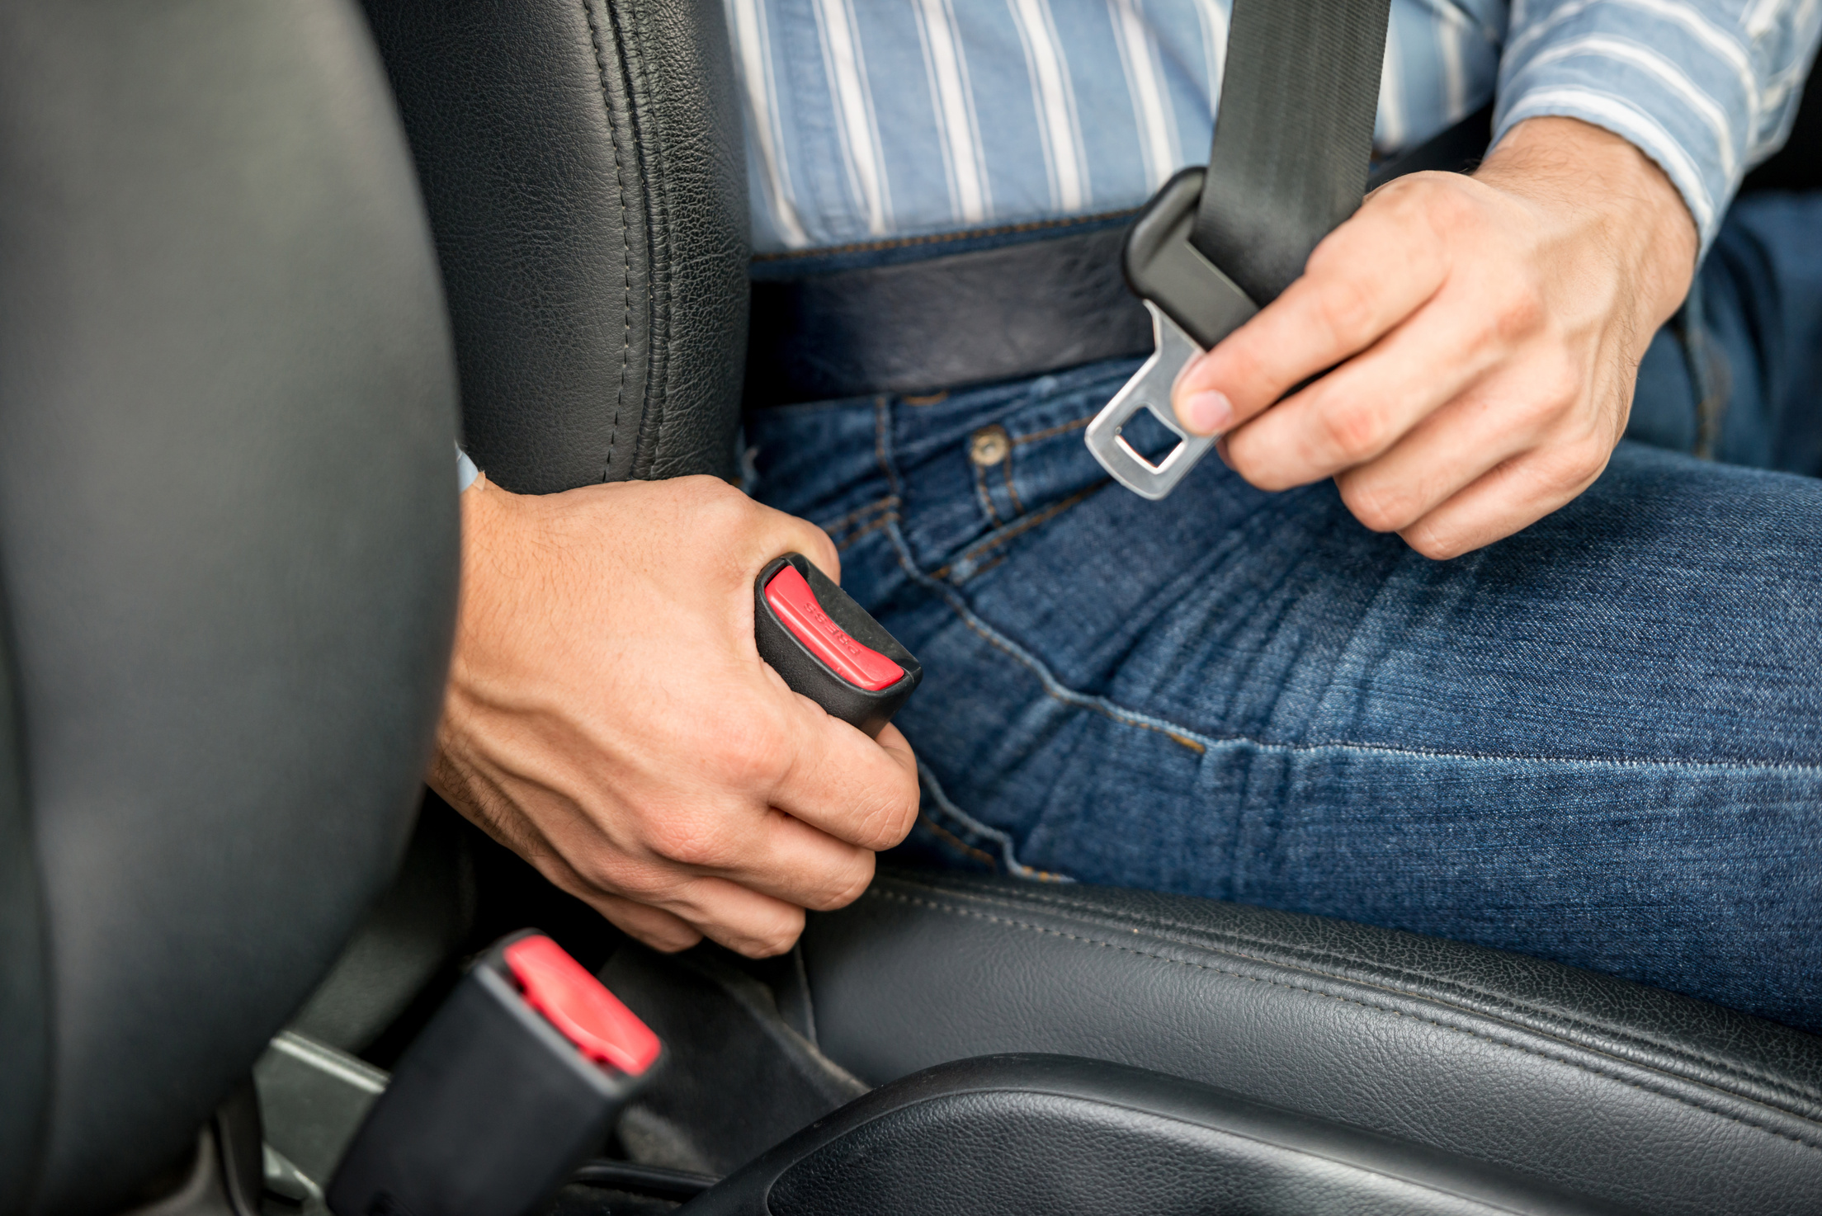
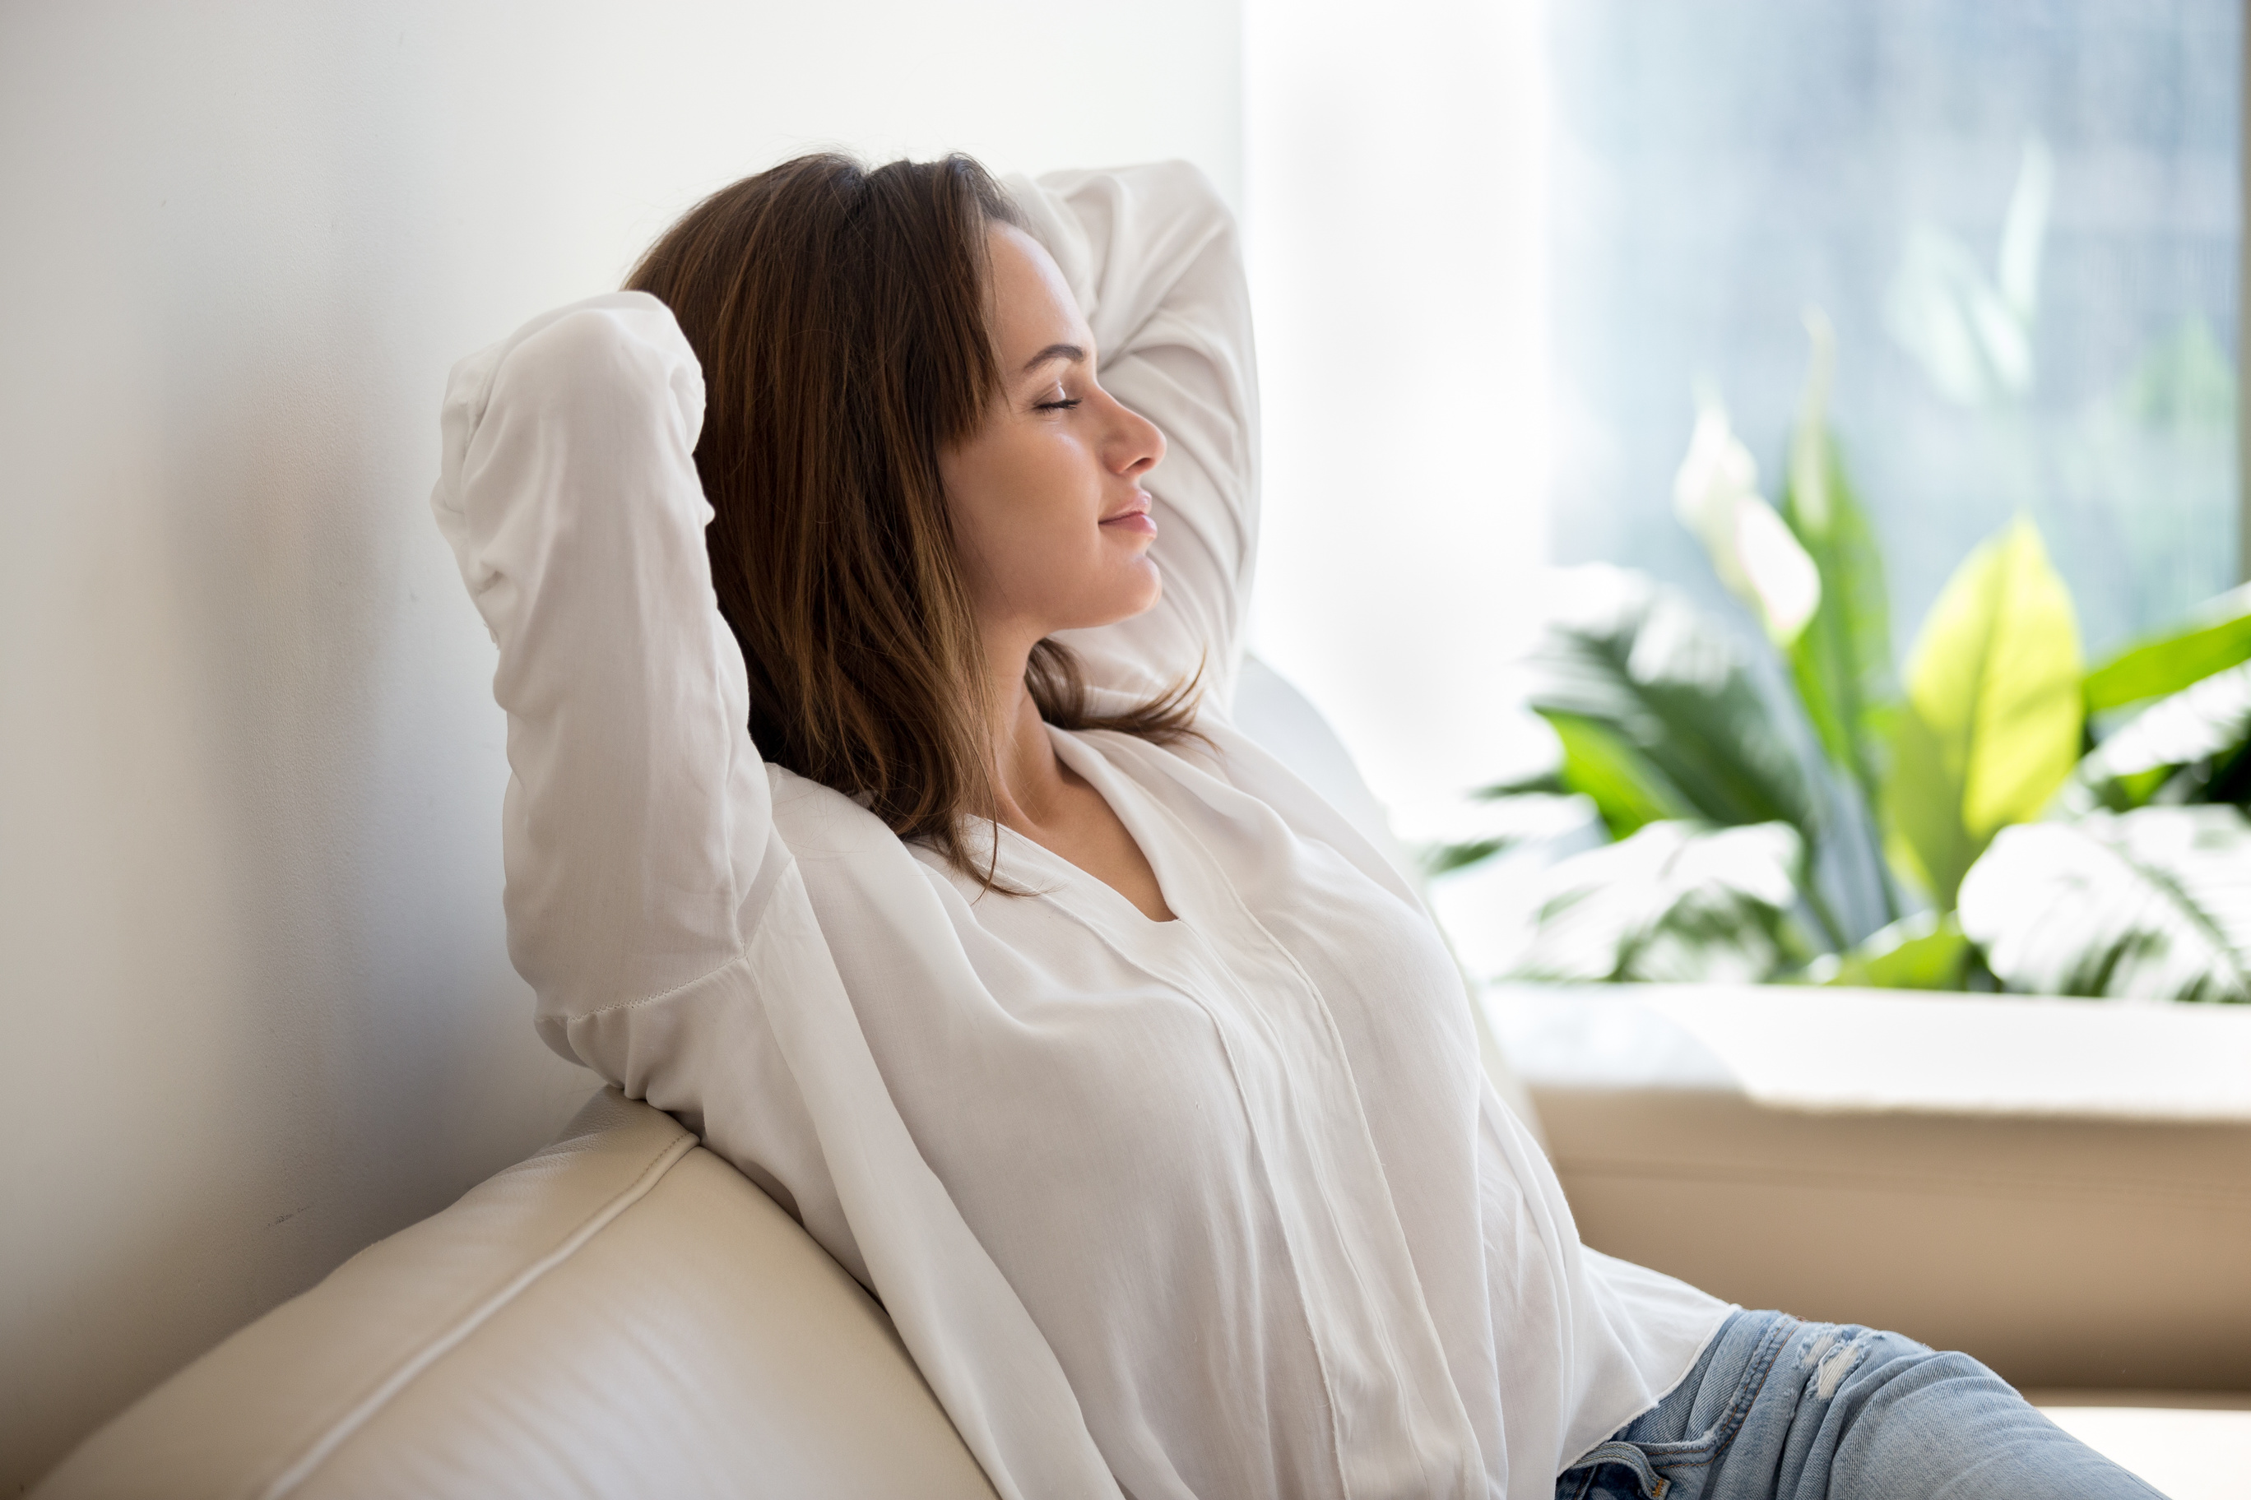
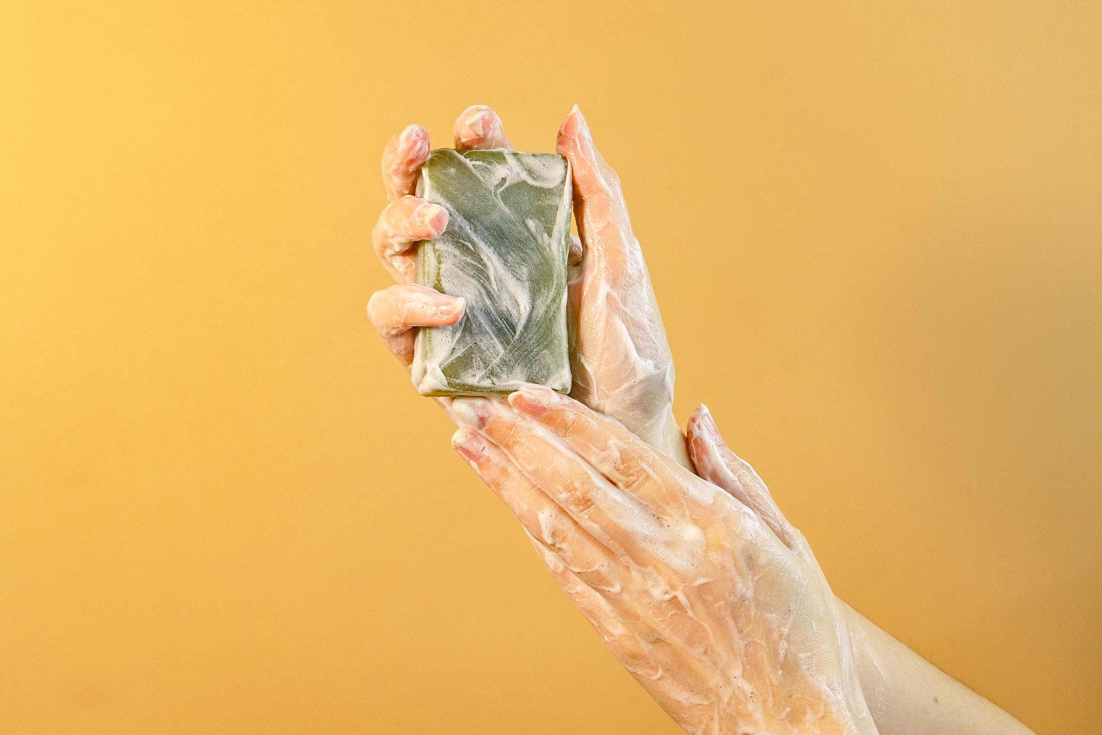
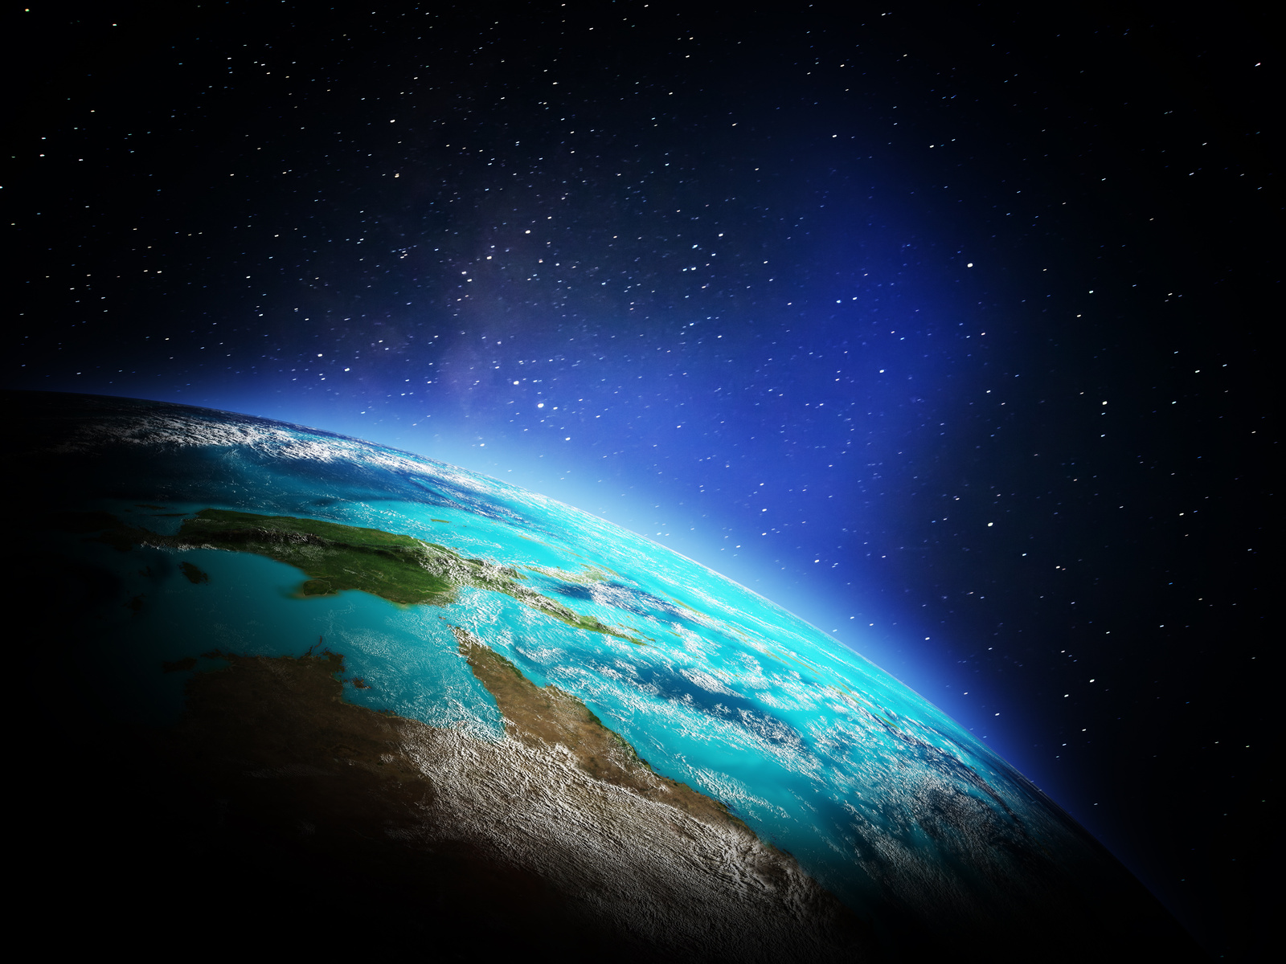
2 Listen, point and repeat. TR: 8.6
fasten
float
relax
soap
space
towel

Slide 9
3
PRACTICE
Answer the questions of the passage.

Slide 10
4
PRODUCTION

Slide 11

Choose the words
floated
relax
soap
fasten
floated
Today was another amazing day in space! I ______ around the spaceship to do my chores, and I had to ______ myself down to eat breakfast. Using _________in zero gravity is so funny because the bubbles float everywhere! In the afternoon, I took some time to _____and watched Earth from the window. Being an astronaut is incredible, and I love every moment of this space adventure!
fasten
soap
relax

Slide 12

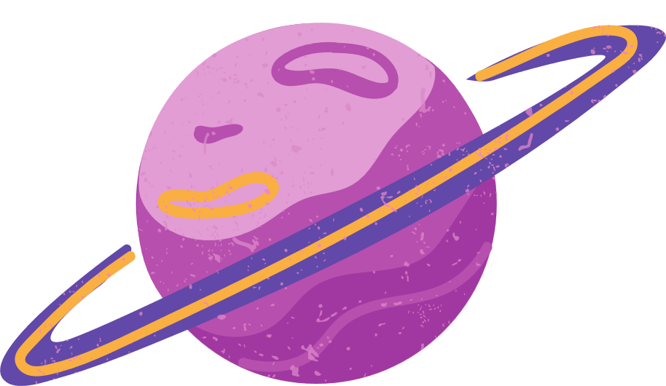







Thanh You
for your attention

