Slide 1









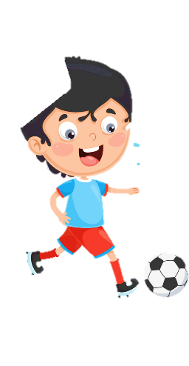
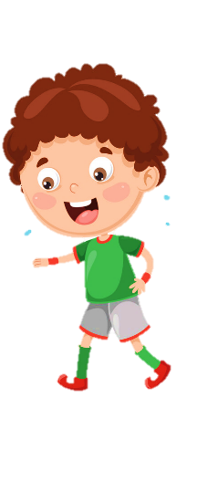










Unit 8
My Town
Lesson 1 – Task 1,2,3

Slide 2






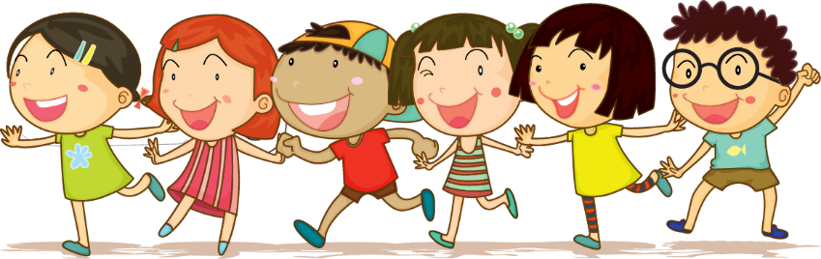



1 Warm up

Slide 3

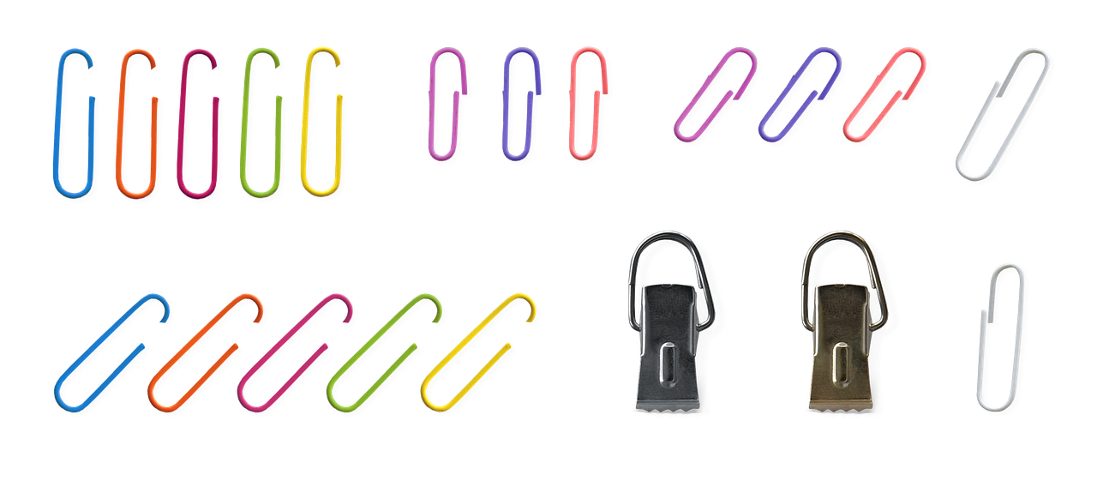
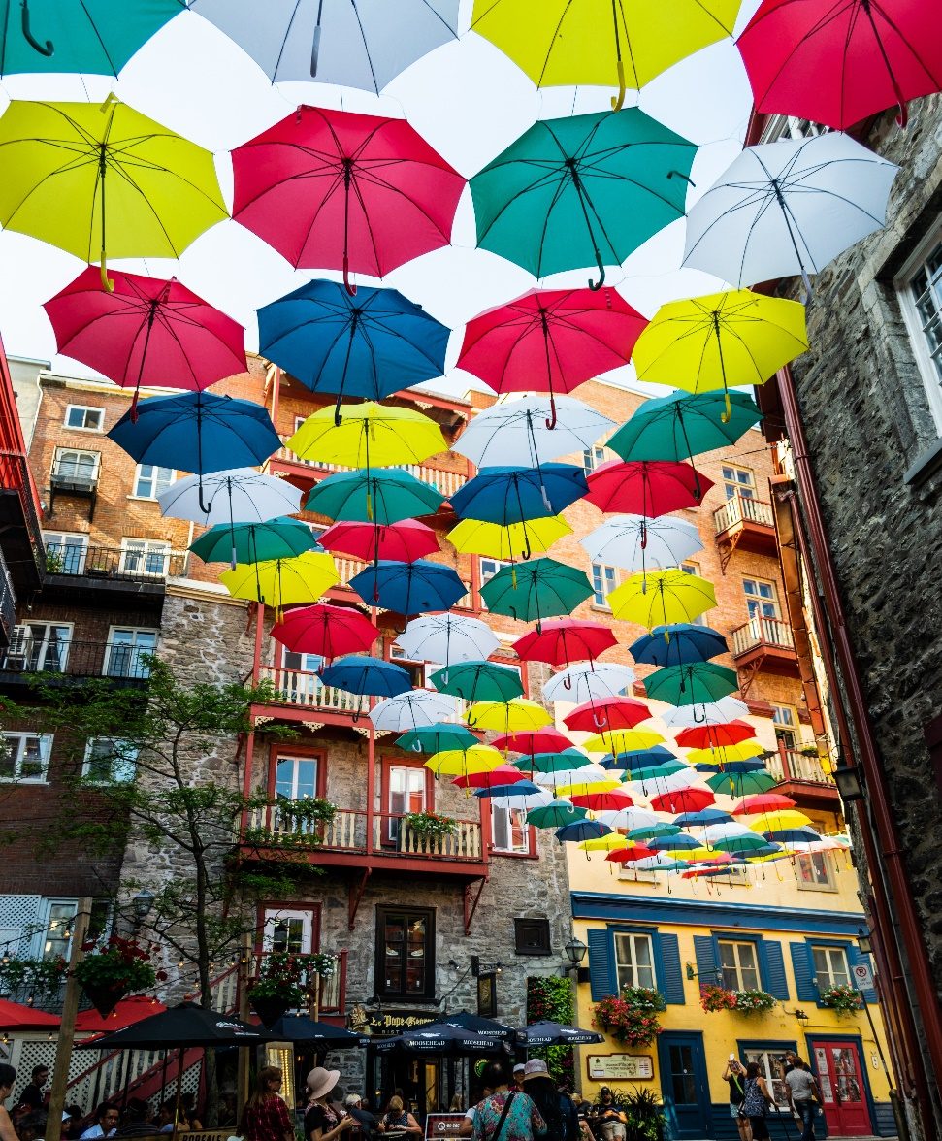


Look. Tick the colours you see.
✓
✓
✓
red
yellow
✓
✓
white
black
Colourful umbrellas in the sky Quebec City, Canada

Slide 4

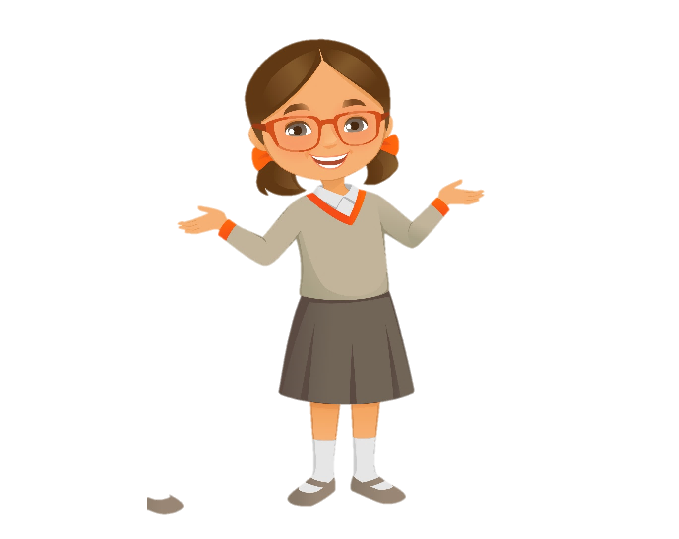
Vocabulary
Notes:
Show picture to teach vocab.

Slide 5
in the library

Slide 6
in the museum

Slide 7
at the theater

Slide 8
at the zoo

Slide 9

Look and choose.

Slide 10
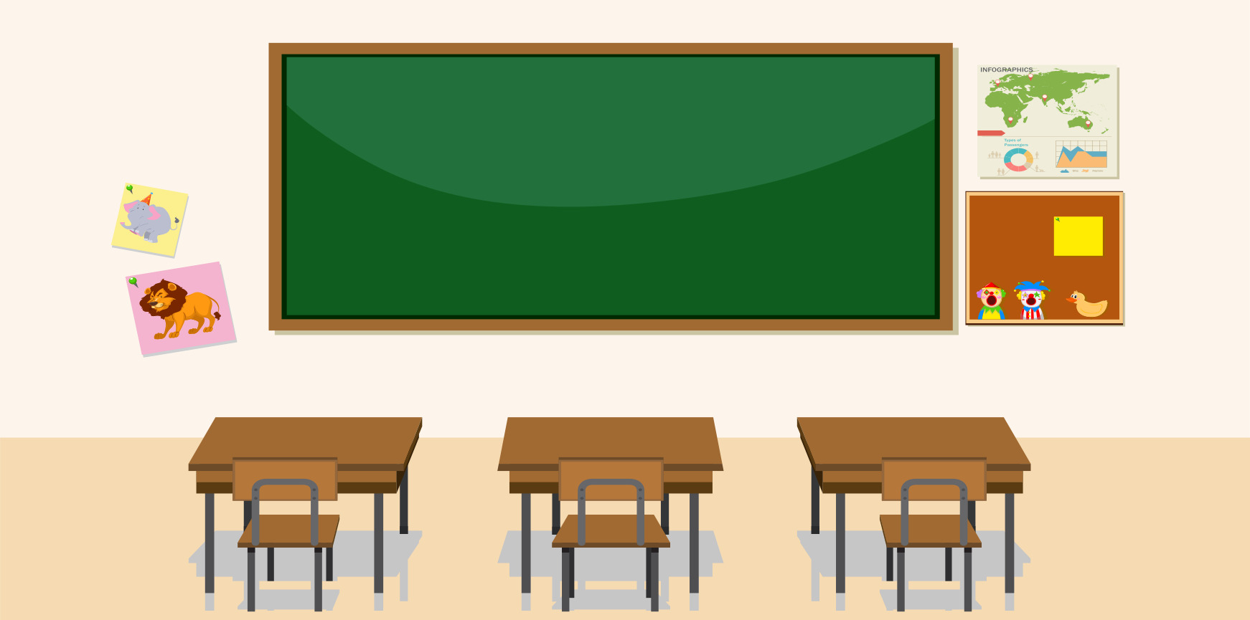
in the library
at the theater

Slide 11
at the zoo
in the museum

Slide 12
at the theater
in the library

Slide 13
in the museum
at the zoo

Slide 14
3 Practice

Slide 15
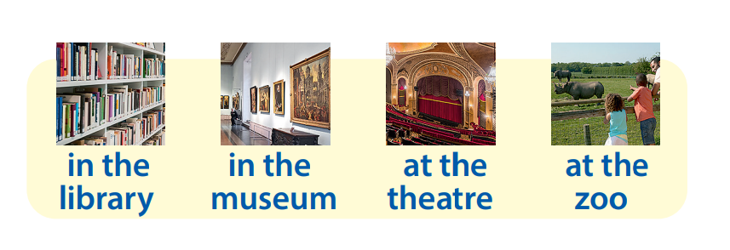
Task 1 Listen and point. Repeat.
Notes:
Font chữ

Slide 16


Task 2 Listen and tick.

Slide 17

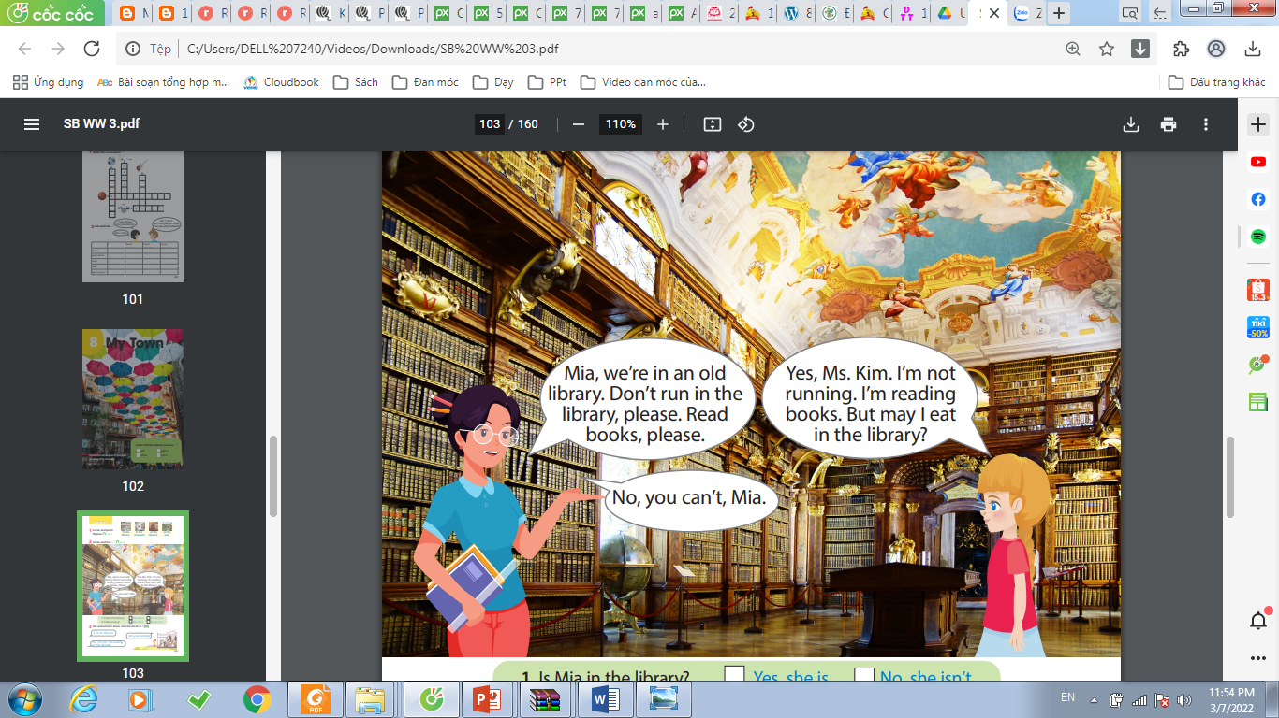
Mia, we’re in an old library. Don’t run in the library, please. Read books, please.
Yes, Ms. Kim. I’m not running. I’m reading books. But may I eat in the library?
No, you can’t, Mia.
✓
✓
Yes, she is.
1 Is Mia in the library?
No, she isn’t.
2 Is Mia running?
✓
No, she isn’t.
Yes, she is.
Notes:
HOẠT ĐỘNG TƯƠNG TÁC. NGHE VÀ TICK CHỌN ĐÁP ÁN ĐÚNG

Slide 18
4 Production

Slide 19


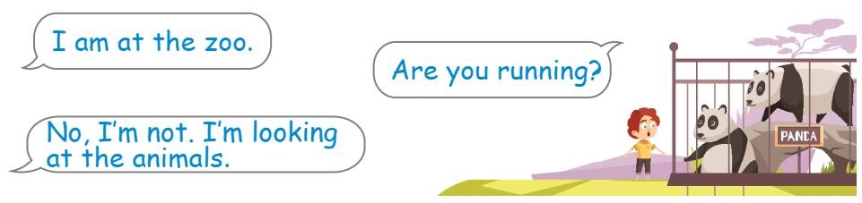
Task 3 Ask and answer. Draw. Use the words in 1.

Slide 20
5 Assessment

Slide 21
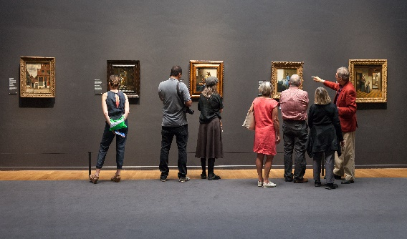
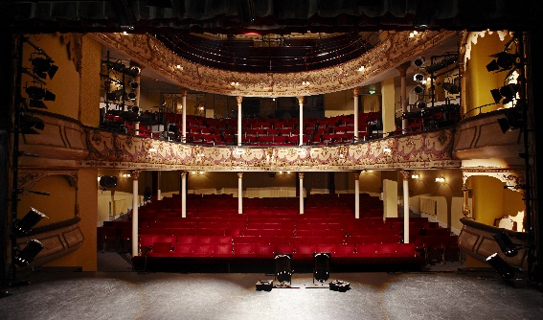
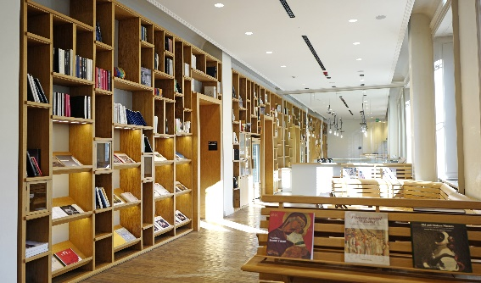
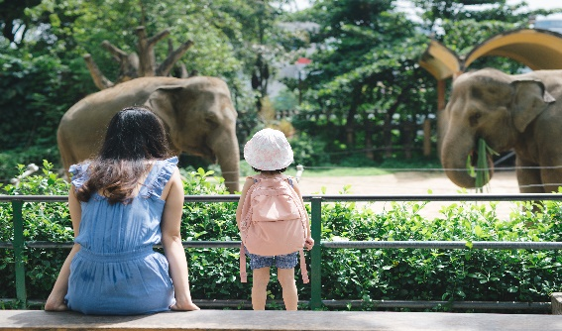
Look and match
1
2
3
4
A. at the zoo
B. in the library
C. at the theater
D. in the museum
I’m in/at _______.
Notes:
HOẠT ĐỘNG TƯƠNG TÁC. NHÌN TRANH VÀ NỐI VỚI CÁC CỤM TỪ ĐÃ CHO.
ĐỀ BÀI. LOOK AND MATCH

Slide 22




Thank you & goodbye!

