Slide 1









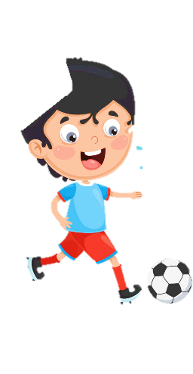












Unit 8
My Town
Lesson 2 – Task 1,2,3

Slide 2










1 Warm up
The secret picture

Slide 3

What is it?
-7 letters
-Start from letter “L”
-Books.
?
library

Slide 4
What is it?
-6 letters
-Start from letter “M”
- Visit to learn history
?
museum

Slide 5
What is it?
-7 letters
-Start from letter “T”
-Music, movie, play
?
theater

Slide 6
What is it?
-3 letters
-Start from letter “Z”
-Elephant, lion, monkey
?
zoo

Slide 7
2 Presentation

Slide 8

Vocabulary

Slide 9

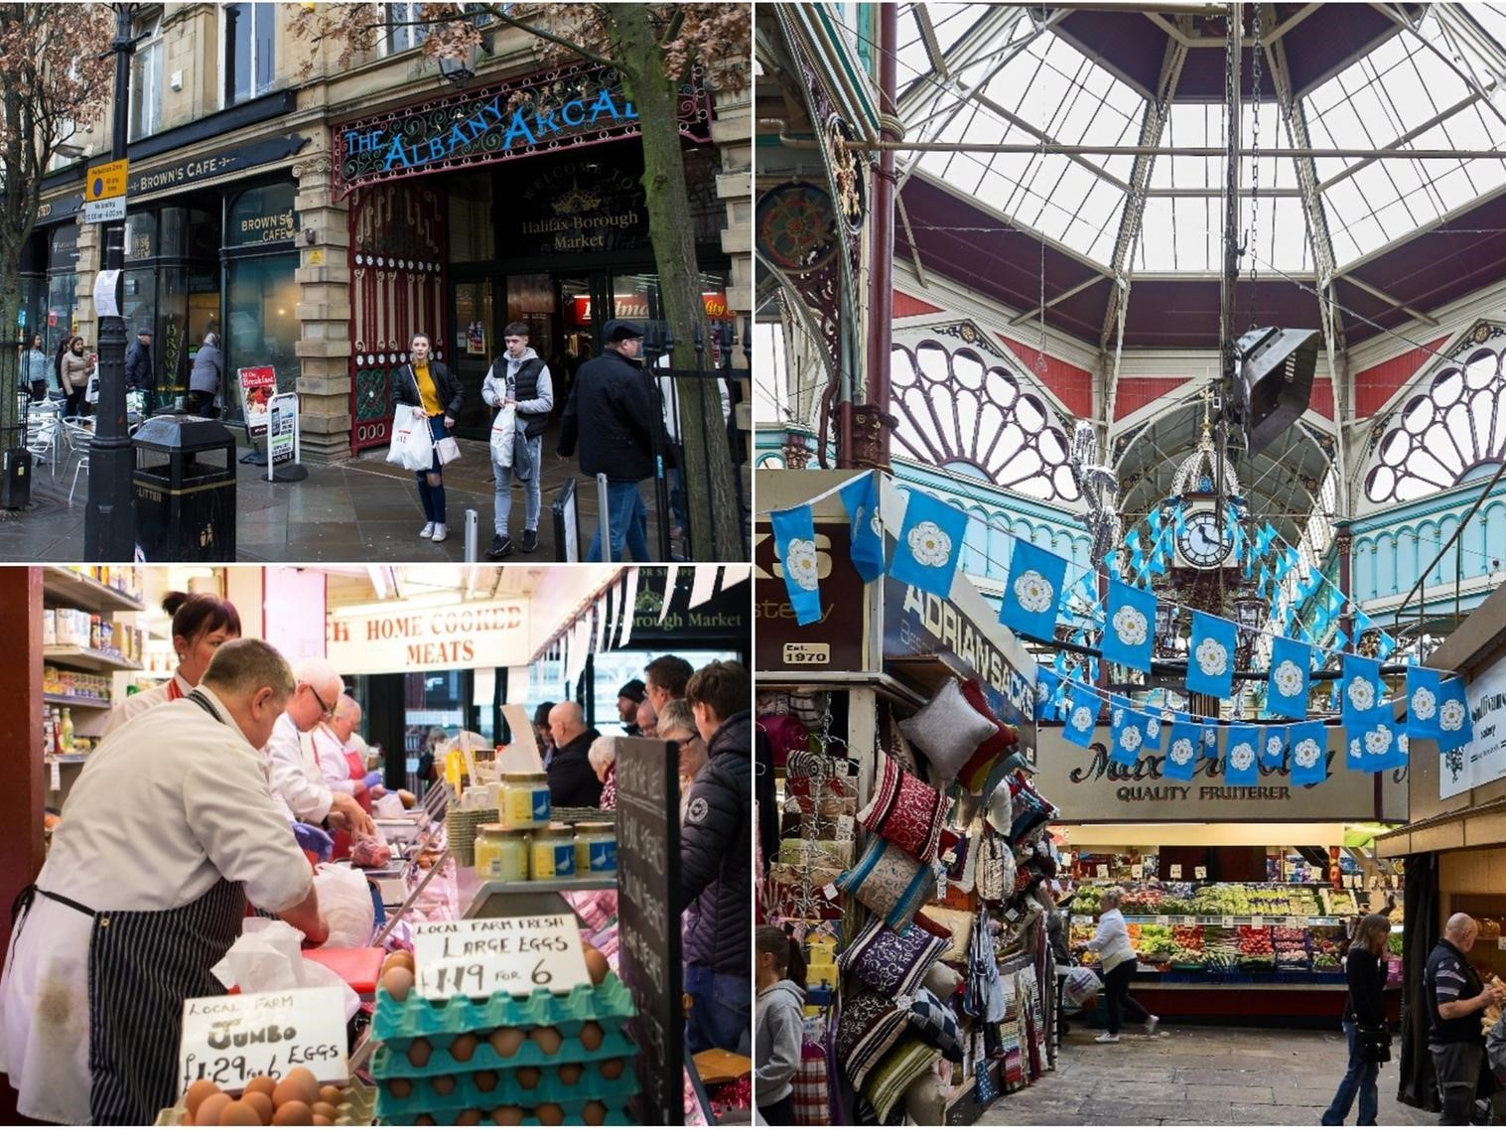
at the market
Notes:
- Show slide and teach vocabulary

Slide 10
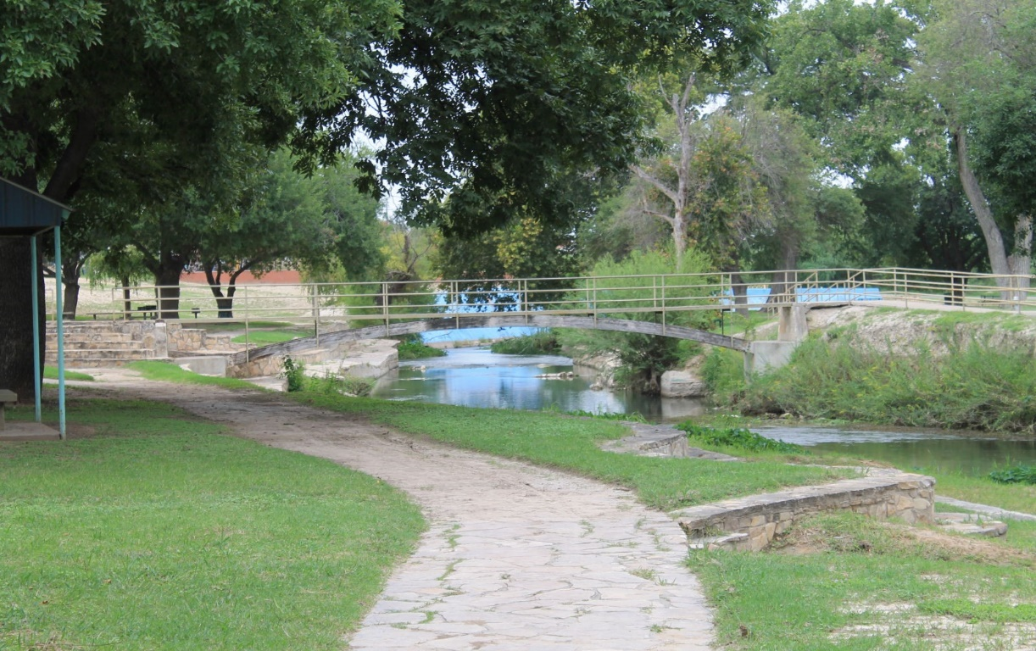
in the park

Slide 11
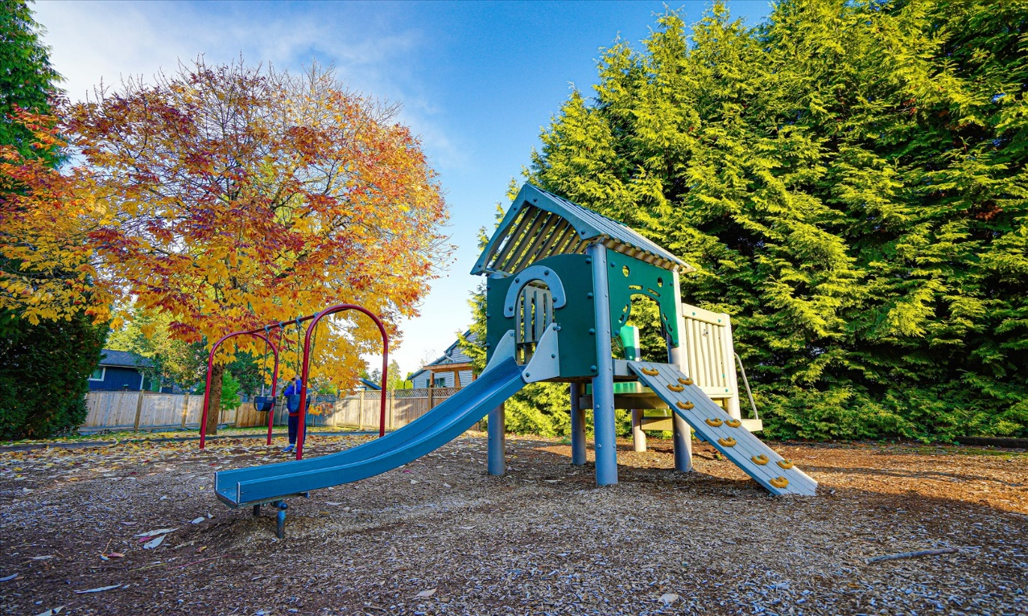
at the playground

Slide 12

in the pool

Slide 13
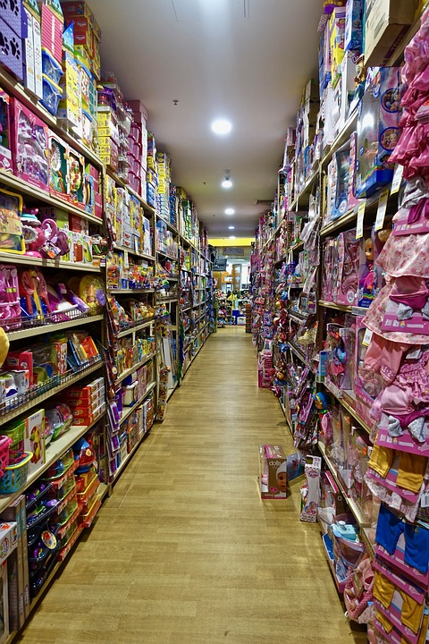
at the toy shop

Slide 14
Task 1 Listen and point. Repeat.

Slide 15


Slide 16
Quick look
Notes:
Bỏ
Show a picture at a fast speed
-Ss quick look and guess where it is.

Slide 17


Look and say
in the pool
Notes:
HOẠT ĐỘNG TƯƠNG TÁC TỪ SLIDE 17->22

Slide 18
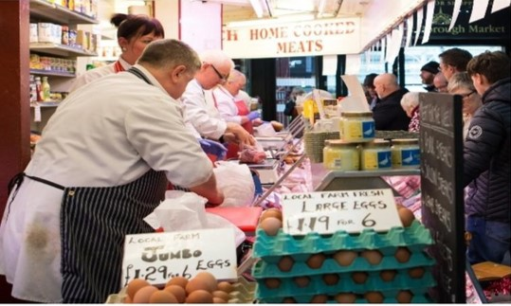
Look and say
at the market

Slide 19
Look and say
at the playground

Slide 20
Look and say
in the park

Slide 21
Look and say
at the toy shop

Slide 22
3 Practice

Slide 23
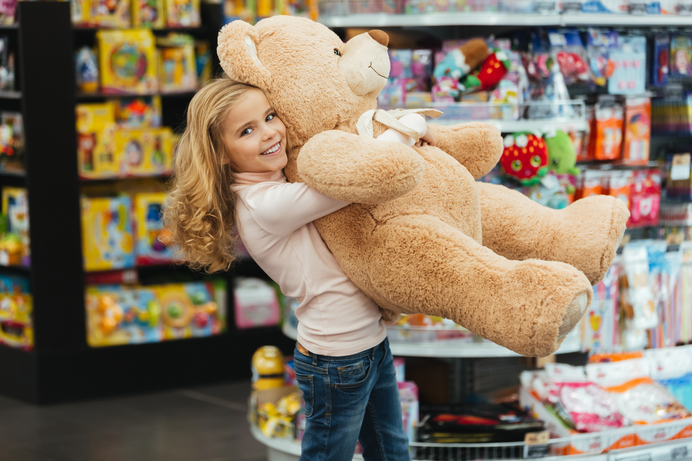


Task 2. Listen and tick.
Hi, Tom.
Hi, Kate.
What are you doing?
I’m buying a teddy bear at the toy shop. There are nice teddy bears here.
Cool!
I’m in the park. We’ve got a new bike. My brother is riding it. It’s fun!
And you?

Slide 24
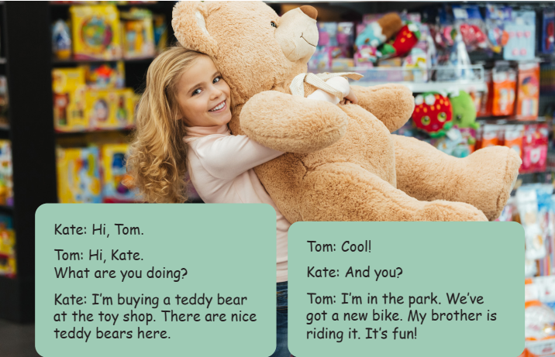
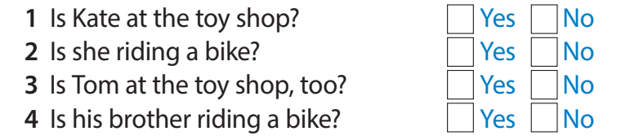
Task 2. Listen and tick.
✓
✓
✓
✓

Slide 25
4 Production

Slide 26




Task 3. Let’s play! Use the phrases in 1.
No, I’m not.
Are you buying toys?
Yes, I am.
Are you swimming?
Yes!
Are you in the pool?

Slide 27
5 Assessment
Look and fill in the blank

Slide 28
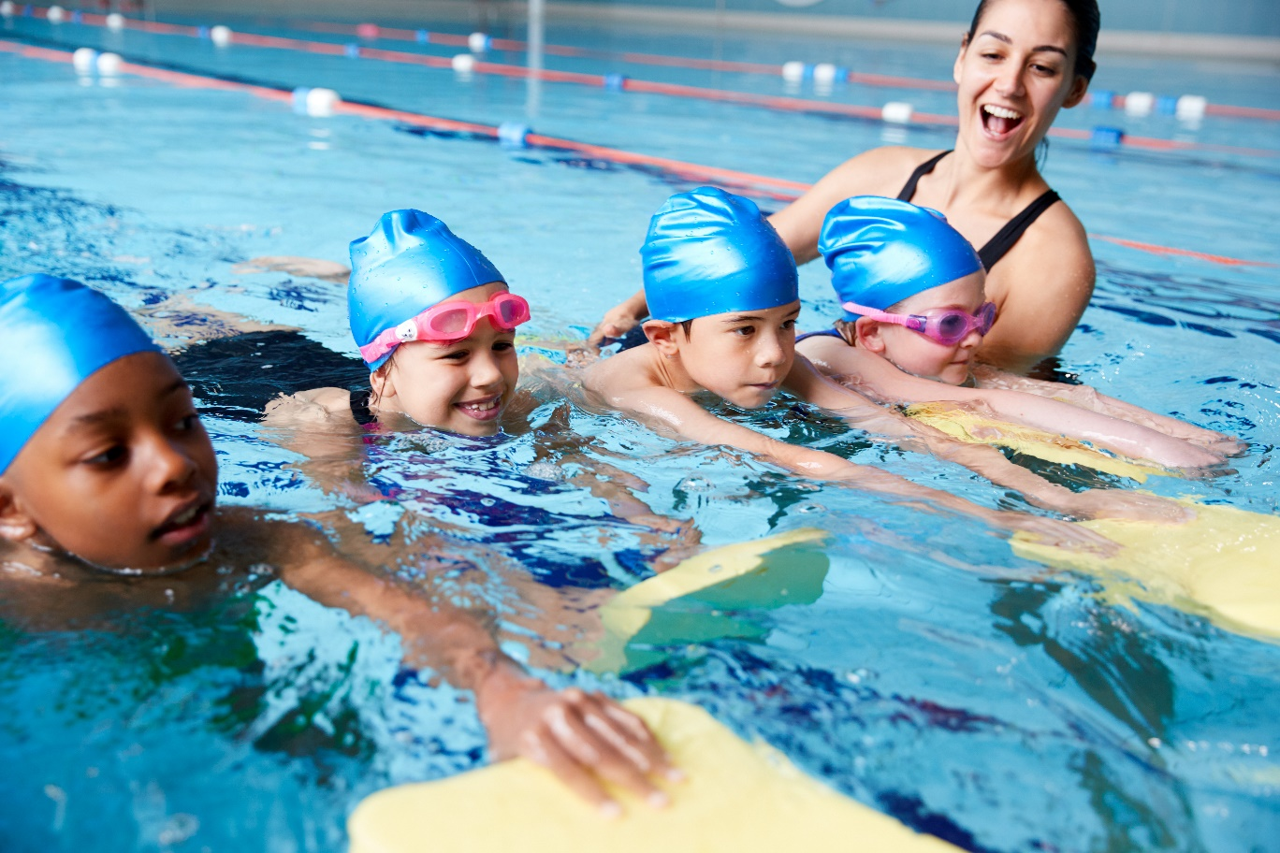
They
in the pool
1. _____’re swimming ___________.
Notes:
HOẠT ĐỘNG TƯƠNG TÁC TỪ SLIDE 29-> 33

Slide 29
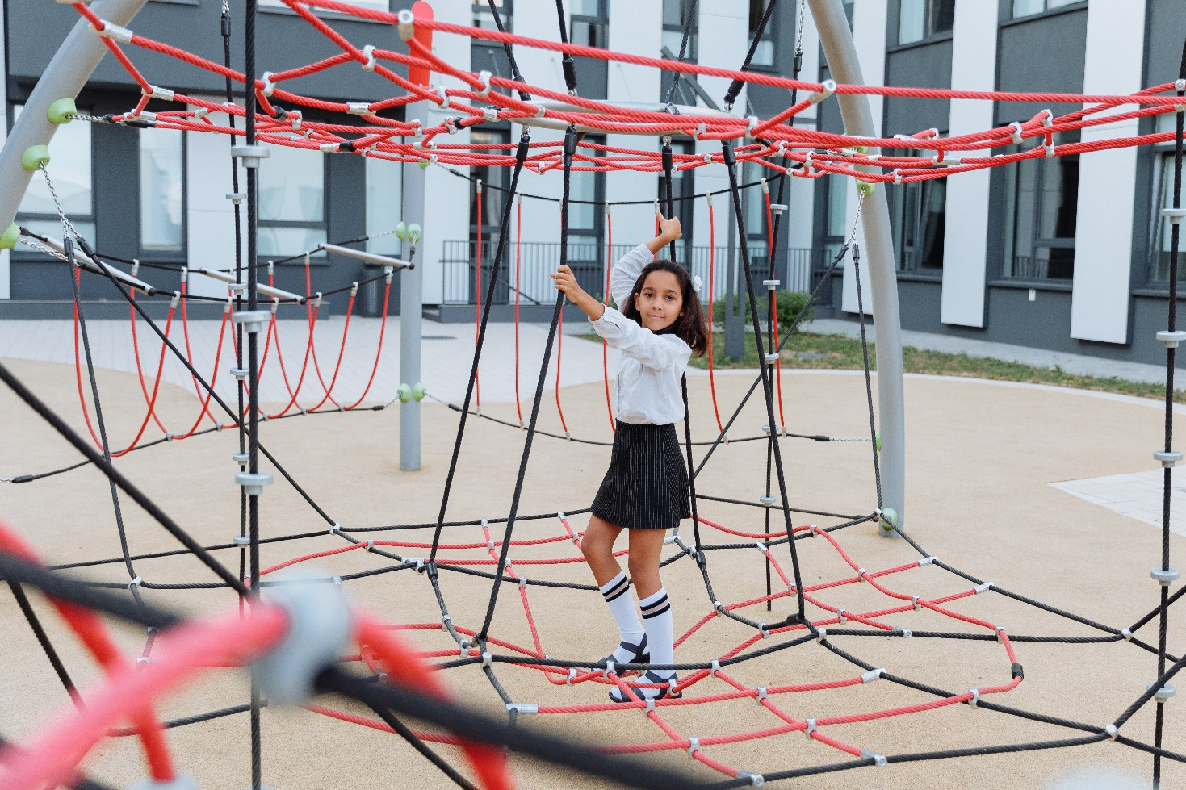
She
at the playground
2. _____’s playing ______________.

Slide 30
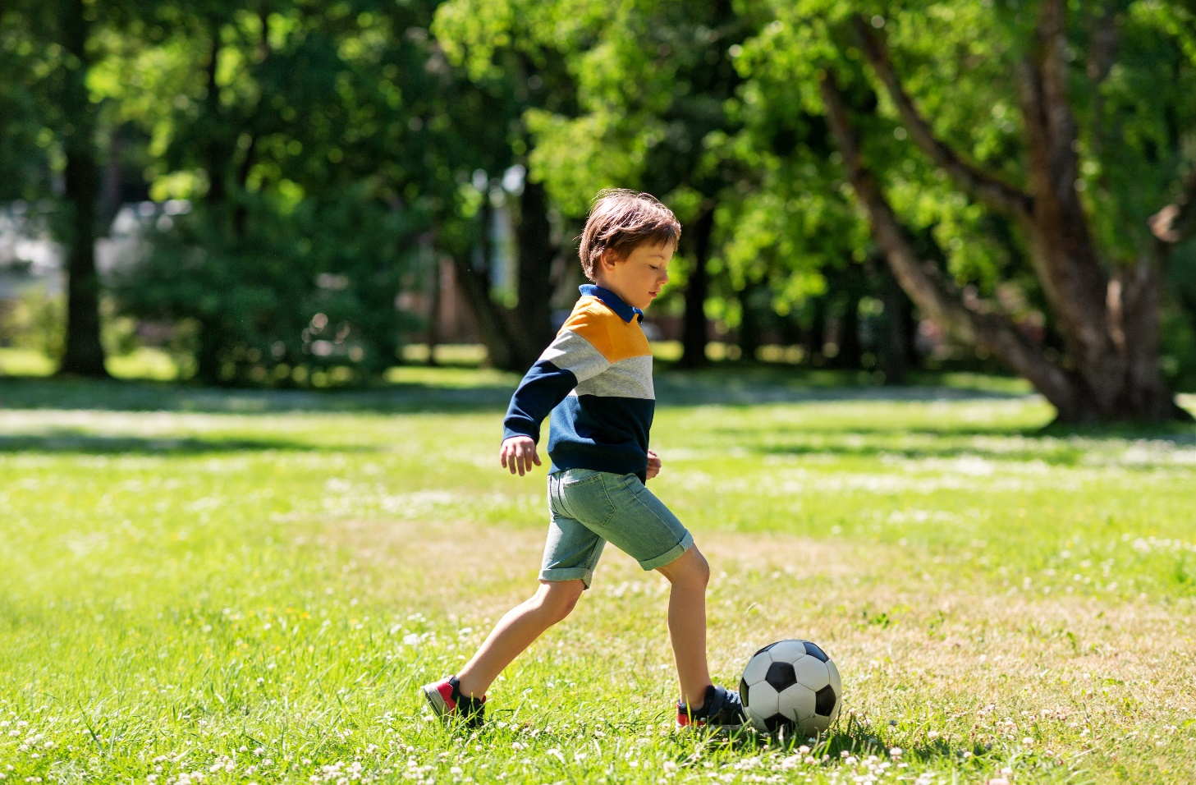
in the park
3. _____’s playing football ___________.
He

Slide 31
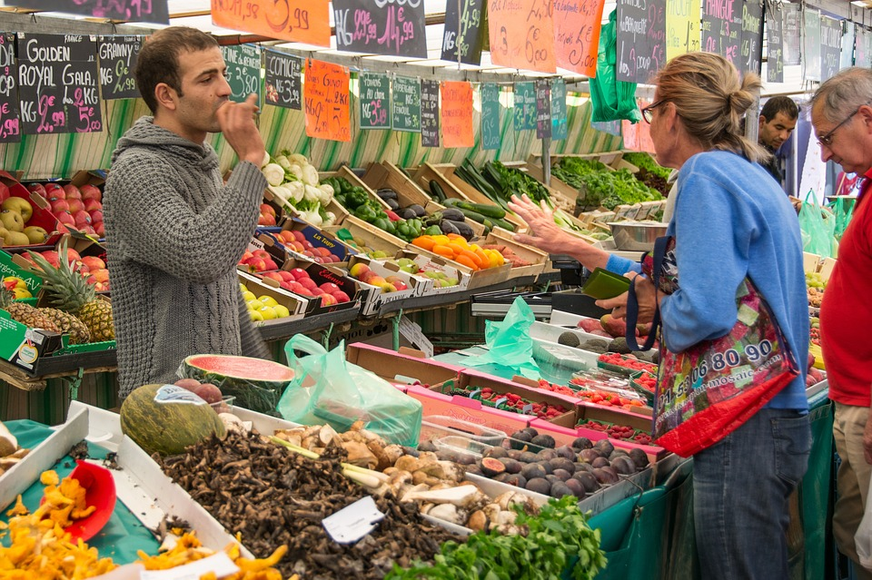
They
at the market
4. _____’re ______________.

Slide 32
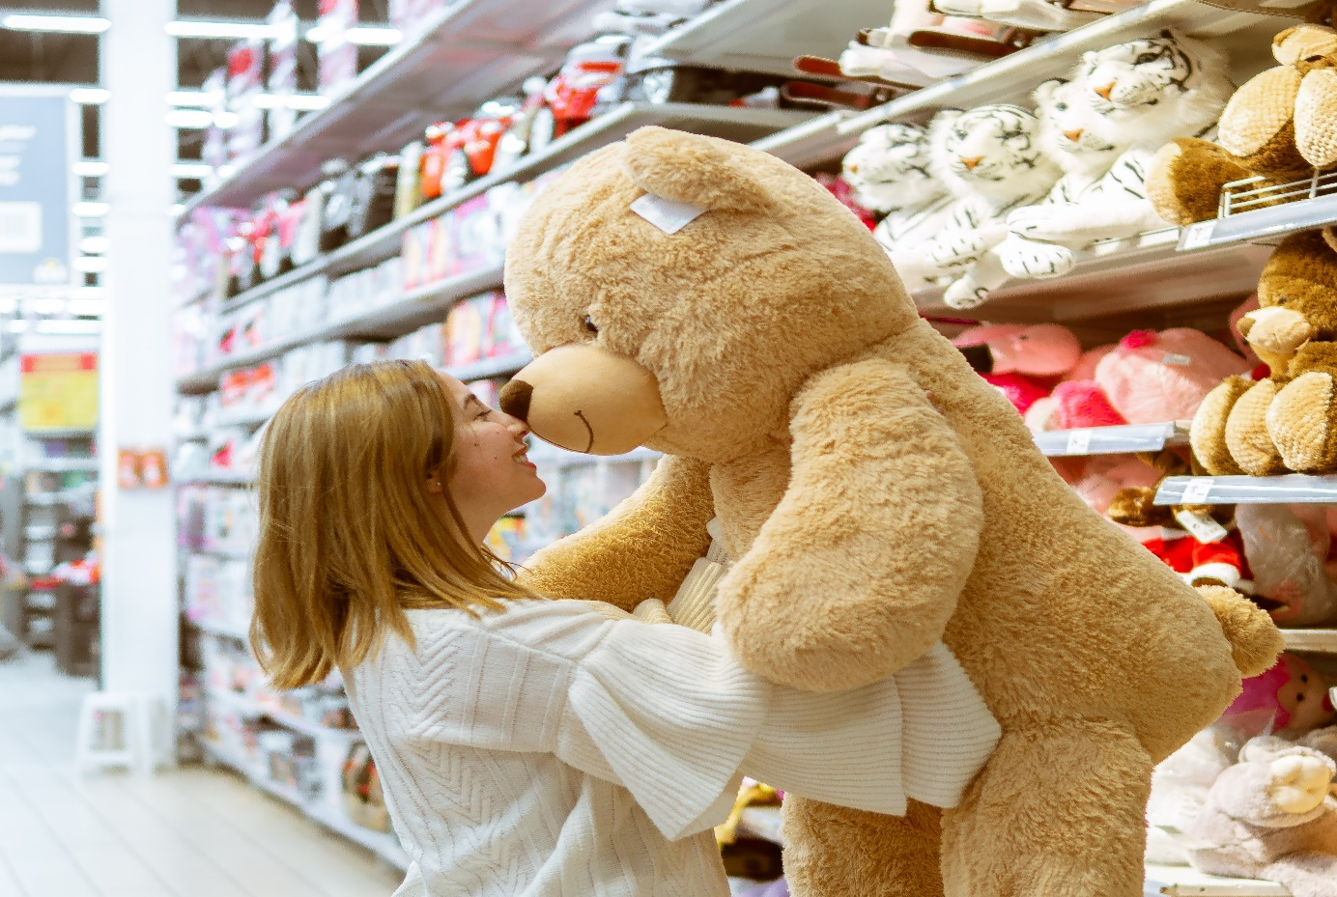
at the toyshop
5. _____’s buying toys ____________.
She

Slide 33




Thank you & goodbye!

