Slide 1









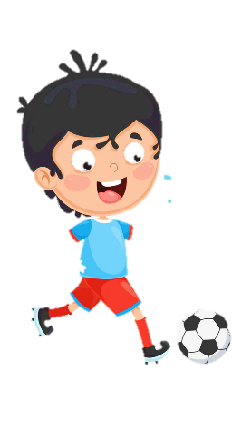
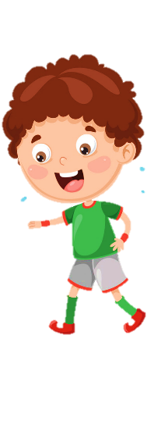










Unit 8
My town
Lesson 2 – Task 4,5,6

Slide 2






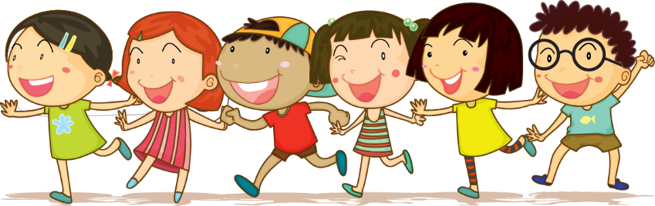



1 Warm up

Slide 3
2 Presentation

Slide 4
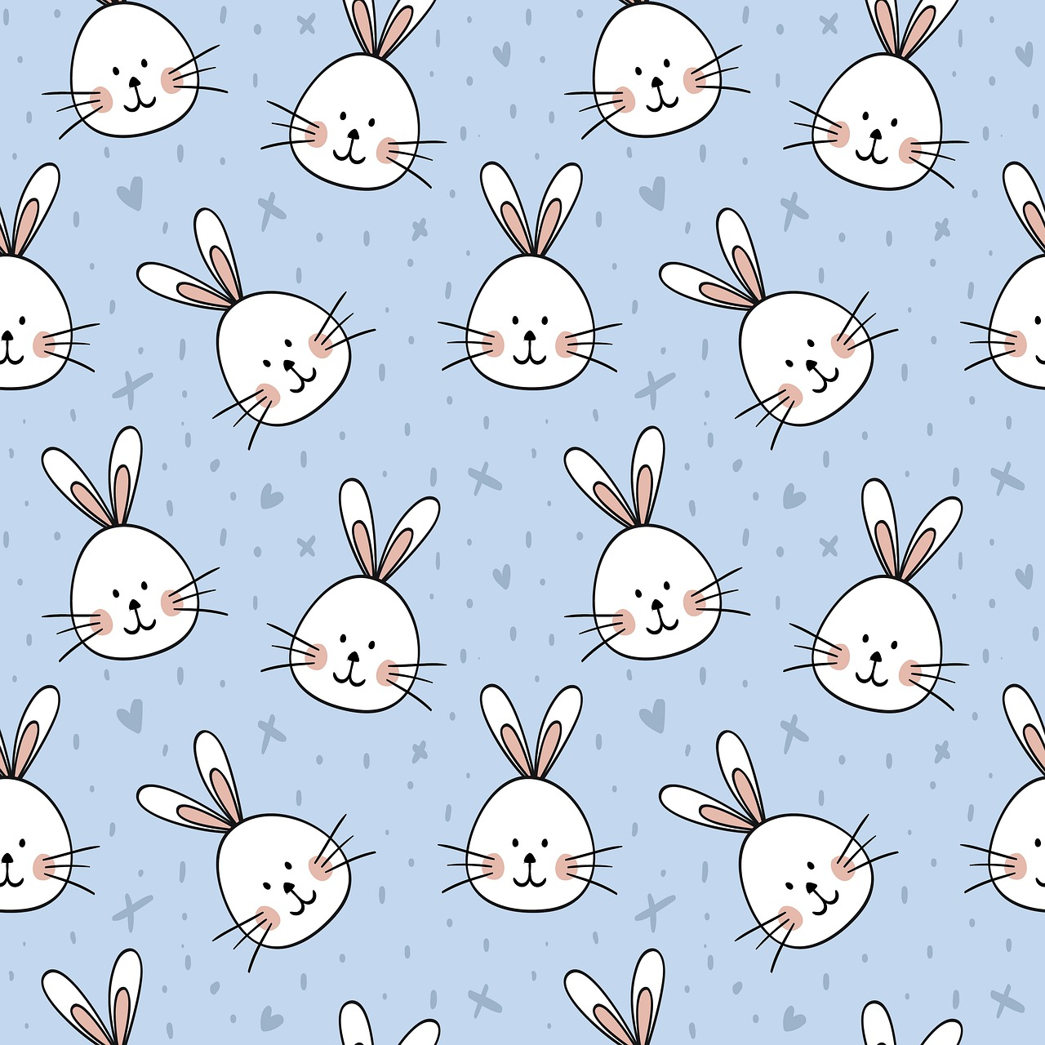
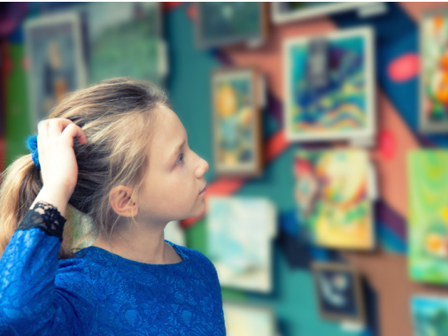
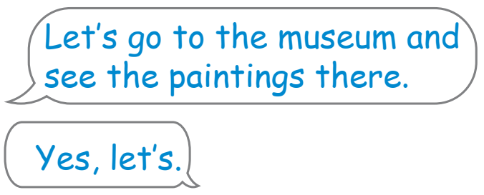
Task 4. Listen and repeat

Slide 5

New structure
Let’_____.
Yes, let’s.

Slide 6


Let’s go to _____ and ______.
Pass the ball
Notes:
.-Play game:" pass the ball"
+T opens a song and students will pass the ball .
+ When the music stops, which students hold that ball has to say
+ Let’s ….and ……./
There is a…..and I can…
( Let’s go to the toy shop and buy a truck .
/ There is a toy shop and I can buy a truck.)

Slide 7
3 Practice

Slide 8





Let’s go to the park and ride the bike there.
Yes, let’s.

Slide 9
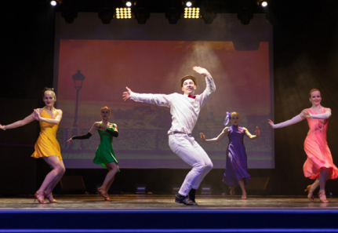

Let’s go to the theater and have fun there.
Yes, let’s.

Slide 10
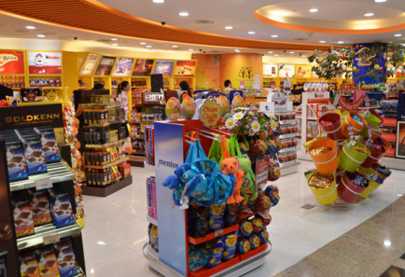

Let’s go to the toy shop and buy toys there.
Yes, let’s.

Slide 11
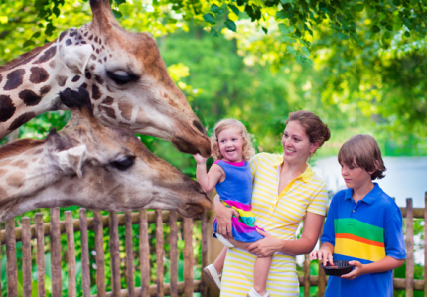

Let’s go to the zoo and watch giraffes there.
Yes, let’s.

Slide 12


Let’s go to my house and take photos there.
Yes, let’s.

Slide 13

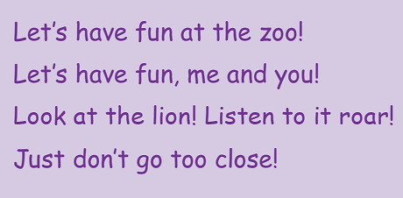
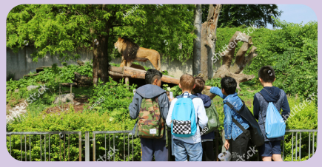
Task 6. Listen and sing

Slide 14
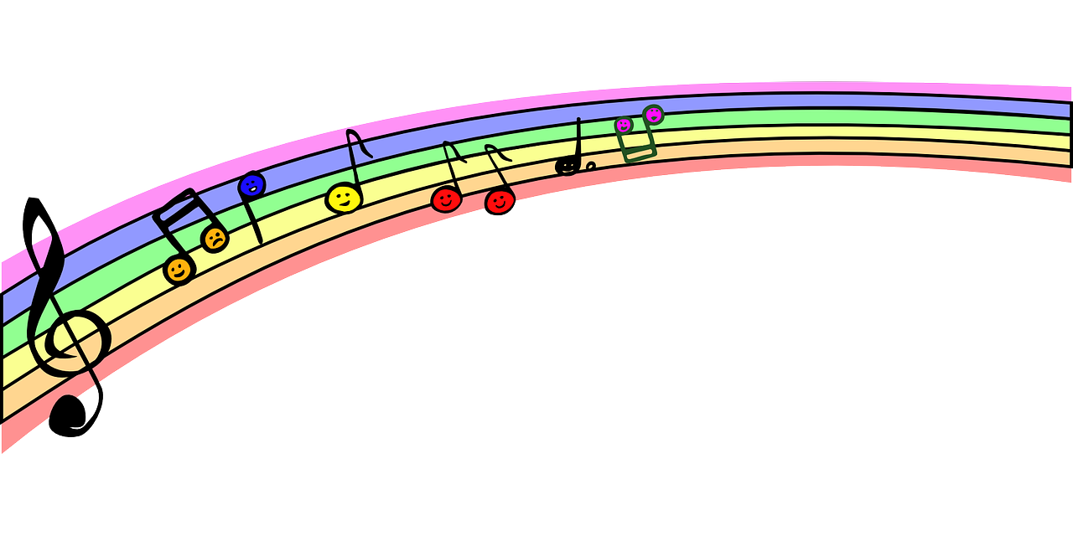

Let’s have fun at the zoo!
Let’s have fun, me and you!
Look at the lion! Listen to it roar!
Just don’t go too close!

Slide 15
4 Production

Slide 16
Song composer
Let’s make new version of the song!

Slide 17
Let’s have fun at the zoo!
Let’s have fun,… and….!
Look at the……! Listen to it……!
Just don’t go too close!

Slide 18
5 Assessment
Match

Slide 19
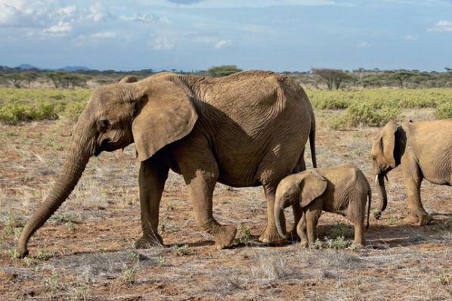
1. Let’s go to the zoo
a. and swim there.
2. Let’s go to the museum
b. and see the paintings there.
3. Let’s go to the park
c. and watch elephants there.
4. Let’s go to the pool
d. and buy teddy bears there.
5. Let’s go to the toy shop
e. and ride a bike there.

Slide 20




Thank you & goodbye!

