Slide 1

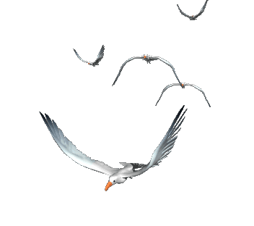


WELCOME TO OUR CLASS

Slide 2

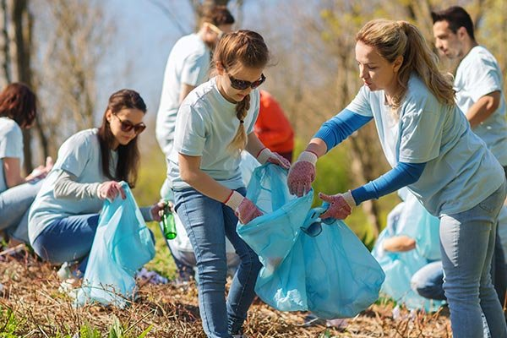
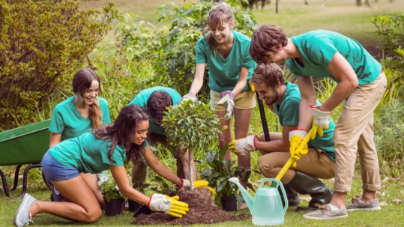

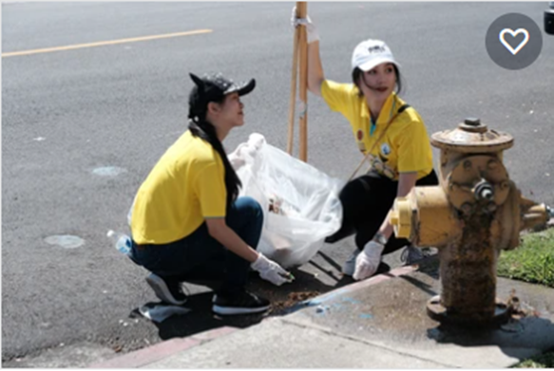
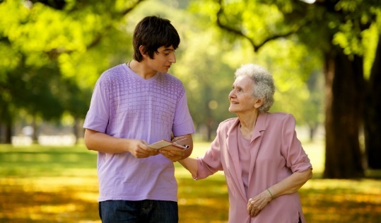
- donating clothes
2
1
3
- collecting
rubbish
- planting trees
Community activities
4
5
- cleaning
the street
- tutoring
homeless children
6
- helping
old people

Slide 3


Unit 3: Community service
LESSON 6: SKILLS 2
Tom and Linda’s community activities last summer.
Listening
Writing
Write an email about your school activities last summer.

Slide 4

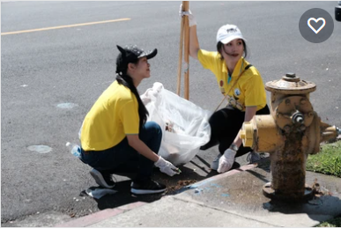
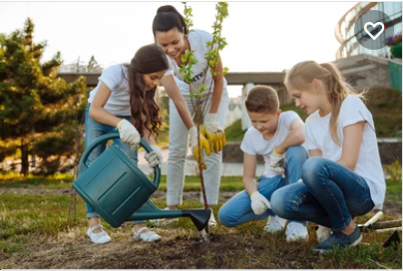
I. LISTENING
1
What community activities are the children doing in the pictures?
1. picking up litter
2. reading books to the elderly
3. planting trees
a
b
c
2. reading books to the elderly
1. picking up litter
3. planting trees

Slide 5
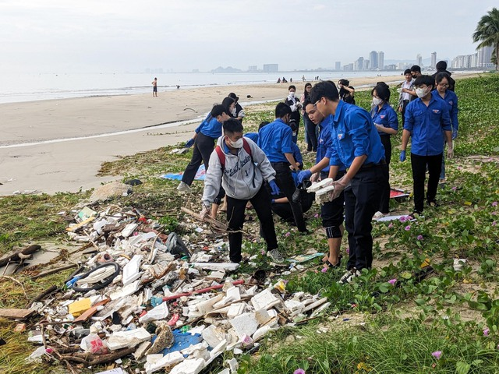
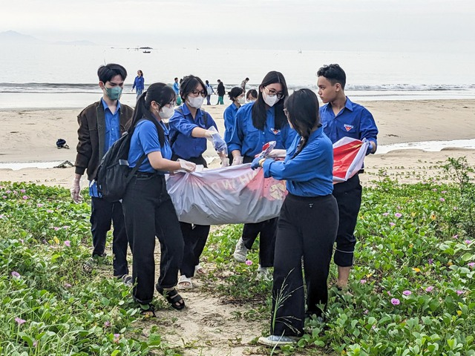

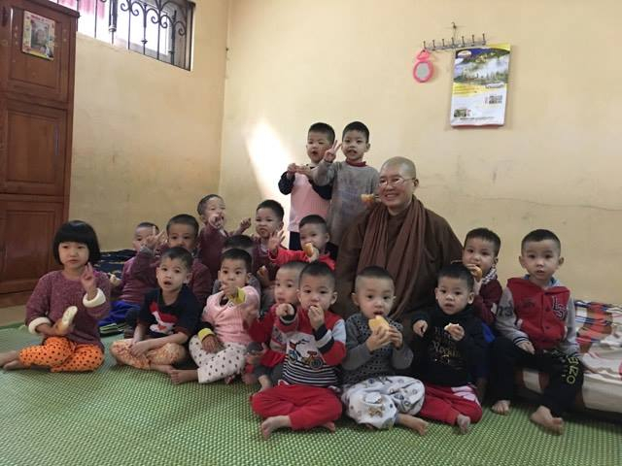
- volunteer (n) :
- rubbish (n) :
- benefit (n) :
- orphanage (n)

Slide 6
2
Listen to Tom and Linda talking about their community activities last summer. Circle the correct answers.
1. Linda and her friends taught ______. A. English and literature B. maths and history C. English and maths 2. Linda and her friends ______ the elderly. A. talked to B. cooked for C. read books to
3. Tom and his friends picked up ______. A. books and paper B. bottles and books C. paper and bottles 4. Tom and his friends ______. A. grew some trees B. tutored maths C. cleaned schools

Slide 7
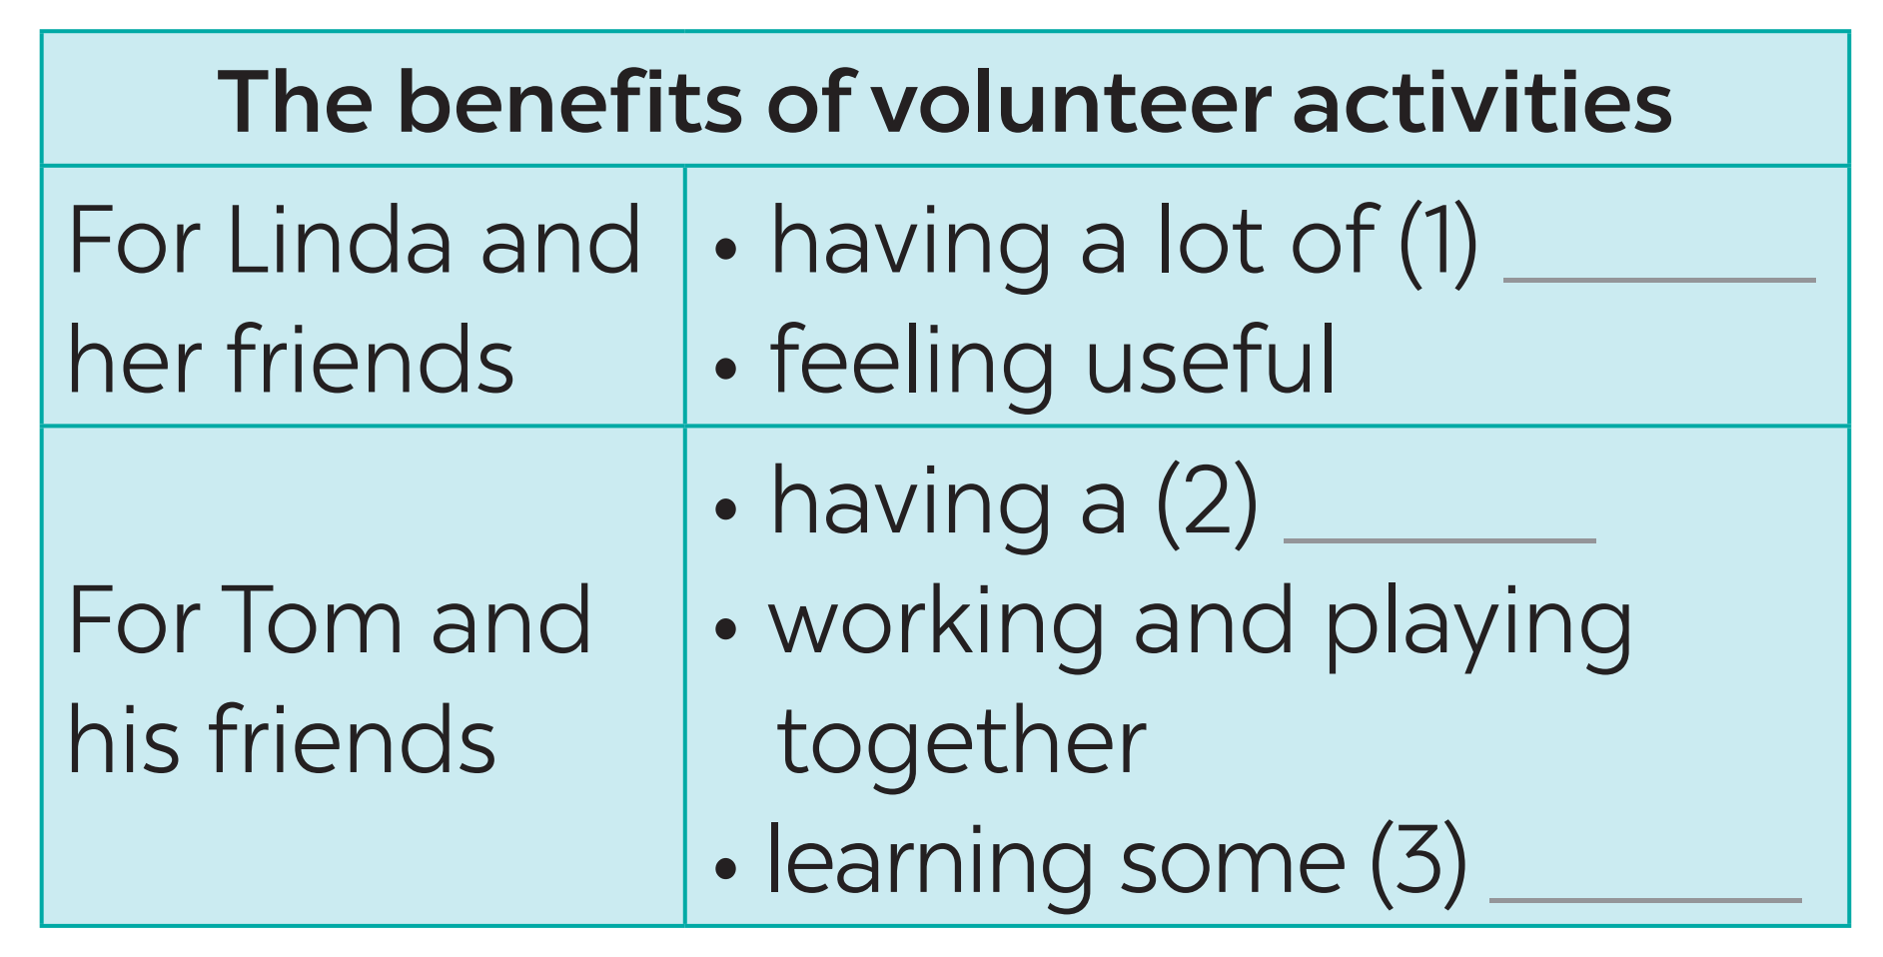
3
Listen again and fill in each blank with no more than two words.
fun
good time
skills

Slide 8
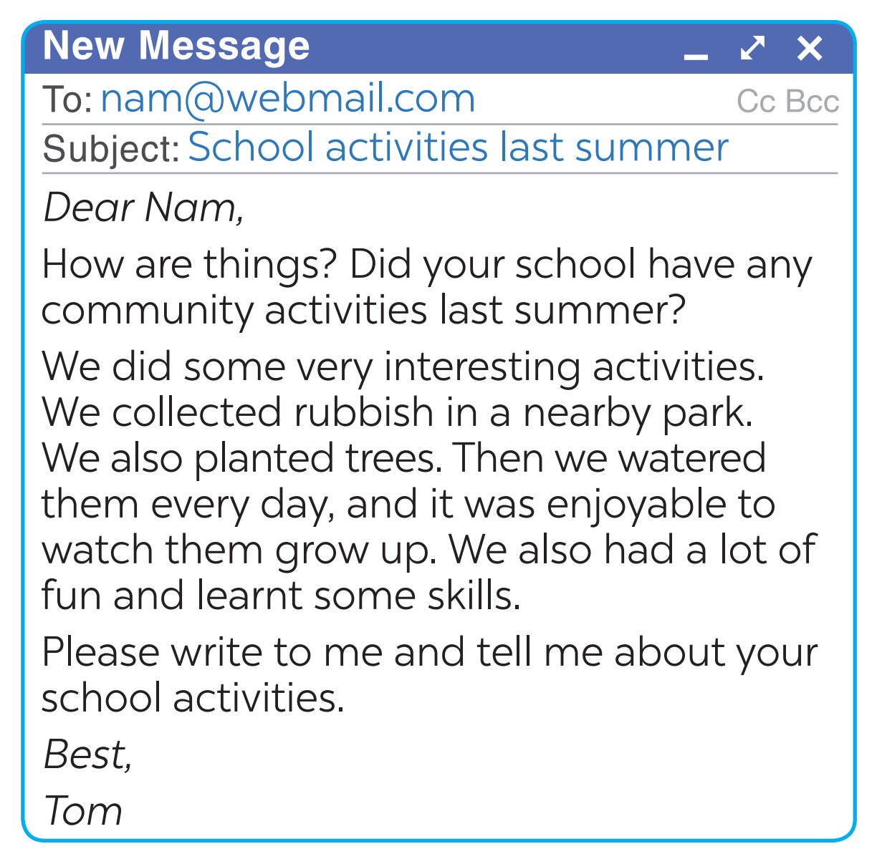
II. WRITING
4
Read Tom’s email to Nam about his school activities last summer.
1. Who is writing to whom?
-> Tom is writing to Nam.
2. What is the subject of the email?
-> School activities last summer.

Slide 9
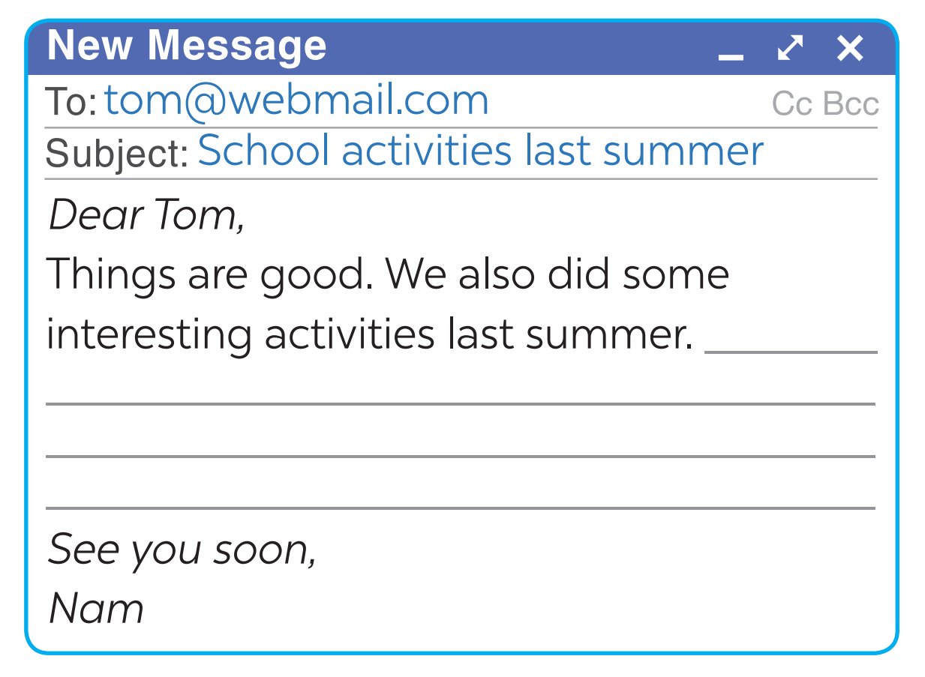
5
You are Nam. Now write an email of about 70 words to Tom about your school activities last summer. Start your email as shown below.
- donate books and clothes for a charity organization
- meet the orphan’s children
- play with them
- give candies to them
We donated
books and clothes for a charity organization. In here, We met the orphan’s children. We played with them. We gave candies to them. They were all happy.
- plant trees in your area
- teach street children to read and write
- sing and dance with elderly in a nursing home
- pick up litter in the park

Slide 10
5
You are Nam. Now write an email of about 70 words to Tom about your school activities last summer. Start your email as shown below.
To: tom@webmail.com
Subject: School activities last summer
Dear Tom,
Things are good. We also did some interesting activities last summer. Latest here on Sunday, I and my brother donated books and clothes for a charity organization. In here, I met the orphan’s children. I played with them. Then I gave candies to them. They were all very happy and so did I.
Please write back to me.
See you soon,
Nam

Slide 11
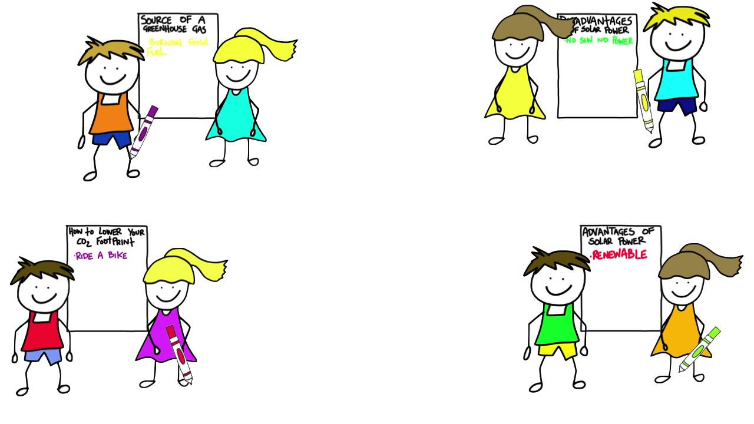
* POST-LISTENING & WRITING
CLASS GALLERY
Students can:
go and see other’s work
give comments to each other

Slide 12

* CONSOLIDATION
1
WRAP-UP
In this lesson, we have learnt to:
listen for specific information about some community activities and their benefits;
write an email about community activities one did last summer.

Slide 13

* CONSOLIDATION
2
HOMEWORK
Rewrite the email on your notebook.
Prepare for the next lesson: Looking back & Project

Slide 14

Goodbye.
See you again.

