Slide 1


An Thang Primary School
WELCOME TO
OUR CLASS 4
Notes:
MADE BY FACEBOOK :TRAN THI THANH TAM

Slide 2

UNIT 6: OUR SCHOOL FACILITIES
LESSON 1 ( 1, 2, 3)
Notes:
MADE BY FACEBOOK :TRAN THI THANH TAM

Slide 3

CONTENTS
1
WARM -UP
2
VOCABULARY
3
LOOK, LISTEN AND REPEAT
4
LISTEN, POINT AND SAY
5
LET’S TALK
6
PLAY GAME
Notes:
MADE BY FACEBOOK :TRAN THI THANH TAM

Slide 4
Warm - up
Notes:
MADE BY FACEBOOK :TRAN THI THANH TAM

Slide 5


SING THE SONG: HEAD, SHOULDERS, KNEES AND TOES
Notes:
Made by FACEBOOK: TRAN THI THANH TAM

Slide 6

Notes:
MADE BY FACEBOOK :TRAN THI THANH TAM

Slide 7



Mountains:núi
Notes:
MADE BY FACEBOOK :TRAN THI THANH TAM

Slide 8

City: thành phố
Notes:
MADE BY FACEBOOK :TRAN THI THANH TAM

Slide 9
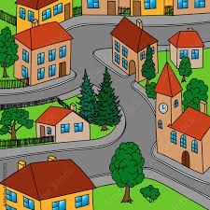
Town: thị trấn
Notes:
MADE BY FACEBOOK :TRAN THI THANH TAM

Slide 10
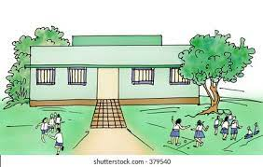
Village: làng
Notes:
MADE BY FACEBOOK :TRAN THI THANH TAM

Slide 11

VOCABULARY
Mountains: núi
Village: làng
City: thành phố
Town: thị trấn

Slide 12

Let's play
MATCHING
Notes:
Made by Facebook: TRAN THI THANH TAM

Slide 13


CHECK VOCABULARY:MATCHING
village
town
city
village

Slide 14
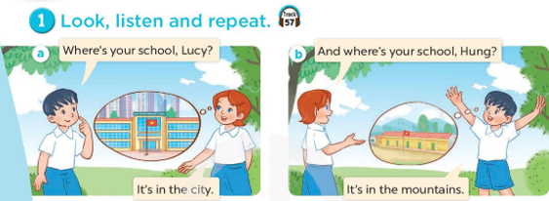
Notes:
MADE BY FACEBOOK :TRAN THI THANH TAM

Slide 15

SENTENCE PATTERN
Notes:
MADE BY FACEBOOK :TRAN THI THANH TAM

Slide 16

Hỏi xem trường của bạn ở đâu?
Where’s your school?
( Trường của bạn ở đâu vậy?)
It’s in the mountains
(Ở miền núi.)
Notes:
MADE BY FACEBOOK :TRAN THI THANH TAM

Slide 17
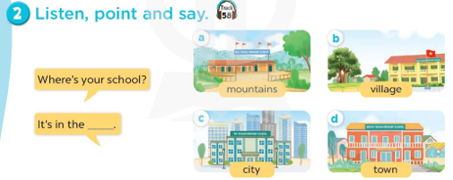
mountains
Notes:
MADE BY FACEBOOK :TRAN THI THANH TAM

Slide 18
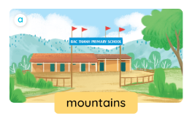
Where’s your school?
mountains
It’s in the ……............
Notes:
MADE BY FACEBOOK :TRAN THI THANH TAM

Slide 19
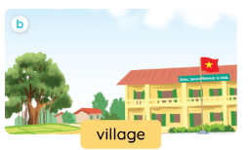
Where’s your school?
village
It’s in the ……............
Notes:
MADE BY FACEBOOK :TRAN THI THANH TAM

Slide 20

Where’s your school?
city
It’s in the ……............
Notes:
MADE BY FACEBOOK :TRAN THI THANH TAM

Slide 21
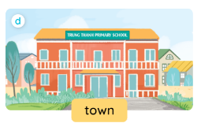
Where’s your school?
town
It’s in the ……............
Notes:
MADE BY FACEBOOK :TRAN THI THANH TAM

Slide 22

It’s in the mountains.
Notes:
MADE BY FACEBOOK :TRAN THI THANH TAM

Slide 23

Let's play
Who’s the faster?
Notes:
MADE BY FACEBOOK :TRAN THI THANH TAM

Slide 24
Where’s your school?
Well done
mountains
It’s in the………………..
Notes:
Teacher says the first sentence. Student replies using the new structure. Click the rabbit to go back to question slide.

Slide 25

Where’s your school?
Well done
village
It’s in the………………..
Notes:
Teacher says the first sentence. Student replies using the new structure. Click the rabbit to go back to question slide.

Slide 26
Where’s your school?
Well done
city
It’s in the………………..
Notes:
Teacher says the first sentence. Student replies using the new structure. Click the rabbit to go back to question slide.

Slide 27
Where’s your school?
Well done
town
It’s in the………………..
Notes:
Teacher says the first sentence. Student replies using the new structure. Click the rabbit to go back to question slide.

Slide 28

SUMMARY
Notes:
MADE BY FACEBOOK :TRAN THI THANH TAM

Slide 29

SUMMARY
1.Vocabulary:
Mountains: núi
Village: làng
City: thành phố
Town: thị trấn
2. Sentence pattern:
-Where’s your school?
( Trường của bạn ở đâu vậy?)
-> It’s in the mountains.
( ở miền núi)

Slide 30

Homework:
- Learn vocabulary by heart
- Prepare Unit 6- Lesson 1 ( 4, 5, 6)
Notes:
MADE BY FACEBOOK :TRAN THI THANH TAM

Slide 31



Thank you very much
Good bye! See you again!
Made by Thanh Tam
Notes:
MADE BY FACEBOOK :TRAN THI THANH TAM

