Slide 1

Unit 1:My friends
Lesson 1 – Period 1

Slide 2

Guessing game

Slide 3





Slide 4









Slide 5





Slide 6

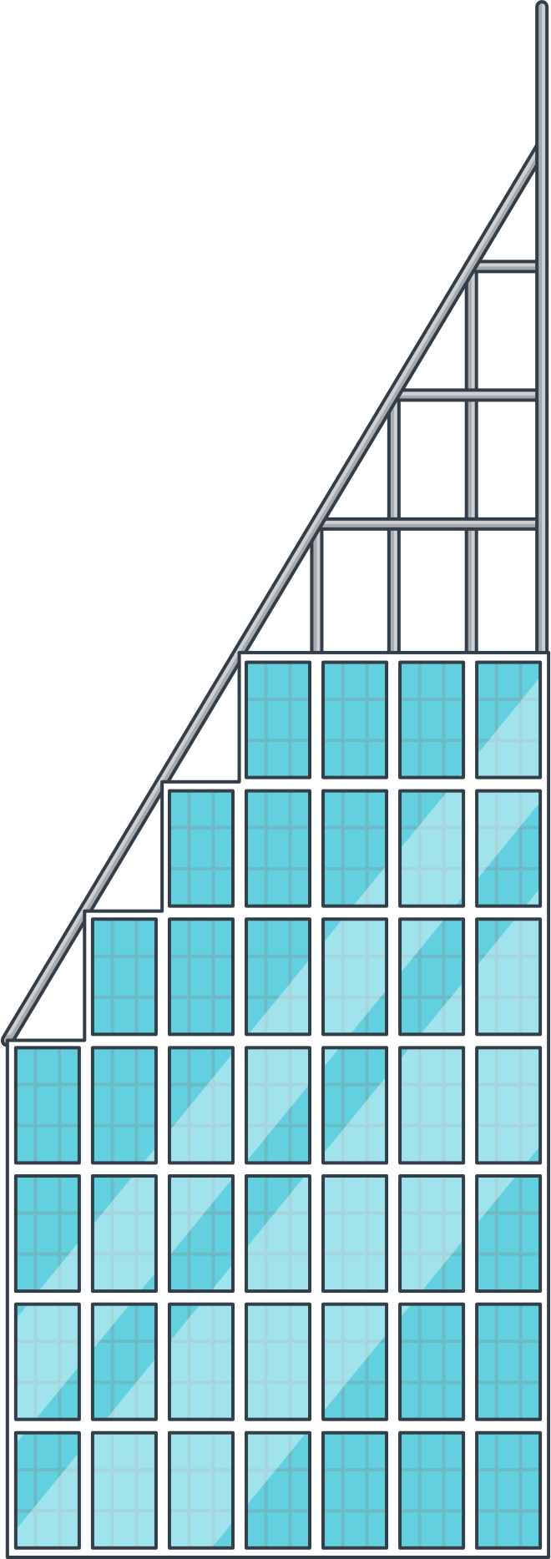







Slide 7
Unit 1 My friends
Lesson 1 – Period 1
1. Look, listen and repeat

Slide 8
2. Listen, point and say.
* Vocab

Slide 9





Britain
Viet Nam
America
Australia

Slide 10


Let’s chant together!
Britain
Viet Nam
America
Australia

Slide 11
2. Listen, point and say.
* Structure

Slide 12

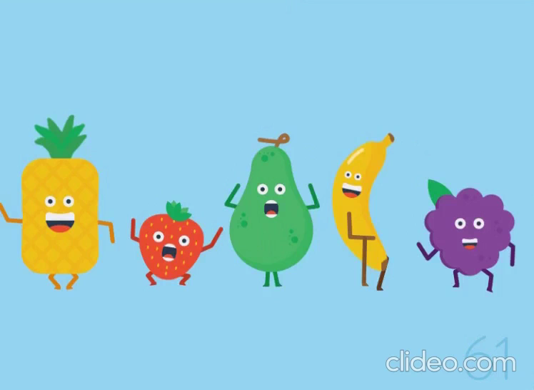
Game “ Passing the letter”

Slide 13
3. Let’s talk

Slide 14



