Slide 1
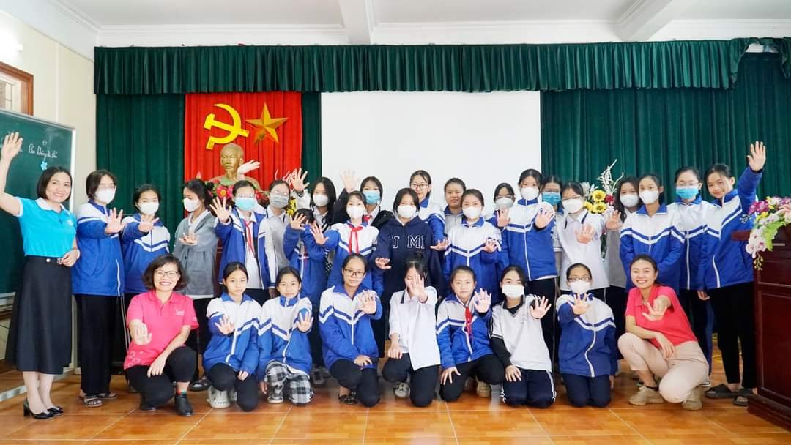

Welcome to PowerPoint
5 tips for a simpler way to work

