Slide 1


TO OUR CLASS
Le Loi Junior High School
Teacher: Vu Thi Hien

Slide 2

WARM-UP

Slide 3

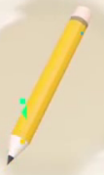
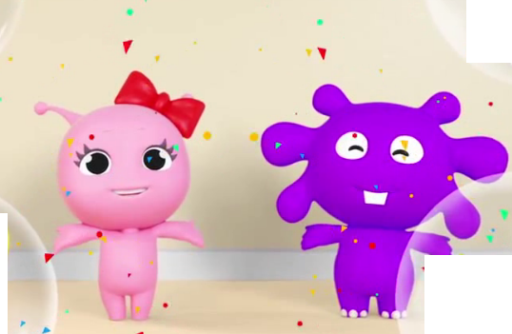
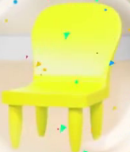
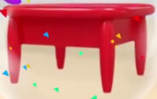
What things can you see in the video?
pencil
paper
chair
desk

Slide 4
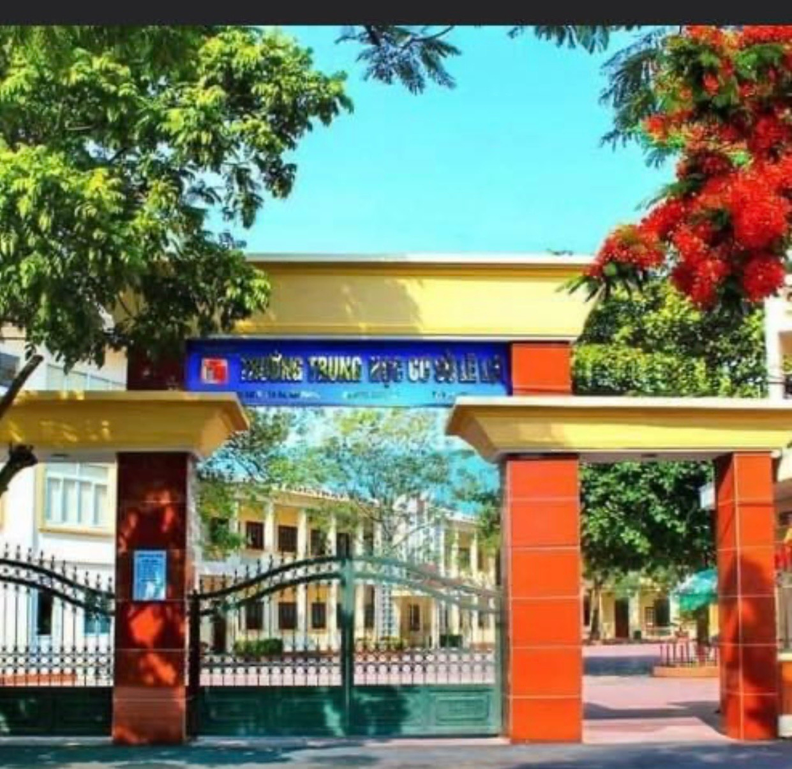
Period 1: UNIT 1: MY NEW SCHOOL
Lesson 1: Getting started/ P.6-7
A special day

Slide 5
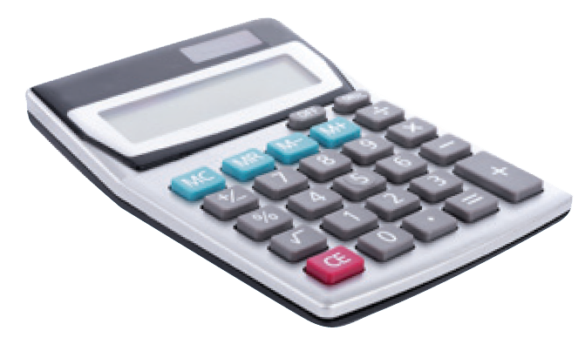
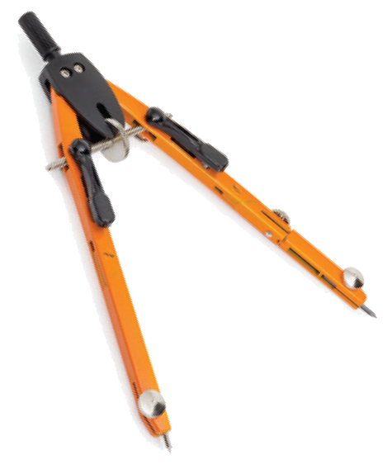
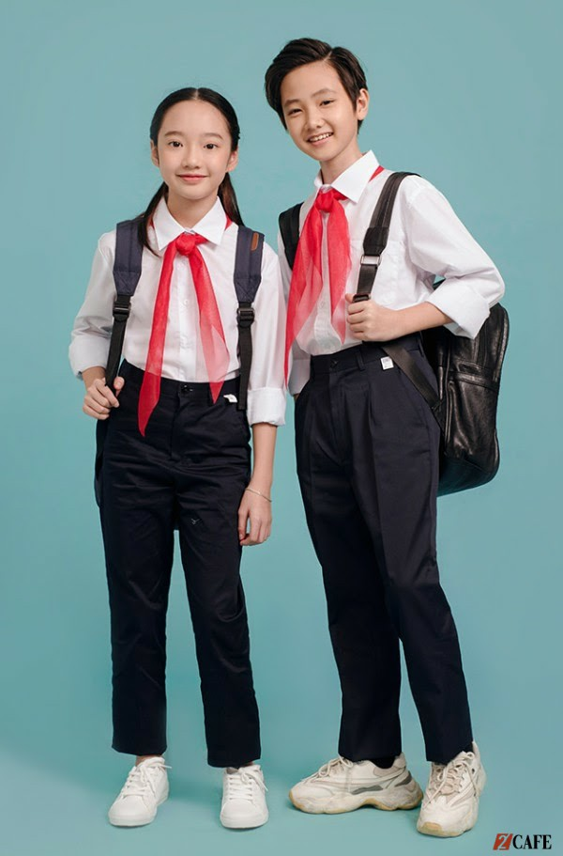

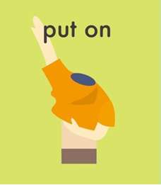
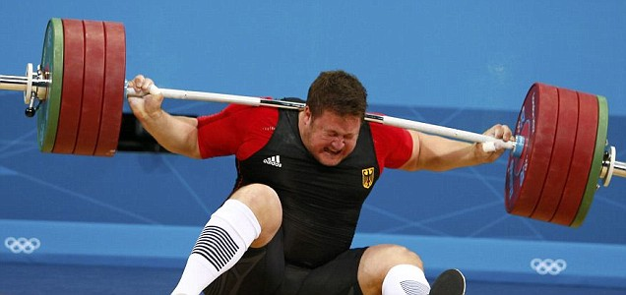
Period 1: UNIT 1: MY NEW SCHOOL
Lesson 1: Getting started/ P.6-7
I. Vocabulary:
- ’calculator (n):
máy tính
đồng phục
- ’uniform (n) :
- smart (adj) :
thanh nhã, lịch sự
put on ( phr .v ) :
mặc ( chuẩn bị mặc vào)
wear ( v ):
mặc ( đang mặc)
- ’compass (n):
cái com-pa
- ’heavy ( adj):
nặng

Slide 6
* Checking words:
UNIT 1: MY NEW SCHOOL
What and Where
calculator
compass
wear
uniform
put on
heavy
smart

Slide 7
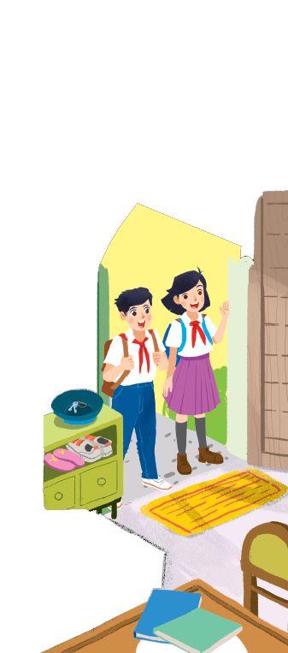
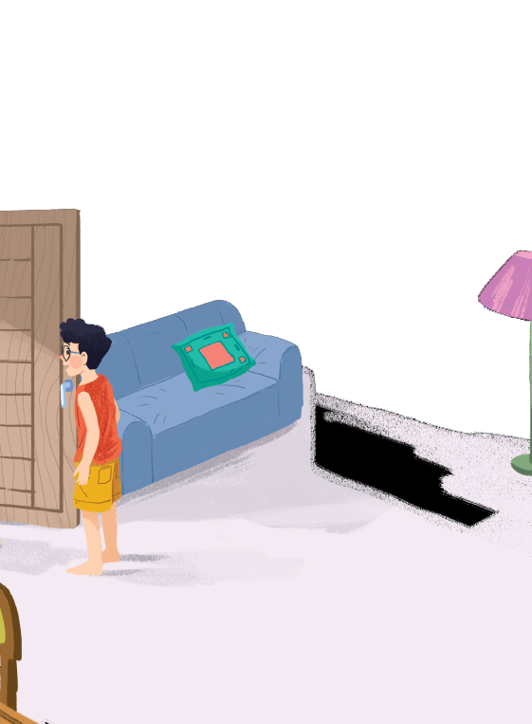

II. Practice:
Task 1. Listen and read.
A special day

Slide 8

Task 1. Listen and read.
A special day
(Loud knock)
Phong: Hi, Vy.
Vy: Hi, Phong. Are you ready?
Phong: Just a minute.
Vy: Oh, this is Duy, my new friend.
Phong: Hi, Duy. Nice to meet you.
Duy: Hi, Phong. I live near here, and we go to the same school!
Phong: Good. Hmm, your school bag looks heavy.
Duy: Yes! I have new books, and we have new subjects to study.
Phong: And a new uniform, Duy! You look smart!
Duy: Thanks, Phong. We always look smart in our uniforms.
Phong: Let me put on my uniform. Then we can go.

Slide 9
Task 1. Listen and read.
A special day
(Loud knock)
Phong: Hi, Vy.
Vy: Hi, Phong. Are you ready?
Phong: Just a minute.
Vy: Oh, this is Duy, my new friend.
Phong: Hi, Duy. Nice to meet you.
Duy: Hi, Phong. I live near here, and we go to the same school!
Phong: Good. Hmm, your school bag looks heavy.
Duy: Yes! I have new books, and we have new subjects to study.
Phong: And a new uniform, Duy! You look smart!
Duy: Thanks, Phong. We always look smart in our uniforms.
Phong: Let me put on my uniform. Then we can go.

Slide 10
Task 2: Read the conversation again and tick () T (True) or F (False).
 |  | T | F
1. | Vy, Phong, and Duy go to the same school.
2. | Duy is Phong’s friend.
3. | Phong says Duy looks smart in his uniform.
4. | They have new subjects to study
5. | Phong is wearing a school uniform.
✓
✓
( Duy is Vy’s friend.)
✓
✓
✓
( Phong isn’t wearing a school uniform.)

Slide 11
Task 3: Write ONE word from the box in each gap.
go
subjects
has
wear
uniforms
wear
1.
Students their uniforms on Monday.
has
2.
Vy a new friend, Duy.
go
3.
- Do Phong, Vy, and Duy to the same school?
- Yes, they do.
uniforms
4.
Students always look smart in their .
5.
subjects
- What do you like to study?
- I like to study English and history.

Slide 12
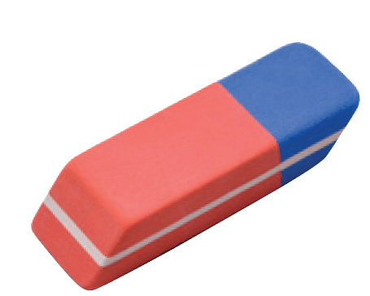
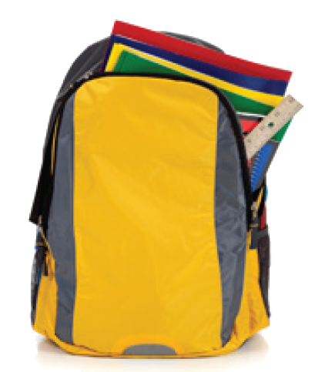
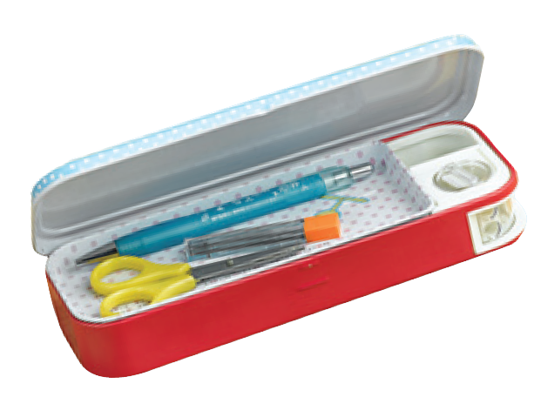
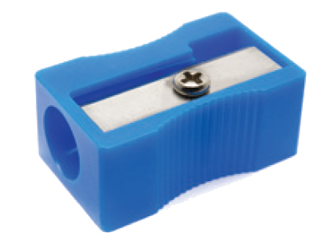
Task 4: Match the word with the school things. Then listen and repeat.
pencil sharpener
4
compass
1
school bag
2
calculator
5
rubber
3
pencil case
6

Slide 13
Task 4: Match the word with the school things. Then listen and repeat.
school bag
rubber
4
1
compass
pencil case
2
5
pencil sharpener
calculator
3
6

Slide 14
Task 5: Look around the class. Write the names of the things you see in your notebook.
chairs, tables, clock, school bags, board, books, pen, flower pot, pencil,…
books,

Slide 15
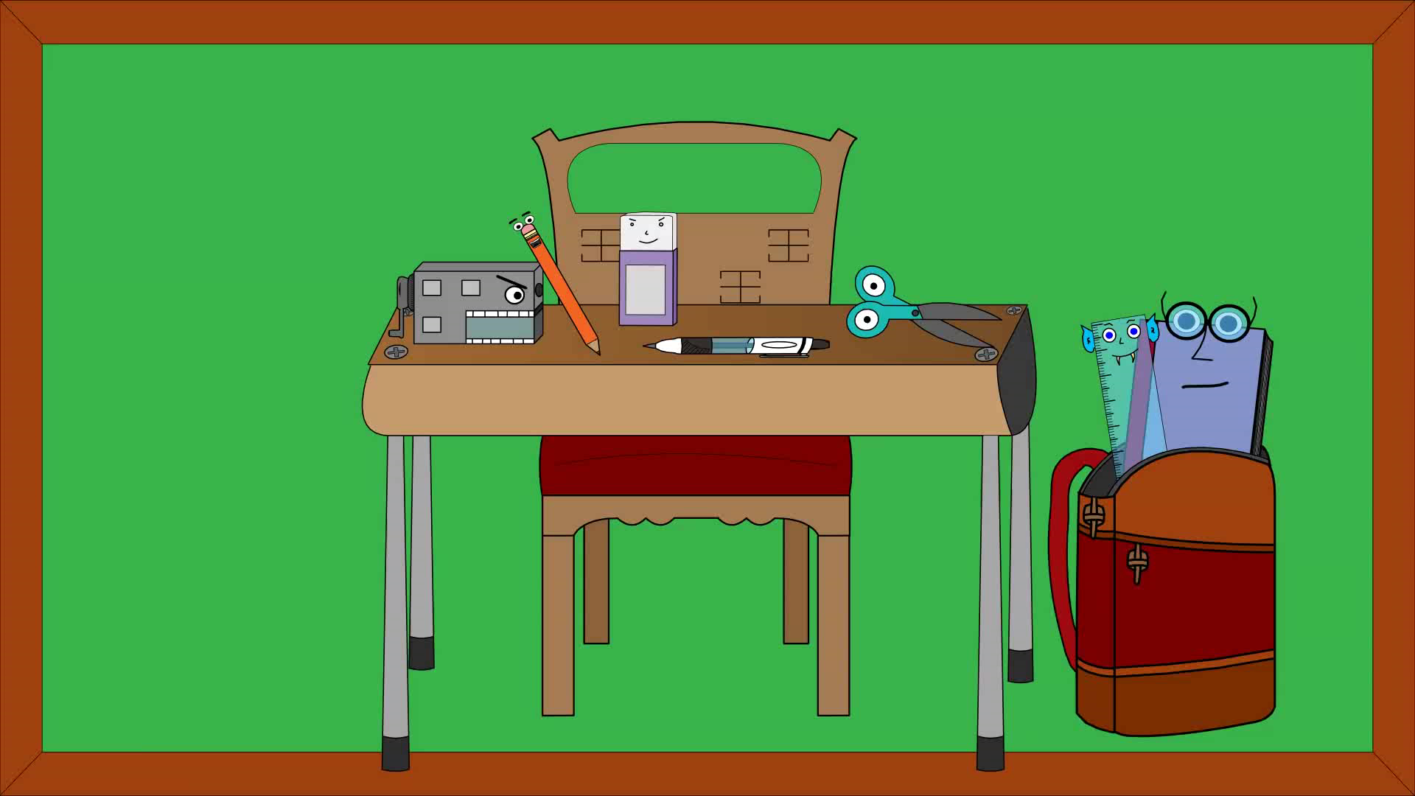

Slide 16
Period 1: UNIT 1: MY NEW SCHOOL
Lesson 1: Getting started/ P.6-7
I. Vocabulary:
- ’calculator (n):
máy tính
đồng phục
- ’uniform (n) :
- smart (adj) :
thanh nhã, lịch sự
put on ( phr .v ) :
mặc ( chuẩn bị mặc vào)
wear ( v ):
mặc ( đang mặc)
- ’compass (n):
cái com-pa
- ’heavy ( adj):
nặng
II. Practice:
Task 1. Listen and read.
Task 2: Read the conversation again and tick () T (True) or F (False).
Task 3: Write ONE word from the box in each gap.
Task 4: Match the word with the school things. Then listen and repeat.
Task 5: Look around the class. Write the names of the things you see in your notebook.

Slide 17

Home assignments:
- Read again the conversation on page 6.
- Write each word in 2 lines and make one example sentence with each word.
- Do Ex A2(P.3), B1,3 (P.4) in workbook.

Slide 18

Goodbye
See you again!!!

Slide 19
Task 1. Listen and read.
A special day
(Loud knock)
Phong: Hi, Vy.
Vy: Hi, Phong. Are you ready?
Phong: Just a minute.
Vy: Oh, this is Duy, my new friend.
Phong: Hi, Duy. Nice to meet you.
Duy: Hi, Phong. I live near here, and we go to the same school!
Phong: Good. Hmm, your school bag looks heavy.
Duy: Yes! I have new books, and we have new subjects to study.
Phong: And a new uniform, Duy! You look smart!
Duy: Thanks, Phong. We always look smart in our uniforms.
Phong: Let me put on my uniform. Then we can go.

