Slide 1


Slide 2




Unit
7
TRAFFIC
LESSON 3: A CLOSER LOOK 2
GRAMMAR:
- It to indicate distance
- should and shouldn’t
Unit
HOBBIES

Slide 3

OBJECTIVES
By the end of the lesson, students will be able to:
Know how to use:
  - It to indicate distance
- should and shouldn’t

Slide 4
LESSON 3: A CLOSER LOOK 2
WARM-UP
Slap the board
PRESENTATION
- It to indicate distance
- should and shouldn’t
Task 1: Write sentences with It. Use these cues.
Task 2: Work in pairs. Ask and answer questions about distances in your neighbourhood.
Task 3: Choose the correct option in brackets.
Task 4: Complete each sentence, using should/ shouldn’t.
PRACTICE
PRODUCTION
Task 5: Look at the pictures. Make sentences, using should/ shouldn’t and the cues.
CONSOLIDATION
Wrap-up
Homework

Slide 5

LESSON 3: A CLOSER LOOK 2
WARM-UP
Slap the board
Aims of the stage:
To activate students’ prior knowledge and vocabulary related to the targeted grammar

Slide 6
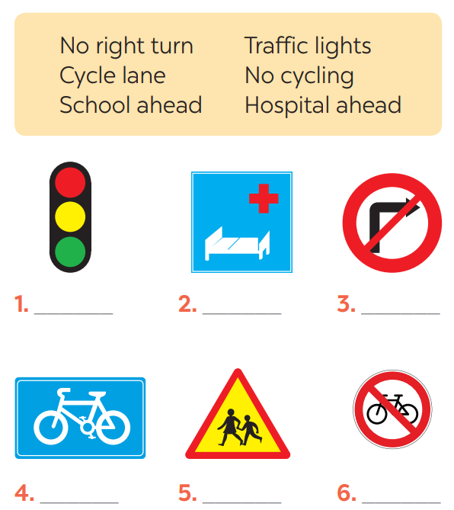
WARM-UP

Slide 7
LESSON 3: A CLOSER LOOK 2
WARM-UP
Slap the board
PRESENTATION
- It to indicate distance
- should and shouldn’t

Slide 8
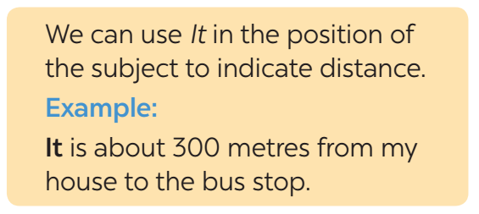

PRESENTATION
IT – INDICATING DISTANCE
What does the sentences tell us about?
What is the structure used in the sentence?

Slide 9
LESSON 3: A CLOSER LOOK 2
WARM-UP
Slap the board
PRESENTATION
- It to indicate distance
- should and shouldn’t
Task 1: Write sentences with It. Use these cues.
Task 2: Work in pairs. Ask and answer questions about distances in your neighbourhood.
Task 3: Choose the correct option in brackets.
Task 4: Complete each sentence, using should/ shouldn’t.
PRACTICE

Slide 10
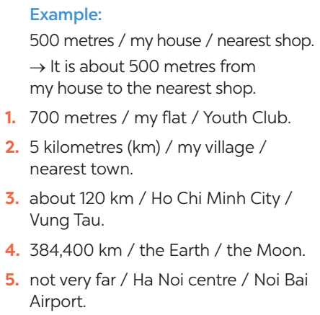

PRACTICE
1
Write sentences with It. Use these cues.
1. It is about 700 metres from my flat to the Youth Club.
2. It is about 5 kilometres from my village to the nearest town.
3. It is about 120 km from Ho Chi Minh City to Vung Tau.
4. It is about 384,400 km from the Earth to the Moon.
5. It is not very far from Ha Noi centre to Noi Bai Airport.

Slide 11
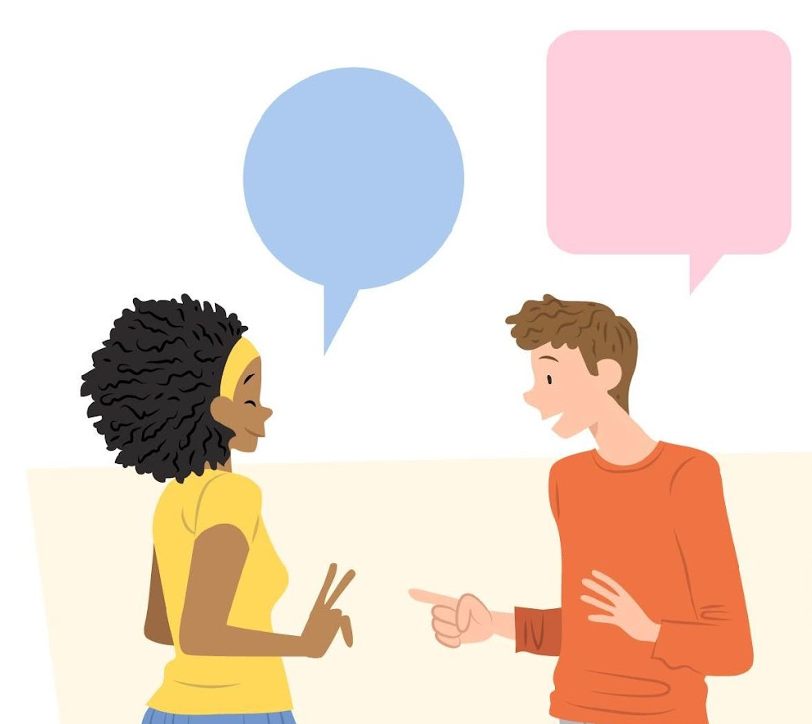
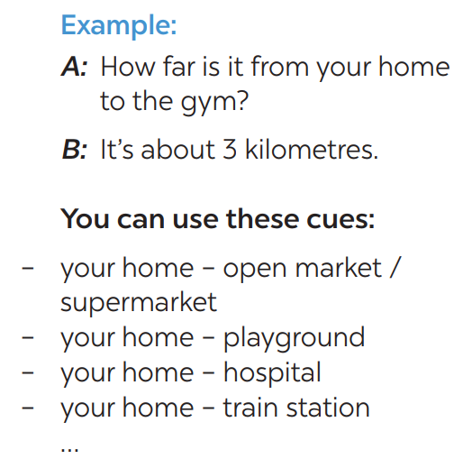
PRACTICE
2
Work in pairs. Ask and answer questions about distances in your neighbourhood
How far is it from your house to the supermarket?
It’s about 1 kilometre.

Slide 12
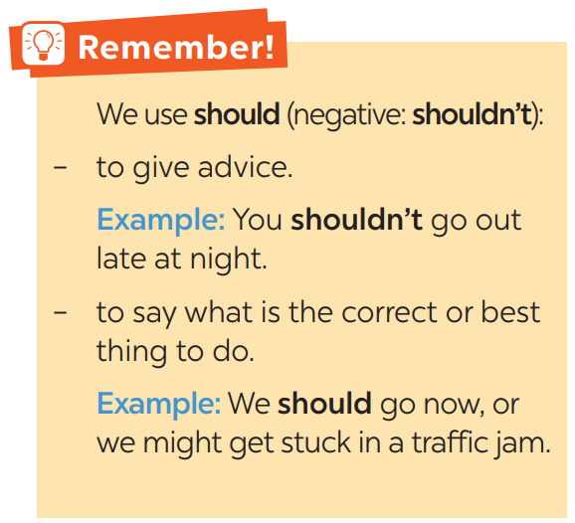
PRACTICE
3
Choose the correct option in brackets.

Slide 13
PRACTICE
3
Choose the correct option in brackets.
1. That’s an interesting book. You (should / shouldn’t) read it.
2. You nearly fell off your bike! You really (should / shouldn’t) be more careful.
3. We (should / shouldn’t) go swimming right after eating.
4. I think that he (should / shouldn’t) eat less. He’s becoming overweight.
5. There are a lot of cars out today. He (should / shouldn’t) drive so fast.

Slide 14
PRACTICE
4
Complete each sentence, using should / shouldn’t.
1. We _________ ride our motorbikes very fast in the rain.
2. You _________ study instead of watching YouTube.
3. My little sister _________ play outside late at night.
4. You _________ help your mum wash the dishes after dinner.
5. You look tired. You _________ probably get some sleep.
6. The children _________ eat so much ice cream.
shouldn’t
should
shouldn’t
should
should
shouldn’t

Slide 15
LESSON 3: A CLOSER LOOK 2
WARM-UP
Slap the board
PRESENTATION
- It to indicate distance
- should and shouldn’t
Task 1: Write sentences with It. Use these cues.
Task 2: Work in pairs. Ask and answer questions about distances in your neighbourhood.
Task 3: Choose the correct option in brackets.
Task 4: Complete each sentence, using should/ shouldn’t.
PRACTICE
PRODUCTION
Task 5: Look at the pictures. Make sentences, using should/ shouldn’t and the cues.

Slide 16
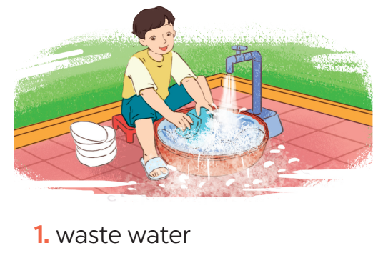
PRODUCTION
5
Look at the pictures. Make sentences, using should / shouldn’t and the cues.
He shouldn’t waste water when washing the dishes.

Slide 17
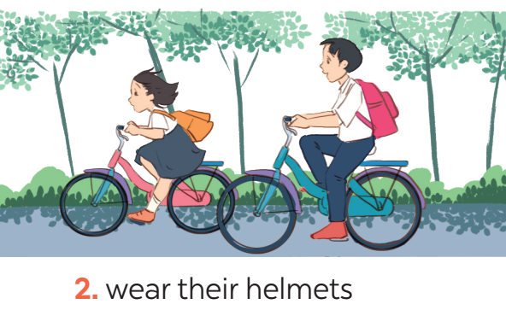
PRODUCTION
5
Look at the pictures. Make sentences, using should / shouldn’t and the cues.
They should wear their helmets when riding bikes.

Slide 18
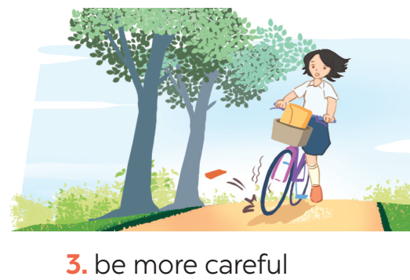
PRODUCTION
5
Look at the pictures. Make sentences, using should / shouldn’t and the cues.
She should be more careful.

Slide 19
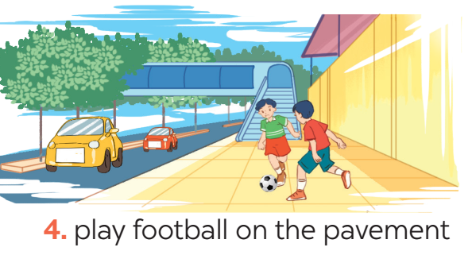
PRODUCTION
5
Look at the pictures. Make sentences, using should / shouldn’t and the cues
They shouldn’t play football on the pavement.

Slide 20
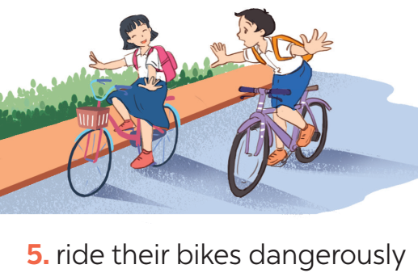
PRODUCTION
5
Look at the pictures. Make sentences, using should / shouldn’t and the cues
They shouldn’t ride their bikes dangerously.

Slide 21
LESSON 3: A CLOSER LOOK 2
WARM-UP
Slap the board
PRESENTATION
- It to indicate distance
- should and shouldn’t
Task 1: Write sentences with It. Use these cues.
Task 2: Work in pairs. Ask and answer questions about distances in your neighbourhood.
Task 3: Choose the correct option in brackets.
Task 4: Complete each sentence, using should/ shouldn’t.
PRACTICE
PRODUCTION
Task 5: Look at the pictures. Make sentences, using should/ shouldn’t and the cues.
CONSOLIDATION
Wrap-up
Homework

Slide 22
CONSOLIDATION
1
WRAP-UP
GRAMMAR:
- It to indicate distance
- should and shouldn’t

Slide 23

CONSOLIDATION
2
HOMEWORK
Exercises in the workbook.

