Slide 1
TAN VIEN SECONDARY SCHOOL
Welcome to our class
6A, 6B
PHAN THỊ MINH HIẾU

Slide 2

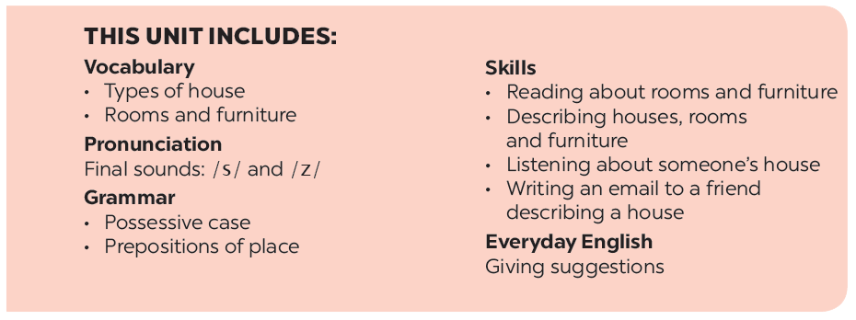
UNIT 2: MY HOUSE
LESSON 5

Slide 3
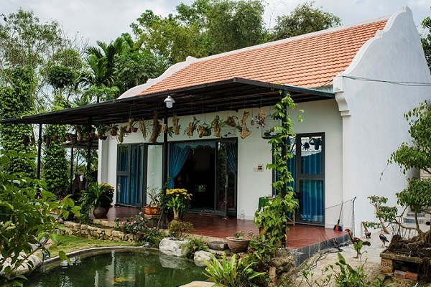
What type of house is this?
Country house

Slide 4
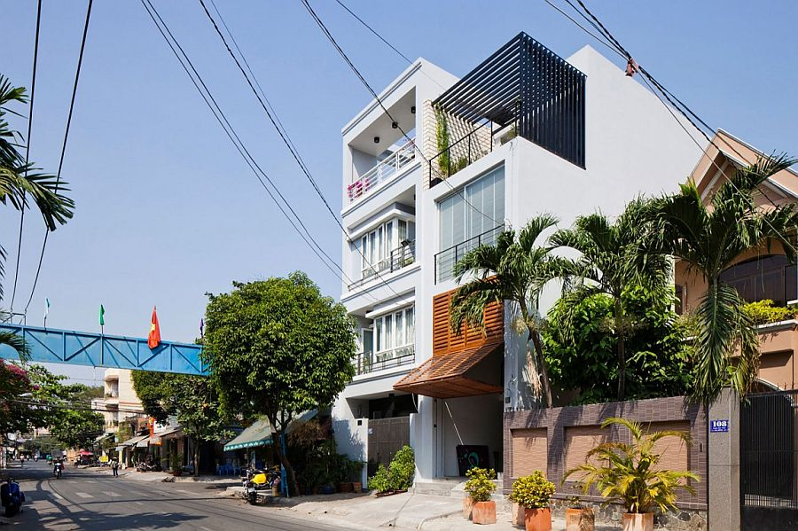
What type of house is this?
Town house

Slide 5
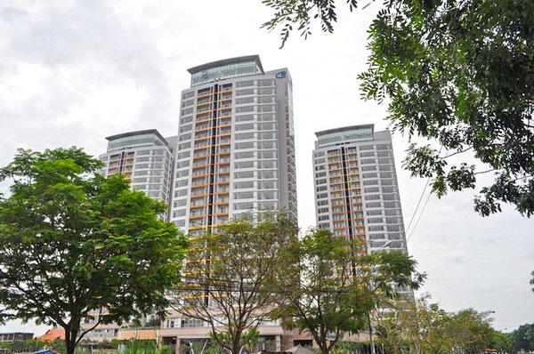
What type of house is this?
flat = apartment

Slide 6
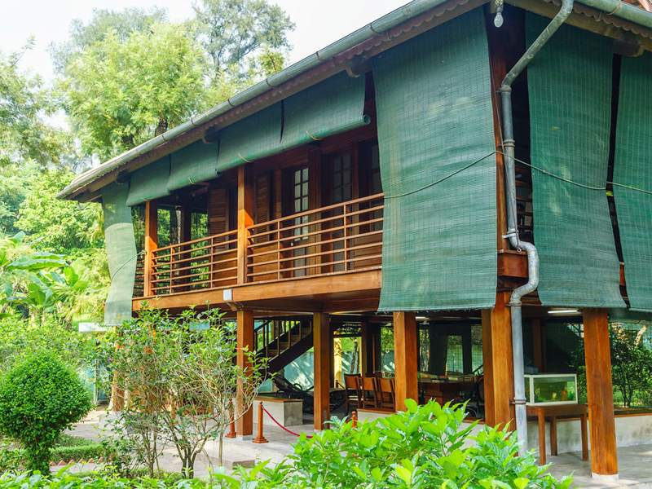
What type of house is this?
Stilt house

Slide 7
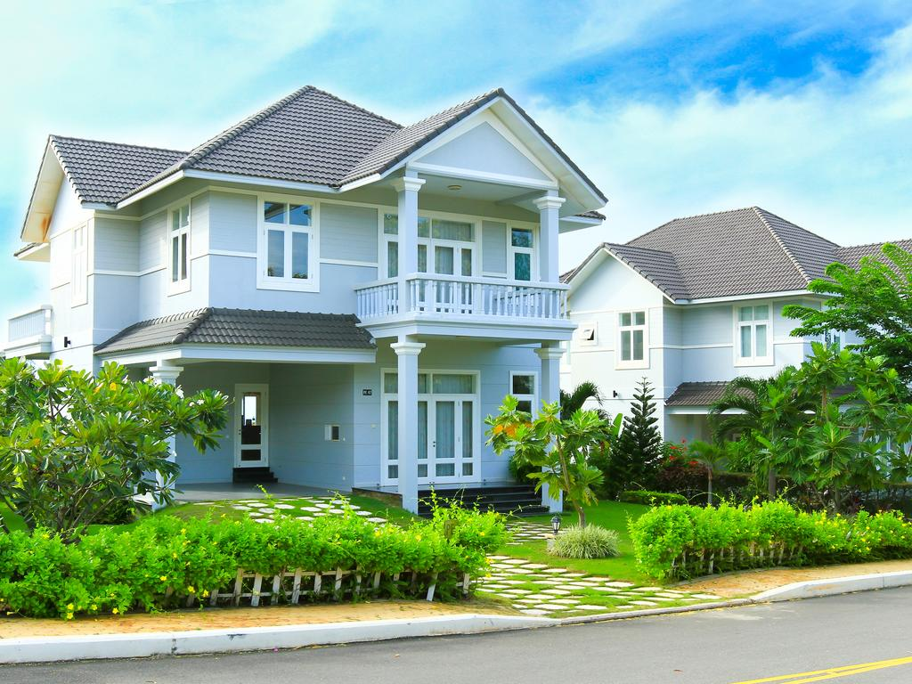
What type of house is this?
Villa

Slide 8
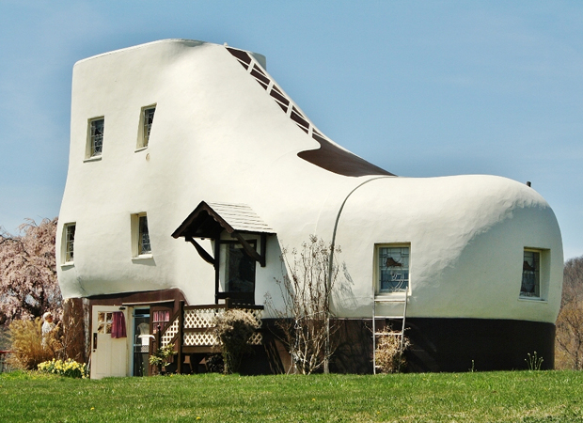
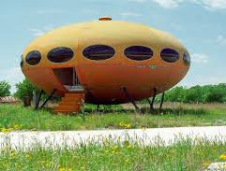
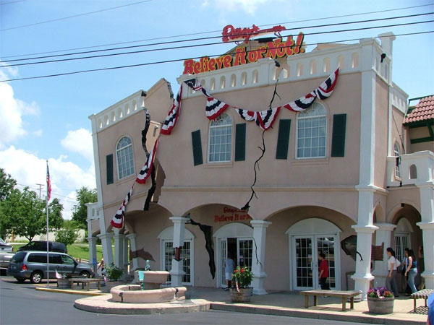
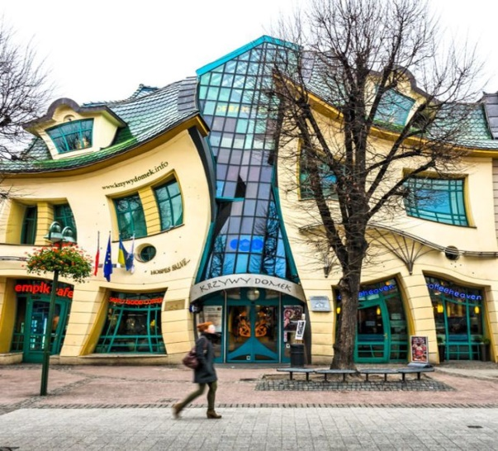
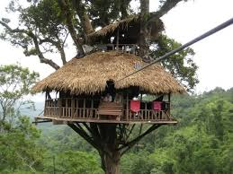
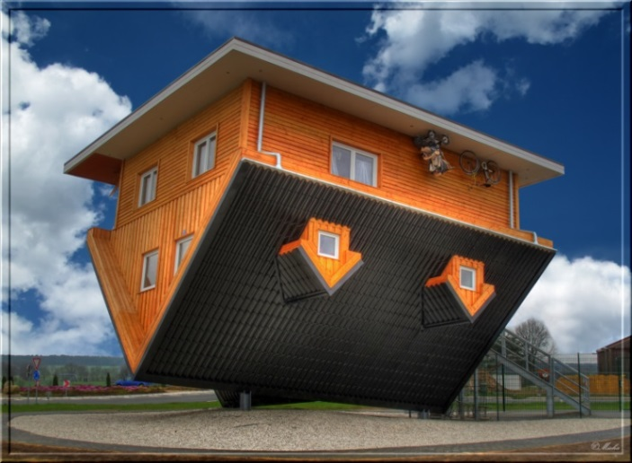
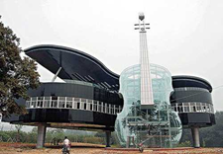
- How are the houses?
- They are strange (crazy) houses.

Slide 9



UNIT 2: MY HOUSE
LESSON 5
I/ Reading

Slide 10
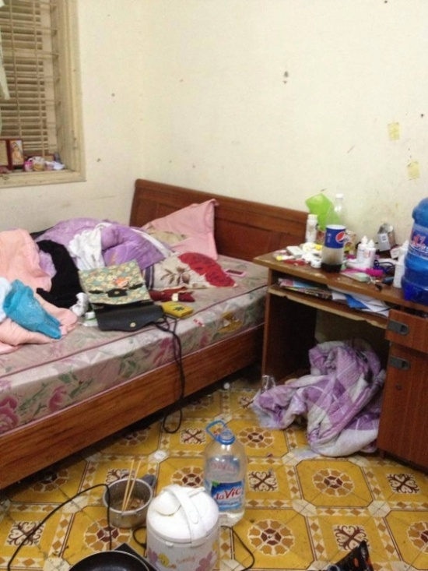
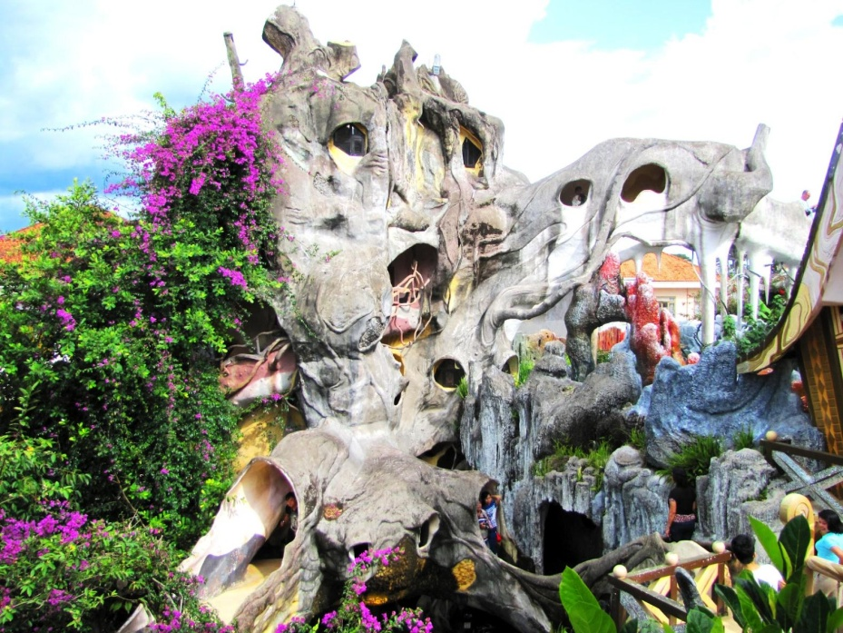
* VOCABULARY
*Vocabulary:
- crazy (adj):
kì lạ, lạ thường
- shape (n):
hình dạng
- messy (adj):
lộn xộn, bừa bộn

Slide 11
* CHECKING VOCABULARY:

Slide 12

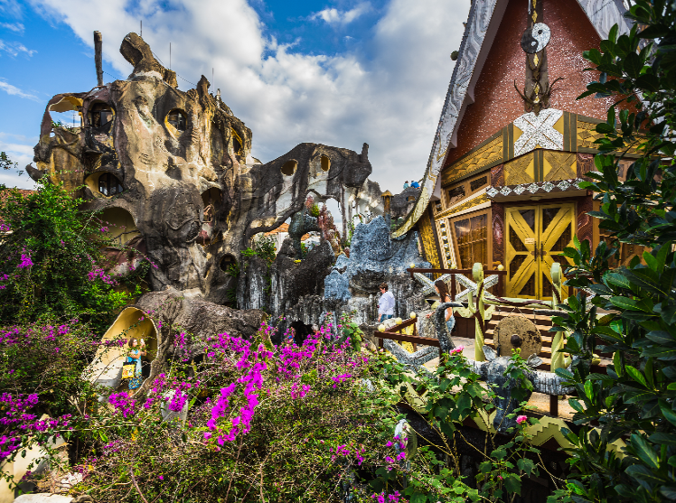
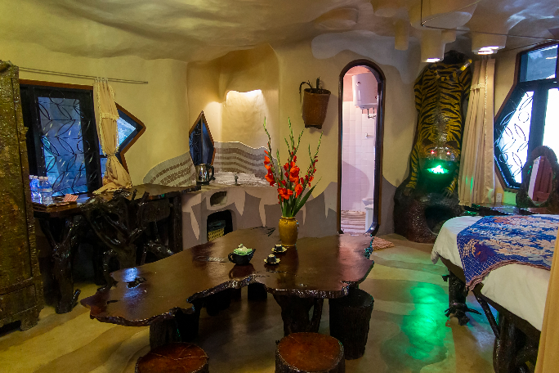

Predicting
Reading skill: Predicting
Predicting makes reading easy.
Before reading, look at the pictures, design and title.
Decide what the text is about.
Think about what you know about the topic.

Slide 13


To: phong@webmail.com; mi@webmail.com
Subject: A room at the Crazy House Hotel
Hi Phong and Mi,
How are you? I’m in Da Lat with my parents. We’re staying at the Crazy House Hotel. Wow! It really is crazy. There are ten rooms in the hotel.
There’s a Kangaroo Room, an Eagle Room, and even an Ant Room. I’m staying in the Tiger Room. It’s called the Tiger Room because there’s a big tiger on the wall.
The tiger is between the bathroom door and the window. The bed is next to the window, but the window is a strange shape. I put my bag under the bed. There’s a lamp, a wardrobe and a desk.
You should stay here when you visit Da Lat. It’s great.
See you soon!
Nick
1. Is it an email or a letter?
It's an email.
2. What is the text about?
The text is about Nick's room at the Crazy House Hotel.

Slide 14

Read the text again and answer the questions.
Who is Nick in Da Lat with?
1.
Who is Nick in Da Lat with?
How many rooms are there in the hotel?
2.
How many rooms are there in the hotel?
Why is the room called the Tiger Room?
3.
Why is the room called the Tiger Room?
Where is Nick’s bag?
4.
Where is Nick’s bag?

Slide 15



Read the text again and answer the questions.
cats
dogs
Lucky Numbers
1
2
3
4
5
6

Slide 16
1. Who is Nick in Da Lat with?
→He's in Da Lat with his parents.

Slide 17
2. How many rooms are there in the hotel?
→There are ten rooms.

Slide 18
3. Why is the room called the Tiger Room?
→Because there's a big tiger on the wall.

Slide 19
4. Where is Nick’s bag?
→ It's under the bed.

Slide 20

LUCKY NUMBER!

Slide 21
LUCKY NUMBER!

Slide 22
Read the text again and answer the questions.
1.
Who is Nick in Da Lat with?
He's in Da Lat with his parents.
2.
How many rooms are there in the hotel?
There are ten rooms.
3.
Why is the room called the Tiger Room?
Because there's a big tiger on the wall.
4.
Where is Nick’s bag?
It's under the bed.

Slide 23
To: phong@webmail.com; mi@webmail.com
Subject: A room at the Crazy House Hotel
Hi Phong and Mi,
How are you? I’m in Da Lat with my parents. We’re staying at the Crazy House Hotel. Wow! It really is crazy. There are ten rooms in the hotel.
There’s a Kangaroo Room, an Eagle Room, and even an Ant Room. I’m staying in the Tiger Room. It’s called the Tiger Room because there’s a big tiger on the wall.
The tiger is between the bathroom door and the window. The bed is next to the window, but the window is a strange shape. I put my bag under the bed. There’s a lamp, a wardrobe and a desk.
You should stay here when you visit Da Lat. It’s great.
See you soon!
Nick

Slide 24

Circle the things in the Tiger Room.
a window
a wardrobe
a cooker
a cupboard
a shelf
a lamp
a desk
a tiger

Slide 25


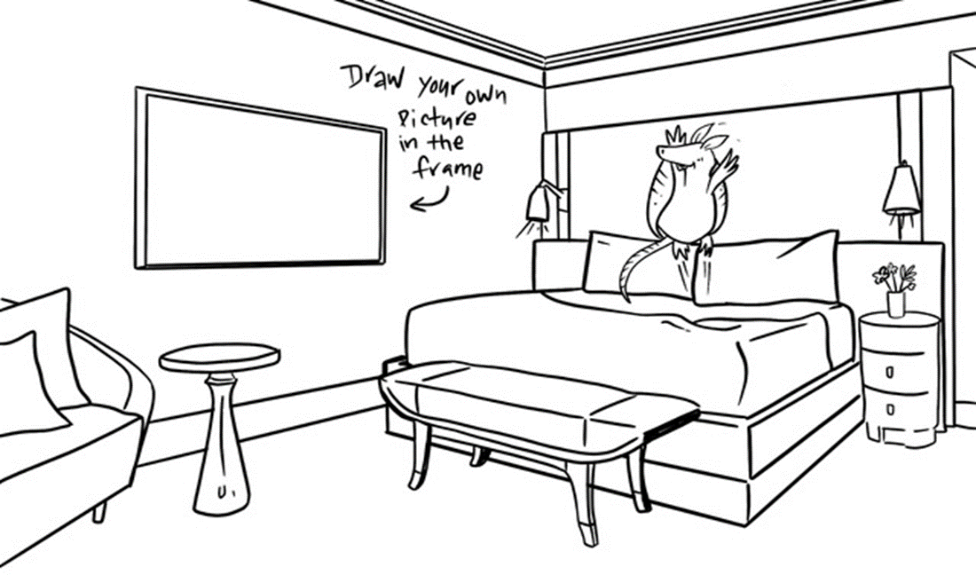


II. Speaking
Create a new room for the hotel. Draw a plan for the room.

Slide 26



Show your plan to your partner and describe it.
Example:
This is the Dolphin Room. There’s a big Dolphin at the door. There’s a table and a sofa in the middle of the room ...

Slide 27

Show your plan to your partner and describe it.

Slide 28


HOMEWORK
Do the excercises C1,2,3 (Speaking) and D1,2,3 (Reading) in the student’s workbook

Slide 29

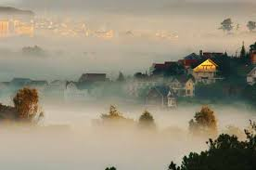

Goodbye!
See you again!

