Slide 1



Unit
2
HEALTHY LIVING
LESSON 5: SKILLS 1
READING
SPEAKING
Unit

Slide 2

WARM-UP
S K I N C O N D I T I O N

Slide 3
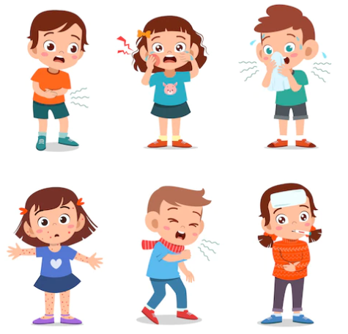
PRE-READING: VOCABULARY
disease (n)
/dɪˈziːz/
bệnh tật

Slide 4

VOCABULARY
serious (adj)
/ˈsɪəriəs/
nghiêm trọng

Slide 5
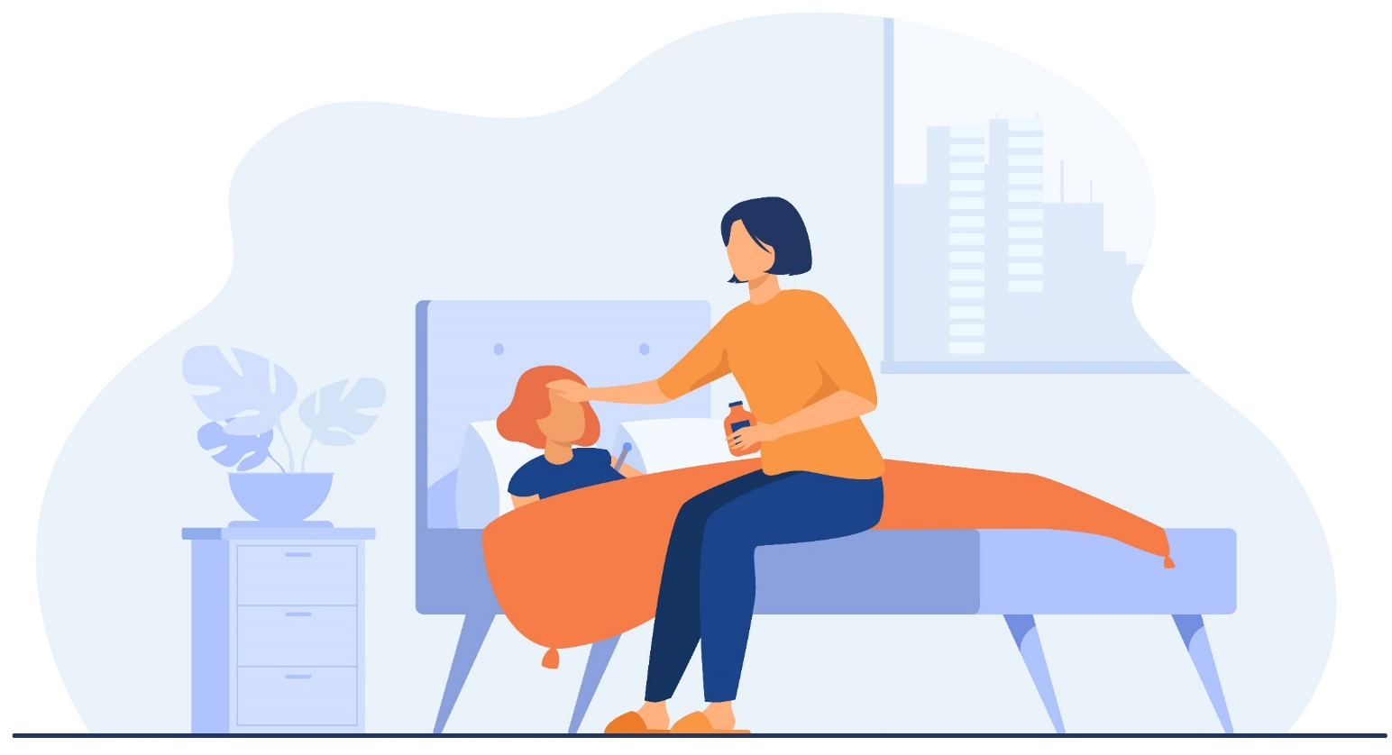
VOCABULARY
take care of (phr v)
/teɪk keər əv/
chăm sóc

Slide 6
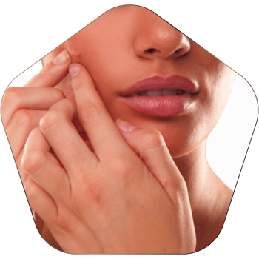
VOCABULARY
pop (v)
/pɒp/
nặn, bóp

Slide 7
VOCABULARY
New words | Pronunciation | Meaning
disease (n) | /dɪˈziːz/ | bệnh tật
serious (adj) | /ˈsɪəriəs/ | nghiêm trọng
take care of (phr v) | /teɪk keər əv/ | chăm sóc
pop (v) | /pɒp/ | nặn, bóp

Slide 8


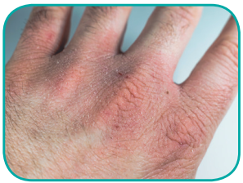
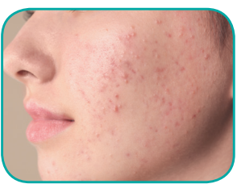
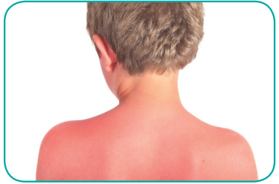
PRE-READING: DISCUSSION
1.
chapped skin
2.
acne
Which skin condition is the most common among teenagers?
3.
sunburn

Slide 9
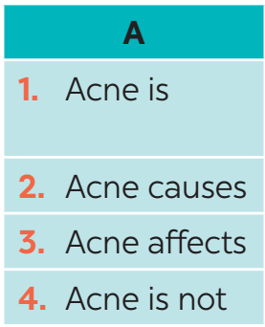
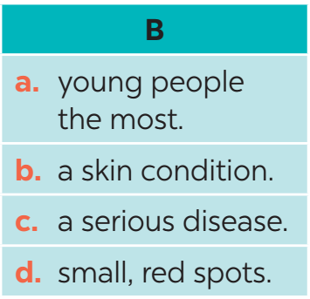
WHILE-READING
1
Read the passage and match the beginnings in A with the endings in B.

Slide 10
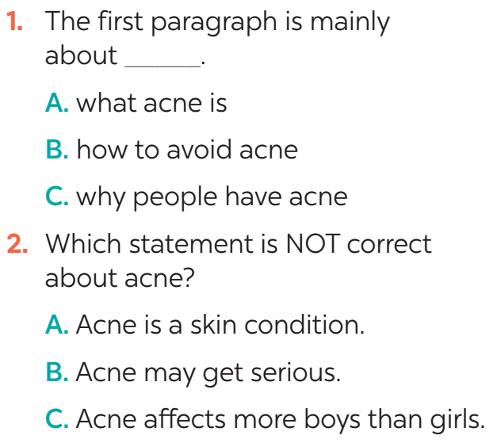
WHILE-READING
2
Read the passage again and choose the correct answer A, B, or C.
Evidence
Acne is a skin condition. It causes small, red spots on the face and the back. It affects 70 -80% of young people between 12 and 30. More girls have acne than boys.

Slide 11
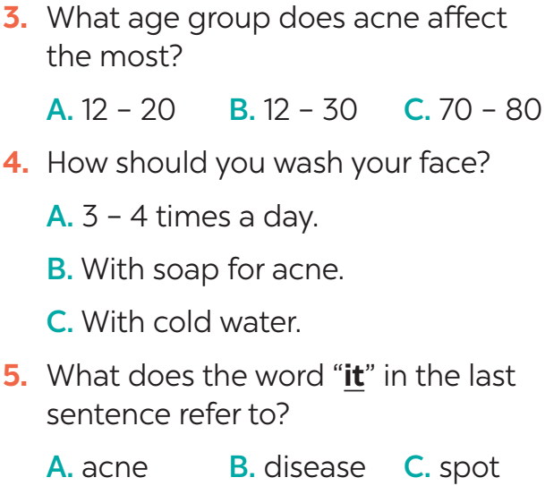
WHILE-READING
2
Read the passage again and choose the correct answer A, B, or C.
Evidence
It affects 70-80% of young people between 12 and 30.
Wash your face with special soap for acne, but no more than twice a day.
Here are some tips for taking care of skin with acne… If it gets serious, see a doctor.

Slide 12
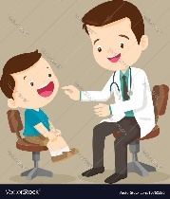
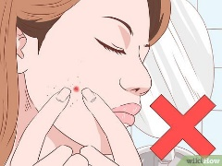
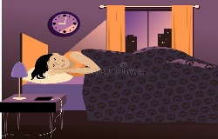


POST-READING
acne
a skin condition
causes small, red spots on the face and back
affects 70-80% of young people between 12 & 30
- more girls have acne than boys.
- not a serious disease
Tips
3
Retelling

Slide 13
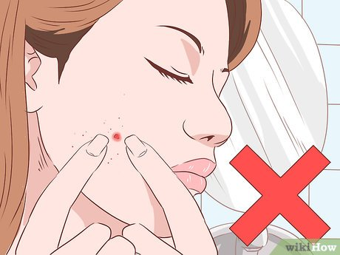
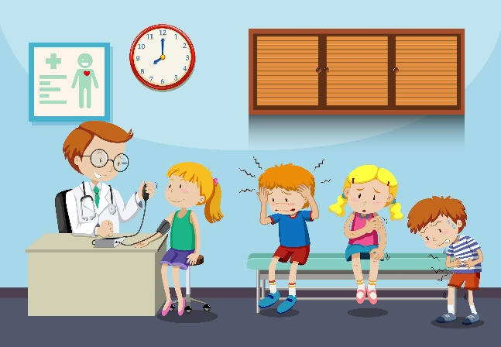



SPEAKING
4
Read the passage again. Pick the tips which you can easily follow. Share your ideas with your partner.

Slide 14
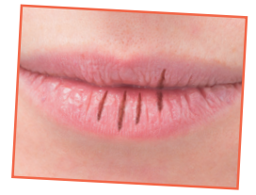
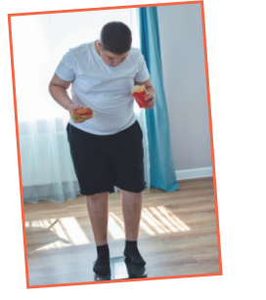
SPEAKING
5
Read about the health problems below. Discuss and make notes of some tips you can give each person. Then share your ideas with the class
1. I have chapped lips.
Use some lip balm.
Use coconut oil or body lotion.
2. I’m putting on weight.
Eat less fast food, meat, and ice cream.
Eat more fruit and vegetable.

Slide 15
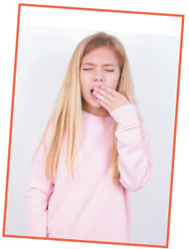
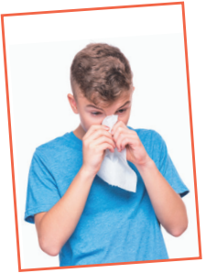
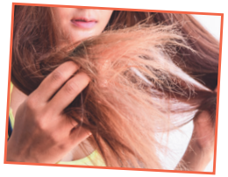
SPEAKING
5
Read about the health problems below. Discuss and make notes of some tips you can give each person. Then share your ideas with the class
3. I often feel sleepy during the day.
Get enough sleep, 7 - 8 hours a day.
Don't go to bed too late.
4. I have the flu.
Keep warm and stay in bed.
Drink plenty of water and eat light food.
5. My hair is dry.
Avoid washing your hair every day.
Take vitamins.

Slide 16
CONSOLIDATION
1
WRAP-UP
READING
SPEAKING

Slide 17

CONSOLIDATION
2
HOMEWORK
Review all the contents
Do exercises in the workbook.

