Slide 1
Unit 3
PEOPLES OF VIETNAM
Lesson 1 Getting started
At the Museum of Ethnology

Slide 2
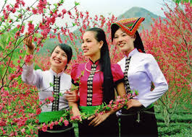
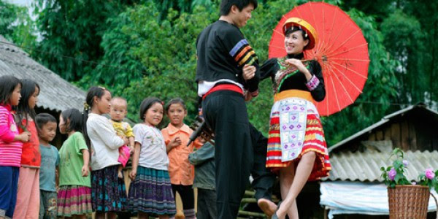
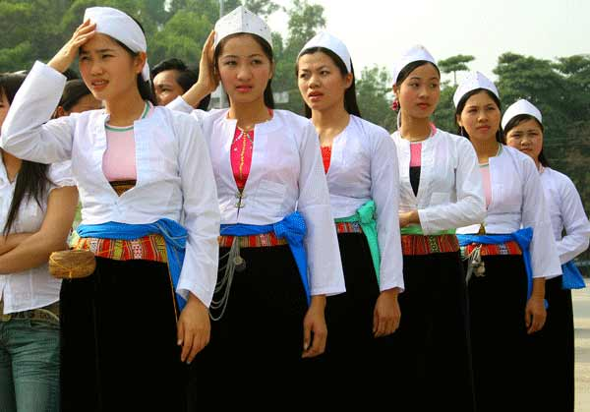
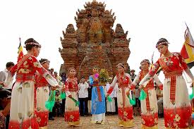
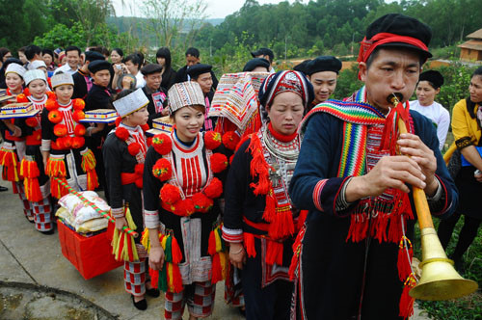
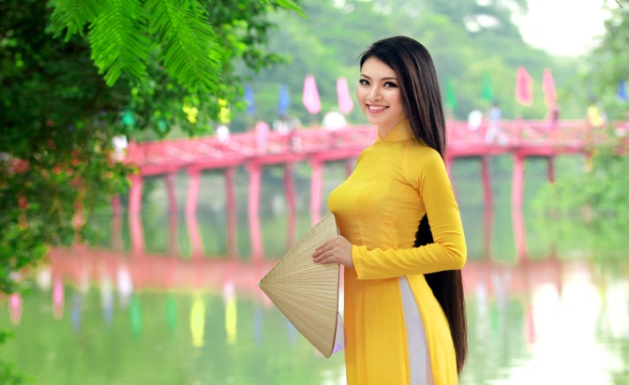
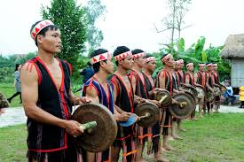
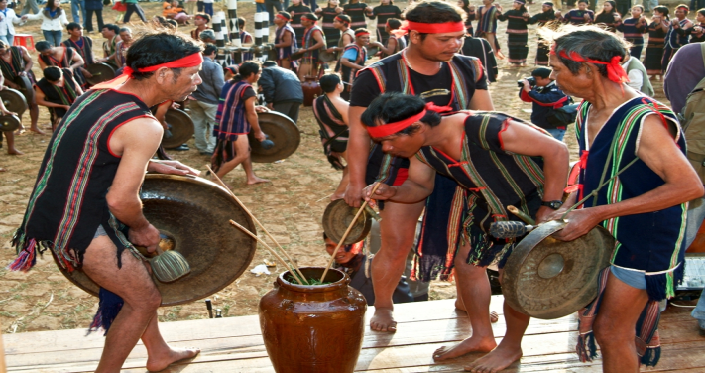
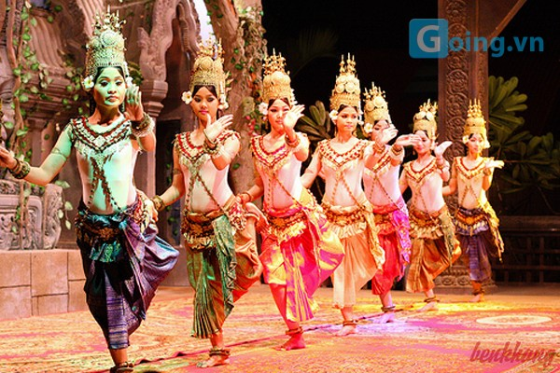
1
2
3
the Thai
the HMong
the Muong
4
5
6
the Yao
the Kinh
the Cham
7
8
9
the Ede
the Bana
the Khmer

Slide 3

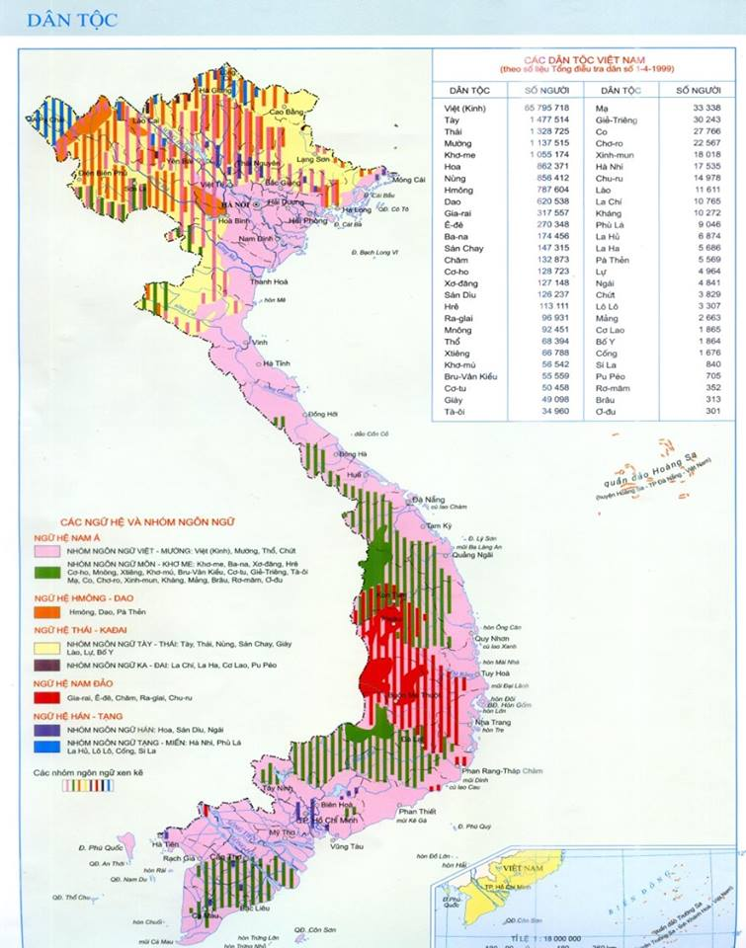



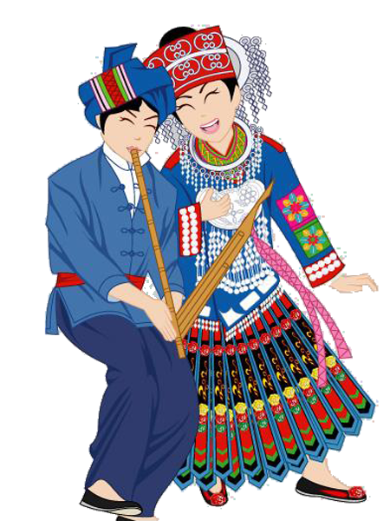

Slide 4

Vocabulary
Peoples
Dân tộc
Majority: đa số, phần lớn
Minority: thiểu số, số ít
awesome (adj) /ˈɔːsəm/
= surprising, amazing
ngạc nhiên
costume (n) /ˈkɒstjuːm/
Trang phục
custom (n) /ˈkastəm/
Phong tục, tập quán
Ethnology (n) /eθˈnɒlədʒi/
Dân tộc học
ethnic (a) /eθˈnik/
thuộc về dân tộc (thường thiểu số)
ethnic group, ethnic people

Slide 5
terraced field (n.p) /ˌterəst fiːld /
ruộng bậc thang
stilt house (n.p) /stɪlt haʊs /
Nhà sàn
heritage site (n.p) /ˈherɪtɪdʒ saɪt /
Di sản
Against the law
Trái luật
discriminate (v) / dɪˈskrɪm.ɪ.neɪt /
Phân biệt đối xử
Recognise (v) / ˈrek.əɡ.naɪz /
Công nhận, ghi nhận, thừa nhận
According to
Theo, dựa theo
Eastern/western/southern/northern
Thuộc về hướng đông/tây/nam/bắc

Slide 6
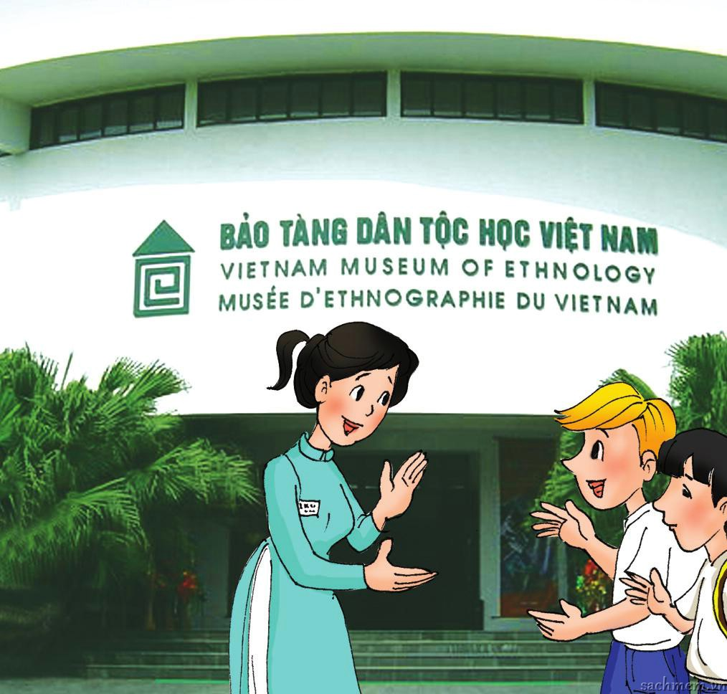
Nick
Duong
a guide

Slide 7

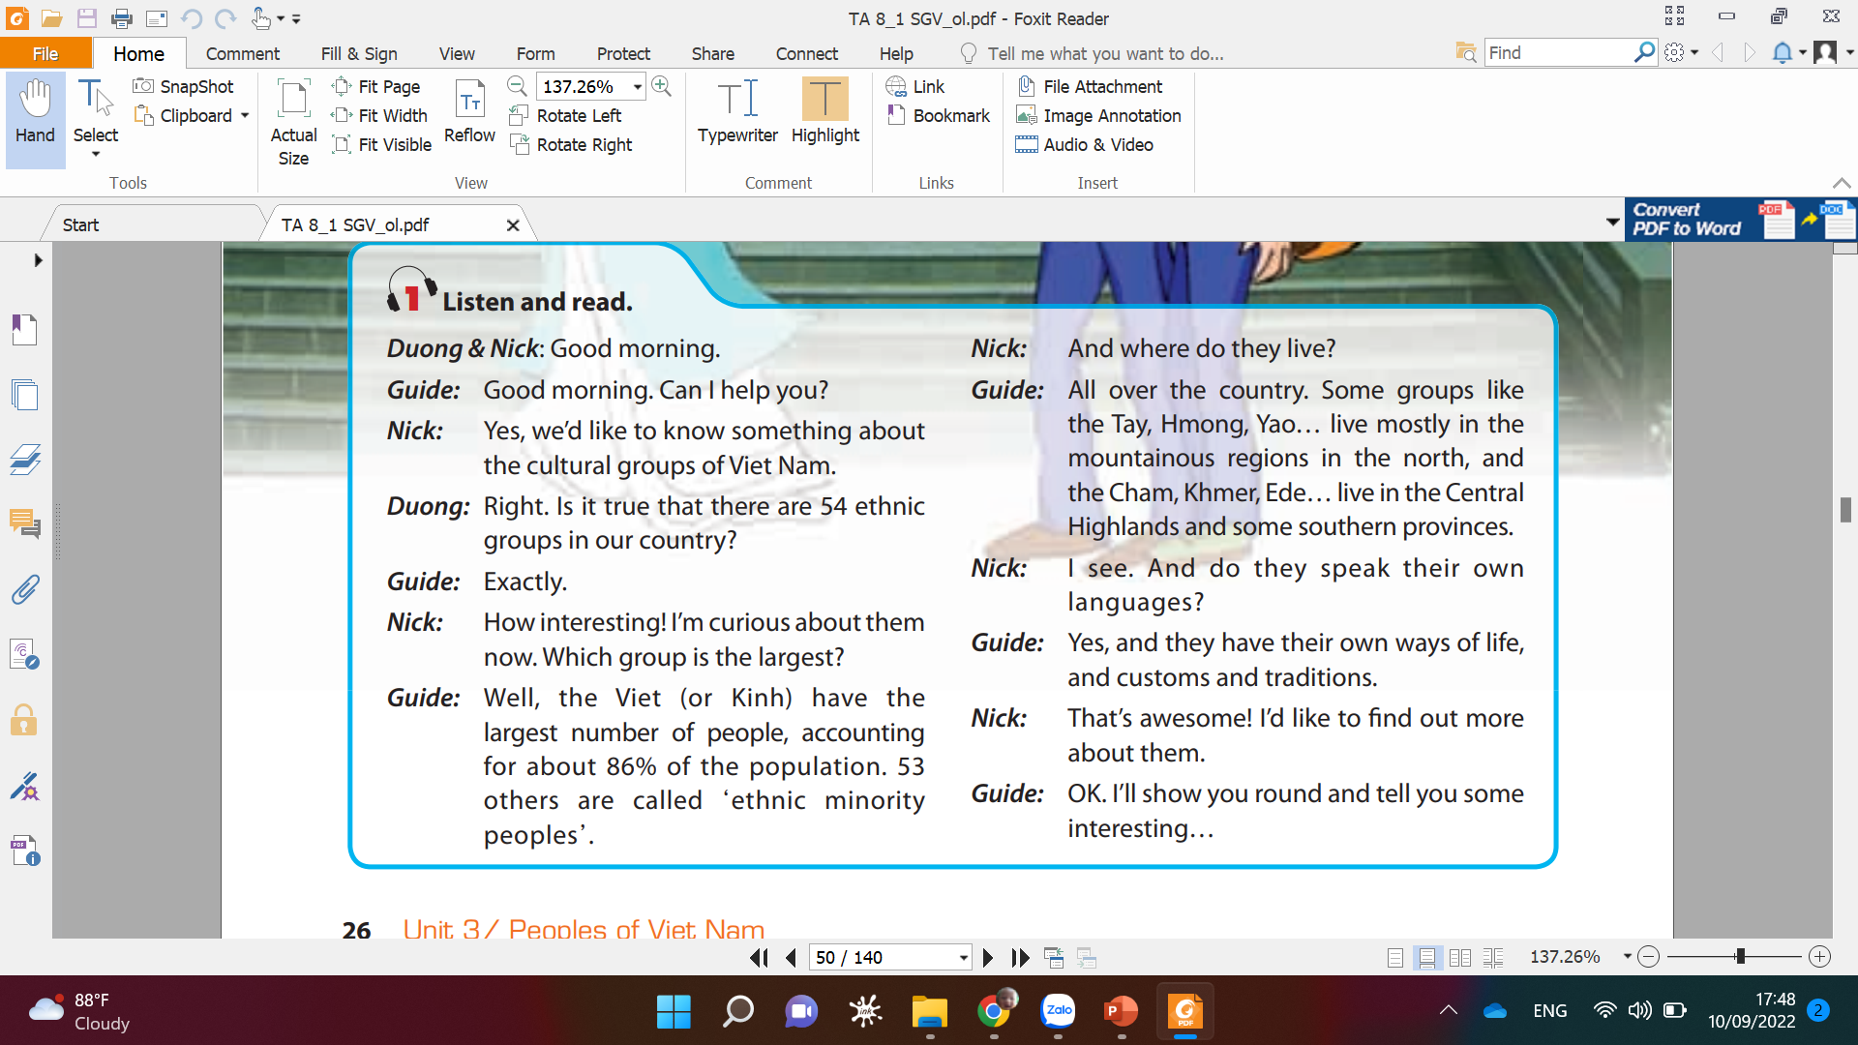
Listen to the conversation

Slide 8
Listen and read.
a. Find the opposite of these words in the conversation.
interesting
boring ><
smallest ><
majority ><
northern ><
largest
minority
southern

Slide 9
1b. Read the conversation again and choose the best answer
Duong and Nick are in the Museum of .........
A. Ethnology B. Ethnic C. History
2. They want to know about the ...................of Viet Nam.
A. landscapes B. ethnic groups C. groups ethnic
3. There are ...................ethnic groups in Viet Nam.
A. 53 B. 86 C. 54
4. The ........................ has the largest population.
A. Kinh B. Thai C. Yao
5. Do the ethnic minority peoples have their own customs and traditions?
A. No information B. No, they don’t C. Yes, they do

Slide 10
Listen and read.
c. Can you find the following expressions in the conversation? Try to explain what they mean.
1. Exactly =>
2. How interesting! =>
3. I see.=>
4. That’s awesome!=>
used as a reply, agreeing with what sb has just said, or emphasising that it is correct.
used to show a strong reaction to sth.
used to show you understand what someone said.
used to show that you think sth is great.

Slide 11
How interesting!
How amazing!
How beautiful!
How peaceful!
How + adjective!

Slide 12

*People:
is used as the plural of ‘person’ to refer to men, women, and children.
*Peoples:
ethnic groups of people who belong to a particular country, race, or area.

Slide 13
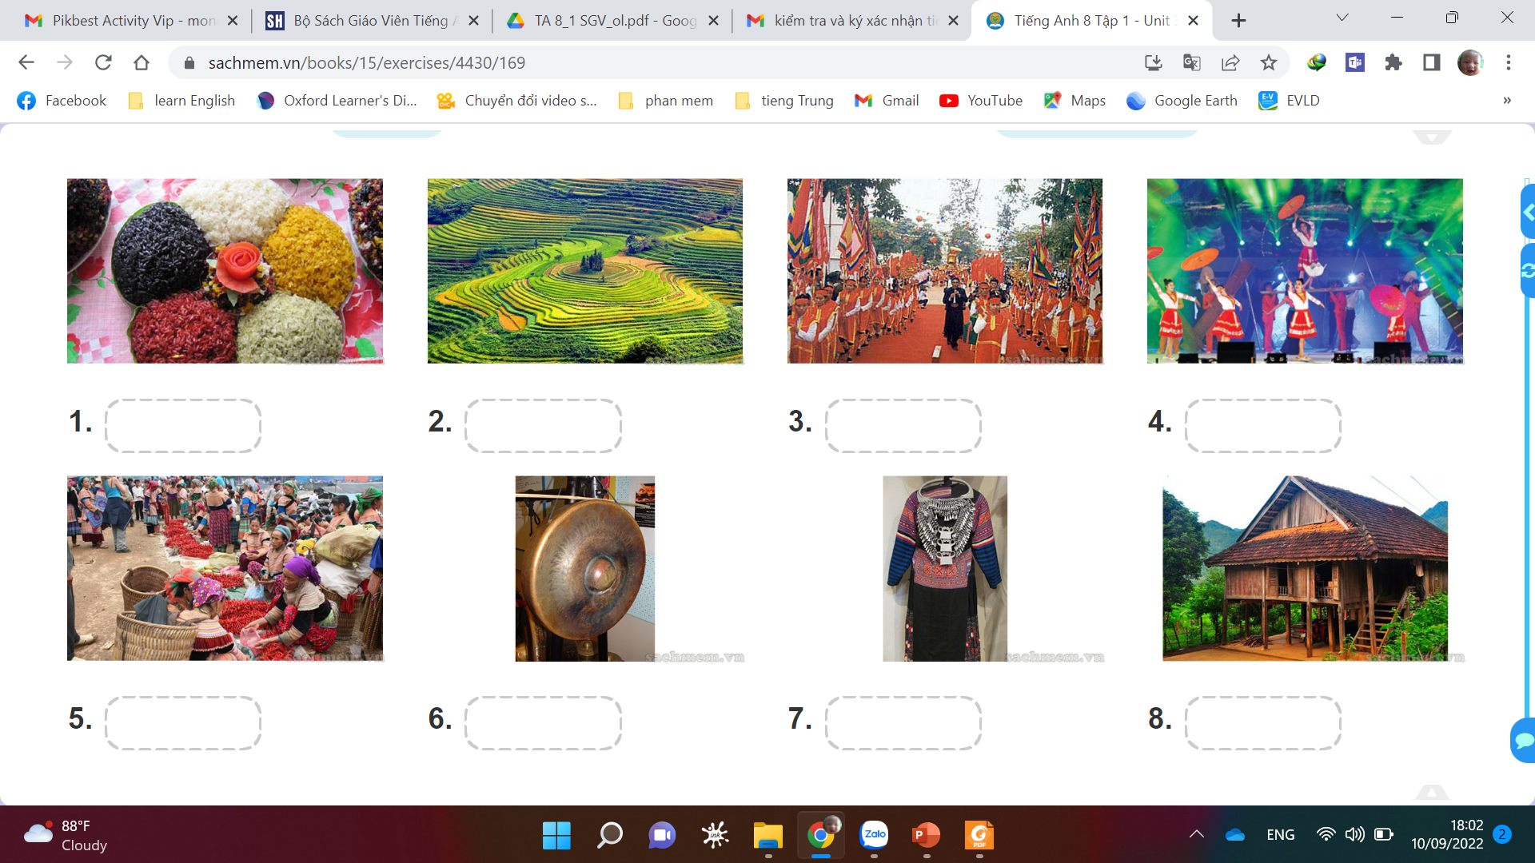
costume stilt house terraced fields open-air market
folk dance musical instrument festival five-coloured sticky rice
Five-coloured sticky rice
terraced fields
festival
folk dance
Open-air market
musical instruments
costume
stilt house

Slide 14

3.Complete the following sentences with the words/phrases in the box.
heritage site stilt houses terraced fields
member ethnic festivals
1. In our country, it is against the law to discriminate against any __________ or religious group.
2. My Son in Quang Nam Province has been recognised by UNESCO as a world ____________.
3. ____________ have been popular among many of Viet Nam’s ethnic groups for a long time.
4. Lunar January is the time for important __________ in the whole country, especially in the north.
5. The exhibition building of the Museum of Ethnology was designed by the architect Ha Duc Linh, a __________ of the Tay ethnic group.
6. The _______________ of Sa Pa have entered in the Top 11 most beautiful terraces in the world, according to Touropia.
ethnic
heritage site
Stilt houses
festivals
member
terraced fields

Slide 15
4. GAME: QUICK QUIZ
Work in pairs. Ask and answer , using the cues:
1. Which / smallest population ? – The Odu group
2. The Hmong / own language ? - Yes
3. Where / the Coho / live ? – Lam Dong Province
4. What colour / the Nung’s clothing ? – Dark indigo
5. Which / larger population / the Tay or the Thai ?
- The Tay
6. Whose arts / displayed / a museum / Da Nang ?
- The Cham’s

Slide 16
4. GAME: QUICK QUIZ
Work in pairs. Ask and answer, using these cues.
Which/ smallest population?
______________________________________________ - The Odu group.
The Hmong/ own language?
______________________________________________ - Yes.
Where/ the Coho/ live?
______________________________________________ - Lam Dong Province.
What colour/ the Nung’s clothing?
______________________________________________ - Dark indigo.
Which/ larger population/ the Tay or the Thai?
__________________________________________________ - The Tay.
Whose arts/ displayed/ a museum/ Da Nang?
______________________________________________
- The Cham’s.
Which ethnic group has the smallest population?
Do the Hmong have their own language?
Where do the Coho live?
What colour is the Nung’s clothing?
Which group has a larger population, the Tay or the Thai?
Whose arts are displayed at a museum in Da Nang?

Slide 17
UNIT 3 – PEOPLES OF VIET NAM
GETTING STARTED:At the museum of Ethnology
Note: a, Vocabulary about Ethnology
b, ‘How + Adj/Adv’ to show a strong reaction to sth.
festival
costume
stilt house
open-air market
ETHNOLOGY
Folk dance
musical instrument
terraced fields
Five-colour sticky rice

Slide 18
Homework
1. Learn by heart:
+ Vocabulary about ethnology.
+ ‘How + Adj/Adv’ to show a strong reaction
to sth.
2. Talking about ethnic groups.
3. Read and translate the conversation again

