Slide 1

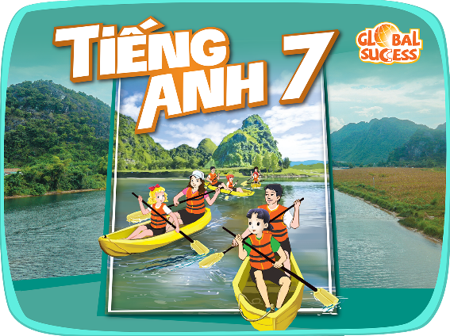

Unit
Monday,November,14th 2022
4
MUSIC AND ARTS
LESSON 5: SKILLS 1 p.46
READING
SPEAKING
Nguyen Thi Hai
Thai Son secondary school
Unit

Slide 2
WARM-UP
Cultural space of Gong
WHAT KINDS OF TRADITIONAL PERFORMANCES DO YOU KNOW ?

Slide 3
Unit
4
MUSIC AND ARTS
LESSON 5: SKILLS 1 p.46
READING
SPEAKING
Nguyen Thi Hai
Thai Son secondary school
Unit

Slide 4
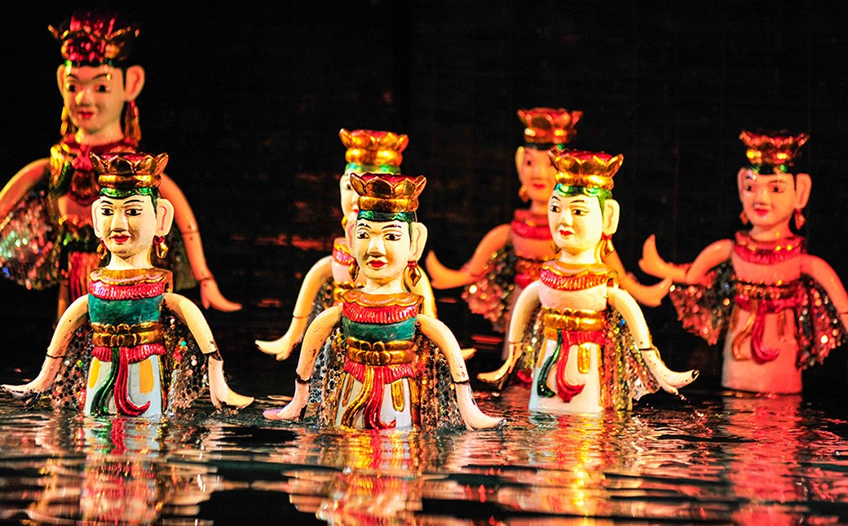
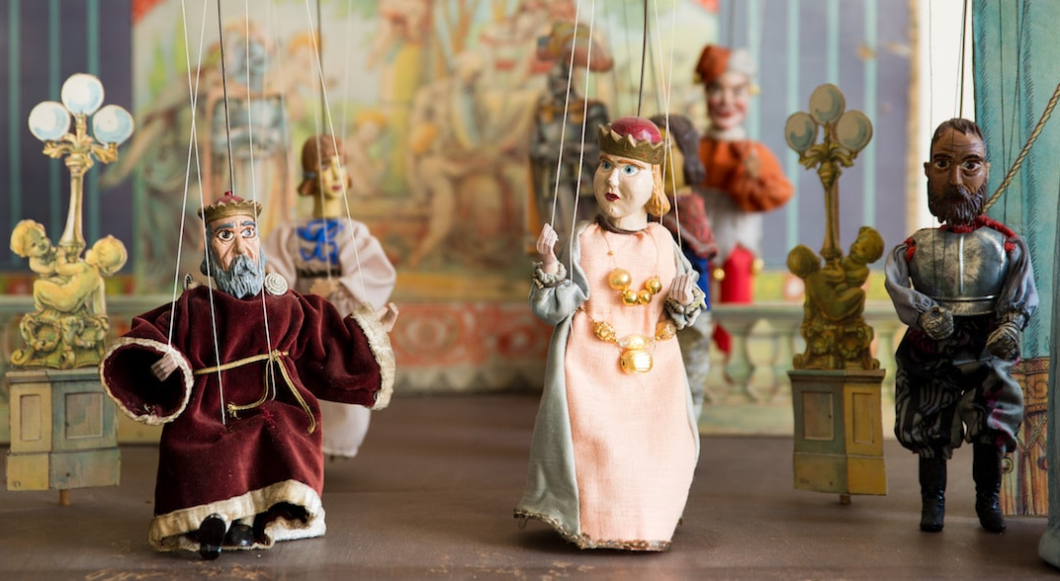
I-Reading
*VOCABULARY
puppetry (n)
/ˈpʌpɪtri/
nghệ thuật múa rối

Slide 5
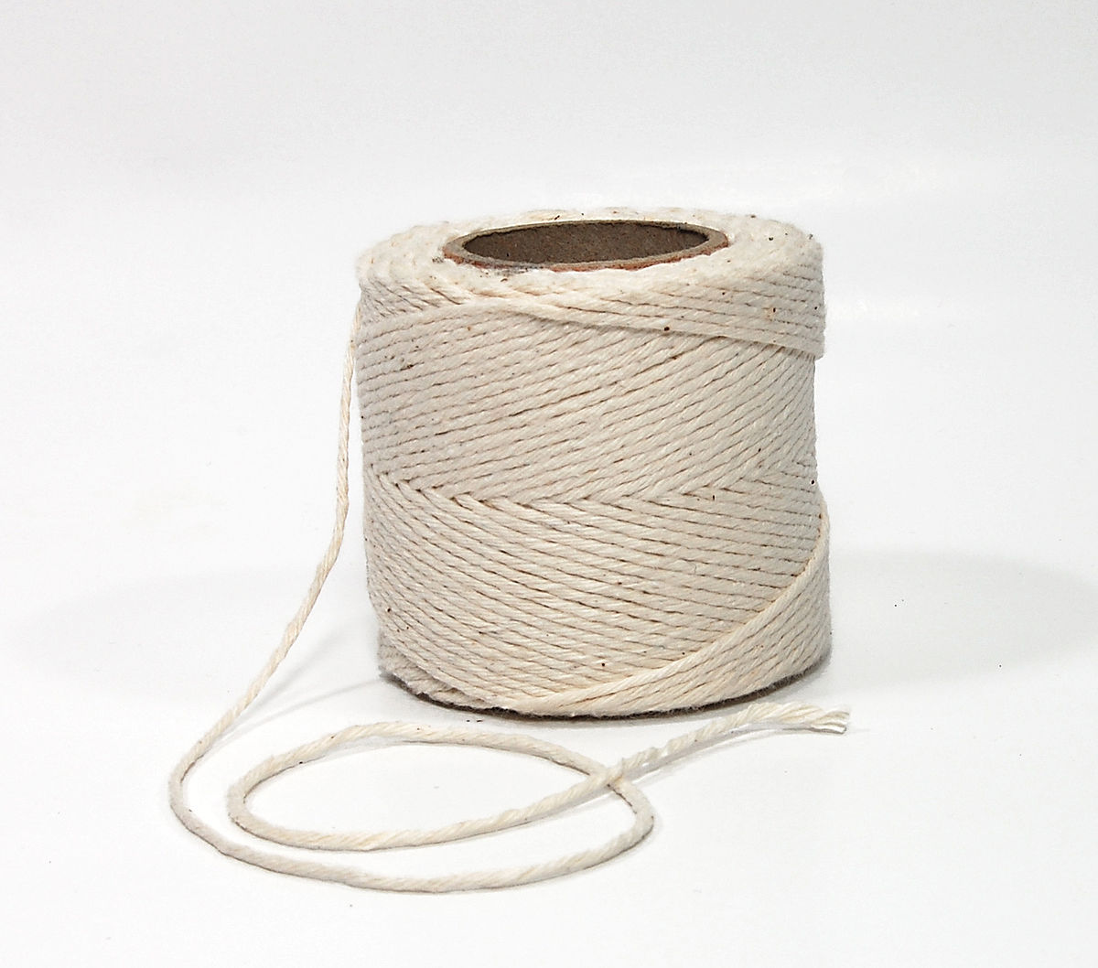
VOCABULARY
string (n)
/strɪŋ/
sợi dây

Slide 6
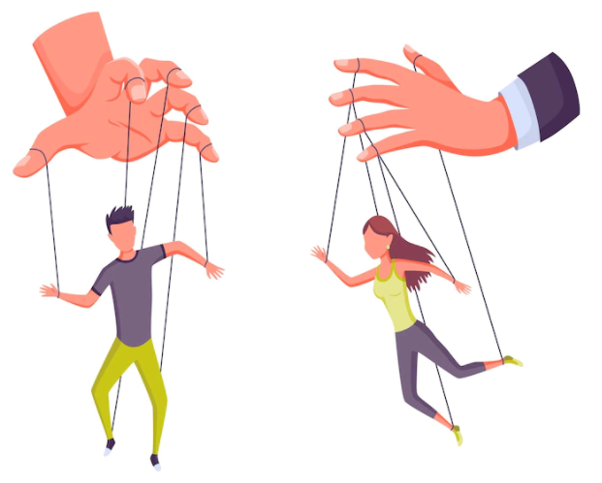
*VOCABULARY
control (v)
/kənˈtrəʊl/
kiểm soát, điều khiển

Slide 8
*VOCABULARY
Vocabulary | Pronunciation | Meaning
puppetry (n) | /ˈpʌpɪtri/ | nghệ thuật múa rối
string (n) | /strɪŋ/ | sợi dây
control (v) | /kənˈtrəʊl/ | kiểm soát, điều khiển

Slide 9

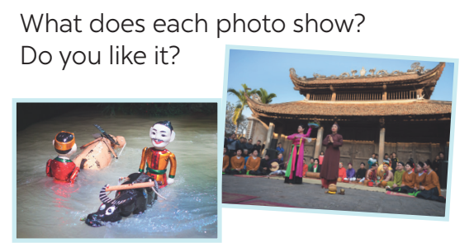
1.Look at the pictures. Discuss the questions .

Slide 10
1.Look at the pictures. Discuss the questions
- The first picture shows a water puppet show.
- The second picture is the Quan Ho singing.
- I like them very much.

Slide 11
2
Read the email and match the highlighted words with their meanings.
To: sue@fastmail.com
Subject: A water puppet show
Dear Sue,
How are things with you? I arrived in Viet Nam three days ago, and everything is perfect.
Yesterday I went to see a puppet show at a theatre in the center of Ha Noi. The show was fantastic! The artists performed the show in a pool. They stood behind a screen. They used strings under the water to control the puppets and make them move on the water! The show was about rice farming and a festival in a village. People say that these shows are normally about everyday life in the countryside of Viet Nam. Water puppetry is a special traditional art form. People love it, and most tourists coming to Viet Nam love to see it. I wish you were here with me. See you next week.
Love,
Mary
showed or presented
2. following tradition
3. nice, interesting
4. event or celebration
→ performed
→ traditional
→ fantastic
→ festival

Slide 12

*
Read the email again and decide these statements are True or False.
Statements | True | False
1. Mary went to see a puppet show in an art museum in the center of Ha Noi.__at a theatre
2. The show was presented by the artists stood behind a screen in a pool.
3. These shows are normally about everyday life in the countryside and in the city of Viet Nam._ of Viet Nam
4. Tourists come to Viet Nam love to see it because it is a special traditional art form.

Slide 13
3
Read the email again and answer the questions.
1. Who went to see a water puppet show yesterday?
2. Where did the artists perform the show?
3. Who controlled the puppets?
4. What are water puppet shows normally about?
5. Is water puppetry a traditional Vietnamese art form?
Notes:
Lucky numbers: 1,4,8
Number 2: Question 1
Number 3: Question 2
Number 5: Question 3
Number 6: Question 4
Number 7: Question 5

Slide 14
1. Who went to see a water puppet show yesterday?
2. Where did the artists perform the show?
3. Who controlled the puppets?
4. What are water puppet shows normally about?
5. Is water puppetry a traditional Vietnamese art form?
-Mary did.
-In a pool.
-The artists did.
-About everyday life in the countryside of Viet Nam.
-Yes, it is.

Slide 15
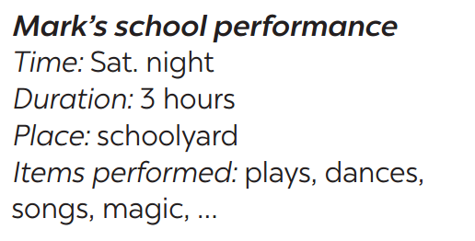

II-SPEAKING
4
Ask and answer about Mark’s school musical performance last year.
A: When was the performance?
B: On Saturday night.
A: How long did it last?
B: It lasted three hours.

Slide 16
A: When was the performance?
B: On Saturday night.
A: How long did it last?
B: It lasted three hours.
A: Where did it take place?
B: It took place in the schoolyard.
A: What items did the performance show?
B: It performed plays, dances, songs, magic,..

Slide 17

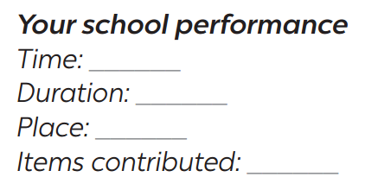
5
Make a plan for the performance and talk about the items you will contribute.
Your school is going to have a musical performance to celebrate Teachers’ Day.

Slide 18

2
HOME ASSIGNMENTS
Make sentences using the vocabulary
Do exercises in part C,D p.31-33 in WB.

