Slide 2

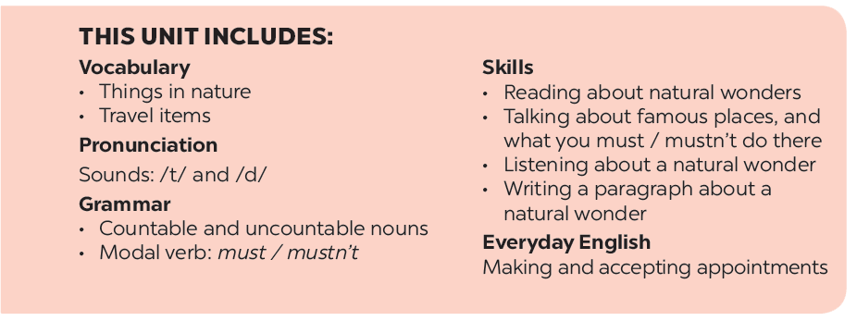

Slide 3








Vocabulary
Grammar
Write the name for each picture.
Find the mistake in each sentence and correct it.
Match the name of a natural wonder in column A with a word indicating it in column B. 1 is an example.
Complete the dialogue, using must or mustn’t.
Write the words.

Slide 4

Thusday,December 8th 2022
Unit 5: NATURAL WONDERS OF VIETNAM
Lesson 7: Looking back and project p.56-57
I. Vocabulary.

Slide 5


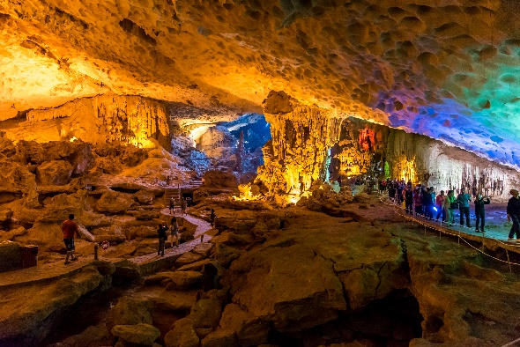
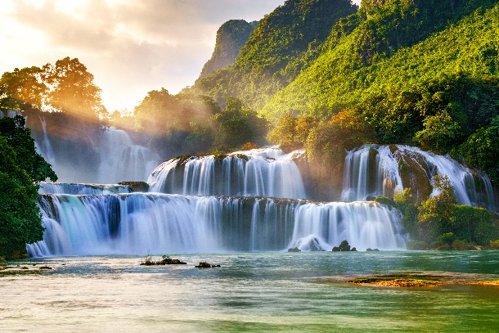
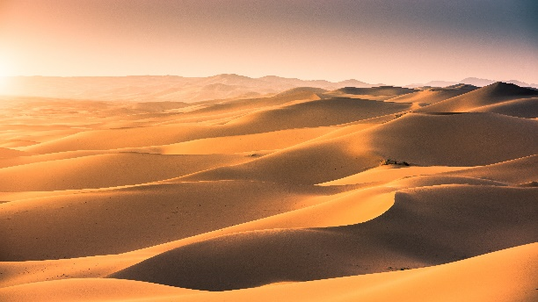
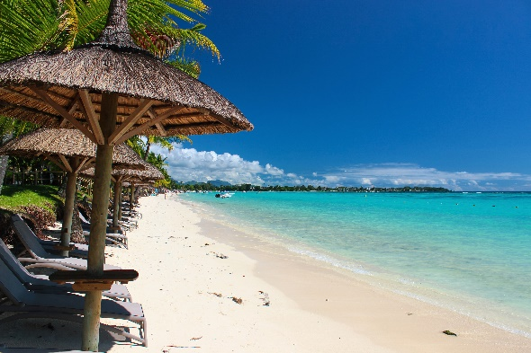
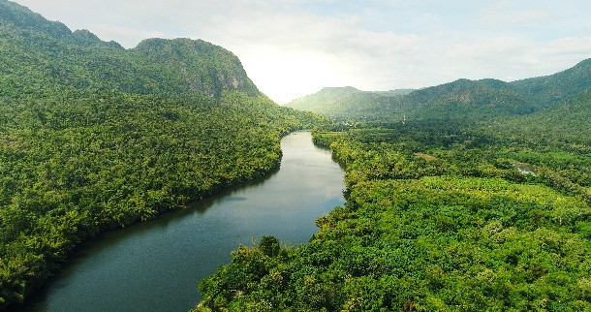
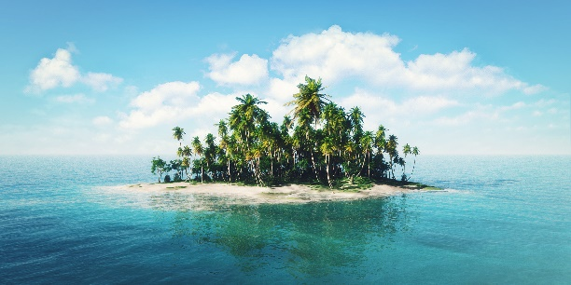
Write the name for each picture.

Slide 6

1.
1. waterfall

Slide 7

2.
2. cave

Slide 8

3.
3. desert

Slide 9

4.
4. river

Slide 10
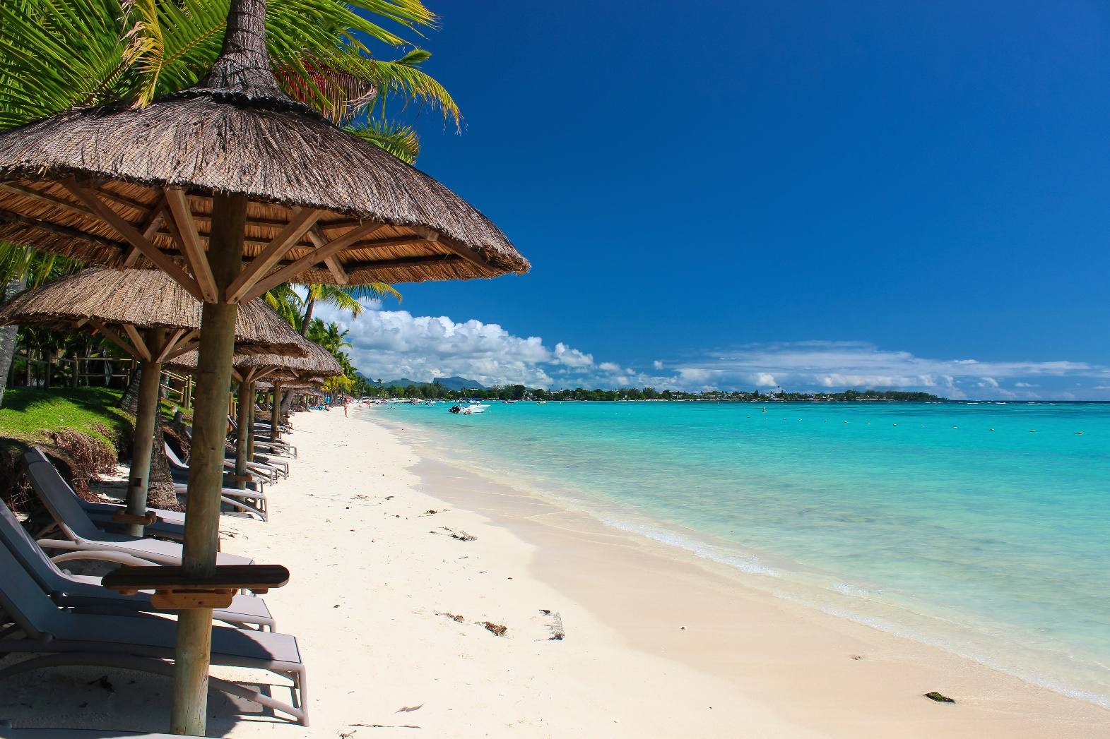
5.
5. beach

Slide 11
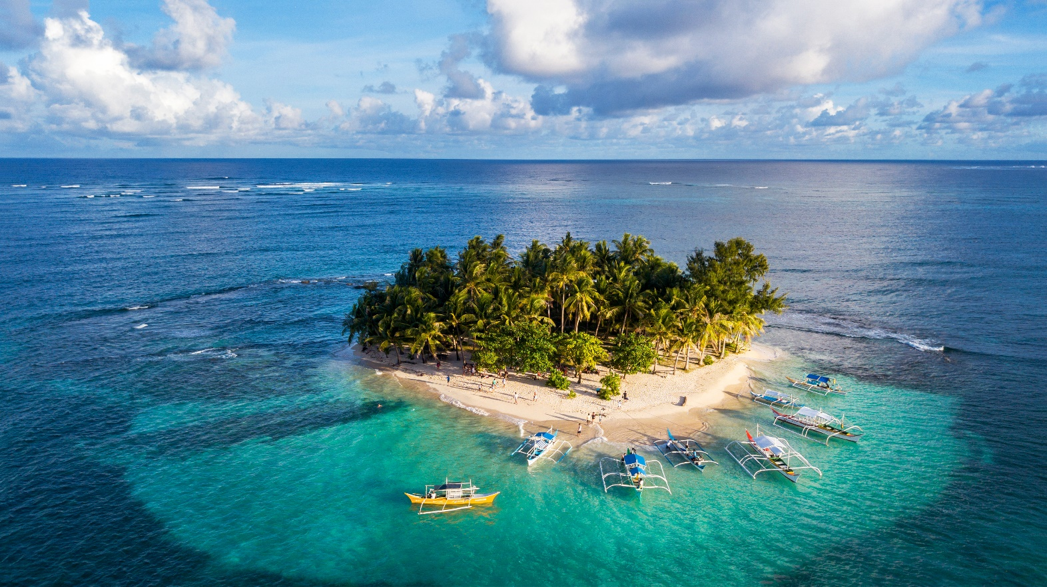
6.
6. island

Slide 12
Write the name for each picture.
2. cave
3. desert
1. waterfall
5. beach
4. river
6. island

Slide 13

Match the name of a natural wonder in column A with a word indicating it in column B. 1 is an example.
A
B
1. Fansipan
a. Bay
d. mount
2. Ban Gioc
b. Island
c. waterfall
3. Ha Long
c. waterfall
a. Bay
4. Cuc Phuong
d. mount
e. forest
5. The Sahara
e. forest
f. desert
6. Con Dao
f. desert
b. Island

Slide 14

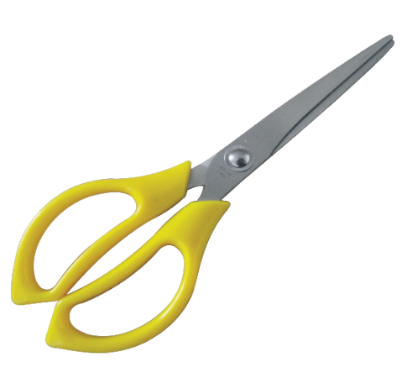
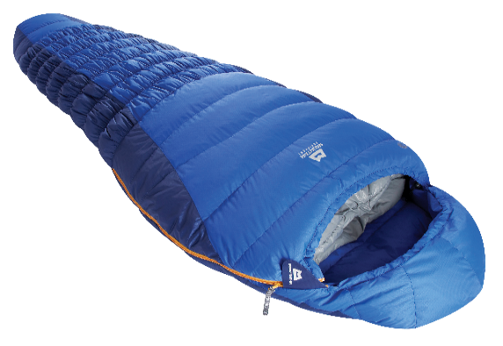
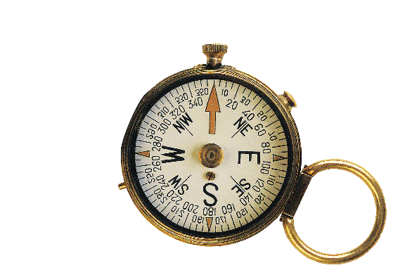
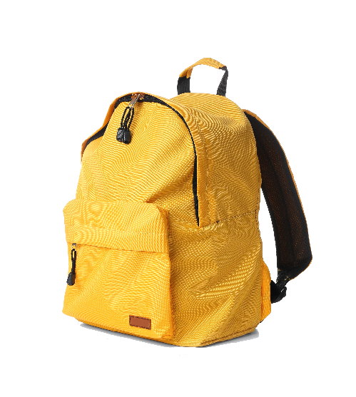
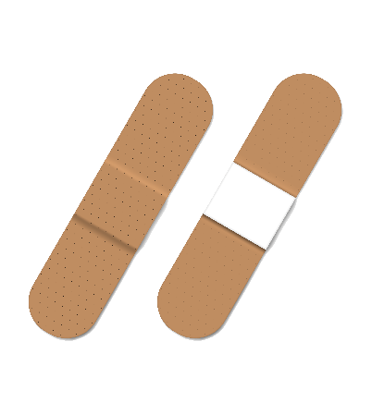
Write the words.
a. scissors
b. sleeping bag
c. compass
a.
b.
c.
d. backpack
e. plaster
d.
e.

Slide 15
Unit 5: NATURAL WONDERS OF VIETNAM
Lesson 7: Looking back and project
I. Vocabulary.
II. Grammar.
Form:
- There is + a/an/ one + N ( đếm được số ít)
+ some/ a little + N ( không đếm được)
- There are + two/ some/ a few …+ N-s (đếm được số nhiều)
How much + N (không đếm được) + is there?
How many + N-s ( đếm được số nhiều) + are there?
=> There is/ are + số lượng ( + Danh từ)

Slide 16

Find the mistake in each sentence and correct it.
Example:
There is some wonderful camping sites in our area.
is are

Slide 17
Find the mistake in each sentence and correct it.
1.
How many candles is on that birthday cake?
is are
2.
There are so much snow on the road.
are is
3.
Michael can play different musical instrument.
instrument instruments
4.
There are not much milk left in the fridge.
are is
5.
Don’t take too much luggages on your trip.
luggages luggage

Slide 18

Complete the dialogue, using must or mustn’t.
It’s dangerous to go hiking there. You (1) tell someone where you are going.
must
A:
B:
Yes. And I (2) take a warm coat.
It’s very cold there.
must
A:
Right. But you (3) bring any heavy or unnecessary things with you.
mustn’t
B:
OK, and I (4) take a mobile phone. It’s very important.
must
A:
And you (5) forget to bring a compass.
mustn’t

Slide 19
Unit 5: NATURAL WONDERS OF VIETNAM
Lesson 7: Looking back and project
I. Vocabulary.
II. Grammar.
III. Project.
DREAM DESTINATION

Slide 20
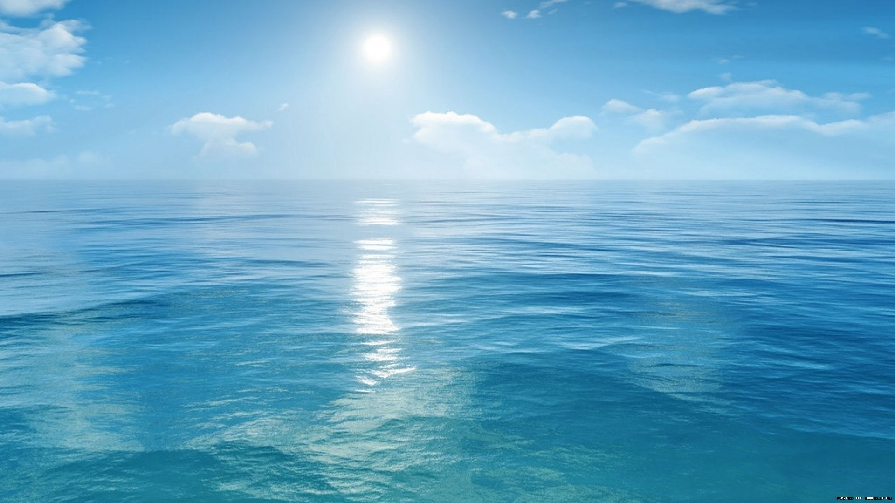

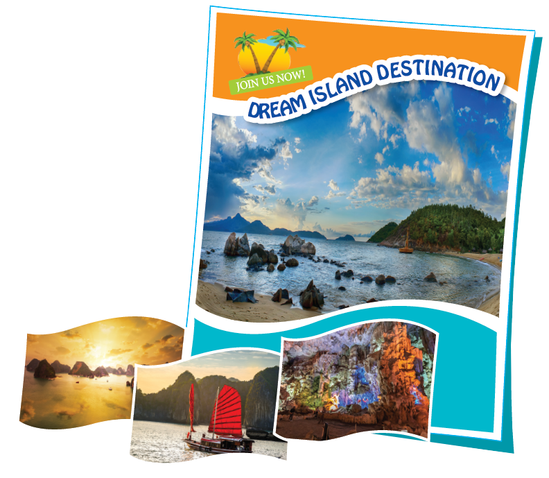
DREAM DESTINATION
In groups, make a poster about a natural wonder you would like to visit. In the poster, draw / print a picture of the place. Then give some information about the place:
what the natural wonder is
where it is
how you can go there
what it is special about
what you can do there
…

Slide 21
DREAM DESTINATION
Introduce the attraction to your class.

Slide 22
Now I can … |  |  | 
use the words related to things in nature and travel items.
pronounce the sounds /t/ and /d/ correctly.
use countable and uncountable nouns.
use the modal verb must / mustn’t.
make and accept appointments.
read about natural wonders.
talk about famous places, and what you must / mustn’t do there.
listen about a natural wonder.
write a paragraph about a natural wonder.

Slide 23
Unit 5: NATURAL WONDERS OF VIETNAM
Lesson 7: Looking back and project
I. Vocabulary
II. Grammar
III. Project.
IV. Home Assignments.
-Review vocabulary & make sentences using the vocabulary
- Do all exercise in your workbooks (in unit 5)
- Prepare Unit 6: Getting started

Slide 24



