Slide 1


Slide 2



Unit
5
FOOD AND DRINK
Monday,December,5th 2022
Lesson 7: LOOKING BACK & PROJECT
Vocabulary review
Grammar review
Project: Eating habits around the world
HOBBIES

Slide 3






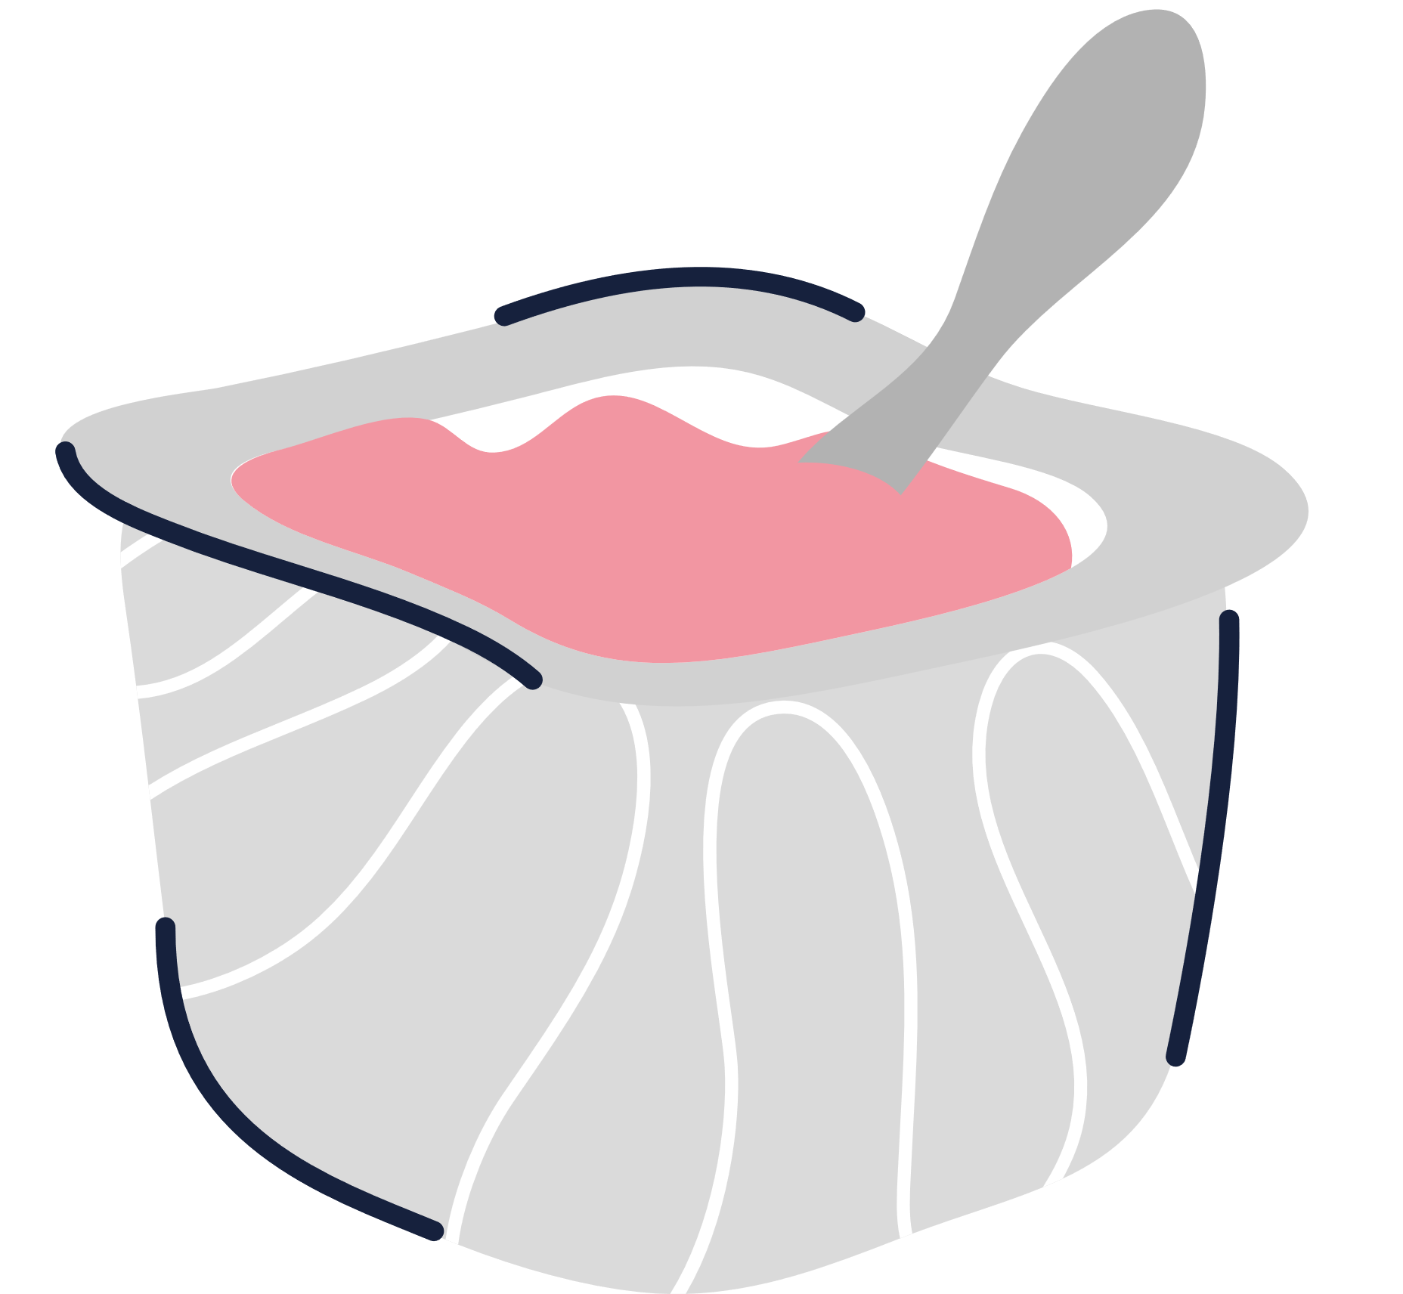

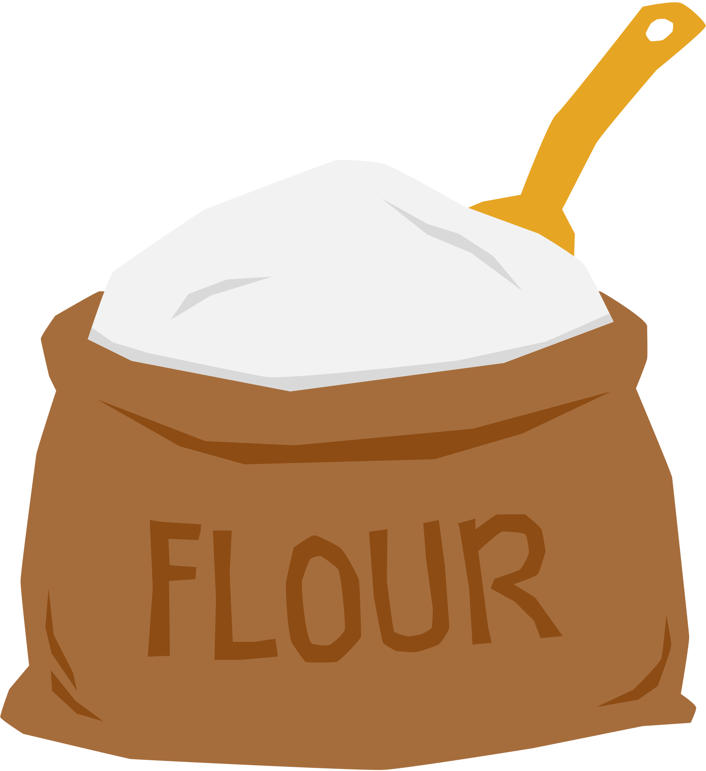

Mini game
Guess: What can you make?
Look at the ingredients.
Write the food you can cook using the ingredients.
Show others your answers.
Strawberry
Butter
Milk
Crepes
Sugar
recipe
Cream
Egg
Flour
Salt

Slide 4
VOCABULARY REVIEW
1
Add the words and phrases you have learnt in the correct columns. Compare with your partner's. Who has more words and phrases? Add any that you did not write.
Dishes | Ingredients | Units of measurement
pancakes | flour | gram (g)

Slide 5
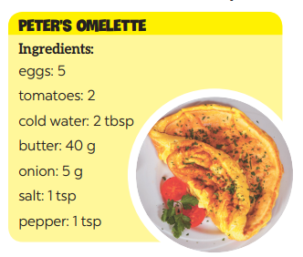
VOCABULARY REVIEW
2
Read the recipe and write sentences as in the example.
Suggested answers:
We need 5 eggs.
We need 2 tomatoes.
We need 2 tablespoons of cold water.
We need 40 grams of butter.
We need 5 grams of onion.
We need 1 teaspoon of salt.
We need a teaspoon of pepper.
Ingredients
eggs: 5
tomatoes: 2
cold water: 2 tbsp
butter: 40 g
onion: 5 g
salt: 1 tsp
pepper: 1 tsp

Slide 6
GRAMMAR REVIEW
3
Complete the sentences. Write some, any, much, or a lot of/ lots of.
1. I have to go to the market now. There isn't food _________ for our dinner.
2. Would you like _________ sugar for your coffee?
3. There are ______________ trees in our village, so the air here is very fresh.
4. I'm very busy, I have ______________ things to do today.
5. We didn't have _________ beef left, so we had _________ fish for lunch.
any
some
a lot of/ lots of
a lot of/ lots of
any
some

Slide 7
GRAMMAR REVIEW
4
Make questions with How many/ How much for the underlined words in the following sentences.
Example: Minh has three apples.
How many apples does Minh have?
1. There are six bottles of juice in the fridge.
_________________________________________________ ?
2. I need some butter for my pancakes.
_________________________________________________ ?
3. We have only one bottle of fish sauce.
_________________________________________________ ?
4. We need ten chairs for the party.
_________________________________________________ ?
5. She put a lot of sugar in her lemonade.
_________________________________________________ ?
How many bottles of juice are there in the fridge?
How much butter do you need for your pancakes?
How many bottles of fish sauce do you/ we have?
How many chairs do you/ we need (for the party)?
How much sugar did she put in her lemonade?

Slide 8
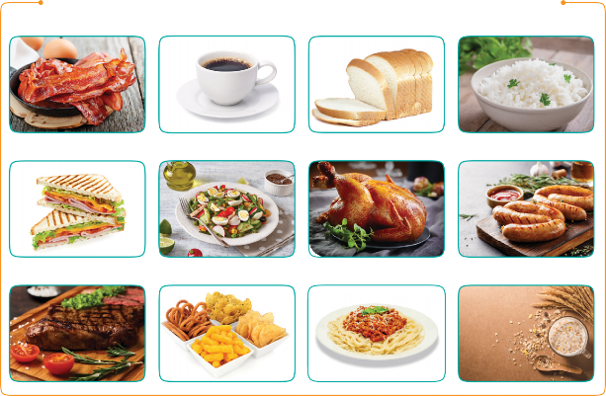
PROJECT
Eating habits around the world
1
Work in groups. Design a poster about eating habits in an area or a foreign country you know, including:
EATING HABITS AROUND THE WORLD
names of main meals and mealtimes
names of common food/ drink for each meal
pictures or photos to illustrate the meals

Slide 9

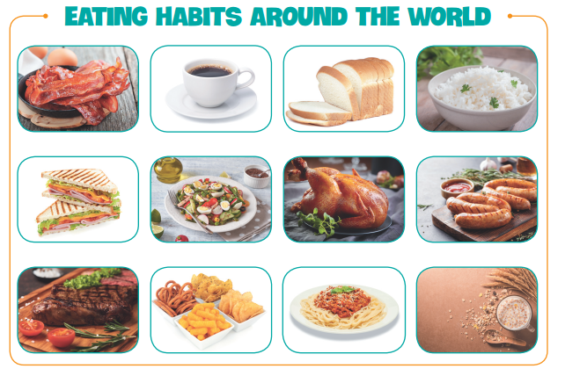
PROJECT
Eating habits around the world
2
Then organise an exhibition of all the posters in your class.
Present your poster to the class.

Slide 10
CONSOLIDATION
1
WRAP-UP
In this lesson, we have learnt to:
Review the vocabulary and grammar of Unit 5
Apply what you have learnt into practice through the project “EATING HABITS AROUND THE WORLD”

Slide 11
CONSOLIDATION
2
HOME ASSIGNMENTS
- Do EX in WB
Prepare for the next lesson, Unit 6: Getting started

Slide 12

Website: sachmem.vn Fanpage: www.facebook.com/sachmem.vn

