Slide 1




Unit 5: FESTIVALS IN Vietnam
Lesson 1: GETTING STARTED

Slide 2
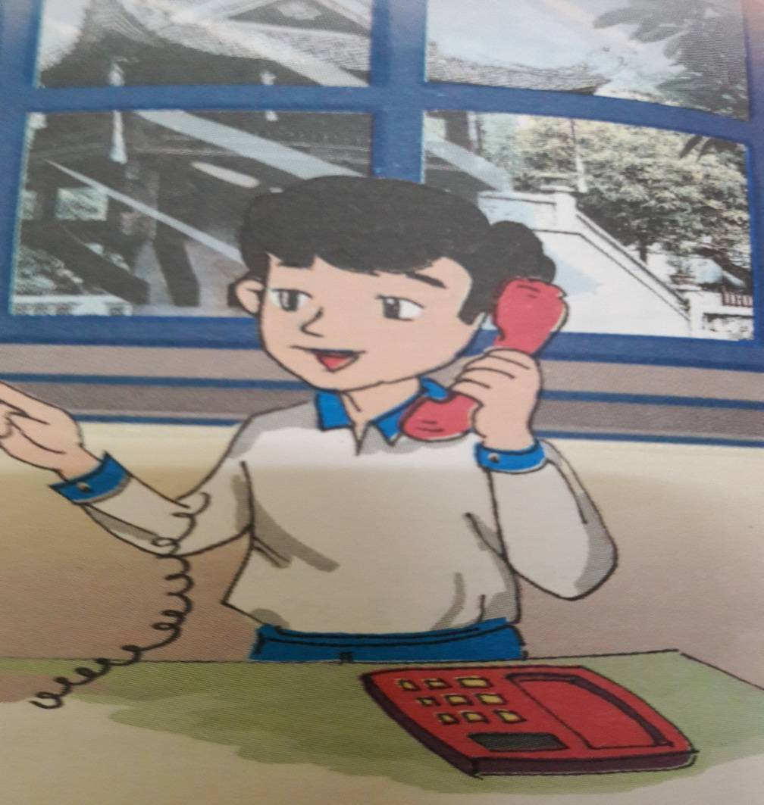


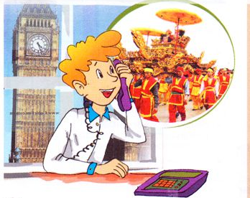

Slide 3
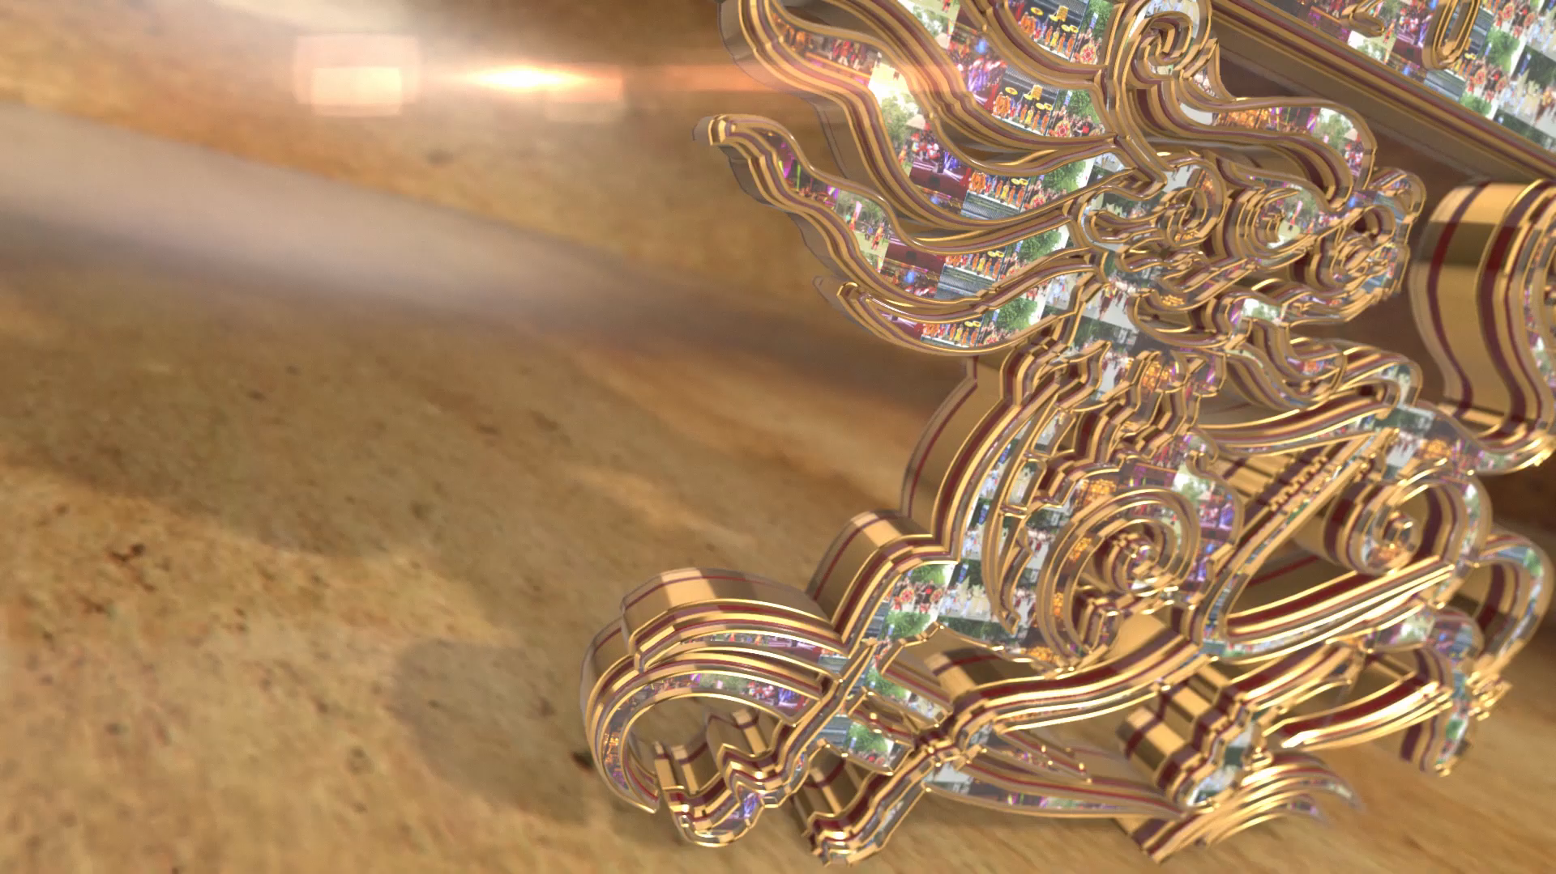
1. What is this video about?
2. Where and when does it take place?
3. What are special things about it?

Slide 4

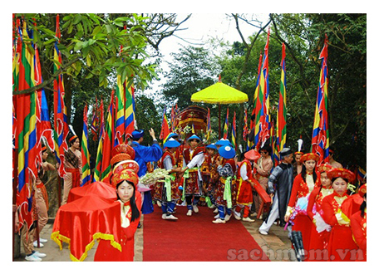
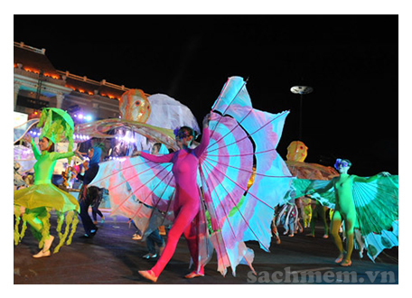
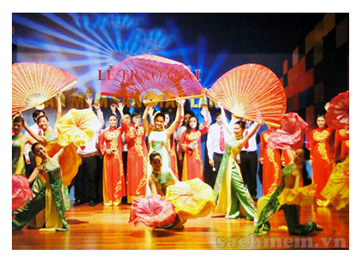
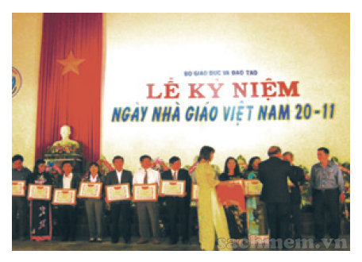
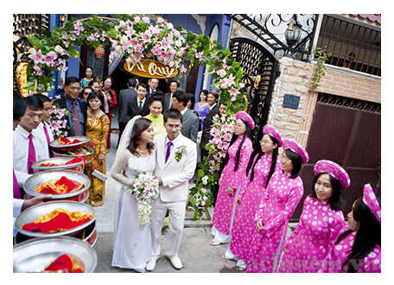
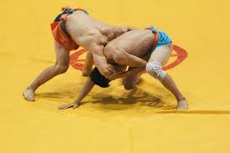
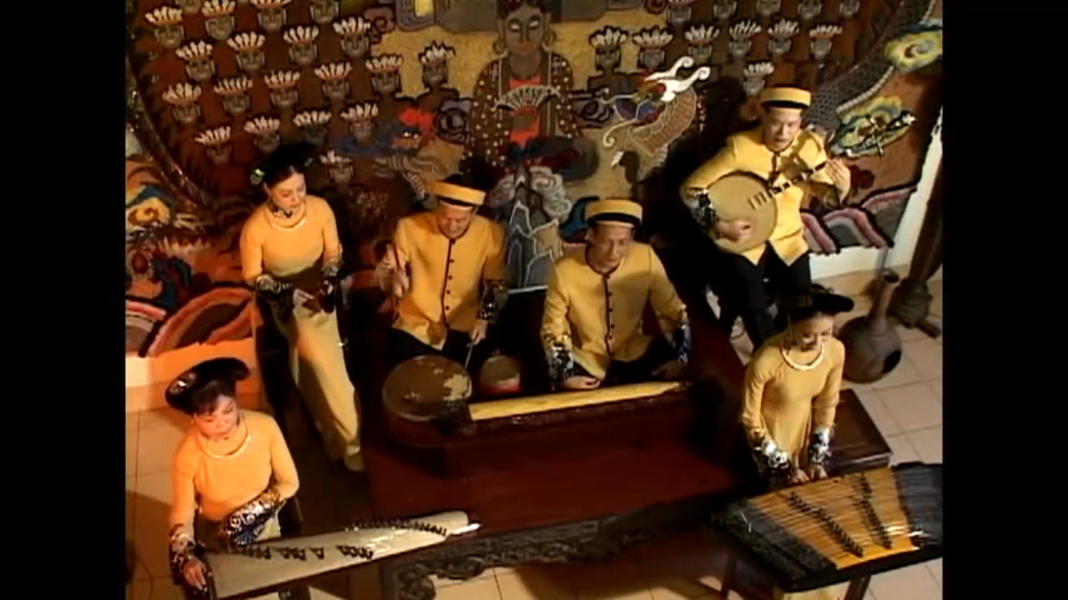
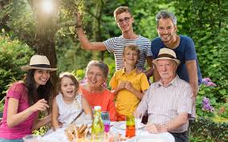
Vocabulary:
ceremony /ˈserəməni/
: nghi lễ
oriental (adj) /ˌɔːriˈentl/
: thuộc phương đông
royal court music
/ˈrɔɪəl kɔːt ˈmjuːzɪk/
: nhã nhạc cung đình
reunion (n) /ˌriːˈjuːniən/
: sự xum họp, đoàn tụ
regret (v) /rɪˈɡret/
: hối hận
swing (v, n) /swɪŋ/
: đánh đu, cái đu
wrestle (v) /ˈresl/
: đấu vật
procession (n) /prəˈseʃn/
: đoàn rước
carnival (n) /ˈkɑːnɪvl/
: lễ hội hóa trang
performance (n) /pəˈfɔːməns/
: buổi biểu diễn
anniversary (n) /ˌænɪˈvɜːsəri/
: lễ kỷ niệm

Slide 5

II. READING:
T | F
PREDICTION:
Tick √ true( T) or false ( F) .
Peter will come to Viet Nam in spring.
2. Peter wants Duong to recommend somewhere
to go.
3.Duong says that Peter should come to Hue and Da Nang.
4. Peter doesn’t want to come to the Hue festival.
5. Duong recommends Peter to see the Hue Festival, the Lim Festival, and to celebrate the Tet holiday with his family.

Slide 6
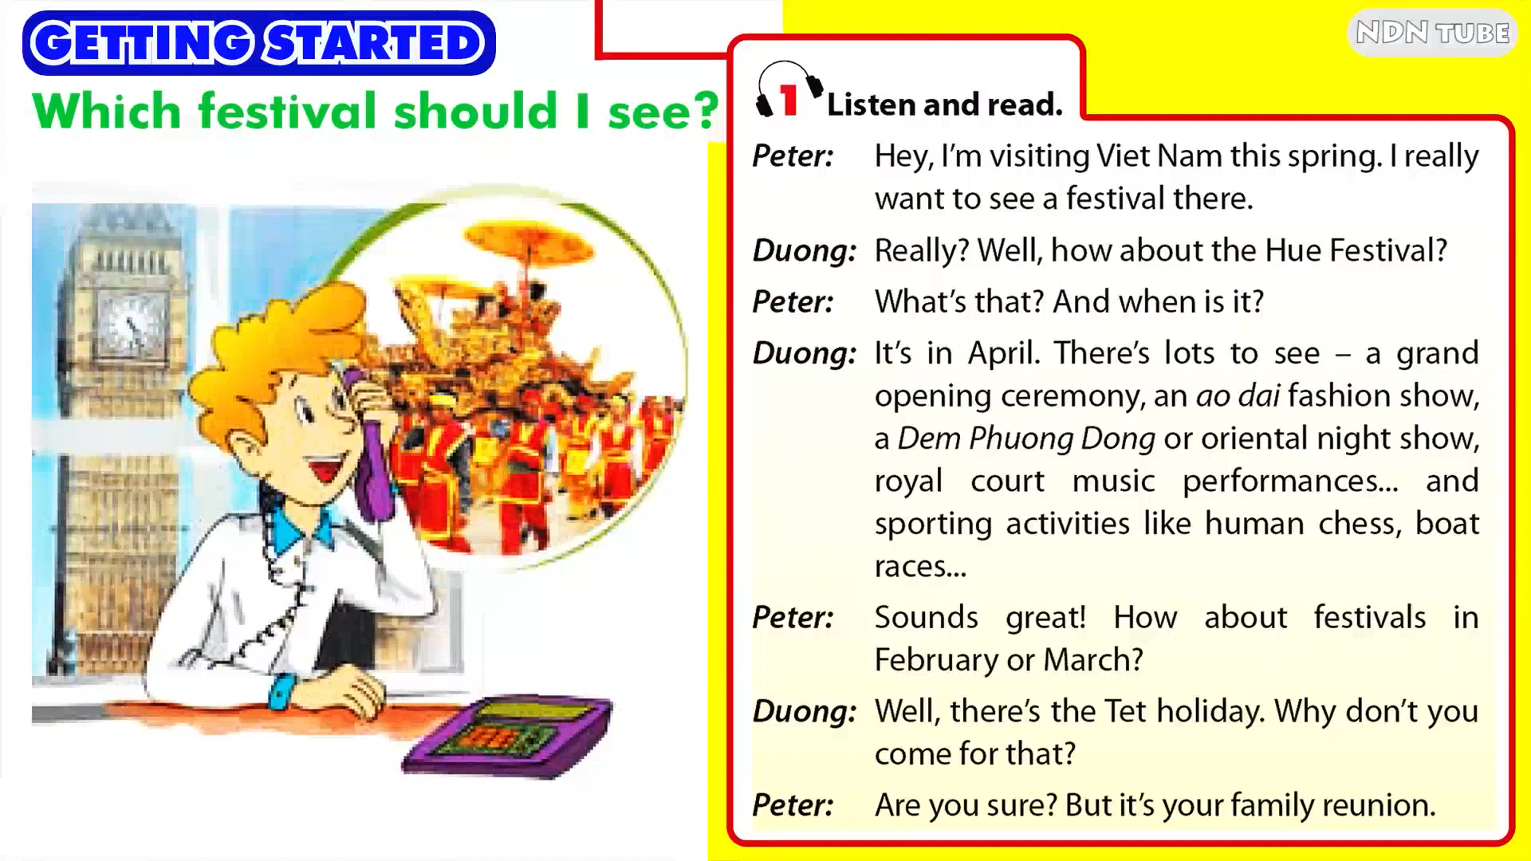


Slide 7
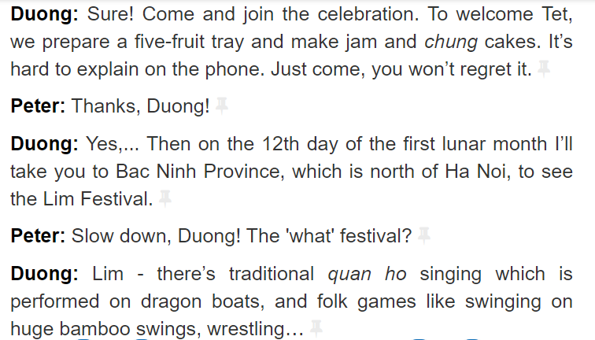

Slide 8
T | F
CHECKING PREDICTION:
√
Peter will come to Viet Nam in spring.
2. Peter wants Duong to recommend somewhere
to go.
3.Duong says that Peter should come to Hue and Da Nang.
4. Peter doesn’t want to come to the Hue festival.
5. Duong recommends Peter to see the Hue Festival, the Lim Festival, and to celebrate the Tet holiday with his family.
√
√
√
√

Slide 9
b. Read the conversation again and answer the question
1. When is the Hue Festival held ? What can visitors see there ?
→ In April . They can see a grand opening ceremony , an ao dai fashion shown , a Dem Phuong Dong or oriental night show, royal court music performances… and sporting activities
2. What does Duong’s family do to welcome Tet ?
→ Duong ‘family prepares a five – fruit tray and makes jam and chung cakes
3. Why does Duong say ‘ It ‘s hard to explain on the phone ?
→ Because there are so many interesting things to see and enjoy , it would take too long to describe them.
4. Where and When is the Lim Festival held?
→ In Bac Ninh , on 12th of the first lunar month
5. Why do you think Duong recommends the Lim Festival ?
→ Because it’s near Ha Noi , It takes place right after Tet holiday and full of traditional events

Slide 10

2. EXPLAIN THE MEANING
1. Why don’t you come for that?
→ Used as suggestion or to give advice.
2. Sounds great !
→ used to give your first impression of what you hear
3. You won’t regret it.
→ to stress that it is worth spending time or money doing something.
4. Are you sure ?
→ to show surprise and to check that something is really Ok to do.

Slide 11

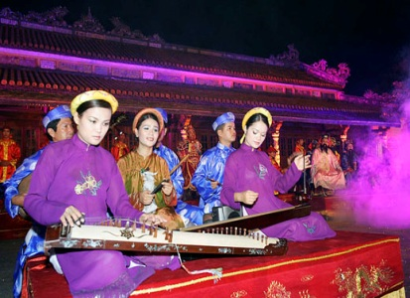
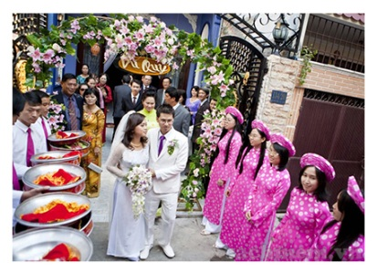
7
1
a. carnival
b. anniversary
2
d. royal court music
6
c. performance
e. reunion
f. procession
g. ceremony
3
5
4

Slide 12
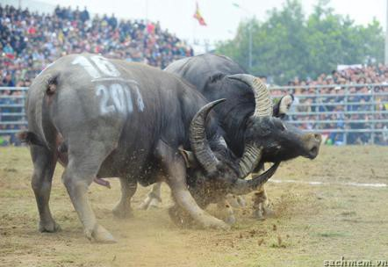
DO SON BUFFALO FIGHTING FESTIVAL

Slide 13
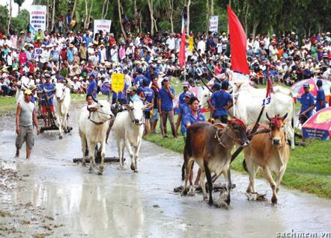
COW RACING FESTIVAL

Slide 14
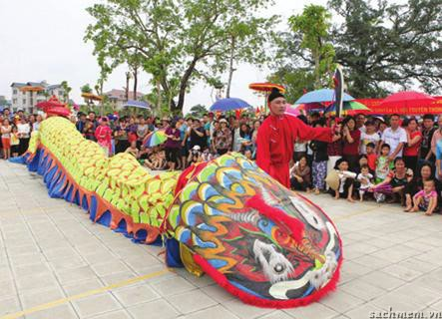
LE MAT SNAKE FESTIVAL

Slide 15
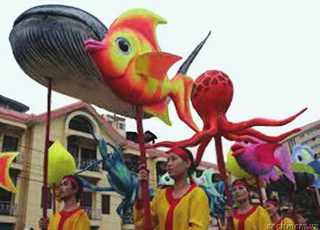
WHALE FESTIVAL

Slide 16
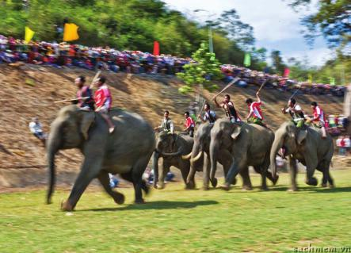
ELEPHANT RACE FESTIVAL

Slide 17
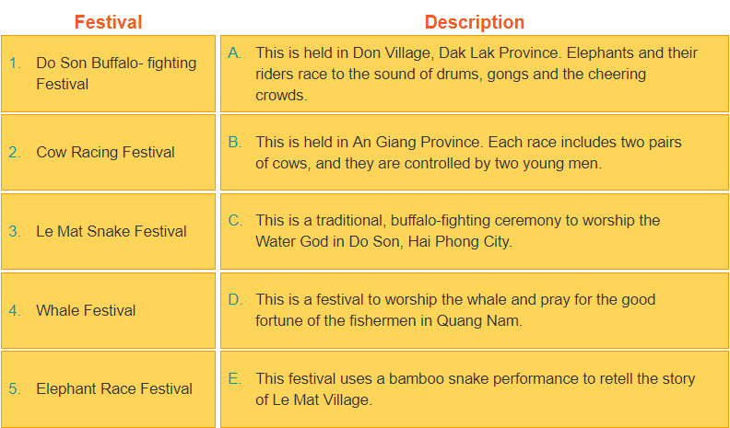
3. MATCHING:

Slide 18


III. GAME

Slide 19



4
3
5
6
7
2
1
8

Slide 20

When is Hue festival held?
in April

Slide 21
Where and when is the Lim festival held?
In Bac Ninh. On 12th of the first lunar month.

Slide 22
Where is the Elephant Race festival held?
In Don village, Dak Lak province

Slide 23
How many cows in each Cow racing festival in An Giang?
Four ( 2 pairs of cows)

Slide 24
Where is the Whale festival held?
In Quang Nam province

Slide 25
What is the aim of the Buffalo-fighting festival in Do Son?
to worship the Water God

Slide 26
What is the snake in Le Mat festival made of?
bamboo

Slide 27


Congratulation!
Lucky Number

Slide 28


