Slide 1


Slide 2
WARM-UP : Brainstorming
Write the names of clubs at school
Arts and crafts club
b. Which of your school clubs do you want to join?

Slide 3
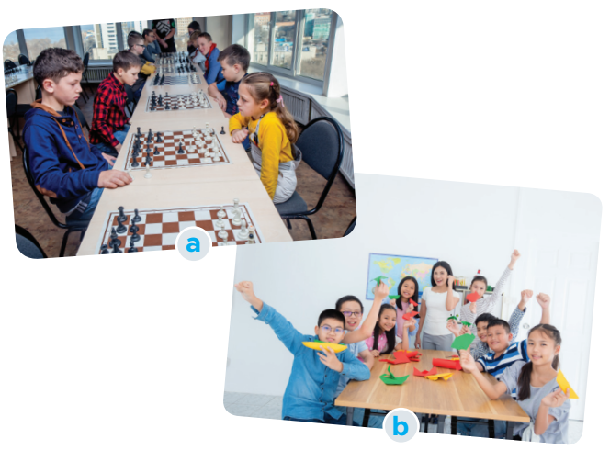
WARM-UP
*
Ask and answer questions:(EX 1 p.33 in st’s book)
a. Look at the picture and say what club it is.
Chess club
Arts and crafts club
b. Which of your school clubs do you want to join?

Slide 4


Unit
3
TEENAGERS
Tuesday, October 24th 2023
LESSON 5: SKILLS 1 p.33-34

Slide 5
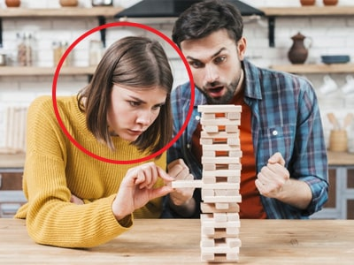

READING
concentrate (v)
/ˈkɒnsntreɪt/
tập trung

Slide 6

READING
focused (adj)
/ˈfəʊkəst/
chuyên tâm, tập trung

Slide 7

READING
craft (n)
/krɑːft/
(nghề, đồ, kỹ nghệ) thủ công

Slide 8
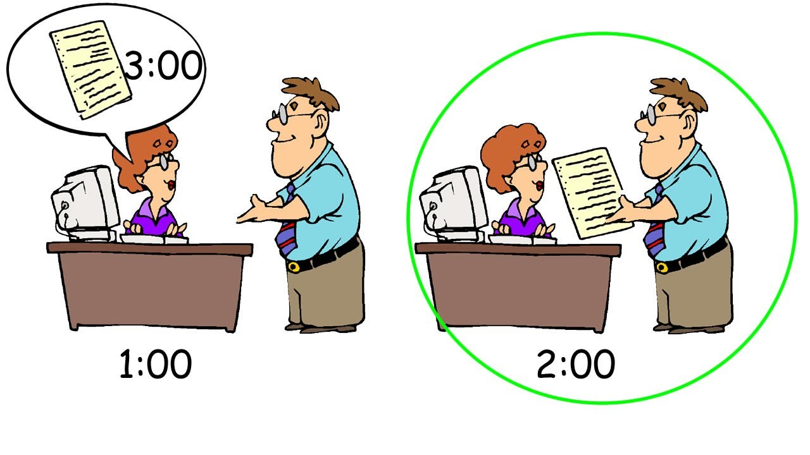
READING
beforehand (adv)
/bɪˈfɔːhænd/
trước

Slide 9
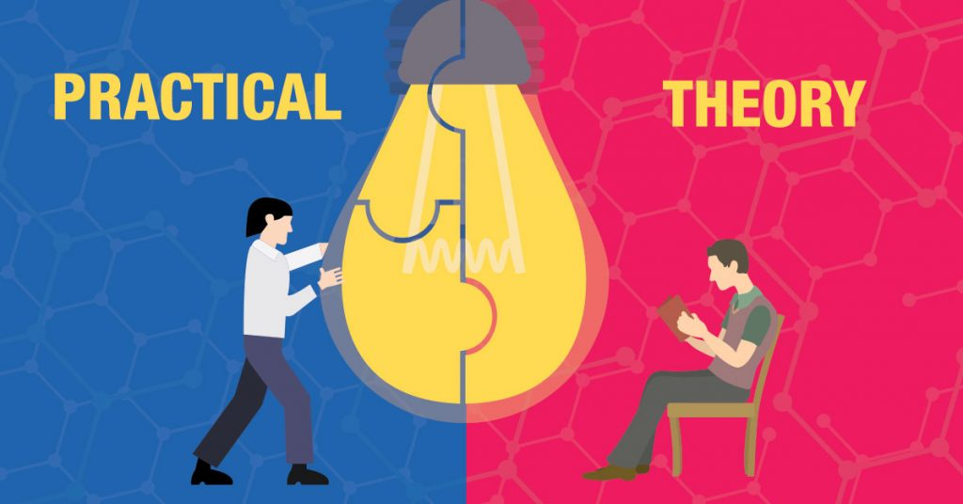
READING
practical (adj)
/ˈpræktɪkl/
thực tế, thực tiễn,thực hành

Slide 10
VOCABULARY
Vocabulary | Pronunciation | Meaning
1. concentrate (v) | /ˈkɒnsntreɪt/ | tập trung
2. focused (adj) | /ˈfəʊkəst | chuyên tâm, tập trung
3. craft (n) | /krɑːft/ | thủ công
4. beforehand (adv) | /bɪˈfɔːhænd/ | trước
5. practical (adj) | /ˈpræktɪkl/ | thực tế, thực tiễn,thực hành

Slide 12

READING
1
Read the conversation and tick T (true) or F (false) for each sentence.Correct (F) sentences
Sentences | T | F
1. The school has badminton, chess, and arts and crafts clubs.
2. The badminton club activities are after school.
3. Tom stayed playing chess when he was five.
4. Members of the arts and crafts club do community activities.
five years ago

Slide 13
READING
2
Read the conversation again and choose the correct answer A, B, or C
1. Tom and Mai are discussing _________.
A. their leisure time activities
B. their school club activities
C. their likes and dislikes
2. Tom started playing chess because ________.
A. he loved it
B. he wanted to stay focused
C. his mum wanted him to play

Slide 14
READING
3. Playing chess helps Tom________.
A. connect with other members
B. concentrate better
C. do community service
4. The word “it” refers________.
A. chess club B. arts and crafts club C. community service
5. Mai will participate in the arts and crafts club to ________.
A. help the school B. coach her friends C. do art projects

Slide 15
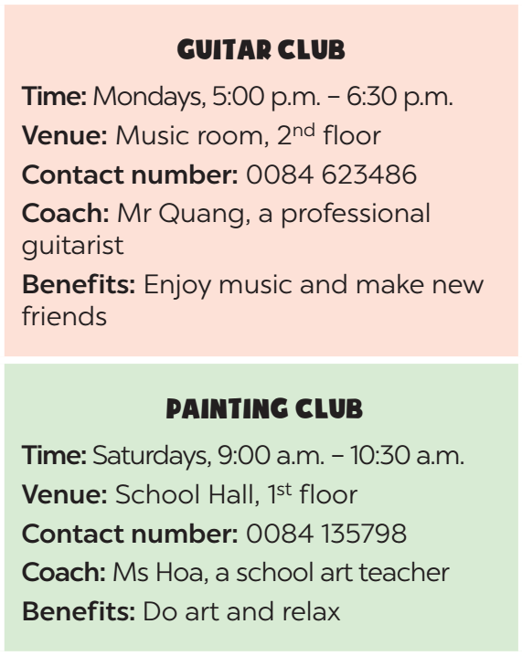
SPEAKING
3
Work in pairs. Make conversations using the given information.
Suggested questions:
- What time does the club meet?
- Where does it meet?
- How can I contact the club? / What is the contact number of the club?
- Who will coach the club?
- What are the benefits you get when you join the club? / Why do you want to join this club?
Example:
A: What time does the guitar club meet?
B: It meets on Mondays, from 5:00 p.m. to 6:30 p.m.
A: Where does it meet?
B: It meets in the music room, on the second floor.

Slide 16
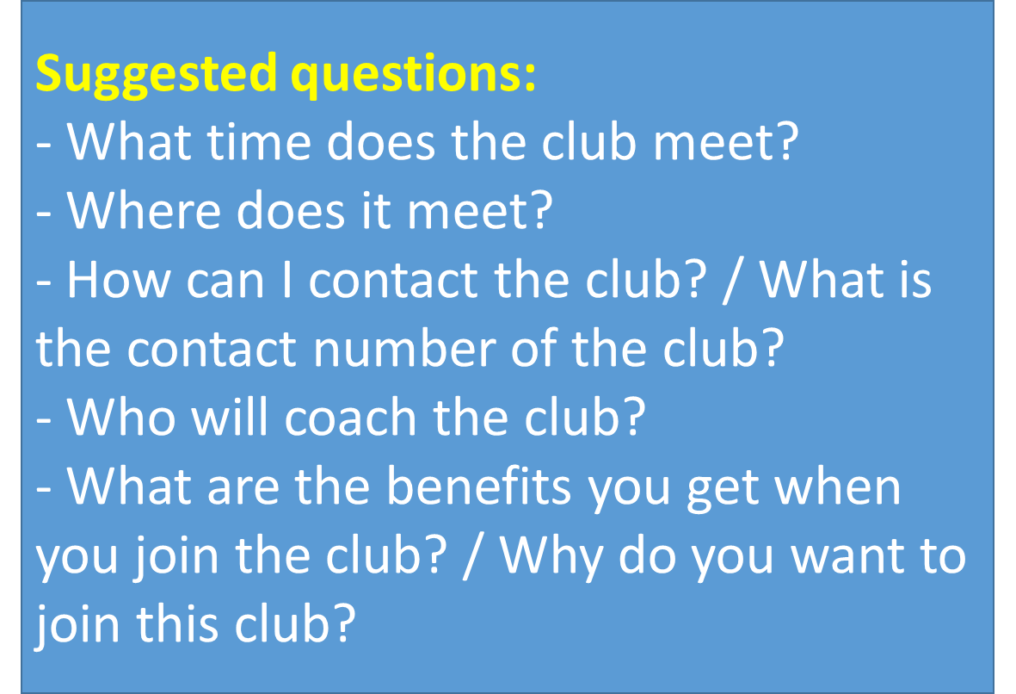
SPEAKING
4
Work in groups. Ask and answer questions about a club at your school. Report the answers to your class.
The music club at my school meets on Tuesdays, from 5:00 p.m. to 6:30p.m. It meets in the music room, on the second floor…

Slide 17

CONSOLIDATION
1
Wrap-up
What have you learned today? – SS answer
- Do an exercise

Slide 18
EX:Minh and Kate are talking about their club activities.Choose A-E to complete their conversation.
A. It meets on Thursdays, from 5:30 p.m. to 7:00 p.m.
B. I'm a member of the chess club.
C. Yes, that's one reason. Playing chess also teaches me to stay calm and solve problems.
D. It meets in the school hall, on the second floor.
E. Mr Tan. He was a chess champion at the national chess competition last year.
Minh: Kate, so what club are you a member of?
Kate: (1)
Minh: Great! I'd love to join it too. So, what time does it meet?
Kate: (2)
Minh: Where does it meet?
Kate: (3)
Minh: Who is the coach?
Kate: (4)
Minh: Is that the reason why you like to join this club?
Kate: (5)

Slide 19
EX:Minh and Kate are talking about their club activities. Choose A-E to complete their conversation.
A. It meets on Thursdays, from 5:30 p.m. to 7:00 p.m.
B. I'm a member of the chess club.
C. Yes, that's one reason. Playing chess also teaches me to stay calm and solve problems.
D. It meets in the school hall, on the second floor.
E. Mr Tan. He was a chess champion at the national chess competition last year.
Minh: Kate, so what club are you a member of?
Kate: (1)
Minh: Great! I'd love to join it too. So, what time does it meet?
Kate: (2)
Minh: Where does it meet?
Kate: (3)
Minh: Who is the coach?
Kate: (4)
Minh: Is that the reason why you like to join this club?
Kate: (5)
B
A
D
E
C

Slide 20


CONSOLIDATION
2
Home Assignments
- Making the sentences using the vocabulary.
- Do exercises in part C,D on p.20-24 in the workbook.

Slide 21

Website: hoclieu.vn
Fanpage: facebook.com/www.tienganhglobalsuccess.vn/

