Slide 1


Slide 2


Unit
2
LIFE IN THE COUNTRYSIDE
LESSON 6: SKILLS 2

Slide 3
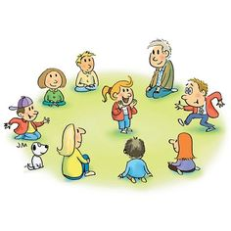
WARM-UP
MIMING GAME

Slide 4

LISTENING
1
1
Work in pairs. Discuss the following question.
What do you like or dislike about life
in the countryside?

Slide 5

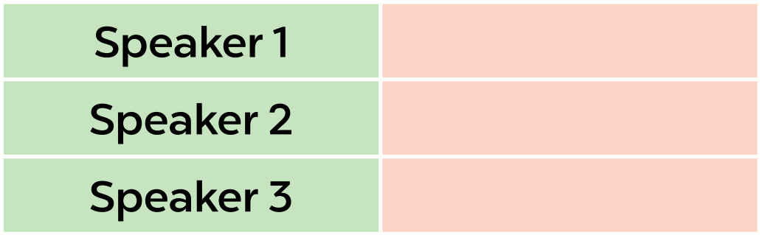
LISTENING
2
Listen to three people talking about life in the countryside. Choose the opinion (A - C) that each speaker (1 - 3) expresses.
B
A
C

Slide 6
LISTENING
3
Listen again and choose the correct answer A, B, or C.
1. According to speaker 1, there is a great sense of ______ in his village. A. security B. duty C. community 2. Speaker 1 says that people in his village are very ______. A. supportive B. unsociable C. well-trained 3. In speaker 2’s opinion, ______ is a big problem in the countryside. A. the cost of living B. safety C. transportation 4. Speaker 2 says that they should ______ in the countryside. A. improve the lives of people B. prevent crime C. protect nature 5. According to speaker 3, life in the countryside is peaceful and ______. A. slow B. simple C. safe

Slide 7

WRITING
4
Work in groups. Discuss and write what you like or dislike about life in the countryside.
LIKE | DISLIKE
– low cost of living – many cheap things | – not many entertainment places, such as theatres, cinemas, etc. – poor means of transport ...

Slide 8
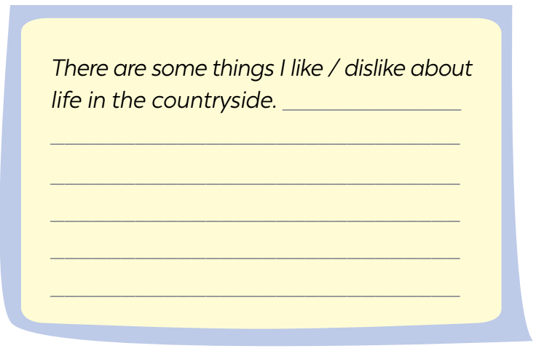
WRITING
5
Write a paragraph (80 - 100 words) about what you like or dislike about life in the countryside.
I live in Duong Lam. It’s an old village outside Ha Noi. It has ……...
…………………………………………………………………………………………………………………………………………………………………………………………………………………………….............................................

Slide 9
I like living in the countryside because of some reasons. Environmentally speaking, it is a peaceful place. The air is fresh. The space is quiet. We can enjoy healthy natural conditions without worrying much about environmental pollution. Moreover, rural life is also easier that in cities. People in cities are easy to get stressed because of pollution, job pressures, competitions, etc ... On the contrary, those bad things are very rare in the countryside. To sum up, except income matters, the countryside is a better residence than cities. To sum up, except income matters, the countryside is a better residence than cities.

Slide 10

CONSOLIDATION
1
Wrap-up
What have we learnt in this lesson?
Listen to someone’s opinion about life in the countryside
Write a paragraph about what someone likes or dislikes about life in the countryside

Slide 11

CONSOLIDATION
2
Home Assignments
Do exercises in the workbook.

Slide 12

Website: hoclieu.vn
Fanpage: facebook.com/www.tienganhglobalsuccess.vn/

