Slide 1
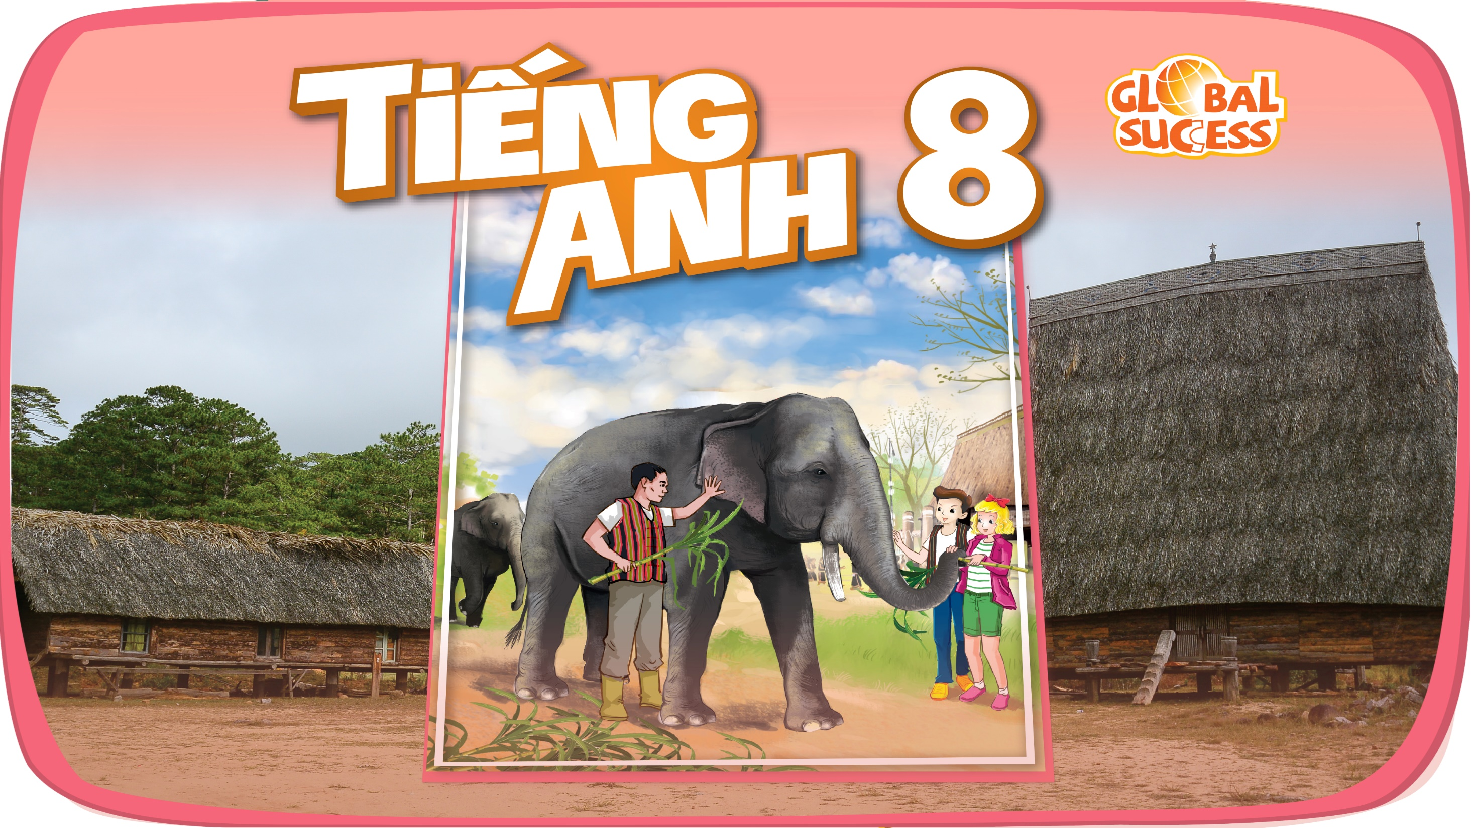

Slide 2


Unit
4
ETHNIC GROUPS OF VIET NAM
Unit
ETHNIC GROUPS OF VIET NAM
LESSON 3: A CLOSER LOOK 2
LESSON 3: A CLOSER LOOK 2
Unit
HOBBIES

Slide 3
LESSON 3: A CLOSER LOOK 2
WARM-UP
Game: Who’s faster?
Vocabulary
Task 1: Change the sentences into Yes / No questions.
Task 2: Choose the correct question word for each question below.
YES / NO AND WH-QUESTION
Task 3: Write C or U for the underlined words.
Task 4: Fill in each blank with a, much, many, a little or a few.
Task 5: Work in groups. Think of six nouns related to each of the topics below, in which three nouns are countable and three nouns are uncountable.
COUNTABLE AND UNCOUNTABLE NOUNS
CONSOLIDATION
Wrap-up
Homework

Slide 4
Who’s faster?
Gong
Communal house
Topic:
Ethnic groups of Viet Nam
Wooden statue
Terraced field
Folk dance
Musical instrument
Bamboo house
Costume
Five-color sticky rice
Stilt house

Slide 5
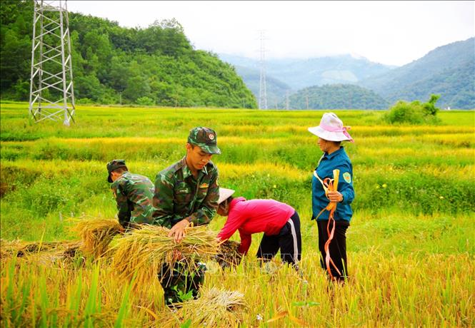
YES / NO AND WH-QUESTION
harvest (v)
/ˈhɑːvɪst/
gặt hái,
thu hoạch

Slide 6
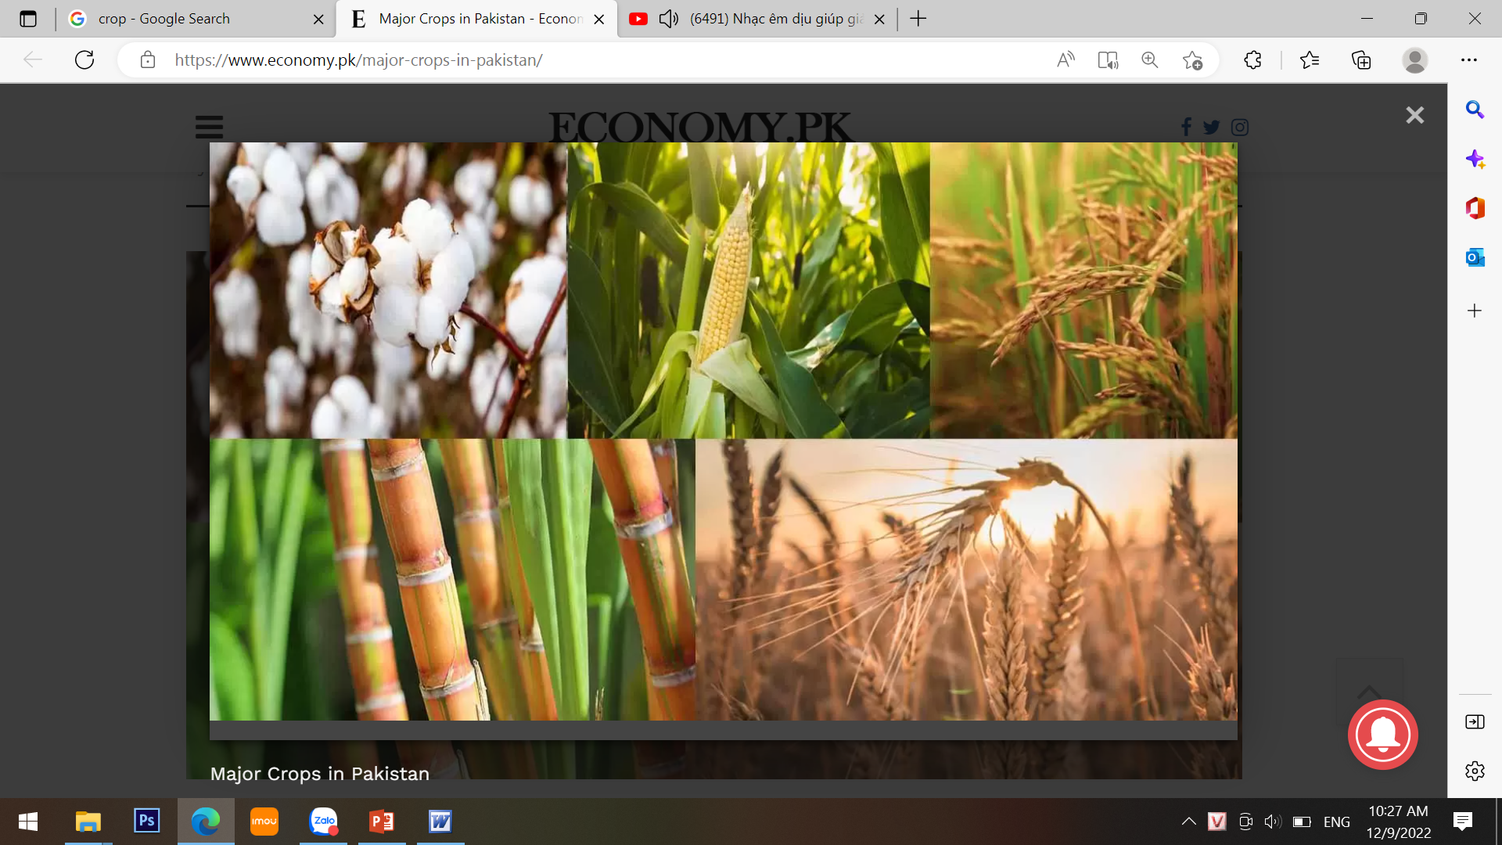
YES / NO AND WH-QUESTION
crop (n)
/krɒp/
vụ mùa,
vụ trồng trọt

Slide 7
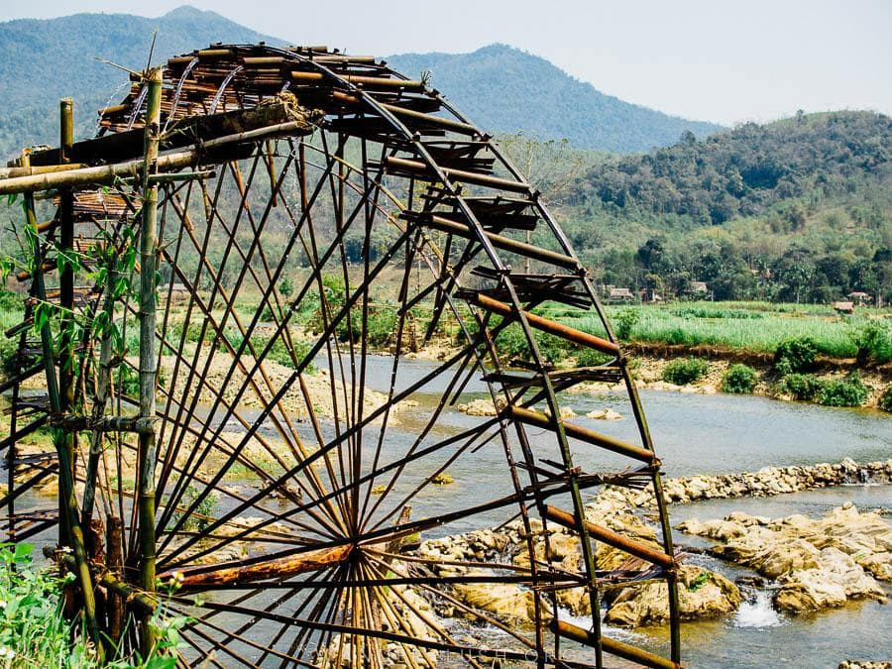
YES / NO AND WH-QUESTION
waterwheel (n)
/ˈwɔːtəwiːl/
bánh xe nước

Slide 8
YES / NO AND WH-QUESTION
1
Change the sentences into Yes / No questions.
1. Women play an important role in a Jrai family.
→ Do women play an important role in a Jrai family?
2. Mua sap is a popular folk dance of the Thai people.
→ Is mua sap a popular folk dance of the Thai people?

Slide 9
YES / NO AND WH-QUESTION
1
Change the sentences into Yes / No questions.
3. We didn’t have boarding schools for minority students in 1950.
→ Did you have boarding schools for minority students in 1960?
4. I attended the Ban Flower Festival in Dien Bien last year.
→ Did you attend the Ban Flower Festival in Dien Bien last year?
5. We will watch a documentary about the Khmer.
→ Will you wach a documentary about the Khmer?

Slide 10
YES / NO AND WH-QUESTION
2
Choose the correct question word for each question below.
1. A: ______ do you like best about Sa Pa?
B: I like its local markets best.
A. Why B. What
2. A: ______ can we find the most beautiful terraced fields?
B: In Mu Cang Chai.
A. When B. Where
3. A: ______ is the Ban Flower Festival?
B: It’s in spring.
A. When B. Why

Slide 11
YES / NO AND WH-QUESTION
2
Choose the correct question word for each question below.
4. A: ______ tall is an average stilt house?
B: About 5 - 6 metres tall.
A. How B. What
5. A: ______ festival is more important for the Kinh: the Mid-Autumn
or the Lunar New Year?
B: The Lunar New Year.
A. What B. Which

Slide 12
COUNTABLE AND UNCOUNTABLE NOUNS
3
Write C (countable) or U (uncountable) for the underlined words.
Some minority (1) groups are farmers. They do not have much (2) land and they use simple farming techniques. After finding an (3) area for a garden, the men cut the (4) trees down and burn them. The (5) ash they collect helps enrich the soil. They then grow a few (6) crops like rice and corn.
____
2. ____
3. ____
4. ____
5. ____
6. ____
C
U
C
C
U
C

Slide 13
COUNTABLE AND UNCOUNTABLE NOUNS
4
Fill in the blank with a, much, many, a little, or a few.
1. My uncle has _____coffee plantation in Kon Tum.
2. How _______ ethnic groups live on the Hoang Lien Son mountain range?
3. There are only _______ waterwheels left in my village.
4. You should add ________ more water to your noodles. It’s a bit dry.
5. How ______ information about the Van Kieu have you collected?
a
many
a few
a little
much

Slide 14
COUNTABLE AND UNCOUNTABLE NOUNS
5
GAME: WORD GAMES
Work in groups. Think of six nouns related to each of the topics below, in which 3 nouns are countable and 3 nouns are uncountable.
Stilt house
Film
Leisure time
Living in the mountain

Slide 15
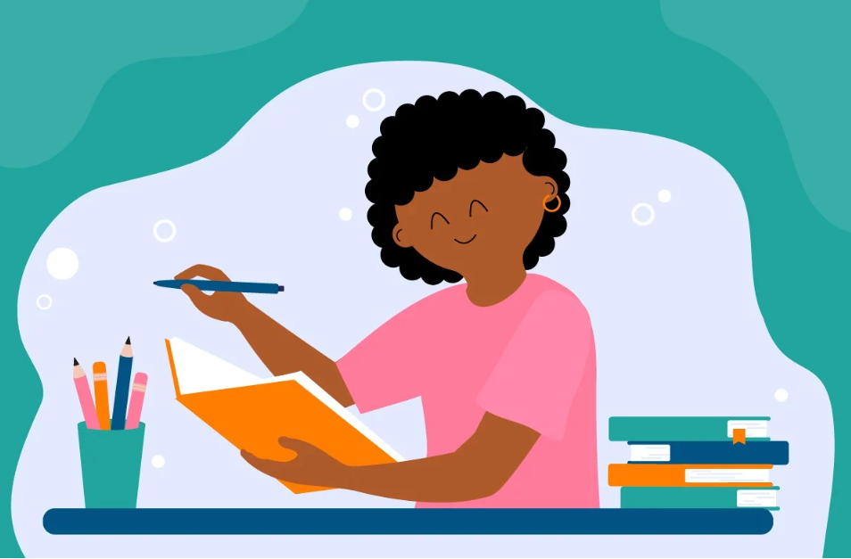
CONSOLIDATION
1
Wrap-up
Grammar: - Yes / No and Wh-questions
- Countable and uncountable nouns

Slide 16

CONSOLIDATION
2
Homework
- Learn by heart all the words.
- Do exercises in the workbook.
- Prepare for Lesson 4 – Communication.

Slide 17

Website: hoclieu.vn
Fanpage: facebook.com/www.tienganhglobalsuccess.vn/

