Slide 1


Slide 2

UNIT 4: LIFE IN THE PAST
Lesson 2: A Closer look 1 p.42-43

Slide 3
1. Vocabulary
- illiterate (adj) mù chữ, không biết đọc /i'litərit/
- street vendor (n) người bán hang rong /'vendɔ:/
- seniority (n) tiền bối, người trên /,si:ni'ɔriti/
- behavior (n) thái độ, hành vi /biˈheiviə/
- bare-footed (n) chân trần
- tug of war (n) trò kéo co
- take a nap (exp) ngủ 1 giấc
- bold (n) sự liều lĩnh, can đảm, dũng cảm /bould/
- hand in (v) nộp, giao nộp
- spear (n) cái mác, cái giáo/ cái xiên /spiə/

Slide 4

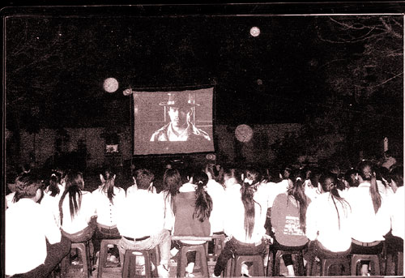
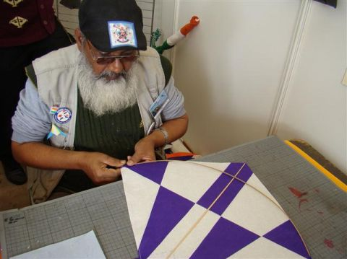
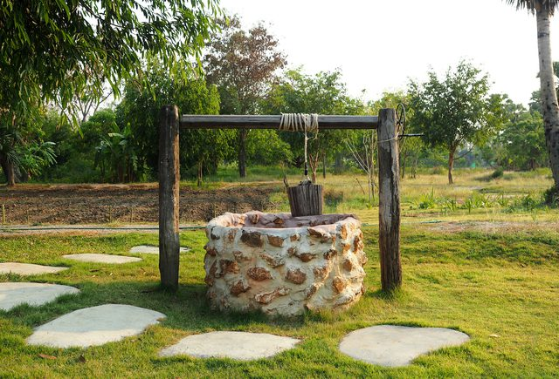
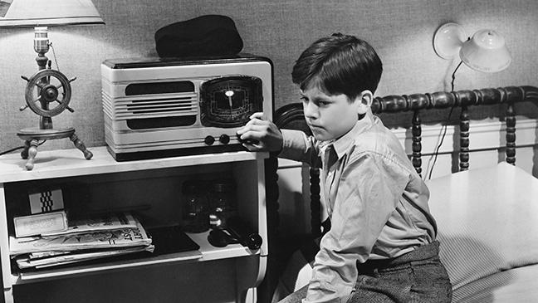
Watch movie
Make a kite
Life in the past
use water from the well
Listen to radio

Slide 5
1. Match a verb in A with a word /phrase in B.
A
B
1. go
2. collect
3. entertain
4. dance
5. act out
6. use
7. preserve
8. keep
a. to drum music
b. themselves
c. stories
d. a diary
e. your imagination
f. bare-footed
g. the post
h. our traditions

Slide 6
2. Use the newly-formed phrases in 1with the verbs in their correct forms to complete the sentences.
1. In my time, most girls ______________ where they could write down their daily thoughts and feelings.
2. ‘Grandpa, how did the children in your village use to ___________________ ?’ – ‘They played games like tug of war, hide and seek, or fl ew their kites.’
3. We should work together to ____________________.. They are of great value to us.
4. _____________________and draw a picture of your dream house.
5. Children are very creative. They are good at ______________.
6. A postman comes once a day to ______________ from the post box.
7. I love ________________ on the beach and feeling the sand under my feet.
8. The Lion Dance is usually performed at Mid-Autumn Festival, where the dancers skilfully ______________________.
kept a diary
entertain themselves
preserve our traditions
Use your imagination
acting out stories.
collect the post
going bare-footed
dance to drum music

Slide 7
3. Choose a word/phrase from the box to complete the sentences.
illiterate, face to face, physical, strict rules, street vendors, seniority
1. Paying respect to people of _________ is a tradition in
Viet Nam.
2. Quite a large number of ethnic people in the
mountains are still _________.They can’t read or write.
3. Eating from ______________ is a popular habit of people in
big cities in Viet Nam.
4. There should be ____________ on the roads to reduce
the number of accidents.
5. _________punishment was common at schools in the past.
6. I prefer talking ___________ to talking on the phone.
seniority
illiterate
street vendors
strict rules
physical
face to face

Slide 8
REMEMBER!
tradition:
habit:
behaviour:
practice:
an inherited way of thinking or acting
(một cách suy nghĩ hoặc hành động kế thừa
what you frequently do
the way in which one acts, especially towards others (cách mà một người hành động, đặc biệt là đối với những người khác)
the actual application or use of an idea, belief, or method (ứng dụng thực tế hoặc sử dụng một ý tưởng, niềm tin hoặc phương pháp)

Slide 9
4. Complete the sentences with the right form of the words below.
tradition
habit
behaviour
practice
1.It’s never easy to break a _________.
2. His bold ____________shocked everybody present.
3. It runs as a _________ in Viet Nam that elderly
grandparents and parents are taken care of by their children until they die.
4. It was his ________ to take a nap after lunch.
5. Using blackboards and chalk as the only teaching aid is still a common __________ in most developing countries.
6. He could be fi red for his rude ____________ towards the VIP guest.
habit
behaviour
tradition
habit
practice
behaviour

Slide 10
Pronunciation Stress on auxiliary verbs in sentences
REMEMBER!
An auxiliary verb combines with another verb
to help form the tense, mood, voice, of the main verb.
They are:
be,
have,
can,
do,
shall
Will,
may,
must,
need,
used (to)..

Slide 11

5. Listen and underline the auxiliary verbs which are stressed. Then practise saying the sentences.
1. Life will be improved in those remote areas.
2. They can see the rain coming in from the west.
3. You did make me laugh!
4. He hasn’t handed in his assignment.
5. I don’t like the idea of going there at night.
6. Sam doesn’t like fast food but I do.

Slide 12
REMEMBER!
An auxiliary is not usually stressed.
Example: We’ll start from here.
Does he like it?
However, an auxiliary will often be stressed when:
* it is emphasised.
Example: I have done my homework.
* we add it to emphasise the main verb.
Example: I did see him at the party.
* it comes at the end of the sentence.
Example: I can’t attend the meeting, but John can.
* it is negative.
Example: He isn’t coming.

Slide 13
6. Underline an auxiliary if it is stressed. Then listen, check, and repeat the sentences.
1. - The men in my village used to catch fish with a spear.
- Could you do that?
- No, I couldn’t.
2. I have told you many times not to leave the door open.
3. We’ re going to visit Howick, a historical village.
4. - You aren’t going to the party? Is it because you can’t dance?
- I can dance. Look!
5. - I hope she doesn’t do any damage to the car.
- Don’t worry. She does know how to drive.

Slide 14
Home Assignments
Make sentences using the vocabulary which appear in the lesson.
Learn the remember box about “stress on auxiliary verbs in sentences” by heart. Practice more at home.

Slide 15



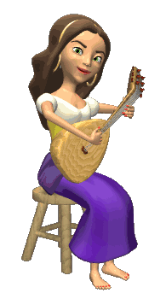

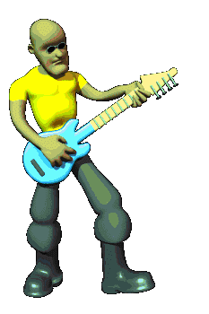
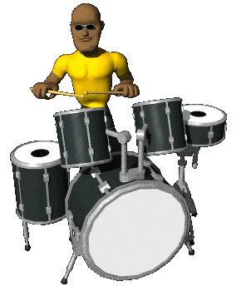



THANK YOU
FOR YOUR ATTENTION
Goodbye !

