Slide 1


Slide 2




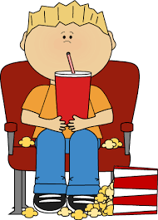

Unit
8
FILMS
LESSON 6: SKILLS 2

Slide 3

OBJECTIVES
By the end of the lesson, students will be able to:
listen for special information about a comedy;
write a short paragraph about your favorite film.

Slide 4
LESSON 6: SKILLS 2
WARM-UP
Game: Name the types of films
Listening
Task 1: Work in pairs and discuss.
Task 2: Listen and check.
Task 3: Listen again and choose the correct answer.
LISTENING
Writing
Task 4: Work in groups. Make notes about your favourite film.
Task 5: Work in groups. Make a film review.
WRITING
POST-LISTEN AND WRITE
Task 6: Class gallery.
CONSOLIDATION
Wrap-up
Homework

Slide 5

LESSON 6: SKILLS 2
WARM-UP
Game: Name the types of films
Aims of the stage:
To waken up students’ interest.

Slide 6

WARM-UP
Watch the video and write down the types of the films.
WHICH TYPES OF FILMS CAN YOU SEE THE MOST IN THE VIDEO?
COMEDY

Slide 7

LESSON 6: SKILLS 2
WARM-UP
Game: Name the types of films
Listening
Task 1: Work in pairs and discuss.
Task 2: Listen and check.
Task 3: Listen again and choose the correct answer.
LISTENING
Aims of the stage:
To help students develop
listening skills for specific information.

Slide 8



PRE-LISTENING
1
Work in pairs. Discuss the following question.
What do you like / dislike about a comedy?
MAKES PEOPLE LAUGH
MOSTLY NOT EDUCATIONAL
HELPS PEOPLE RELAX
SOME ARE NOT SUITABLE FOR CHILDREN
REDUCES STRESS

Slide 9

WHILE-LISTENING
WHILE-LISTENING
2
Mark and Hoa are talking about the film Naughty Twins.
Listen to their conversation. Who stars in the film?
Linda Brown and Susan Smith
Linda Smith and Susan Brown
Linda Brown and Susan Smith
Susan Linda and Brown Smith

Slide 10
WHILE-LISTENING
3
Listen to the conversation again. Choose the best answer to each question below.
1. Naughty Twins is a ______. A. comedy
B. science fiction film
C. horror film
2. The main characters are ______. A. old classmates
B. twin brothers
C. twin sisters

Slide 11
WHILE-LISTENING
3
Listen to the conversation again. Choose the best answer to each question below.
3. Where do the twins meet each other for the first time? A. At a summer camp.
B. At a summer school.
C. At a hospital.
4. People say Naughty Twins is a film that ______. A. young people should see B. young people shouldn’t see C. is shocking

Slide 12

LESSON 6: SKILLS 2
WARM-UP
Game: Name the types of films
Listening
Task 1: Work in pairs and discuss.
Task 2: Listen and check.
Task 3: Listen again and choose the correct answer.
LISTENING
Writing
Task 4: Work in groups. Make notes about your favourite film.
Task 5: Work in groups. Make a film review.
WRITING
Aims of the stage:
To teach students how to write a film review.

Slide 13
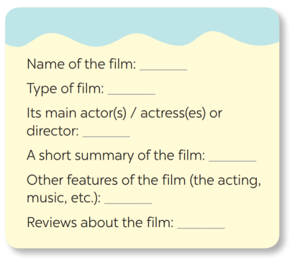
PRE-WRITING
4
Make notes about one of your favourite films.
Harry Potter
Fantasy / Fiction
Daniel Radcliffe, Emma Watson,
Rupert Grint
A group of teenage wizards and witches in Hogwarts fight against the Dark Lord.
Great acting, beautiful scences
Gripping, moving, funny

Slide 14
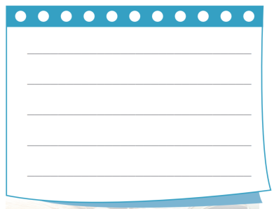

WHILE-WRITING
5
Write a paragraph of about 70 words about your favourite film, using the information in .
4
My favourite film is the Harry Potter series. It is based on one of the best selling novels. They are fantasy and fiction films about the wizard named Harry Potter and his friends starred in this film. I like this film and I find it moving and funny. The scenes were set in the beautiful spots in the UK and the acting was really great.

Slide 15
LESSON 6: SKILLS 2
WARM-UP
Game: Name the types of films
Listening
Task 1: Work in pairs and discuss.
Task 2: Listen and check.
Task 3: Listen again and choose the correct answer.
LISTENING
Writing
Task 4: Work in groups. Make notes about your favourite film.
Task 5: Work in groups. Make a film review.
WRITING
POST-LISTEN AND WRITE
Task 6: Class gallery.

Slide 16

PRODUCTION
Class gallery
Students can:
go and see other’s work
give comments to each other

Slide 17

CONSOLIDATION
1
Wrap-up
In this lesson, we have learnt to:
listen for special information about a comedy;
write a short paragraph about your favorite film.

Slide 18

CONSOLIDATION
2
Homework
Prepare for the next lesson: Looking back & Project

Slide 19


