Slide 1


Unit 9. Cities of the world
LESSON 1
Vocabulary
Pronunciation
/əʊ/ and /aʊ/

Slide 2
* Vocabulary:
landmark /ˈlændmɑːk/
rainy /ˈreɪni/
crowded /ˈkraʊdɪd/
exciting = interesting
delicious /dɪˈlɪʃəs/
(n): địa danh
(adj): có mưa
(adj): đông đúc
(adj): thú vị, hào hứng
(adj): ngon (thức ăn)

Slide 3


1. Listen and read.
What nice photos!
Mai: Tom, are these photos from your vacations?
Tom: Yes, they are. This is Sydney, a city in Australia.
Mai: What’s it like?
Tom: It’s exciting with a lot of beaches.
Mai: What a beautiful place!
Tom: Yes, its beaches are very clean.
Mai: Wonderful. Oh, this is London. Isn’t it raining?
What bad weather!
Tom: Yes, it rains all the time. Can you see Big Ben?
Mai: Yeah ... on the River Thames. It’s a landmark of London.
Tom: It is. And this is Times Square in New York, crowded but interesting.
Mai: You’re lucky to visit many places.
Tom: I am. What about your vacations?
Mai: Here are some photos of mine. This is ...

Slide 4


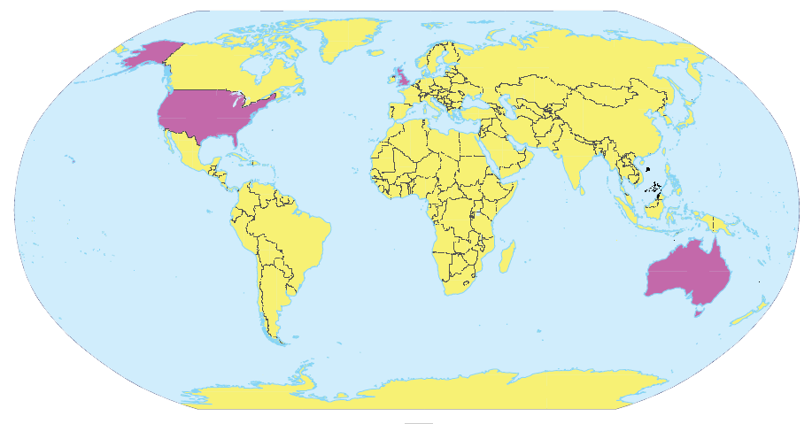
Write the names of the cities in the correct place.
1.
New York
2.
London
Sydney
London
New York
3.
Sydney

Slide 5
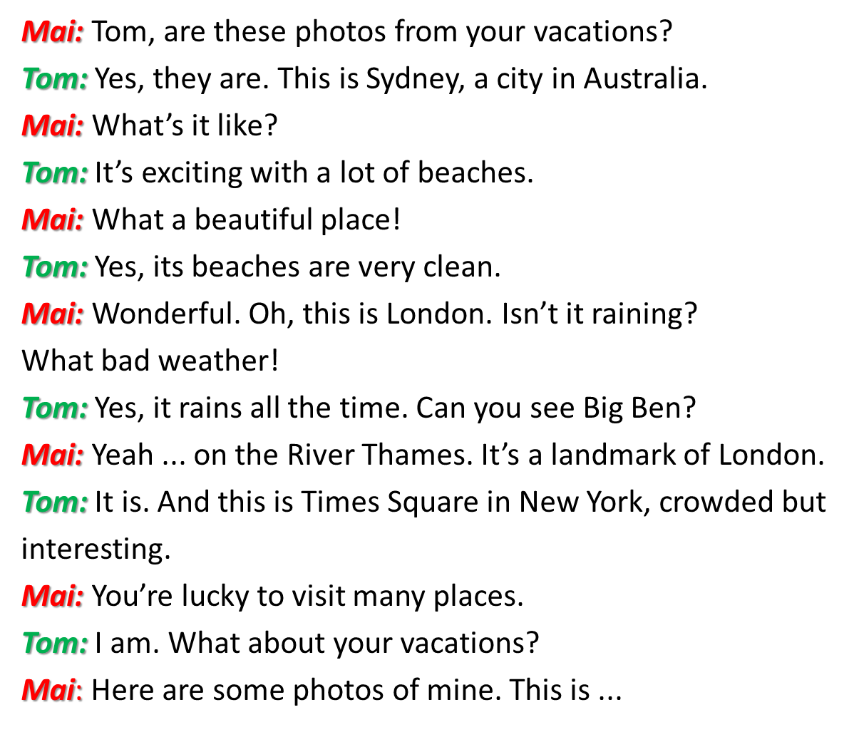
3. Read the conversation again and match the cities with the adjectives describing them.
a. rainy
1. Sydney
?
b. crowded
2. London
c. exciting
?
d. beautiful
3. New York
?
e. interesting

Slide 6

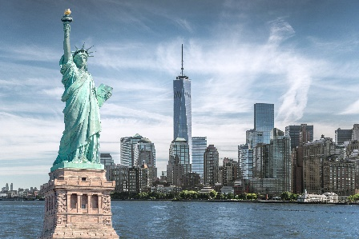
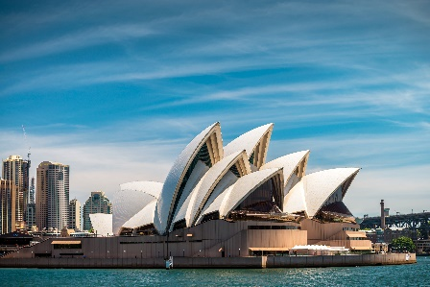
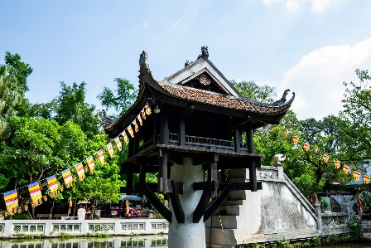
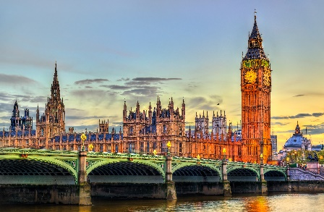
Match the cities with their landmarks.
a
1. Ha Noi
b
2. London
c
3. New York
d
4. Sydney

Slide 7


What city is it?
Example:
A: What’s it like?
B: It has beautiful beaches.
C: Is it in Australia?
B: Yes, it is.
A: It’s Sydney.
B: Right.

