Slide 1
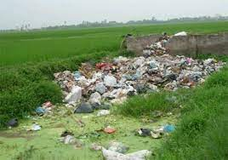
English 8
UNIT 7 . POLLUTION
PERIOD 54: GETTING STARTED
A PROJECT ON POLLUTION
Welcome to our class

Slide 2

* WARM UP: BRAINSTORMING
Air pollution
Water pollution
POLLUTION
Soil pollution
Light pollution
Noise pollution

Slide 3
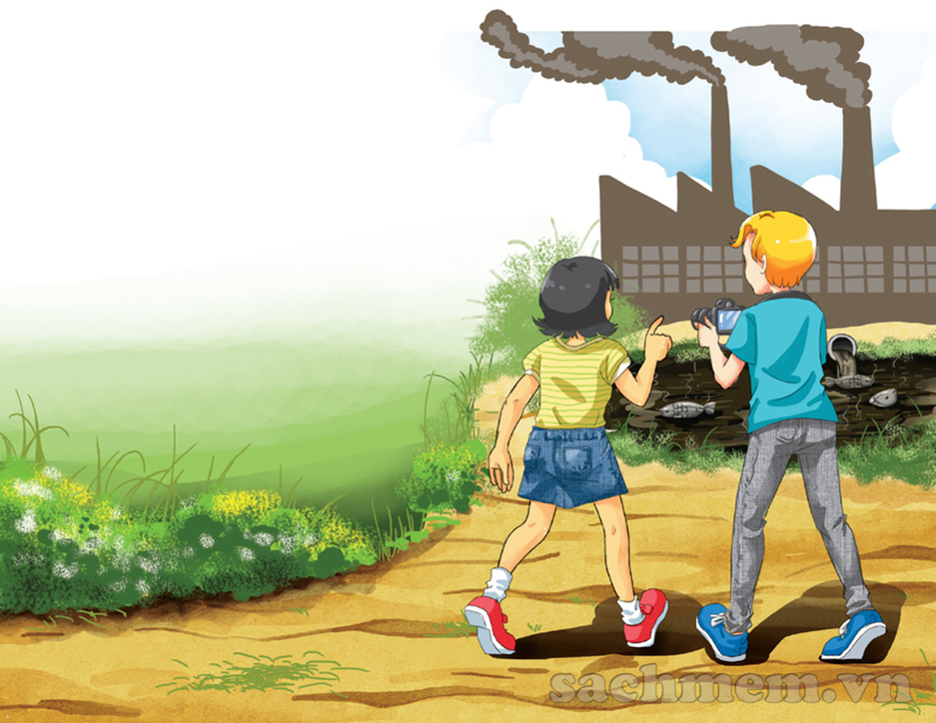
1.Who can you see in the picture?
→ Mi and Nick
2. Where do you think they are?
→ They are in Mi’ s home village.
3. What can you see in the picture ?
smoke from the factory, waste,
poison from the factory, water is
black, the fish are dead.
4. What do you think the people in the picture are talking about?
→ They are talking about their environmental project.

Slide 4


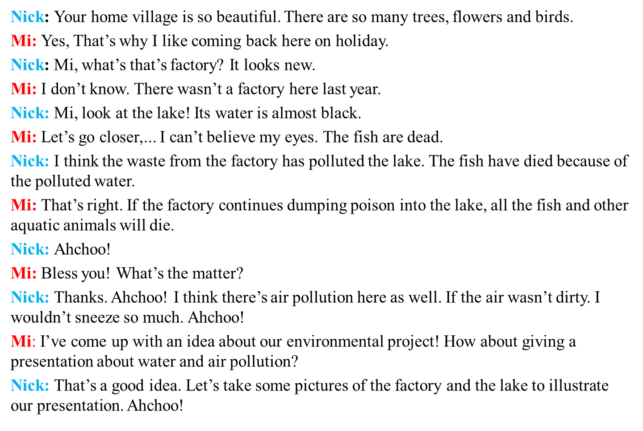

Slide 5
I. NEW WORDS
1. Pollution (n)
: sự ô nhiễm
2. poison (n)
: chất độc
3. Die (v)
: chết
→ Die – dead - death
4. Aquatic (adj)
: dưới nước
5. Dump (v)
: thải
6. to come up with
: nghĩ ra
7. illustrate (v)
: minh họa
8. radioactive (a)
: thuộc về phóng xạ
9. thermal (a)
: thuộc về nhiệt
10. visual (a)
: thuộc về thị giác

Slide 6
1a. Find a word / phrase that means :
dead
1. no longer alive
L10
2. growing or living in, on, or near water
aquatic
L16
3. throwing away something you do not want, especially in a place with is not allowed
dump
L10
4. A substance that can make people or animals ill or kill them if they eat or drink it
poison
L15
5. Made unclear or unsafe to use
L13
polluted
6. To think of an idea, or a plan
to come up with
L22

Slide 7
1b. Answer the questions.
1. Where are Nick and Mi ?
→ They are in Mi’s home village.
2. What does the water in the lake look like ?
→ Almost black
3. Why is Mi surprised when they get closer to the lake?
→ Because she sees the fish dead.
4. What is the factory dumping into the lake?
→ poison.
5. Why is Nick sneezing so much ?
→ Because the air is not clean.

Slide 8
1c. Tick ()true (T) , false (F), or no information (NI)
T | F | NI
1. The water in the lake has been polluted by a ship.
2. Water pollution in the lake has made the fish die.
3. Aquatic plants may also die because of the polluted water.
4. Nick wouldn’t sneeze so much if the air was clean.
5.Nick and Mi will give a talk about water and air pollution.






Slide 9
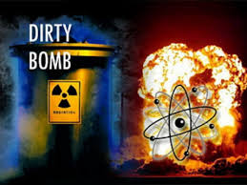

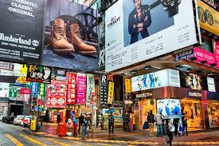
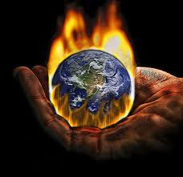
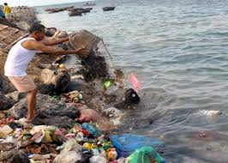
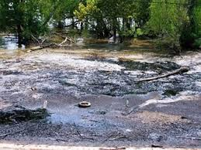
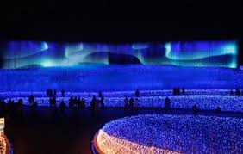
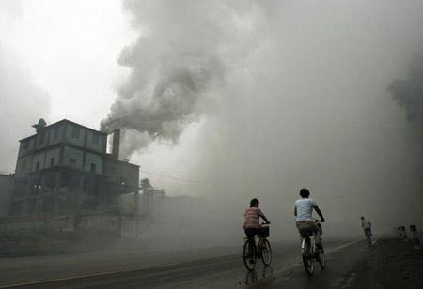
2. There are different types of pollution. Write each type under
a picture:
Water pollution land/ soil pollution air pollution noise pollution Thermal pollution light pollution radioactive pollution visual pollution
b. noise
pollution
c. visual
pollution
d. thermal
pollution
a. radioactive
pollution
e. water
pollution
f. land/ soil
pollution
g. light
pollution
h. air
pollution

Slide 10
3. Complete the sentences with the types of pollution.
thermal pollution
1. When ……………............. happens, the water temperature in streams, rivers, lakes, or oceans changes.
2. ……………………. occurs when the atmosphere contains gases, dust, or fumes in harmful amounts.
3. When radiation goes into the land, air or water, it is called ………………………
4. Too much use of electric lights in cities may cause …………..
5. ………………….. is the contamination of lakes, rivers, oceans, or groundwater, usually by human activities.
6. ………………………… happens when human activities destroy the Earth’s surface.
7. …………..…… occurs because there are too many loud sounds in the environment.
8. The sight of too many telephone poles, advertising billboards, overhead power lines, or shop signs may case ……………………
Air pollution
radioactive pollution
light pollution
Water pollution
Land/ Soil pollution
Noise pollution
visual pollution

Slide 11
4. Work in groups. Which types of pollution in 3 does your neighbourhood face? Rank them in order of seriousness. Give reasons for your group’s order.
→ It’s air pollution, noise pollution and visual pollution.
→ Air pollution does harm to your health. Noise pollution can make you stressed. Visual pollution is nit good for sight around.

Slide 12


- Practice the dialogue again.​
- Do exercises B1,2,3 in workbook (page 4).​

