Slide 2
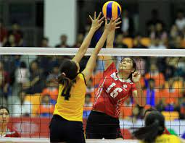
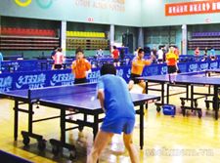
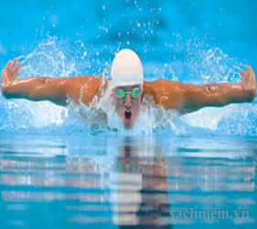
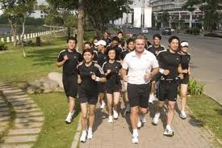
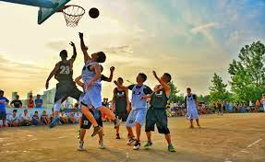
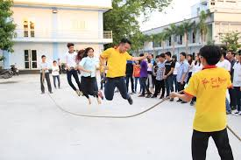
WARM UP
volleyball
table tennis
swimming
running
basketball
skipping
NVL

Slide 3

Wednesday, March 2nd, 2022
Period: 62
Unit 8: SPORTS AND GAMES
LESSON 1: GETTING STARTED
At the gym (P16-17)
NVL

Slide 4







At the gym
Listen and read.
Name these sports and games, using the words from the box.
Put a word from the conversation in each gap.
Work in pairs. Ask your partner these questions to find out how sporty they are.

Slide 5
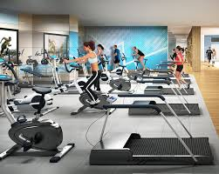

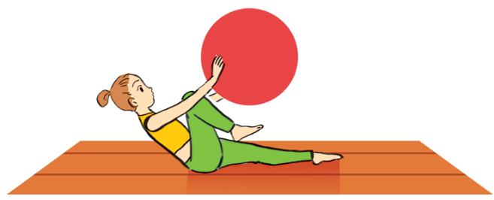
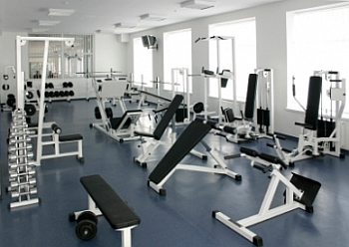

❖ Vocabulary:
1. gym (n):
phòng tập thể dục
2. (to) win – won
: chiến thắng
3. equipment (n):
thiết bị, dụng cụ
4. fit (a):
mạnh khỏe, cân đối
5. do aerobics:
tập thể dục nhịp điệu
6. Congratulations:
lời chúc mừng

Slide 6
* Checking vocabulary:
What and Where
win
gym
equipment
congratulations
fit
do aerobics

Slide 7
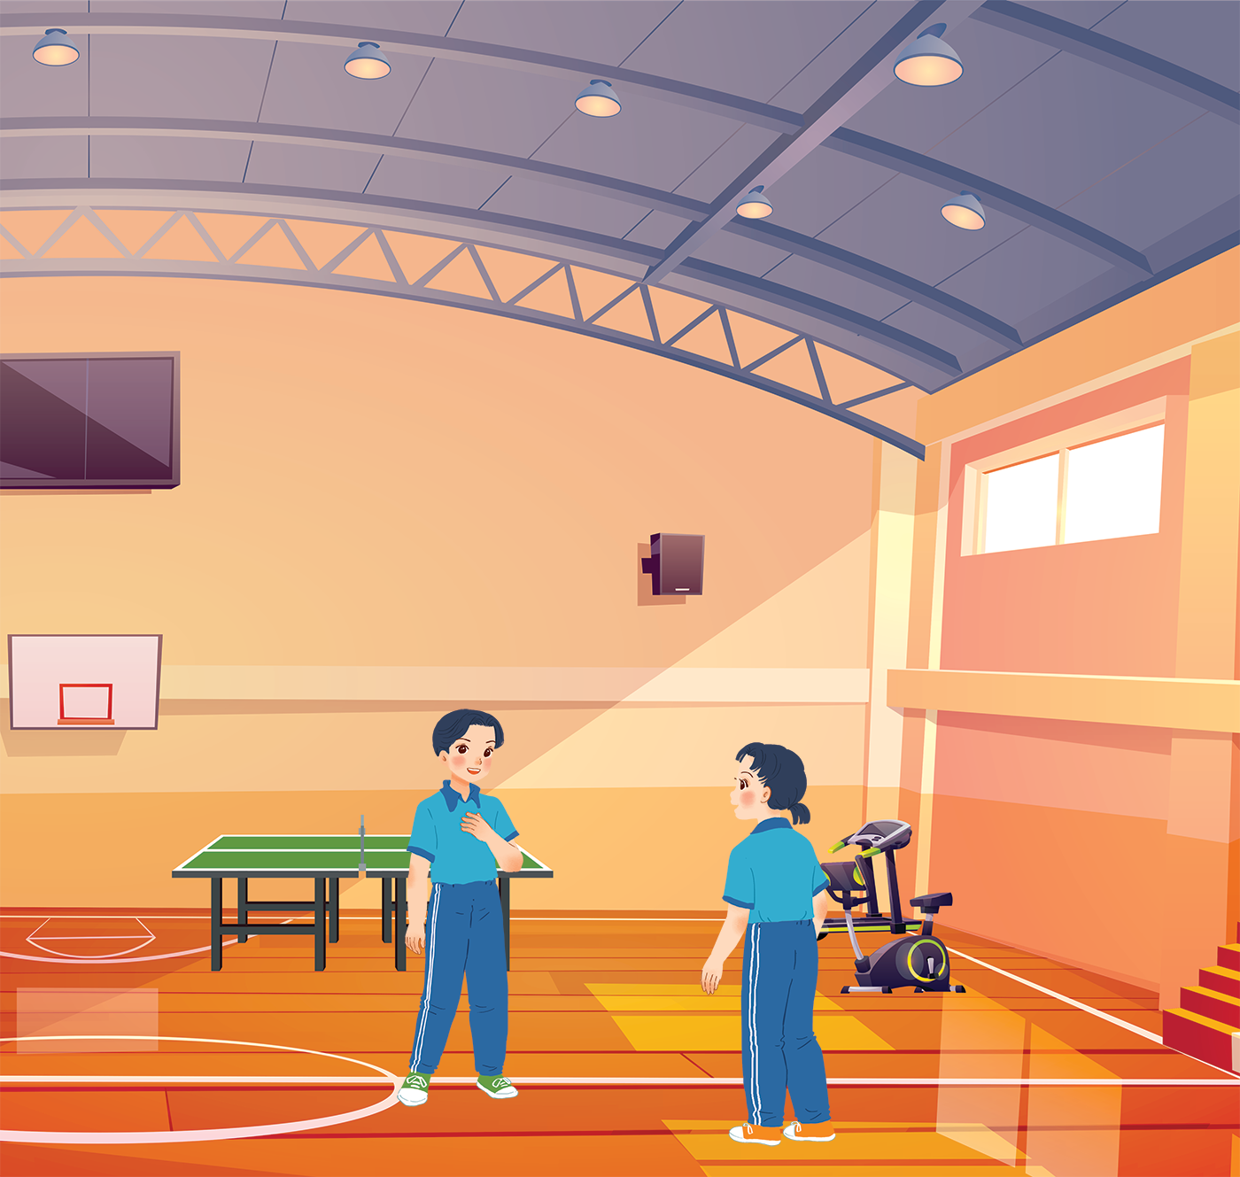

- Who are they in the picture ?
- Where are they?
- What are they talking about?
Duong
Mai
NVL
NVL

Slide 8

At the gym
Duong: Wow! This gym is big!
Mai: Yeah. The equipment is great. What sports do you do, Duong?
Duong: Well, I do karate, and I play table tennis. Yesterday I played with Duy, and I won!
Mai: Congratulations! You look f it! I’m not good at sports.
Duong: I have an idea – you can go to the karate club with me.
Mai: No, I can’t do karate.
Duong: But you can learn! You’ll love it.
Mai: Well ... OK.
Duong: Great! I’ll meet you there at 10 a.m. on Sunday.
Mai: Where’s the club?
Duong: It’s Superfit Club, in Pham Hung Road. You can cycle there.
Mai: OK. See you then.

Slide 9
- Who are they in the picture ?
They are Duong and Mai.
- Where are they?
 They are at the gym.
- What are they talking about?
They are talking about some
sports and games.
Duong
Mai
NVL
NVL

Slide 10
At the gym
Duong: Wow! This gym is big!
Mai: Yeah. The equipment is great. What sports do you do, Duong?
Duong: Well, I do karate, and I play table tennis. Yesterday I played with Duy, and I won!
Mai: Congratulations! You look f it! I’m not good at sports.
Duong: I have an idea – you can go to the karate club with me.
Mai: No, I can’t do karate.
Duong: But you can learn! You’ll love it.
Mai: Well ... OK.
Duong: Great! I’ll meet you there at 10 a.m. on Sunday.
Mai: Where’s the club?
Duong: It’s Superfit Club, in Pham Hung Road. You can cycle there.
Mai: OK. See you then.

Slide 11


Put a word from the conversation in each gap.
Duong looks
_______. He often does karate.
1.
fit. He often does karate.
2.
gym. The equipment there is great.
Mai likes coming to the
_______. The equipment there is great.
Duong played
table tennis with Duy yesterday, and he won.
3.
_______ with Duy yesterday, and he won.
Mai and Duong will meet at Superfit
Club on Sunday.
4.
_______ on Sunday.
5.
Mai will
_______ to Superfit Club.
cycle to Superfit Club.

Slide 12

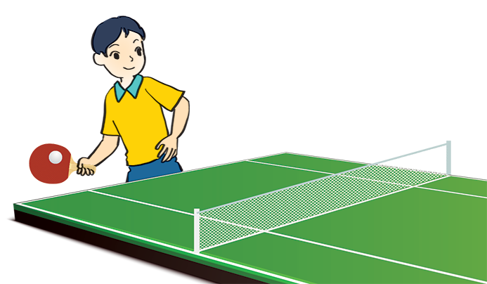

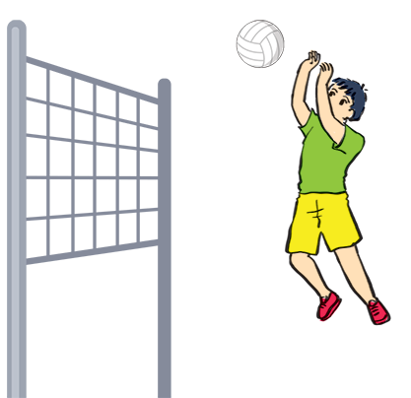
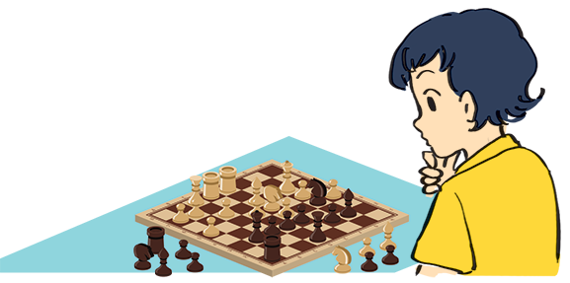
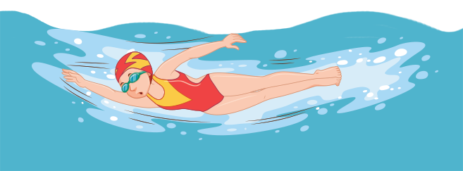
Name these sports and games, using the words from the box.
chess
cycling
aerobics
swimming
table tennis
volleyball
1.
cycling
2.
3. table tennis
aerobics
3.
swimming
5.
chess
6.
volleyball
4.

Slide 13
What is the diﬀerence between a sport and a game?

Slide 14
The difference between a sport and a game:
Sport: an activity that you do for pleasure and that needs physical exercise. (Môn thể thao: một hoạt động mà mọi người làm vì niềm vui và cần những bài tập thể chất.)
Game: an activity or sport with rules in which people or teams compete against each other. (Trò chơi: một hoạt động hay một môn thể thao có luật lệ mà mọi người hay các đội thi đấu với nhau.)

Slide 15

Work in pairs. Ask your partner these questions to find out how sporty they are.
If your answers to the questions are mostly “A”, you are sporty. If they are mostly “B”, do more sport and try to be more active.
1.
Can you swim?
A.
Yes.
B.
No.
2.
Do you play outdoors every day?
A.
Yes.
B.
No.
3.
Do you usually do morning excerise?
A.
Yes.
B.
No.
4.
What do you usually do at break time at school?
A.
Play in the school yard.
B.
Sit in the classroom.
5.
What do you think of sports and games?
A.
Very good.
B.
Not useful.

Slide 16

HOMEWORK
- Learn by heart vocabulary.
- Practice the conversation again and translate
it into Vietnamese.
- Prepare: Lesson 2: A Closer look 1 on P.18.

Slide 17


Thanks for
your attention!
Goodbye!
Thanks for
your attention!

