Slide 1
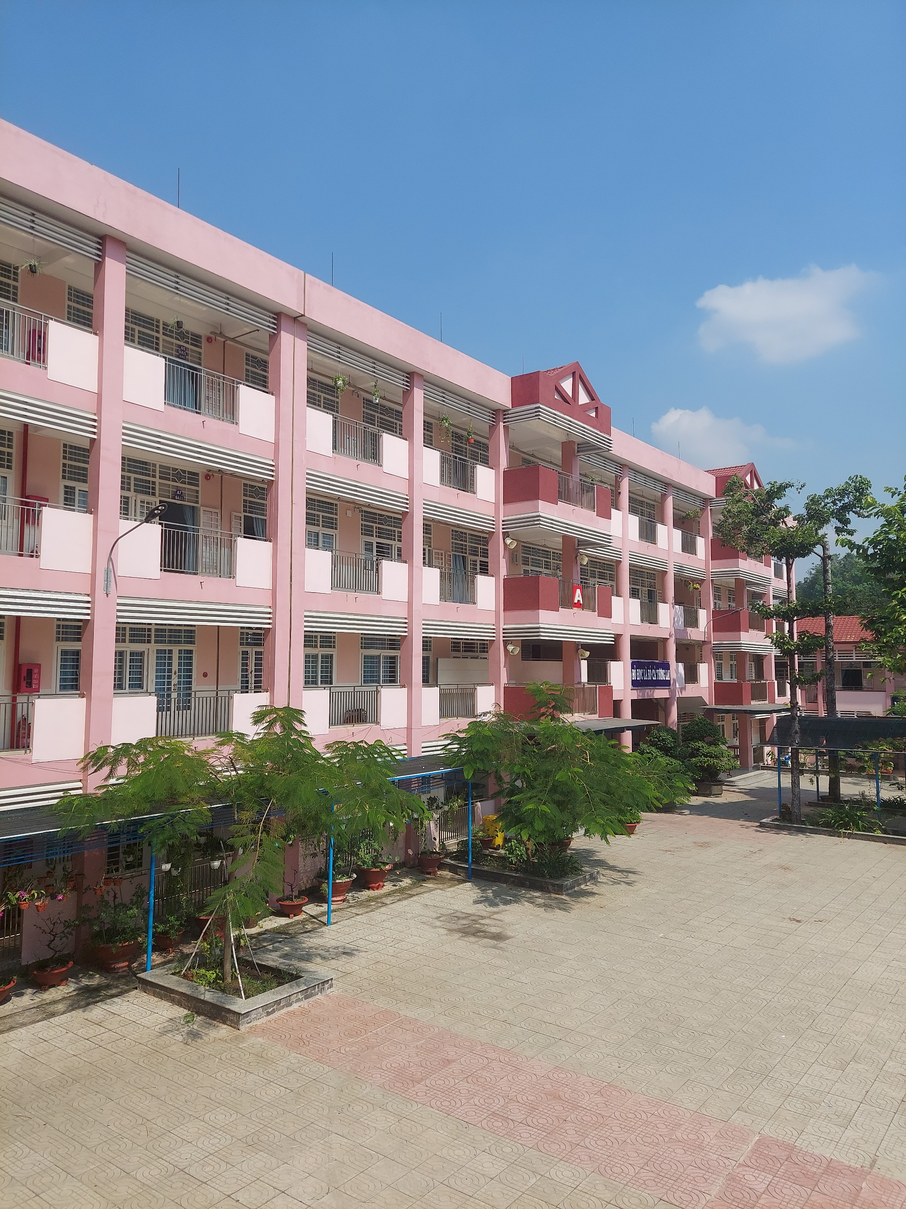

Slide 3
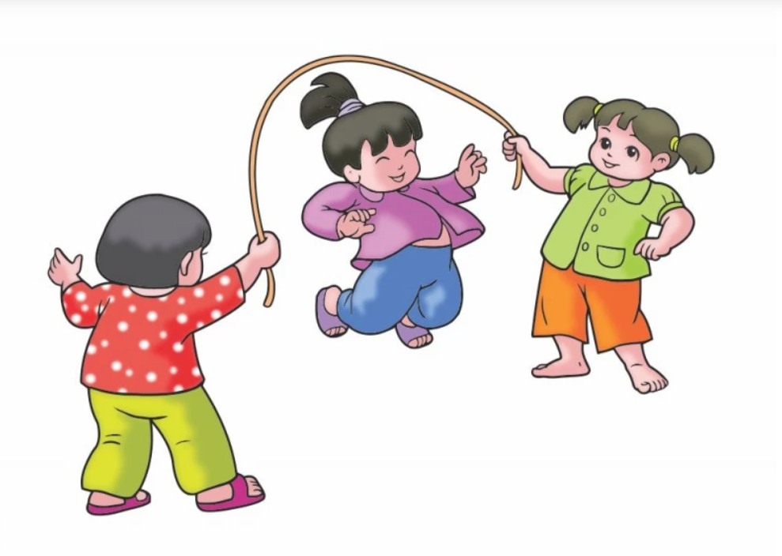

Slide 4


Slide 5

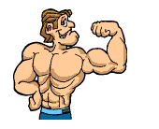



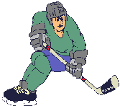
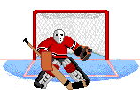
Unit 8. Sports and Games
Skills 2

Slide 6








Listening
Writing
Listen to the passages. Who are they about?
Work in pairs. Talk about the sport / game you like. Use the following questions as cues.
Listen to the passages again. Then tick () T (True) or F (False) for each sentence.
Write a paragraph of 40-50 words about the sport / game you talked about in 4. You can also refer to the listening passages.
Listen again and fill each blank with a word to complete each sentences.

Slide 7
Listening

Slide 8



Listen to the passages. Who are they about?
The listening passages are about Hai and Alice.

Slide 9

Listen to the passages again. Then tick () T (True) or F (False) for each sentence.
 | T | F
1. The passages are about two sportsmen.
2. Hai goes cycling at the weekend.
3. Hai’s favourite sport is karate.
4. Alice doesn’t like doing sport very much.
5. Alice plays computer games every day.

Slide 10
Listen to the passages again. Then tick () T (True) or F (False) for each sentence.
 | T | F
1. The passages are about two sportsmen.
2. Hai goes cycling at the weekend.
3. Hai’s favourite sport is karate.
4. Alice doesn’t like doing sport very much.
5. Alice plays computer games every day.






Slide 11

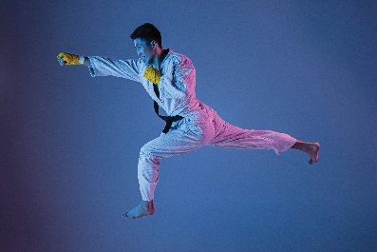

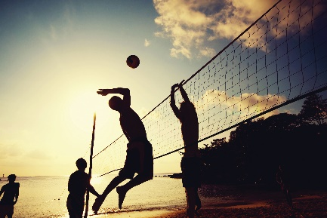
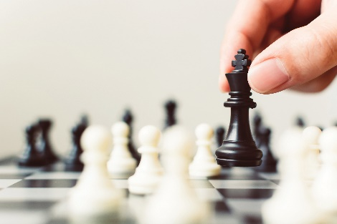
Listen again and fill each blank with a word to complete each sentence.
volleyball
1.
Hai plays
_______ at school.
2.
three
Hai practises karate at the club
_______ times a week.
Alice
3.
_______ likes watching sport on TV.
chess
4.
Alice plays
_______ every Saturday.

Slide 12
Audio script
Hello. My name's Hai. I love sport. I play volleyball at school and I often go cycling with my dad at the weekend. But my favourite sport is karate. I practise it three times a week. It makes me strong and confident.
My name's Alice. I'm twelve years old. I don't like doing sport very much, but I like watching sport on TV. My hobby is playing chess. My friend and I play chess every Saturday. I sometimes play computer games, too. I hope to create a new computer game one day.

Slide 13
Writing

Slide 14

Work in pairs. Talk about the sport / game you like. Use the following questions as cues.
What is the name of the sport / game?
How many players are there?
How often do you play it?
What equipment does it need?
Why do you like it?

Slide 15
1. What is your favorite sport/ game?
--> I like/ love/ enjoy ............................
--> My favourite sport/game is ....................
--> I am interested in ............................

Slide 16
2. Is it a team or a solo sport/ game?
How many players are there?
--> It is a solo/ team sport.
--> There are ......................... players.

Slide 17
3. How often do you play it?
--> I play it every day.
- at the weekend
- every day/ afternoon/ Saturday/ Sunday
- twice/ three times/ four times … a week/ month

Slide 18
4. What equipment does it need?
--> It needs ....................
--> We can play it with ............

Slide 19
5. Why do you like it?
--> I love it because it helps me keep fit.

Slide 20



Write a paragraph of 40-50 words about the sport / game you talked about in 4. You can also refer to the listening passages.

Slide 21
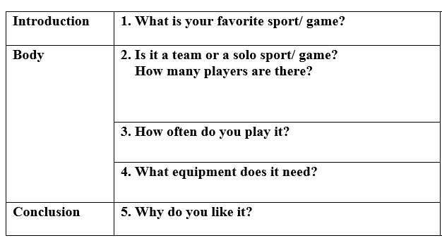

Slide 22
I love sport. I play volleyball at school and I often go cycling with my dad at the weekend.
But my favourite sport is karate. I practise it three times a week.
It makes me strong and confident.

Slide 23
I love sport. I play volleyball at school and I often go cycling with my dad at the weekend. But my favourite sport is karate. I practise it three times a week. It makes me strong and confident.

Slide 25
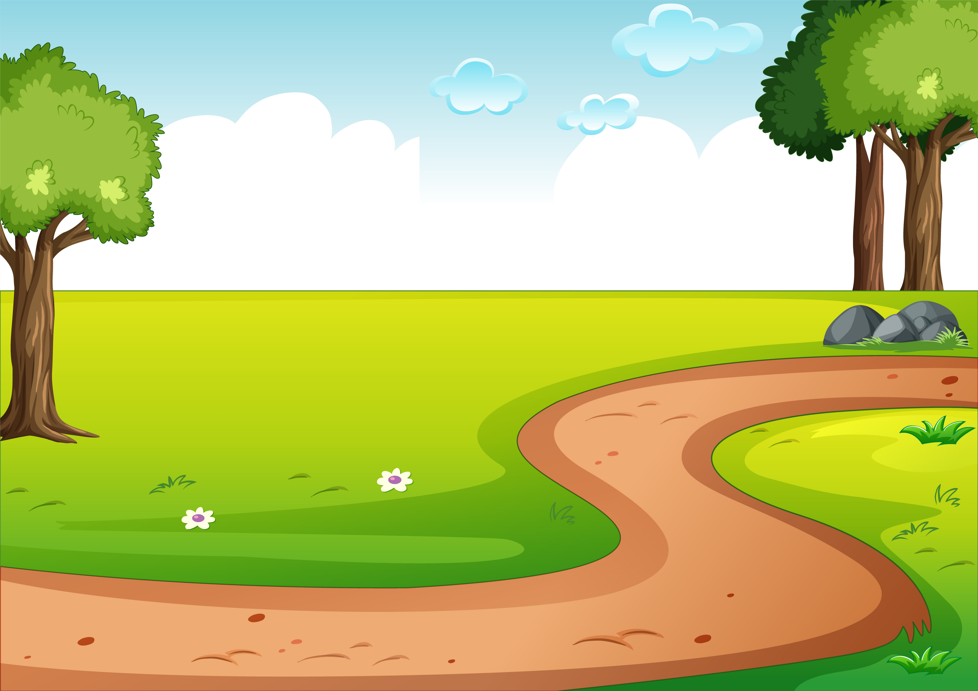
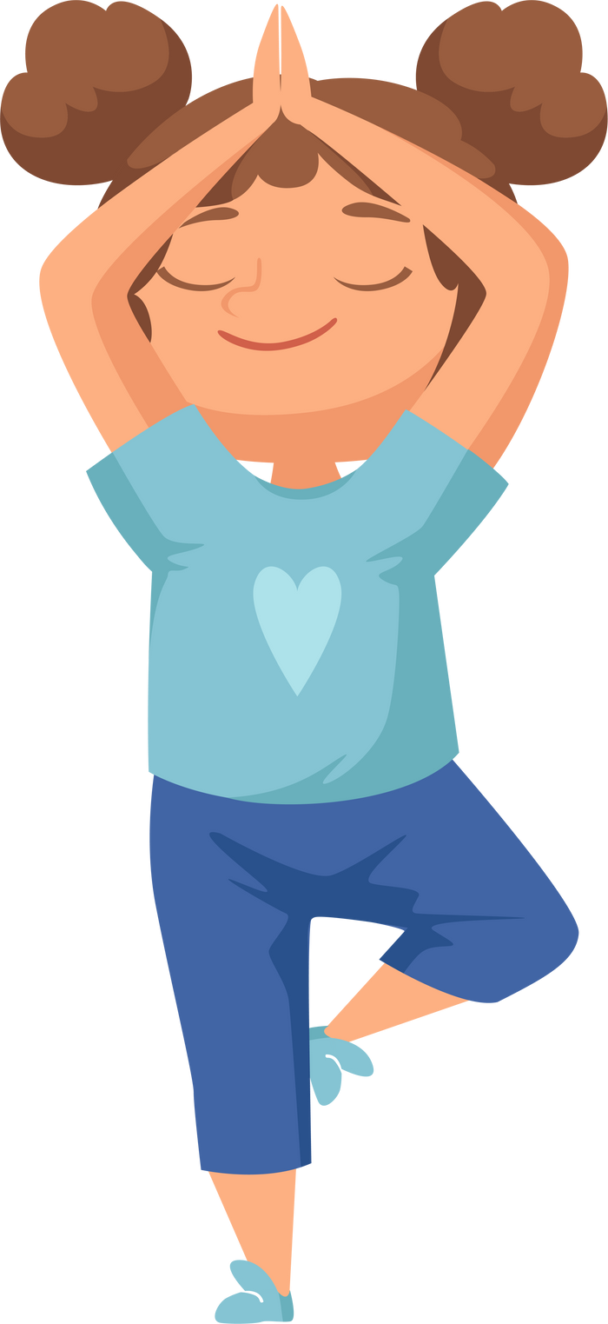
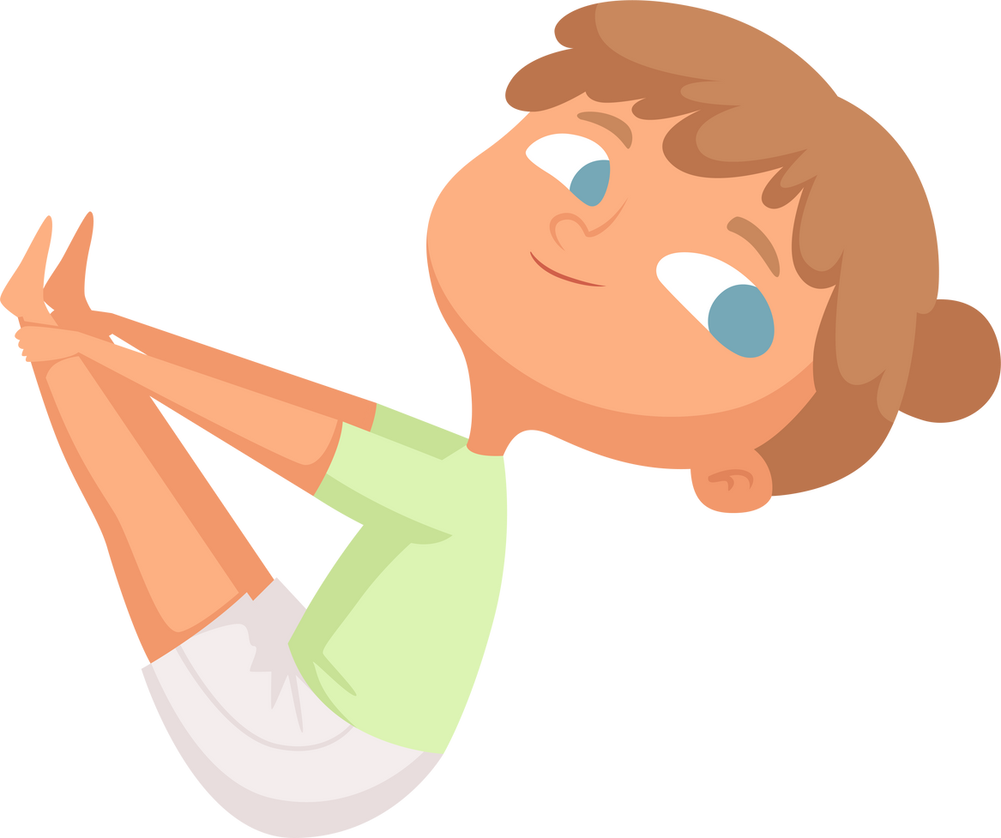


Health is wealth

Slide 26







