Slide 1
Tuesday , March 1st , 2022
UNIT 8:SPORTS AND GAMES
Lesson 5: SKILLS 1

Slide 2
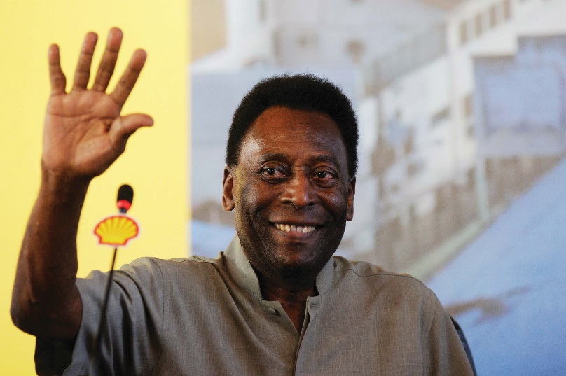
Act 1. Work in pairs. Discuss the questions.
1.
What do you know about Pelé?
2.
What is special about him?
… best footballer
… from Brazil
… won the World Cup
… the King of Football

Slide 3
*Vocabulary:
1. be born :
Sinh ra
2. total: (n)
Tổng cộng
3.goal(v,n)
Bàn thắng, ghi bàn, mục đích
4.Career (n ) :
Sự nghiệp , nghề nghiệp
5. Century (n):
Thế kỉ
6. Tournament (n) :
Giải đấu
7. National hero: (n)
Anh hùng dân tộc
8. medal(n)
Huy chương

Slide 4

Act 2.Read the dialogue quickly to check your ideas in 1.
The PE teacher is talking to her students about Pelé.
Teacher: Today we’re going to talk about Pelé. Do you know him?
Nick: Yes, I think he’s the best footballer of all time.
Teacher: Right. He was born in 1940 in Brazil. His father taught him to play football at a very young age.
Susan: Oh. When did he begin his career in football?
Teacher: At 15, when he started playing for Santos Football Club. In 1958, he won his first World Cup.
Nick: How many goals did he score in his career?
Teacher: 1,281 goals in total, I think.
Nick and Susan: Wow! Amazing!
Teacher: And he became “Football Player of the Century” in 1999.
Michael: Surely Pelé’s a national hero in Brazil.
Teacher: Yes, and he’s known around the world as “The King of Football”.

Slide 5
Act 3: True (T) or False (F)
F
Pelé is 80 years old.
2. He was born in the countryside of Vietnam.
F
3. His father taught him how to play at a very young age.
T
4. He won the 1st World Cup when he was 15.
F
5. He won three World Cups.
T

Slide 6
Act 4. Read the text again and answer the questions.
1.
When was Pelé born?
Pelé was born in 1940.
2.
Who first taught him to play football?
His father did. / His father taught him.
3.
How many goals did he score in total?
He scored 1,281 goals in total.
4.
When did he become “Football Player of the Century”?
(He became Football Player of the Century) in 1999.
5.
What do people call him?
They call him “The King of Football”.

Slide 7
Act 5.Read the following facts about two famous sportspeople.
Hoang Giang – No. 1 sportsman in shooting
Born: 1978 in Viet Nam
1995: finished sports school
1996: took part in a shooting competition
2001: won a gold medal for shooting
Jenny Green – one of the best female golfers in history
Born: 1972 in Greenland
1987: became a member of local golf club
1994: took part in a female golf tournament
2002: became the female golf champion

Slide 8
Act 6. Choose one sportsperson in 4. Talk about him / her. Use the following cues.
His / Her name
The sport he / she plays
Why he / she is famous
You like him / her or not
Explain why

Slide 9
His name is Hoang Giang, he was born in 1978 in Viet Nam. He plays shooting. He is famous for being No.1 sportsman in shooting. In 1996, he took part in a shooting competition. In 2001, he won a medal for shooting.

Slide 10
- Her name is Jenny Green. She was born in 1972 in Greenland. She plays golf. She is famous for being one of the best female golfers in history. In 1987, she became a member of local golf club. In 1994, she took part in a female golf tournament and in 2002, she became the female golf champion.

Slide 11

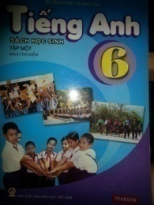
Do exercises: C - in workbook
-Prepare new lesson: SKILLS 2
Home work

