Slide 2
Thursday ,March 9th 2023
Unit 9:Cities of the world
Lesson 6: Skills 2 p.33

Slide 3
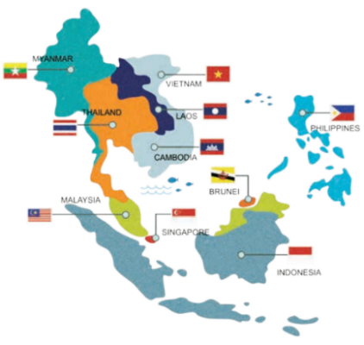
* Game: Relay-race to capital cities of ASEAN countries.
+ Greeting + Chatting
Suggested answers:
1.Ha Noi of Viet Nam
2.Phnom Penh of Cambodia
3.Jakarta of Indonesia
4.Manila of Philippines
5.Naypyitaw of Myanmar
6.Kuala Lumpur of Malaysia
7.Singapore of Singapore
8.Vientiane of Laos
9.Bangkok or Krung Thep of Thailand
10. Banda Seri Begawan of Brunei Darussalam

Slide 4


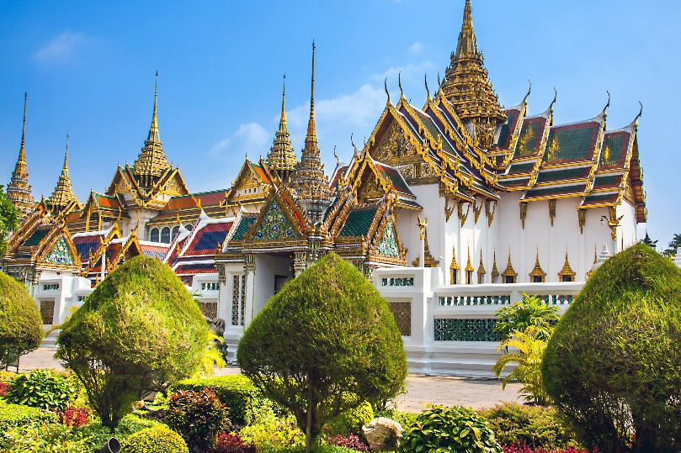
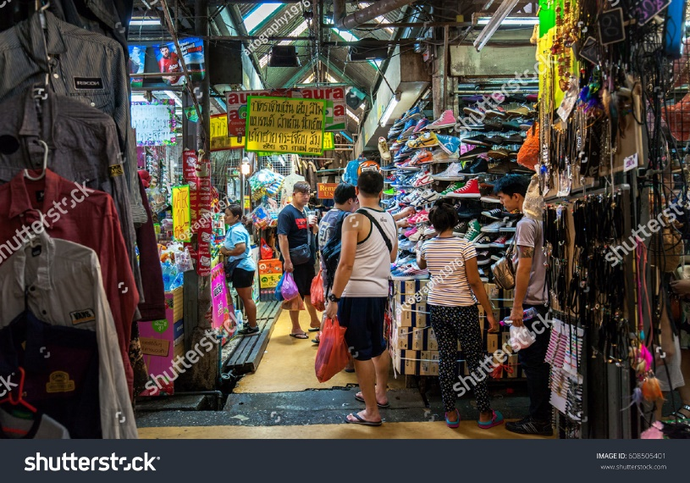
Work in groups. Discuss and answer the questions.
Listening
1.
Where is Bangkok?
2.
What is Bangkok famous for?

Slide 5
1. Bangkok is in Thailand.
– It is the capital and the biggest city.
– It has the population of about 8 million.
2. It’s famous for pagodas, temples, open/night/ ﬂoating markets and shopping centres, silk, street food, friendly people, and entertainments.

Slide 6


Listen and tick () T (True) or F (False).
 |  | T | F
1. | Bangkok is famous for palace.
2. | Things at Chatuchak market are expensive.
3. | The floating market is on the sea.
4. | You can find food stalls all around Bangkok.
✓
?
✓
?
✓
?
✓
?

Slide 7
SUGGEST
Bangkok is famous for its markets and street food. Visit the Chatuchak, the largest weekend market in the world. There are over 15,000 stalls selling nearly everything, at cheap prices. It’s only five minutes’ walk from the station. When you visit this market, you can see part of Thai people’s life.
Another interesting type of market is the floating market on the river. Don’t forget to try street food in Bangkok. It’s easy to find food stalls all around Bangkok, serving different Thai dishes. They are really delicious.

Slide 8
SUGGEST
Bangkok is famous for its markets and street food. Visit the Chatuchak, the largest weekend market in the world. There are over 15,000 stalls selling nearly everything, at cheap prices. It’s only five minutes’ walk from the station. When you visit this market, you can see part of Thai people’s life.
Another interesting type of market is the floating market on the river. Don’t forget to try street food in Bangkok. It’s easy to find food stalls all around Bangkok, serving different Thai dishes. They are really delicious.

Slide 9
SUGGEST
Bangkok is famous for its markets and street food. Visit the Chatuchak, the largest weekend market in the world. There are over 15,000 stalls selling nearly everything, at cheap prices. It’s only five minutes’ walk from the station. When you visit this market, you can see part of Thai people’s life.
Another interesting type of market is the floating market on the river. Don’t forget to try street food in Bangkok. It’s easy to find food stalls all around Bangkok, serving different Thai dishes. They are really delicious.

Slide 10
SUGGEST
Bangkok is famous for its markets and street food. Visit the Chatuchak, the largest weekend market in the world. There are over 15,000 stalls selling nearly everything, at cheap prices. It’s only five minutes’ walk from the station. When you visit this market, you can see part of Thai people’s life.
Another interesting type of market is the floating market on the river. Don’t forget to try street food in Bangkok. It’s easy to find food stalls all around Bangkok, serving different Thai dishes. They are really delicious.

Slide 11

Listen again and fill each gap with one word / number.
1.
15,000
Chatuchak market has over stalls.
?
2.
5
Chatuchak market is about minutes’ walk from the station.
?
3.
life
You can see part of Thai people’s at a market.
?
4.
Street food in Bangkok is .
delicious
?
Audio script

Slide 12
AUDIO SCRIPT
Bangkok is famous for its markets and street food. Visit the Chatuchak, the largest weekend market in the world. There are over 15,000 stalls selling nearly everything, at cheap prices. It’s only five minutes’ walk from the station. When you visit this market, you can see part of Thai people’s life.
Another interesting type of market is the floating market on the river. Don’t forget to try street food in Bangkok. It’s easy to find food stalls all around Bangkok, serving different Thai dishes. They are really delicious.

Slide 13
SUGGEST
Bangkok is famous for its markets and street food. Visit the Chatuchak, the largest weekend market in the world. There are over 15,000 stalls selling nearly everything, at cheap prices. It’s only five minutes’ walk from the station. When you visit this market, you can see part of Thai people’s life.
Another interesting type of market is the floating market on the river. Don’t forget to try street food in Bangkok. It’s easy to find food stalls all around Bangkok, serving different Thai dishes. They are really delicious.

Slide 14
SUGGEST
Bangkok is famous for its markets and street food. Visit the Chatuchak, the largest weekend market in the world. There are over 15,000 stalls selling nearly everything, at cheap prices. It’s only five minutes’ walk from the station. When you visit this market, you can see part of Thai people’s life.
Another interesting type of market is the floating market on the river. Don’t forget to try street food in Bangkok. It’s easy to find food stalls all around Bangkok, serving different Thai dishes. They are really delicious.

Slide 15
SUGGEST
Bangkok is famous for its markets and street food. Visit the Chatuchak, the largest weekend market in the world. There are over 15,000 stalls selling nearly everything, at cheap prices. It’s only five minutes’ walk from the station. When you visit this market, you can see part of Thai people’s life.
Another interesting type of market is the floating market on the river. Don’t forget to try street food in Bangkok. It’s easy to find food stalls all around Bangkok, serving different Thai dishes. They are really delicious.

Slide 16
SUGGEST
Bangkok is famous for its markets and street food. Visit the Chatuchak, the largest weekend market in the world. There are over 15,000 stalls selling nearly everything, at cheap prices. It’s only five minutes’ walk from the station. When you visit this market, you can see part of Thai people’s life.
Another interesting type of market is the floating market on the river. Don’t forget to try street food in Bangkok. It’s easy to find food stalls all around Bangkok, serving different Thai dishes. They are really delicious.

Slide 17

Work in groups. Talk about a city in your country, using the questions below as a guide.
Writing
What city is it?
What is it like? (the weather, the people, the food)
What can you see and do there?

Slide 18


Write a postcard of about 50 words about your holiday in a city. Use the information in 4.
Dear Mum and Dad,
To:
Love,
Trang

Slide 19
Sample paragraph:
Dear Mum and Dad,
How are you? I’m having a really great time in Hạ Long city. The weather is cool. People are friendly and helpful. The food, especially seafood, is fresh, cheap and delicious. In Hạ Long city, I can visit Hạ Long Bay, go to Tuần Châu island, climb Poem mountain, visit Bái Tử Long Bay, Ba Vàng pagoda, Hạ Long night market, Quảng Ninh museum. You should come here one day.
Love,
Anne

Slide 20
Home Assignments:
- Make sentences using the vocabulary
- Do EX E1,2 p.20-21 in WB.

Slide 21

