Slide 1


Slide 2



9
Monday,March 6th 2023
Unit
FESTIVALS AROUND THE WORLD
LESSON 6: SKILLS 2 p.99

Slide 3
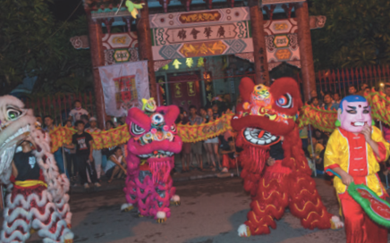
WARM-UP

Slide 4
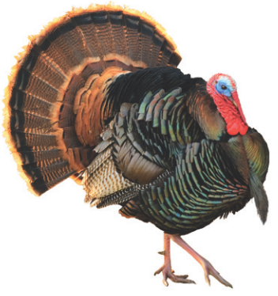

LISTENING
1
Look at the animal below. Discuss the following questions with a partner.
1. What is it?
2. What festival is it a part of?

Slide 5

LISTENING
2
Listen to Mark talking about how his family celebrates a festival. Check your answers.
1. What is it?
2. What festival is it a part of?
A turkey.
Thanksgiving.

Slide 6
LISTENING
3
Listening again and decide whether the following statements are true or false.
 | True | False
1. Only people from the USA celebrate Thanksgiving.
2. People celebrate it on the third Thursday of November.
3. Family members and friends usually gather to have a feast.
4. In his family, only adults prepare the feast.
5. Cornbread is one of the traditional dishes.
6. After the feast, they play board games.
✓
✓
✓
✓
✓
✓

Slide 7
WRITING
4
Think about a festival that your family usually celebrates. Fill in the blanks with your answers.
When do you celebrate it?
__________
What food does your family eat? __________
What festival is it?
__________
What activities does your family do?
__________
Do you like the festival? Why or why not?
__________

Slide 8
WRITING
5
Now write an email of about 70 words to tell Mark about the festival. Use the notes in 4.

Slide 9
1. The Edinburg Festival is the biggest arts festival in the world. Every August, thousands of people come to the city to join the festival. It lasts for three weeks and has a lot of activities. People enjoy music and dance performances in the streets from early morning until late at night. They also see artists painting pictures in the streets. One of the most interesting parts of the festival is “Fringe". Fleer people enjoy comedy shows by students in small halls and cafes. At this festival, tourists also have a chance to see new films, plays and listen to famous musicians playing great music. Although it is the world’s largest arts festival, its tickets are quite cheap. This is one of the reasons why it attracts so many people every year.
2. La Tomatina is a unusual festival. It’s a fun fight with tomatoes. People hold it in Bunol, Spain on the last Wednesday of every August. In the town square, there is a high pole with a ham on top of it. People climb the pole and get the ham. At 11 a.m., a jet of water shoots from the water cannons, and people start throwing tomatoes. People throw bags of tomatoes at the crowd. They then throw tomatoes at one another. After one hour, there is another jet of water, and people stop throwing. The whole square now is red with rivers of tomato juice.
After the fight, may people go to restaurants to try paella. It is traditional Spanish rice dish. It has rice, chicken, seafood, and herbs.

Slide 10

PRODUCTION
CLASS GALLERY
Students can:
go and see other’s work
give comments to each other

Slide 11

CONSOLIDATION
1
WRAP-UP
In this lesson, we have learnt to:
- listen for special information about a festival
- write an email to describe a festival

Slide 12

CONSOLIDATION
2
HOME ASSIGNMENTS
Prepare for the next lesson: Looking back & Project
Rewrite the emails on your notebook.
Do Exercises in WB (unit 9)

Slide 13

Website: sachmem.vn
Fanpage: facebook.com/sachmem.vn/

