Slide 1


Slide 2
WARM-UP
hydro
solar
coal
TYPES OF ENERGY
natural gas
oil
wind

Slide 3



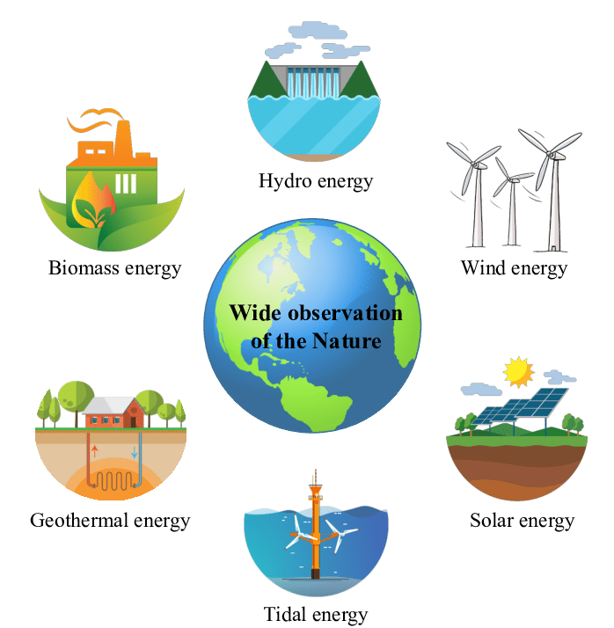
Thursday,April 6th 2023
Unit
10
ENERGY SOURCES
LESSON 5: SKILLS 1 p.110
Unit

Slide 4
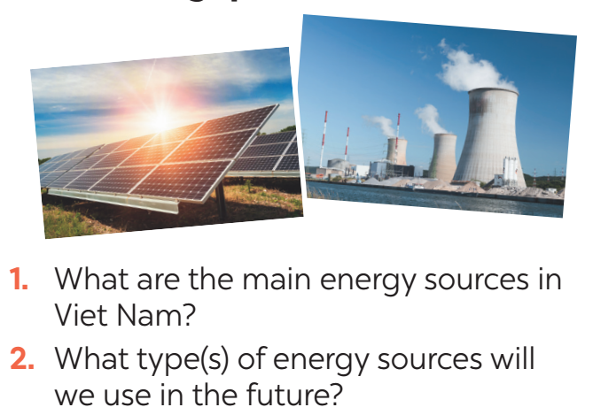

READING
1
Work in pairs. Discuss the following questions.

Slide 5
2.Mr Lam is giving a lecture on energy sources .Read the text and choose the best option A,B or C to complete the sentences
* Vocabulary:

Slide 6
READING
produce (v)
= to make things, mostly in large quantity
Examples:
Companies produce many toys for children before Christmas.
/prəˈdjuːs/
sản xuất

Slide 7
READING
limited (adj)
= not very great in amount or extent
Examples:
Coal is limited.
/ˈlɪmɪtɪd/
hạn chế ,có giới hạn

Slide 8
READING
available (adj)
= that you can get, buy or find
Examples:
The coal takes a long time to be available again.
/əˈveɪləbl/
có sẵn

Slide 9
READING
Vocabulary | Pronunciation | Meaning
produce (v) | /prəˈdjuːs/ | sản xuất
limited (adj) | /ˈlɪmɪtɪd/ | hạn chế,có giới hạn
available (adj) | /əˈveɪləbl/ | có sẵn

Slide 11
READING
2
Read the text and choose the best option to complete the sentences.
1. Non-renewable sources are cheap and ______.
A. available B. easy to use C. expensive
2. ______ come from the sun, wind or water.
A. Renewable sources B. All energy sources C. Non-renewable sources
3. When energy comes from water, we call it ______.
A. wind energy B. solar energy C. hydro energy
4. Renewable energy sources are better for ______.
A. the environment B. our cars C. hydro energy

Slide 12
READING
3
Read the text again and answer the questions.
1. How many energy sources are there? What are they?
_________________________________________________________
2. What do non-renewable sources include? _________________________________________________________
3. What are the advantages of renewable energy?
_________________________________________________________
4. What will we rely more on in the future?
_________________________________________________________
There are two. They are non-renewable and renewable.
They include coal, oil and natural gas.
It’s available, clean, and safe to use.
We will rely more on renewable energy sources in the future.

Slide 13
SPEAKING
4
Work in groups. Discuss and put the following words or phrases in the appropriate columns.
run out limited easy to use cheap expensive
available safe to use good for the environment
Advantages | Disadvantages
easy to use
run out
cheap
limited
available
expensive
safe to use
good for the environment

Slide 14

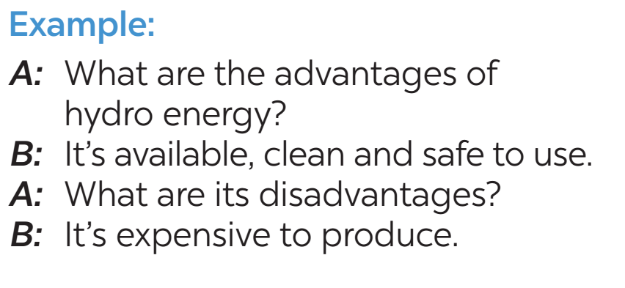
SPEAKING
5
Work in pairs. Ask and answer questions about the advantages and disadvantages of different energy sources

Slide 15


PRODUCTION
6
Presentation: Advantages and disadvantages of a source of energy.

Slide 16
A: What type of energy is oil?
B: It is a non-renewable source of energy, because it can't be easily be replaced.
A: What are its advantages and disadvantages?
B: It can be used to power machinery, but it also pollutes the environment.

Slide 17
CONSOLIDATION
1
WRAP-UP
READING
SPEAKING

Slide 18

CONSOLIDATION
2
HOME ASSIGNMENTS
Make sentences using the vocabulary
Do exercises in part C,D on p.80-81 in the workbook.

Slide 19

Website: sachmem.vn
Fanpage: facebook.com/sachmem.vn/

