Slide 1
UNIT 10: OUR HOUSES IN THE FUTURE
LESSON 2: A CLOSER LOOK 1

Slide 2
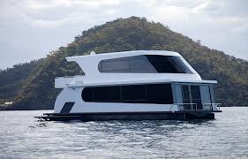
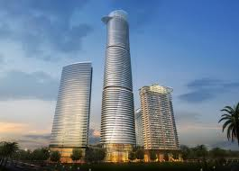
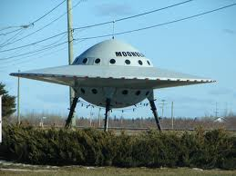
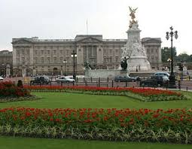
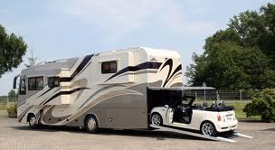
* Warm up: Match the words with the pictures.
1. UFO
2. Houseboat
3. Motorhome
4. Skyscraper
c.
a.
b.
5. Palace
d.
e.

Slide 3
Vocabulary:

Slide 4
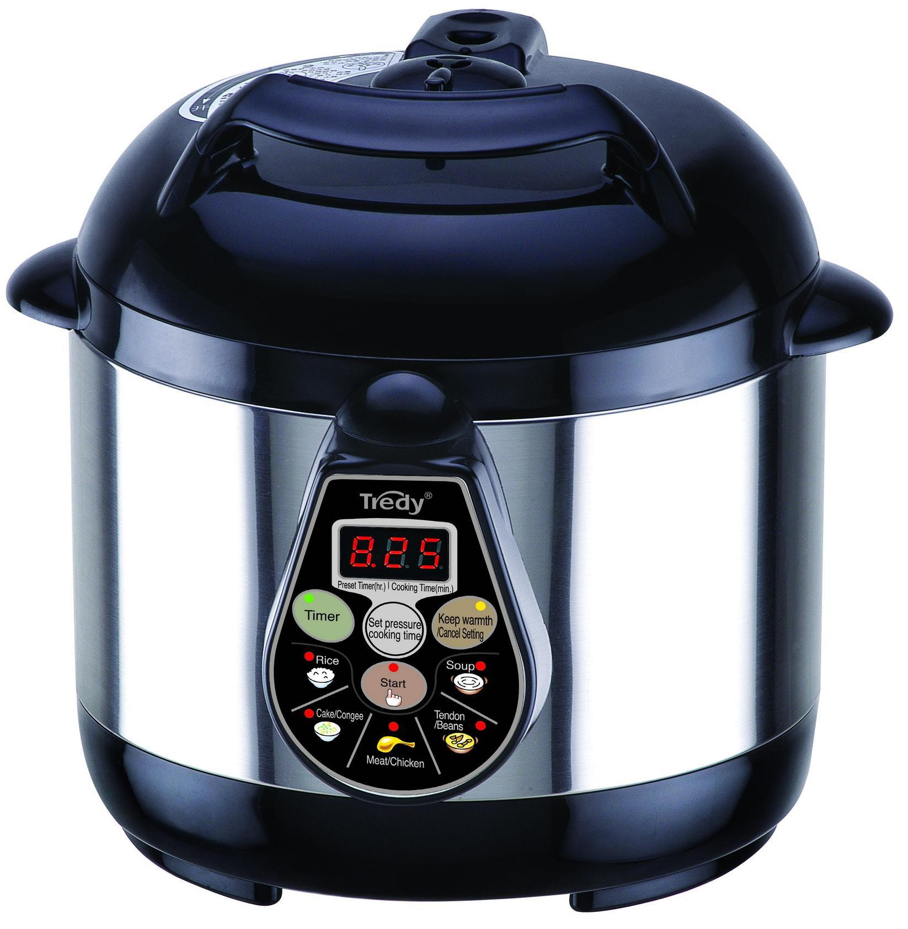
Electric cooker

Slide 5
Vocabulary
1. electric cooker (n) /i’lektrik kʊkə/ - nồi cơm điện

Slide 6
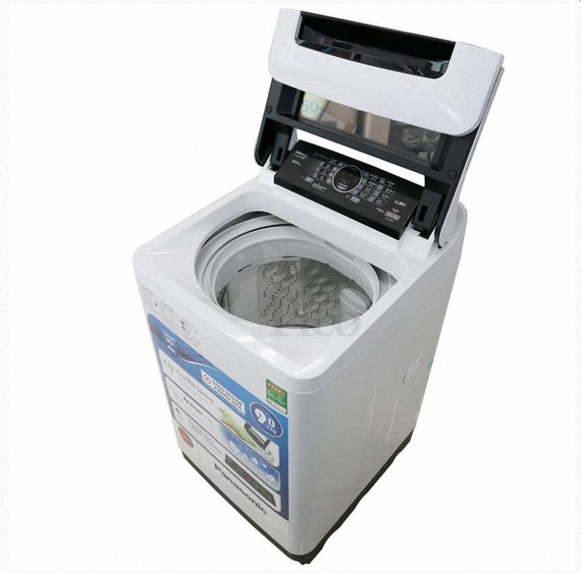
washing machine

Slide 7
Vocabulary
1. electric cooker (n) /i’lektrik kʊkə/ - nồi cơm điện
2. washing machine (n) /’wɒꭍɪŋ məꭍi:n/ - máy giặt

Slide 8
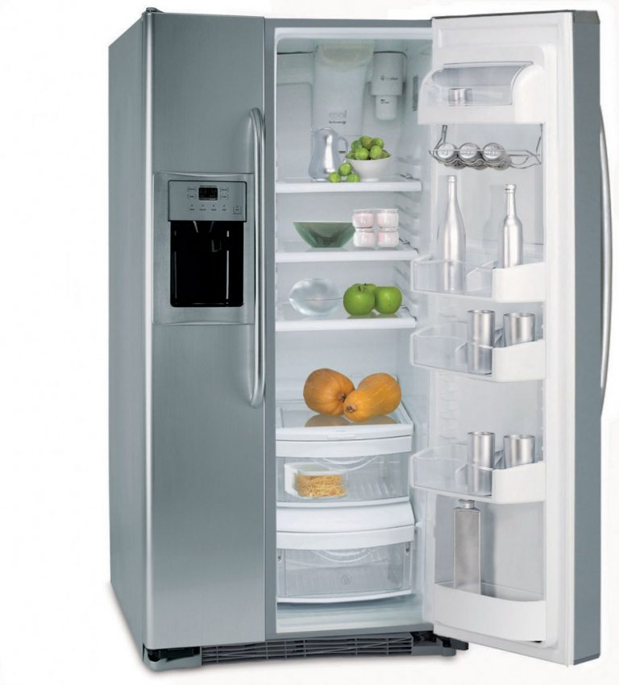
fridge

Slide 9
Vocabulary
1. electric cooker (n) /i’lektrik kʊkə/ - nồi cơm điện
2. washing machine (n) /’wɒꭍɪŋ məꭍi:n/ - máy giặt
3. fridge (n) /friddʒ/ - tủ lạnh

Slide 10
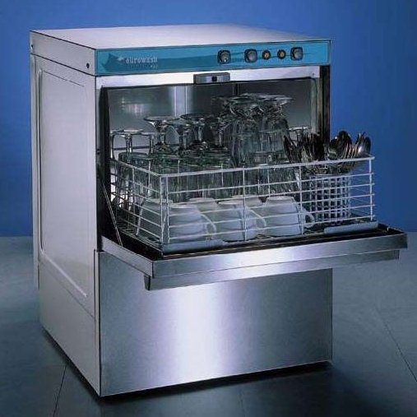
dishwasher

Slide 11
Vocabulary
1. electric cooker (n) /i’lektrik kʊkə/ - nồi cơm điện
2. washing machine (n) /’wɒꭍɪŋ məꭍi:n/ - máy giặt
3. fridge (n) /friddʒ/ - tủ lạnh
4. dishwasher (n) /dɪꭍwɒꭍə/ - tủ lạnh

Slide 12
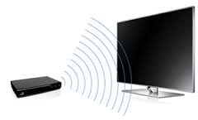
wireless TV

Slide 13
Vocabulary
- electric cooker (n) /i’lektrik kʊkə/ - nồi cơm điện
- washing machine (n) /’wɒꭍɪŋ məꭍi:n/ - máy giặt
- fridge (n) /friddʒ/ - tủ lạnh
- dishwasher (n) /dɪꭍwɒꭍə/ - máy rửa bát
- wireless TV (n) /’waɪə׀əs/ - TV không dây
- cooker (n) /kʊkə/ -- bếp điện

Slide 14
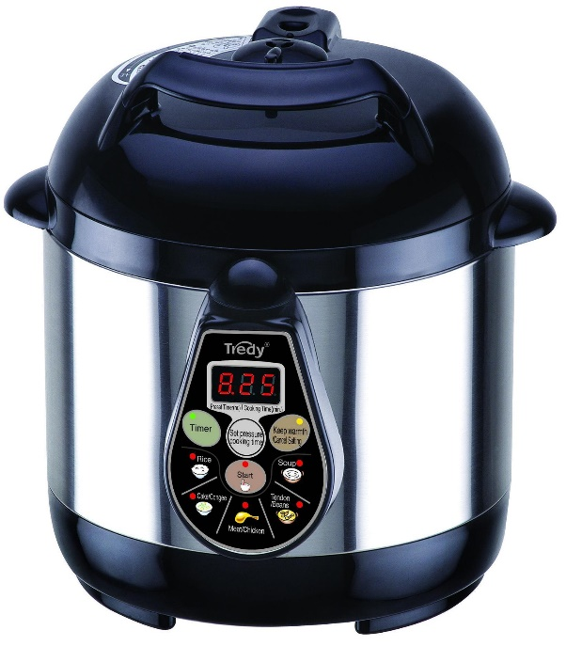
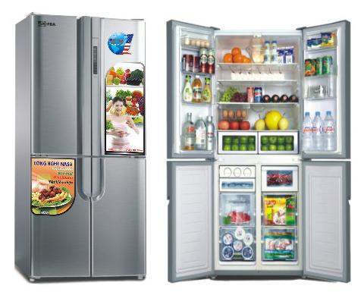
* Checking vocabulary:
washing machine
2.
1.
dishwasher
3.
electric cooker
4.
wireless TV
5.
fridge

Slide 15
Vocabulary
- electric cooker (n) /i’lektrik kʊkə/ - nồi cơm điện
- washing machine (n) /’wɒꭍɪŋ məꭍi:n/ - máy giặt
- fridge (n) /friddʒ/ - tủ lạnh
- dishwasher (n) /dɪꭍwɒꭍə/ - máy rửa bát
- wireless TV (n) /’waɪə׀əs/ - TV không dây
- cooker (n) /kʊkə/ -- bếp điện

Slide 16



Listen and repeat the words / phrases in the box. Then put them in the appropriate columns. You may use some more than once.
electric cooker
fridge
dishwasher
electric fan
washing machine
computer
wireless TV
smart clock
living room | bedroom | kitchen
wireless TV
wireless TV
electric cooker
electric fan
smart clock
fridge
smart clock
computer
dishwasher
computer
washing machine

Slide 17

Match the appliances in A with what they can help us to do in B.
A
1. electric cooker
2. dishwasher
3. fridge
4. washing machine
5. computer
B
B
c. cook rice
d. wash and dry dishes
b. keep food fresh
e. wash and dry clothes
a. receive and send emails
a. receive and send emails
b. keep food fresh
c. cook rice
d. wash and dry dishes
e. wash and dry clothes

Slide 18

Work in pairs. Ask and answer questions about appliances, using the information in 2.
Example:
A: What can an electric cooker help us to do?
B: It can help us to cook rice.
Notice :
- Help sb to do st: giúp ai làm gì đó

Slide 19

LUCKY NUMBER!
1
2
3
4
5
6

Slide 20

2. dishwasher / wash and dry dishes
A: What can a dishwasher help us to do?
B: It can help us to wash and dry dishes.

Slide 21

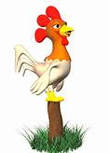
Lucky Number
Lucky Number

Slide 22
3. fridge / keep food fresh
A: What can a fridge help us to do?
B: It can help us to keep food fresh.

Slide 23
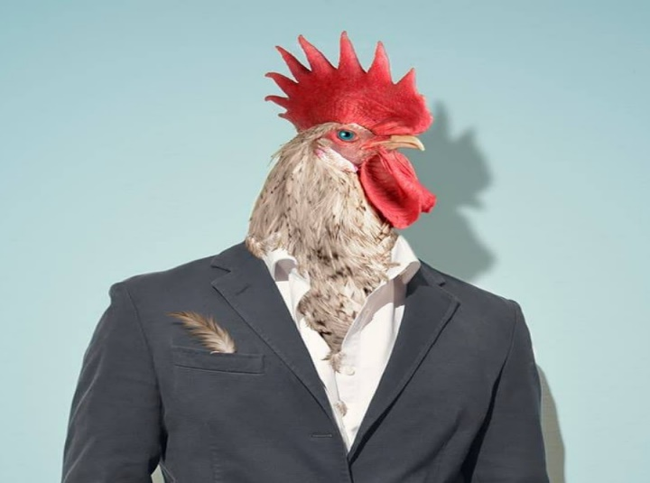
Lucky Number
Lucky Number

Slide 24
4. washing machine / wash and dry clothes
A: What can a washing machine help us to do?
B: It can help us to wash and dry clothes.

Slide 25
5. computer / receive and send emails
A:What can a computer help us to do?
B: It can help us to receive and send emails.

Slide 26
II.Pronunciation
Stress in two-syllable words

Slide 27

Listen and repeat the words.
‘picture
‘robot
‘bedroom
‘kitchen
‘housework
‘palace
‘village
‘mountains

Slide 28


Listen and repeat the sentences. Pay attention to the stress of the underlined words.
1.
The picture is on the wall of the bedroom.
2.
The robot helps me to do the housework.
3.
There’s a very big kitchen in the palace.
4.
Their village is in the mountains.

Slide 29
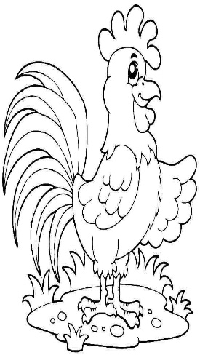
HOMEWORK
- Learn by heart new words.
- Prepare: A closer look 2.
Do exercise: A1,2.
B1,2.

Slide 30
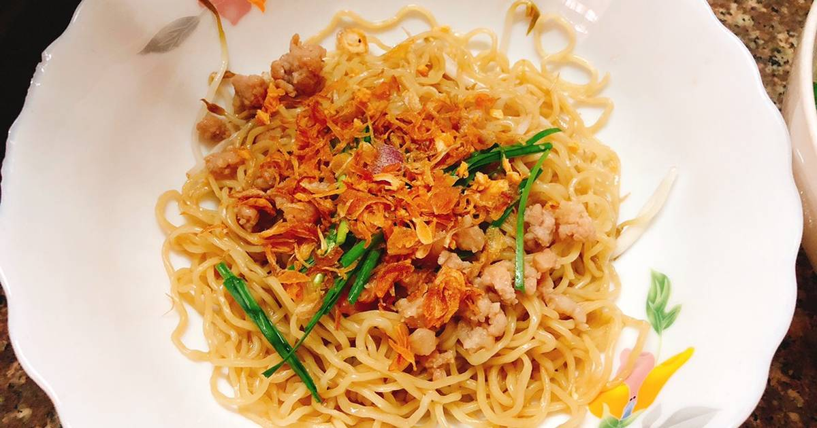
THANK YOU
FOR
your attention!!!

