Slide 1

PERIOD 81:UNIT 10: OUR HOUSES IN THE FUTURE
A CLOSER LOOK 2

Slide 2
I. Future simple: Thì tương lai đơn
Example:
( + ) We will live in that cottage next year.
(-) We won’t live in that cottage anytime soon. (will not = won’t)
(?) Will they live on the Moon? -Yes, they will./ No, they won’t.
(+): S + will + V + ……. (S+will= S’ll)
(-): S + will not/ won’t + V + ……. (willnot=won’t)
(?): Will + S + V + …….?Yes, S + will/ No, S + won’t.
Form:
Use: Cách dùng: Chúng ta sử dụng thì tương lai đơn giản để nói về hành động sẽ xảy ra trong tương lai
Signature: Dấu hiệu nhận biết
- tomorrow : ngày mai
- next (week/month/year)
in the future
Soon/ someday

Slide 3

Task 1:Fill the blanks with will ('ll) or won’t to make the sentences true for you.
Example:
I think I’ll listen to music in the afternoon.
1.
I think I ____________ stay at home tonight.
will
/Won’t
will
/Won’t
2.
My friends ____________ go to the library this afternoon.
will
/Won’t
3.
My mum _____________ make a cake today.
will
4.
I _____________ have an English test tomorrow.
/Won’t
5.
will
/Won’t
Our family ___________move to the new house next week.

Slide 4
Task 2:Complete the conversation with will ('ll) or won’t.
A: Oh, no. The dog ran away again!
B: Don’t worry – he (1)
A: Are you sure he (2)
B: OK, he might not come back today. But I’m sure he (3)
come back tomorrow.
A: I don’t believe you! He (4)
never see him again. I’m sure.
B: Oh, look ... Here he is!
_______ come back.
will / ‘ll come back.
will?
_______?
_______
will / ‘ll
won’t come back. We (5)
_______ come back. We (5) _______
_______
will / ‘ll

Slide 5
Task 3: Write sentences, using will ('ll) or won't and the words given.
1.
computer / do / housework
A computer won’t (help me ) do my housework.
2.
robot / water / ﬂowers
A robot will help me water the flowers.
3.
smart TV / cook / meal
A smart TV won’t help me cook meals.
4.
washing machine / iron / clothes
A washing machine won’t help me iron the clothes.
5.
smartphone / take care / children
A smartphone won’t help me take care of the children.

Slide 6
II.Might for future possibility:
Example:
(+)We might live in a UFO. Chúng ta có thể sống trong vật thể bay không xác định.
(-) We might not live in a UFO. Chúng ta không thể sống trong….
(?) Might we live in a UFO? Yes, we might/ No, we might not.
Chúng ta có thể sống trong vật thể bay không xác địnhkhông?
Form:
(+): S + might + Vinf…
(-): S + might not + Vinf…
(?): Might + S + Vinf…
Yes, S + might
/ No, S + might not
Use:Chúng ta sử dụng might + Vinf để nói về những hành động có thể xảy ra trong tương lai (Chúng ta không chắc liệu chúng có xảy ra hay không).

Slide 7

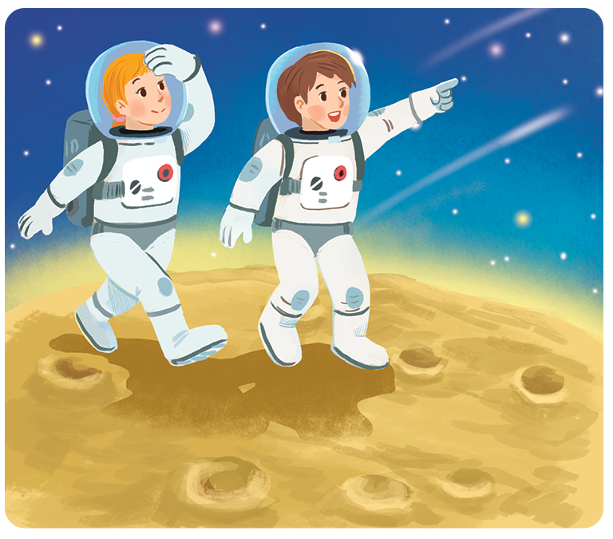
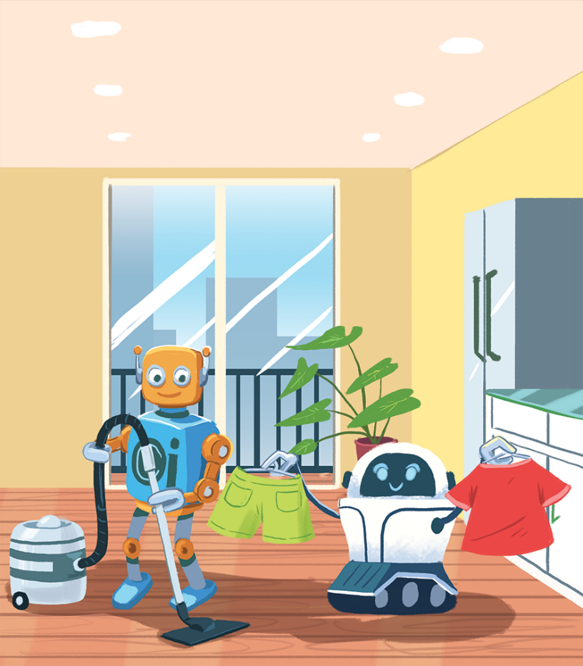
Task 4: Read the two poems. Tick () T (True) or F (False).
In the future
We might live with robots.
They might clean our houses.
They might wash our clothes.
They might not talk to us.
Jenny, aged 12
In the future
We might go on holiday to the Moon.
We might stay there for a long time.
We might have a great time.
We might come home soon.
Henry, aged 11

Slide 8
 | T | F
1. Jenny thinks we might live with robots.
2. Henry thinks we might travel to the Moon.
3. Jenny thinks robots might not clean our houses.
4. Henry thinks we will stay on the Moon for a short time.
5. Jenny thinks robots might help us to do the housework.
6. Henry thinks we might not have a great time on the Moon.







Slide 9
Task 5: Work in groups. Think about what you might do or have in the future. Share your ideas with your classmates. (Game: Give me 5)
Example:
I might have a smartphone to surf the internet.

Slide 10







