Slide 1

6A

Slide 2

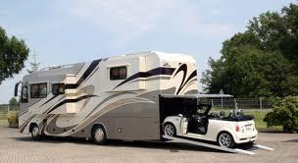
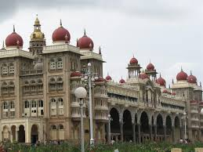
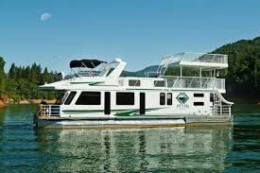
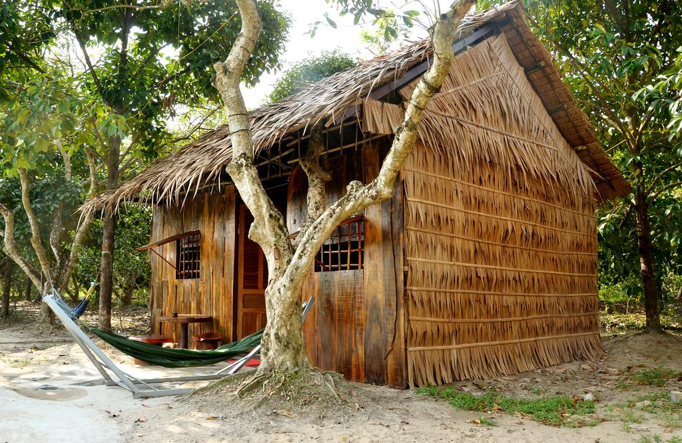
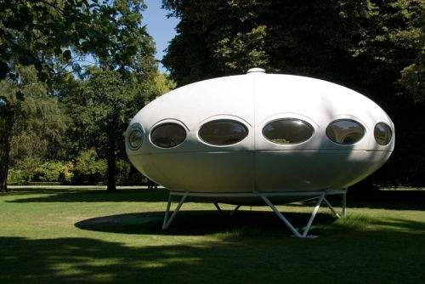
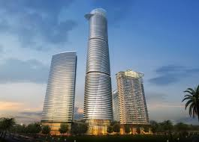
KIM’S GAME:
How many types of house are there in the video ?

Slide 3

Answer key: There are six.

Slide 4
Name these pictures
houseboat
castle
UFO
skyscraper
motorhome
cottage

Slide 5

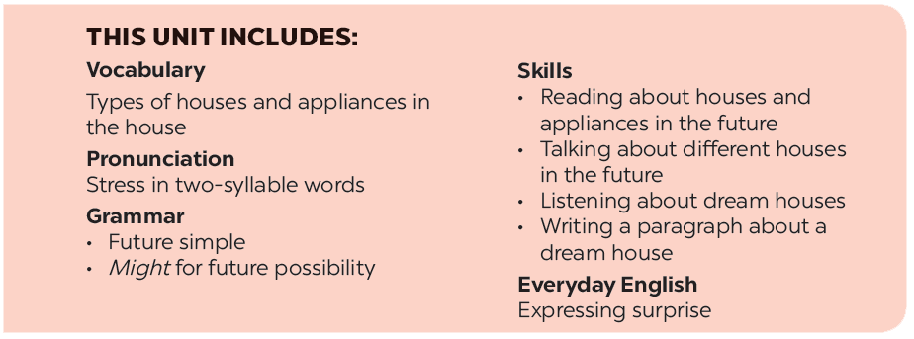

Slide 6







Everyday English
Houses and appliances in the future
Expressing surprise
Read the questions in the class survey below. Tick () Y (Yes) or N (No).
Listen and read the conversation. Pay attention to the highlighted sentences.
Work in pairs. Use the questions in 3 to interview your partner.
Work in pairs. Express your surprise when you see your partner’s new watch, TV, mobile phone, etc.
Tell the class about your interview.

Slide 7
Everyday English
Expressing surprise

Slide 8



Listen and read the conversation. Pay attention to the highlighted sentences.
David: John! Hello!
John: Oh, hi, David. Wow! Is that your computer? It looks great.
David: Yes, it’s my new computer. My parents gave it to me for my birthday.

Slide 9

How can we express surprise?

Slide 10

The structure to express surprise
* Wow! Is that + object?
* It looks + adjective.

Slide 11
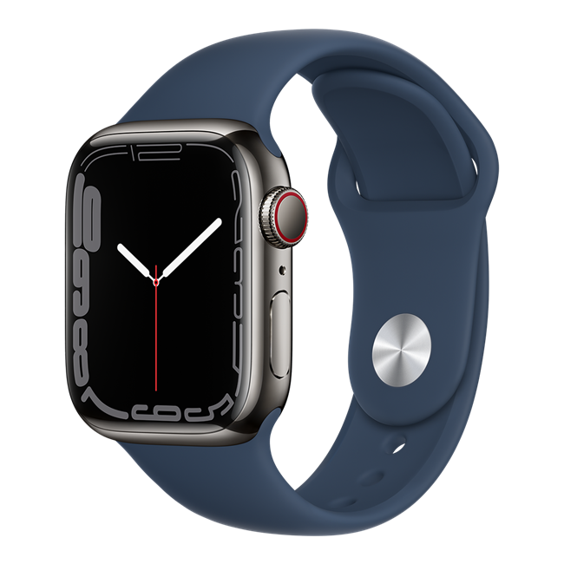
Example:
- Wow! Is that your new watch? It’s really beautiful!

Slide 12
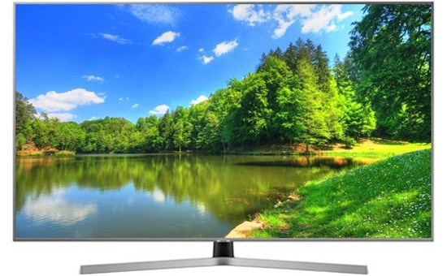
- Look! You have a new TV, don’t you? It’s so amazing!

Slide 13


Slide 14

Work in pairs. Express your surprise when you see your partner’s new watch, TV, mobile phone, etc.
E.g.
David: John! Hello!
John: Oh, hi, David. Wow! Is that your new watch? It
looks great.
David: Yes, it’s my new watch. My parents gave it to me for my birthday.

Slide 15
Houses and appliances in the future

Slide 16
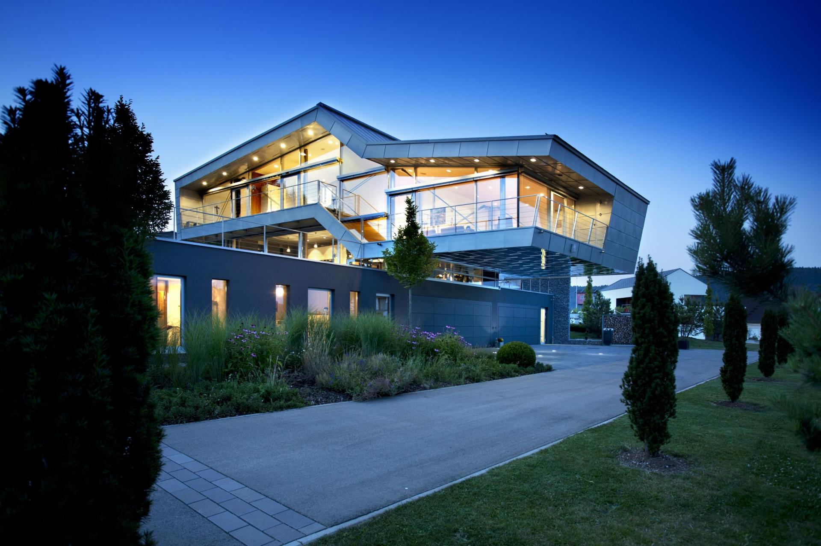

Slide 17


Slide 18

Read the questions in the class survey below.
Tick () Y (Yes) or N (No).
 | Y | N
1. Will you live in a hi-tech house?
2. Will your house be in space?
3. Will you have a lot of trees and ﬂowers around your house?
4. Will you have a fridge that can cook your meals?
5. Will you have a robot that can look after your children?
6. Will you have a car that can ﬂy?
✓
✓
✓
✓
✓
✓
✓
✓
✓
✓
✓
✓

Slide 19

Work in pairs. Use the questions in 3 to interview your partner.
Suggested answer:
A: Will your house have a fridge?
B: Yes, it will.
A: What will it do for you?
B: It will cook my meals.
Notes:
City landmarks phải ở trên mục 3

Slide 20
E.g. of note taking
Type of the house: cottage
Location: in the mountains
Surroundings: trees, flowers and mountains
Appliances: robot (look after the children), fridge (cook meals), computer (send and
receive emails), etc.

Slide 21

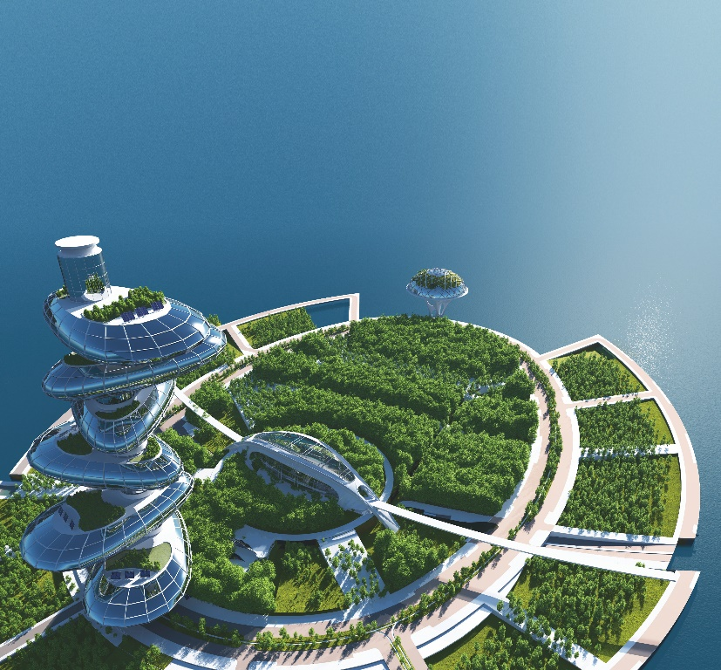
Tell the class about your interview.
Example:
In the future, Nam will live in a hi-tech house.
It won’t be in space. It might be by the sea.
He might have a robot to help him with his home.

Slide 22

- Learnt by heart new structure.
- Do exercises in the Workbook.
- Prepare for next lesson

Slide 23


