Slide 1

Tuesday, April 26th 2022.
Unit 10: OUR HOUSE IN THE FUTURE
Lesson 5: Skills 1

Slide 2








Reading
Speaking
Look at the picture and discuss it with a partner.
Work in pairs. Ask your partner about his / her future house. Use the suggested questions.
Read the text and match the beginnings in A with the endings in B.
Work in groups. Tell your partners about your future house. You can use the information in 4.
Read the text again and circle the option (A, B, or C) to complete the sentences.

Slide 3
I. Reading

Slide 4


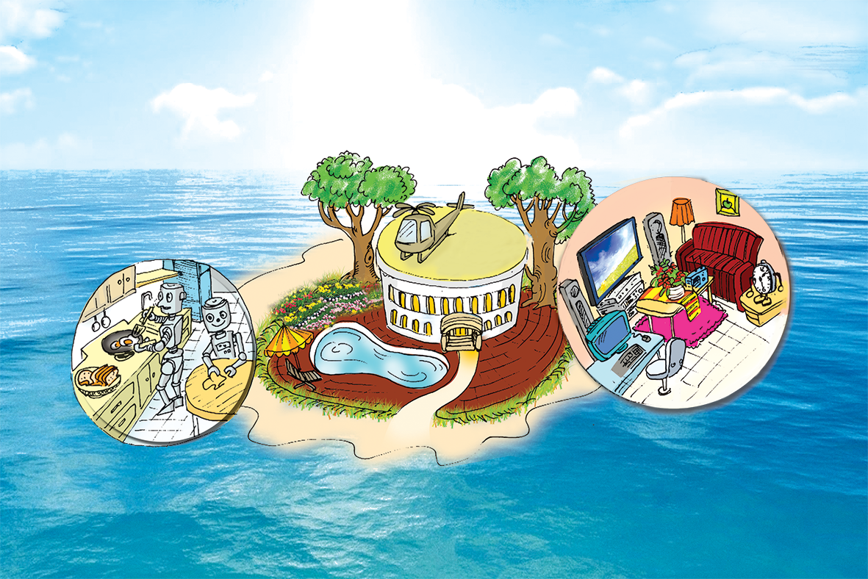
Look at the picture and discuss it with a partner.
1.
What type of house do you think it is?
2.
Where do you think the house is?
E.g.
A: What type of house do you think it is?
B: I think it’s a villa(Biệt thự).
A: Where do you think it is?
B: I think it’s on an island( hòn đảo).

Slide 5

Read the text and match the beginnings in A with the endings in B.
My future house will be on an island. It will be surrounded (bao quanh) by tall trees and the blue sea. There will be a swimming pool in front of the house. There will be a helicopter on the roof. I can ﬂy to school in it.
There will be some robots in the house. They will help me to clean the ﬂoors, cook meals, wash clothes and water the ﬂowers. They will also help me to feed the dogs and cats.
There will be a super smart TV. It will help me to send and receive emails, and contact my friends on other planets. It will also help me to buy food from the supermarket.

Slide 6
1. Surround /sə'raʊnd/ (v) bao quanh, vây quanh
2. Helicopter /'helikɒptə[r]/(n) máy bay trực thăng
3. Roof /ru:f/ (n) mái nhà/ nóc nhà
4. Receive /ri'si:v/ (v) nhận
5. Contact /kɒn’tæt/ (v ) liên lạc
6. Planet /'plænit/ (n): hành tinh
7. Supermarket /'su:pəmɑ:kit/(n) siêu thị

Slide 7
2. Quickly read the text. Check your ideas from 1
My future house will be on the Ocean. It will be surrounded by tall trees and blue sea. There will be a swimming pool in front and a large flower garden behind the house. There will be a helicopter on the roof so that I can fly to school.
My future house will have solar energy. There will be some robots in the house. They will help me do the housework, such as: cleaning the floors, cooking meals, washing clothes, watering the flowers and feeding the dogs and cats.
I will have a super smart TV in my house. It will help me surf the Internet, send and receive my e-mails, and contact my friends on other planets. It will also help me order food from the supermarket.

Slide 8
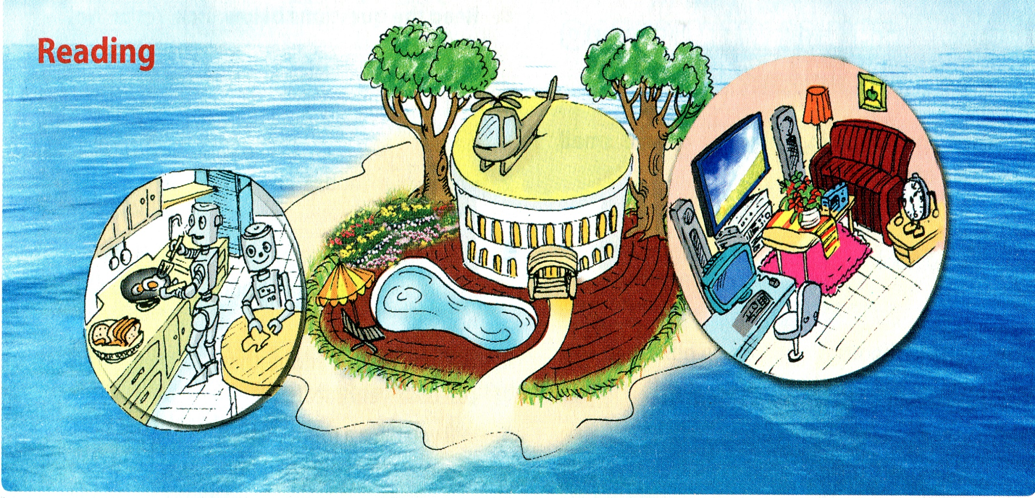
1. What type of house do you think it is?
a villa
2. Where do you think the house is?
on the Ocean
3. What can you see around the house?
a flower garden, a swimming pool, tall trees, a helicopter on the roof, …

Slide 9
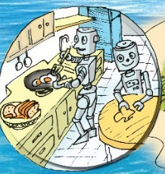
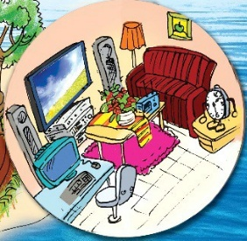
4. What can you see in the house?
Robots in the kitchen; a wireless TV, a computer, a stereo,... in the living room.

Slide 10
A
B
a. clean the floors.
c. wash clothes.
e. cook meals.
g. feed the dogs and cats
h. water the flowers.
b. contact my friends.
d. buy food from the supermarket.
B
a. clean the floors.
b. contact my friends.
1.
The house will have robots to
c. wash clothes.
d. buy food from the supermarket.
e. cook meals.
2.
The house will have a super smart TV to
f. send and receive emails.
g. feed the dogs and cats.
h. water the flowers.

Slide 11

Read the text again and circle the option (A, B, or C) to complete the sentences.
1.
The house will be _______.
A.
in the mountains
B.
on an island
C.
on the Moon
2.
There will be a _______ in front of the house.
A.
garden
B.
pond
C.
swimming pool
3.
The house will have _______ robots.
A.
B.
some
many
C.
a lot of
4.
The _______ will help me to feed the dogs and cats.
A.
helicopter
B.
robot
C.
super smart tv

Slide 12
Speaking

Slide 13

Work in pairs. Ask your partner about his / her future house. Use the suggested questions.
Example:
A: What type of future house do you think it will be?
B: It’ll be a palace.

Slide 14
1.
What type of future house do you think it will be?
My future house will be a palace.
2.
Where will it be?
It’ll be on the Moon.
3.
What will it look like?
It’ll look like a UFO.
4.
How many rooms will it have?
It’ll have twenty rooms.
5.
What appliances will it have and what will they help you to do?
It’ll have a smart TV and ten robots to help
me do the housework.

Slide 15

Choose one sportsperson in 4. Talk about him / her. Use the following cues.
Example:
My future house will be a palace. It’ll be on the Moon. It’ll look like a UFO. It’ll have twenty rooms. There’ll be a smart TV and ten robots in the house to help me do the housework.

Slide 16
SPEAKING
Discribe your future house/ bed room to your partner.
Trees
Around the house
Garden
Swimming pool
Blue sea
big table
My future house
nice sofa
Living room
wirelessTV
Bathroom
wirelessTV
Kitchen
Air conditioner
In the house
Smart phone
Bedroom
modern bed
Robots
lamps

Slide 17

HOMEWORK
Learn the new words.
Read text again.
- Prepare for the next lesson:
Unit 10 - skills 2.

Slide 18


