Slide 1
WELCOME TO MY CLASS

Slide 2
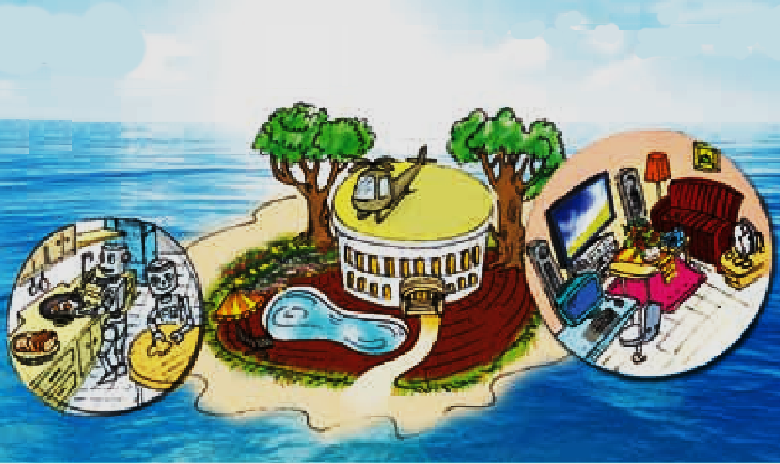
Warm up:
Revision
- Hey, guys. Do you still remember the future house you already read about in Lesson 5?
- I would like to check your memory with this table. Those who have got good answers will get good marks.
Type of house
Location
Surroundings
Appliances in the room
villa
on the ocean
trees, a garden, a swimming pool
robots, smart T.V

Slide 3
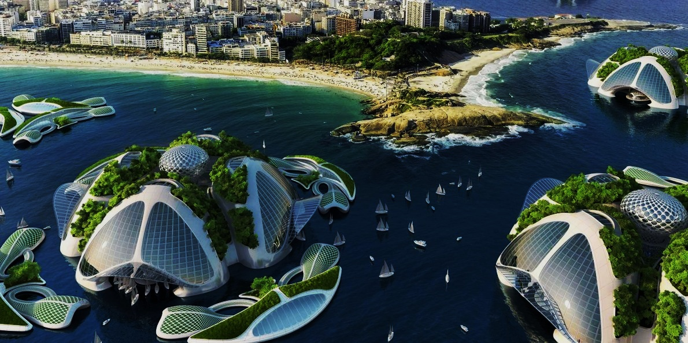
NEW LESSON
UNIT 10
OUR HOUSES
IN THE FUTURE
PERIOD 85: SKILLS 2

Slide 4
Vocabulary
- coast (n)
- view (n)
- spacious (a)
- satellite (n)
- contact (v)
- operate (v)
- preserve (v)
bờ biển
quang cảnh
rộng rãi
vệ tinh
tiếp xúc
vận hành, chạy (máy móc)
bảo quản

Slide 5
Checking vocabulary:
- coast (n)
- view (n)
- spacious (a)
- satellite (n)
- contact (v)
- operate (v)
- preserve (v)
bờ biển
quang cảnh
rộng rãi
vệ tinh
tiếp xúc
vận hành, chạy (máy móc)
bảo quản

Slide 6
LISTENING

Slide 7
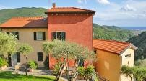
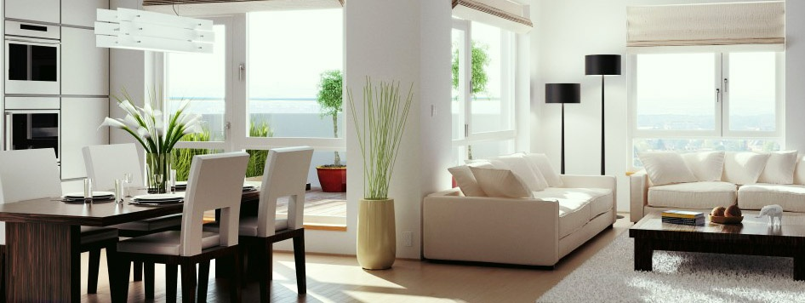
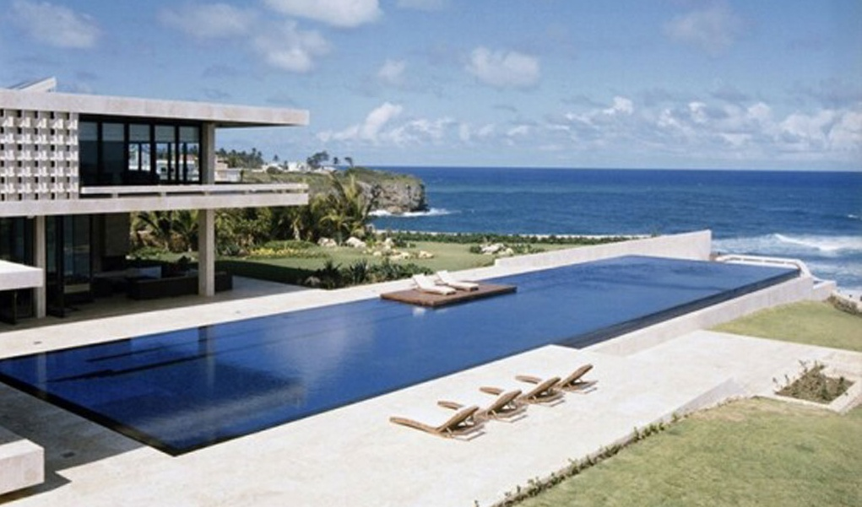

1. Listen to Nick and Linda talking about their dream houses. Which house would each prefer? Write their names under the correct pictures.
Nick: (apartment in the city)
Linda: (villa by the sea, with a swimming pool and a garden)

Slide 8
2. Listen to the conversation again. What is important to Nick? What is important to Linda? Tick (✓) the columns.
1. park view
Linda | Nick
2. city view
3. sea view
4. swimming pool
5. garden
6. cable TV
7. quiet

Slide 9
Audio script:
N: Can you tell me about your dream house, Linda?
L: Well, my dream home is a big villa near the coast with a great view of the sea. It has a swimming pool, and it has a garden too.
N: What kind of garden?
L: A flower garden, you know. And my dream house will be a quiet one. You see, no noise.
N: My dream house is completely different.
L: Really? What is it like?
N: It’s an apartment in the city. And it has a super cable TV so I can watch films from other planets.
L: Oh, that sounds great!
N: And I don’t need a yard or a garden. In front of the house I want it to have a nice park view, and at the back, I want it to have a great city view.
L: That sounds interesting too. But I think it’ll be...

Slide 10
WRITING

Slide 11
3. Work in pairs. Discuss the following ideas
about your dream house.
1. What type of house it is
2. Where it is located
3. What it looks like
4. What surrounds it
5. What appliances it has
Example:
S1: What type of dream house is it?
S2: It’s a villa.
S1: Where is it located?
S2: It’s by the sea. …

Slide 12
4. Now fill in the table about your dream house.
Type of house
Location
Number of rooms
Surroundings
Things in the house and what they will / might do for you

Slide 13
5. Use the information in 4 to write about your dream house.
Type of house
Location
Number of rooms
Surroundings
Things in the house and what they will / might do for you
country house
in the countryside
5 rooms
many trees and green fields
an automatic dishwasher to wash & dry dishes, an automatic washing machine to wash clothes, a super smart TV to watch TV programmes from satellites and contact friends, solar and wind power to operate all appliances

Slide 14
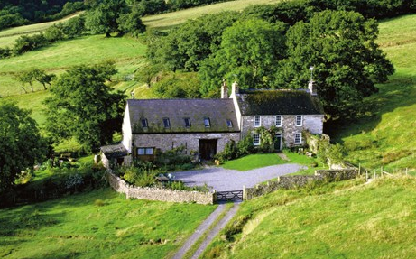
Modal writing 1:
My future house will be in the countryside. It is surrounded by many trees and green fields.
Outside my window I can see a river and a lake. It'll be a spacious house and there will be 5 rooms in it. My future house will have an automatic dishwasher to wash and dry dishes and an automatic washing machine to wash clothes. I also have a super smart TV to watch TV programmes from satellites and contact friends from all over the world. I will have solar and wind power to operate all appliances. It’ll be a wonderful place for me to live in.

Slide 15
5. Use the information in 4 to write about your dream house.
Type of house
Location
Number of rooms
Surroundings
Things in the house and what they will / might do for you
villa
near the coast
10 rooms
rows of coconut tree
a big garage to store super cars, a modern fridge to preserve food, cook meals, an automatic dishwasher to wash dishes, a washing machine to wash clothes, a super smart TV to surf the internet, watch favourite programmes from space or contact friends, wind power and solar energy to run all appliances

Slide 16

Modal writing 2:
My dream house will be a large villa. It is near the coast, surrounded by rows of coconut tree and the blue sea. It’ll be a big house with ten rooms.
There will be a big garage so that I can store my super cars there. It’ll have wind power and solar energy to run all appliances such as a modern fridge to preserve food and cook meals, an automatic dishwasher to wash dishes and a washing machine to wash clothes. They can be controlled by voice. There will be a super smart TV, so I might surf the internet, watch my favourite TV programmes from space or contact friends on other planets. I might also join online classes on TV and I might not go to school. It’s a wonderful house isn’t it?

Slide 17
Now you have ten minutes to write about your dream houses and then present them to the class!

Slide 18
Please tell me what you have learnt today.
Yes, through the lesson we can now listen to get information about dream houses; write about a dream house.

Slide 19



HOMEWORK
- Learn the new words by heart.
- Listen to the recording again.
- Do exercise E1,2 in workbook (pages 31).
- Prepare for Unit 10: LOOKING BACK & PROJECT.
+

Slide 20

THANKS FOR YOUR ATTENTION!
Goodbye!
See you again!

