Slide 1

WELCOME TO OUR CLASS
9A

Slide 2

REVISION UNIT 1,2,3

Slide 3

UNIT 1 :
LEISURE ACTIVITIES

Slide 4

I. VOCABULARY

Slide 5
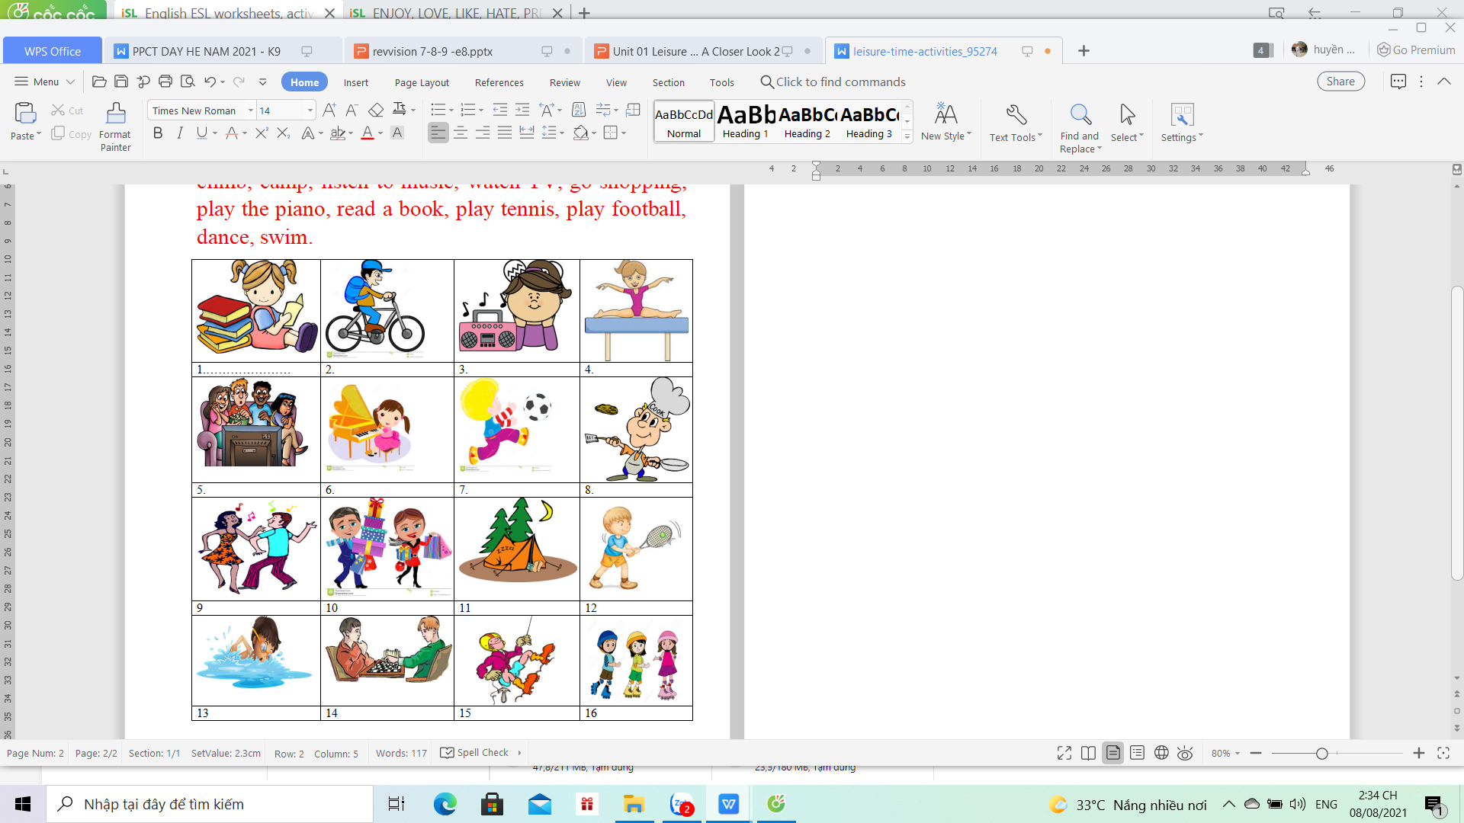
MATCHING
A.Ride a bike
B. cook
C. do gymnastics
D. play chess
E. skate
F. climb
G camp
H. listen to music
I. watch TV
K. go shopping
L. play the piano
M. read a book
N. play tennis
O. play football
P. dance
Q. swim.
KEYS : 1-M , 2-A , 3- H , 4- C , 5- I, 6- L , 7- 0 , 8- B ,
9- P, 10- K , 11- G , 12- N , 13- Q, 14- D , 15- F , 16- E

Slide 6

II. GRAMMAR.
adore
love
like, enjoy, fancy
don’t mind,
dislike/ don’t like
hate
detest
prefer
1. Verbs of liking:
+ gerund (V_ing)

Slide 7
Write what you like and what you don’t like doing.
reading book
I like __________________
I adore ____________
I don’t like _____________
I enjoy ____________
I hate ________________
I prefer _______________
I am interested in _______
I fancy ___________
I detest _________

Slide 8
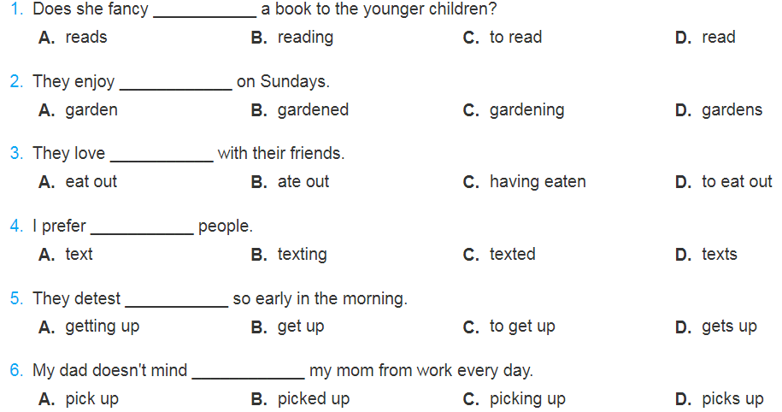


Slide 9
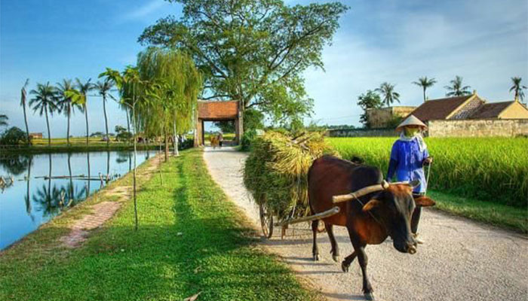
Unit 2
LIFE IN THE COUNTRYSIDE

Slide 10
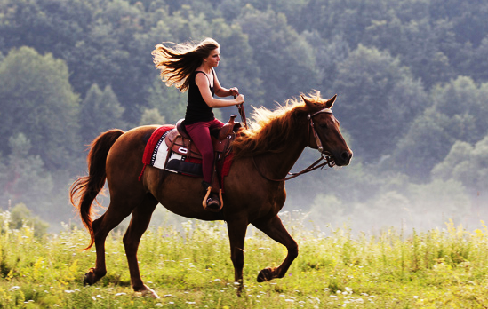
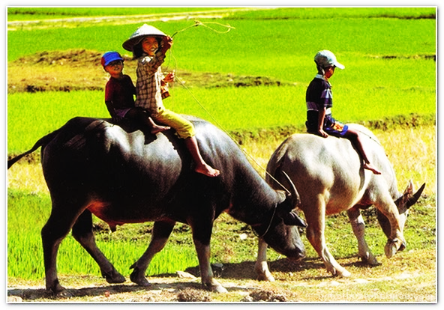
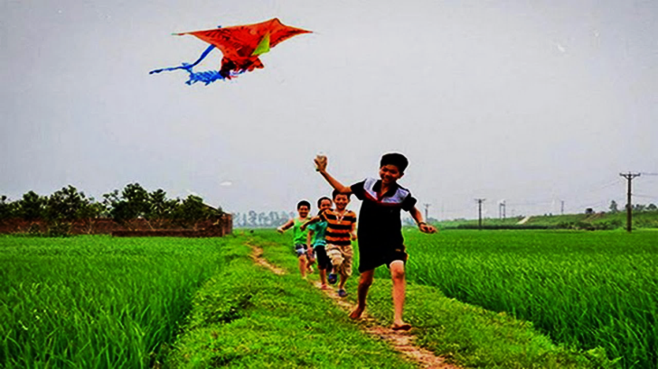
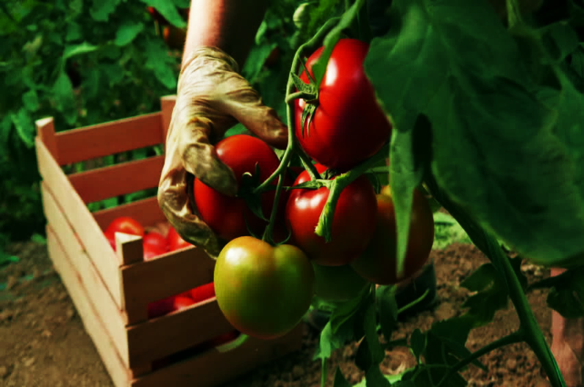
WARM-UP:
Choose the right phrase and then put it under the appropriate picture.
picking tomatoes
drying the rice
riding a horse
herding the buffaloes
flying kites
collecting water

Slide 11

I. ADJECTIVES(adj) AND COMPARISON

Slide 12
Ex1: Circle the Adjectives (Game)
sing happy boring fast dance
herb nomadic beautiful play write slow colourful inconvenient friendly brave people teacher singer fat slow handsome repeat read country ugly cold strong
thin factory house school ruler long eraer short wonderful peaceful difficult

Slide 13
fast
happy
ugly
fat
thin
short
tall
long
strong
slow
friendly
brave
cold
difficult
boring
wonderful
beautiful
peaceful
handsome
inconvenient
colourful
nomadic
Short Adjectives
Long Adjectives
1, 2 syllables
(2- y )
2,3 syllables

Slide 14
short adjectives
long adjectives
Eg: I am taller than my sister
Eg: Countryside is more peaceful than city
S1 + Tobe (am/is/are) + Adj ..... than S2
S1 + tobe + ........ Adj than + S2

Slide 15
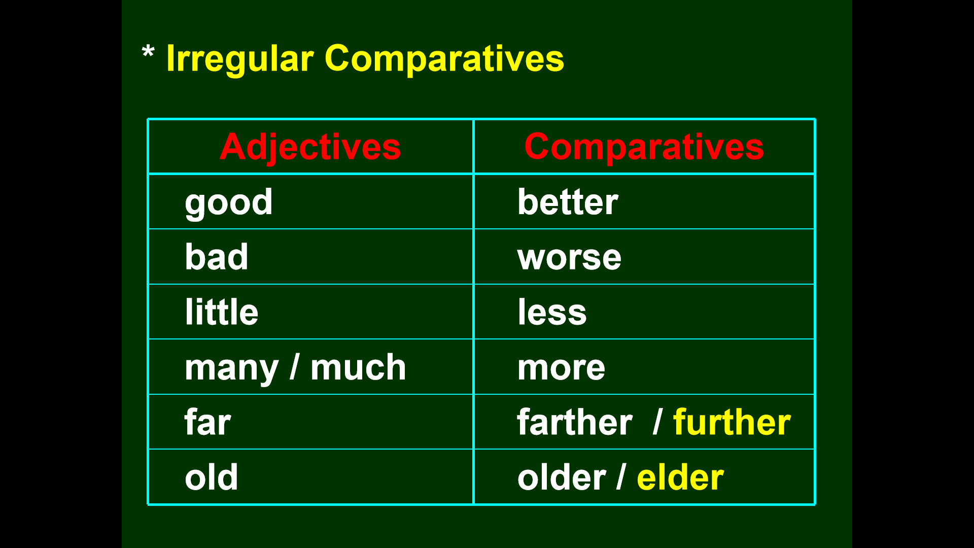

Slide 16
I. Use the comparison to complete the sentences
1. This hotel is ………...........the other one ( comfortable )
2. I think this shop is ……...................that one ( good)
3. Mary is …….....................Betty ( old)
4. His homework is ……..................mine ( bad)
5. The weather is …………..............at home ( cold)
6. This lesson is ….......................the last one ( difficult)
7. You are …………...............you were yesterday ( tired)
8. Is the new car ……………..the old one ? ( expensive)

Slide 17
II. ADVERBS (adv) AND COMPARISON

Slide 18

ADVERBS = ADJECTIVE + LY
SHORT ADVS
LONG ADVS
hard----- harder
early --- earlier
late --- later
fast --- faster
soon --- sooner
more beautifully
more peacefully
more difficultly
more conveniently
more historically
................

Slide 19
ADVERBS = ADJECTIVE + LY
SHORT ADVS
LONG ADVS
eg: I study harder than my brother
eg: Mary sings more beautifully than Jenny
S1 + V + ADV-ER THAN S2
S1 + V MORE ADV THAN S2

Slide 21
2. Fill in the correct adverb form (comparative ) of the adjectives in brack
1. I speak English (fluent) .............................now than last year.
2. She smiled (happy)............................................ than before
3. Planes can fly (high)...........................................than birds.
4. He had an accident last year. Now, he drives (careful).................... than before.
5. Jim can run (fast)............................................ than John
6. He worked (hard) ........................................than ever before

Slide 22
TO SUM UP: UNIT 1,2
1. Verbs of liking
like
enjoy
fancy
dislike + V-ing
hate
detest
prefer
Comparatives
Adjectives:
S1+ tobe + Adj(short) -er than S2
S1+ tobe+ more Adj(long) than S2
Adverbs:
S1+ V+ Adv(short)-er than S2
S1+ V+ more Adv(ly) than S2

Slide 23
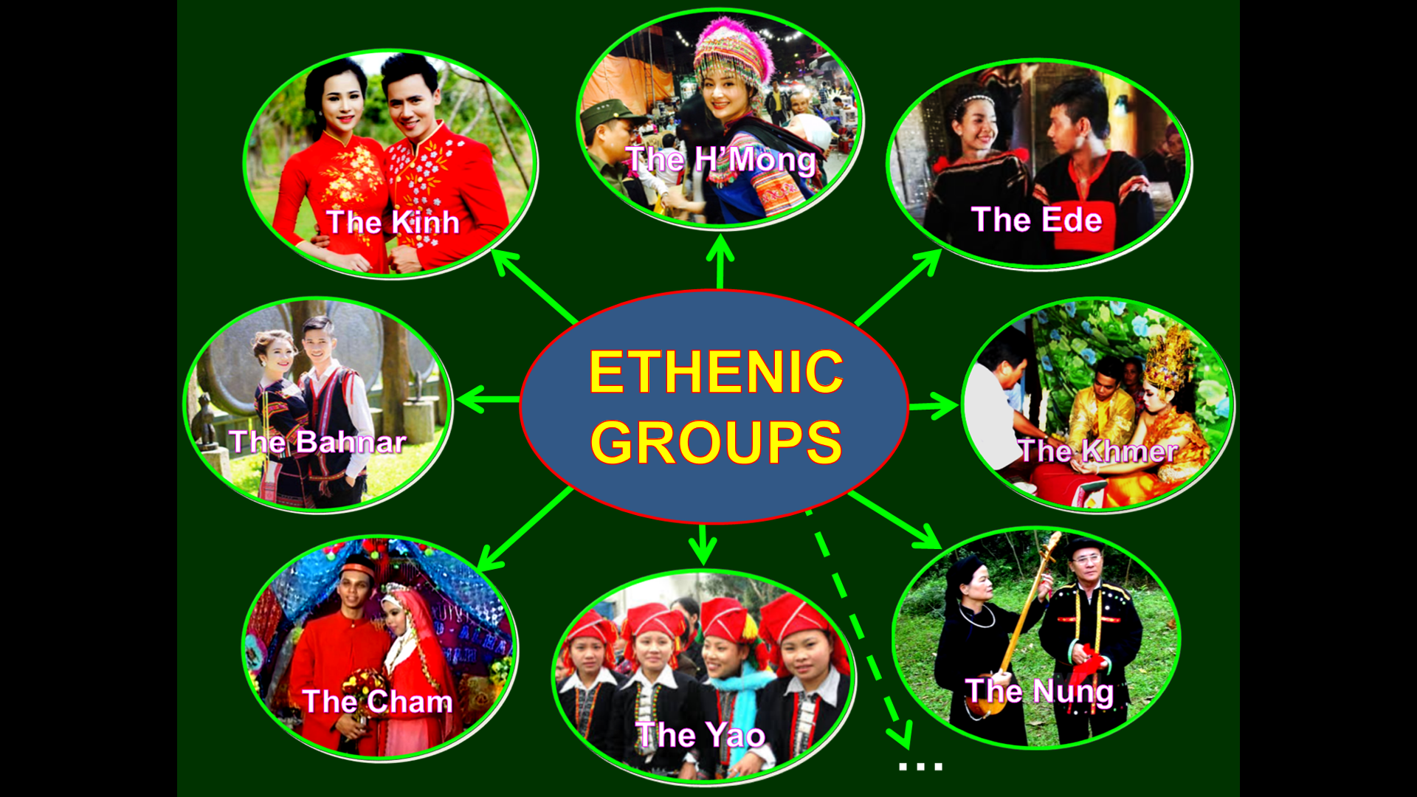

UNIT 3: PEOPLES OF VIETNAM

Slide 24
I. VOCABULARY

Slide 25
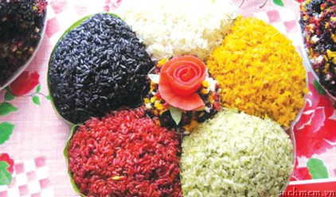
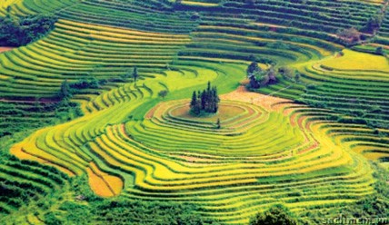
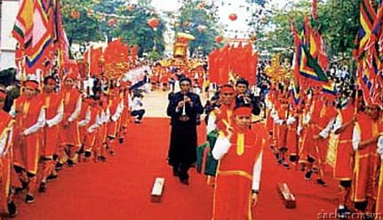
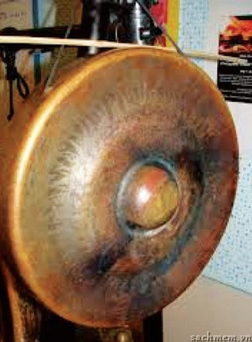
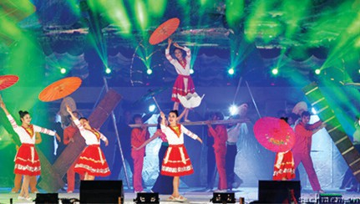
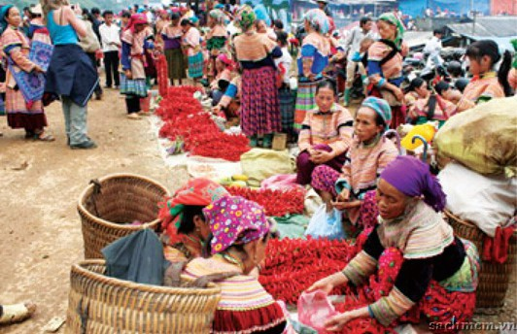
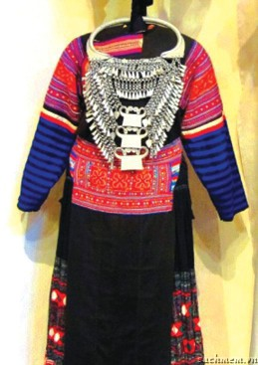
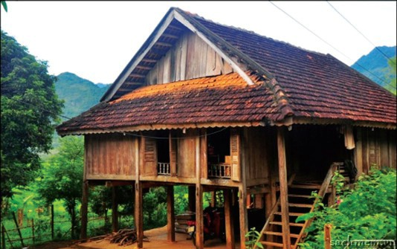
1. five-coloured sticky rice
2. terraced fields
3. festival
1
4. folk dance
5. open-air market
6. musical instrument
7. stilt house
7. costume

Slide 26
II. GRAMMAR

Slide 27
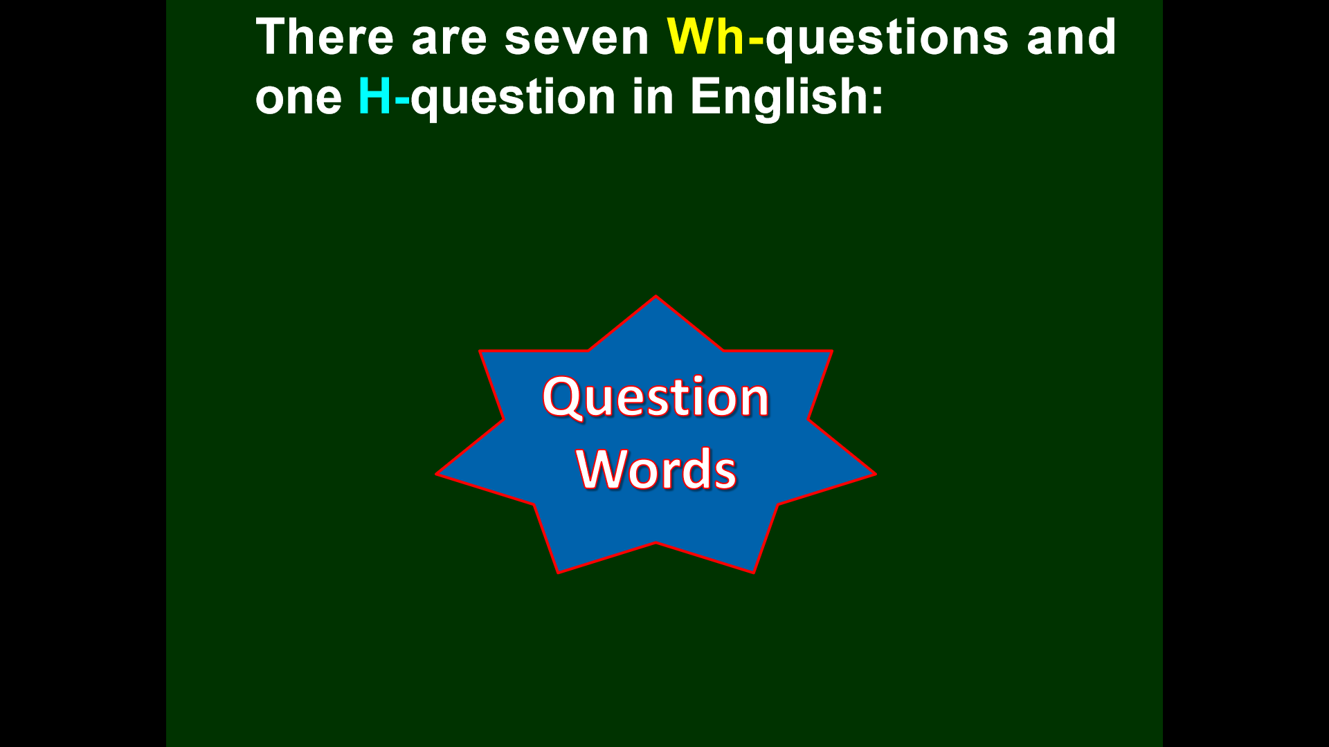

Slide 28
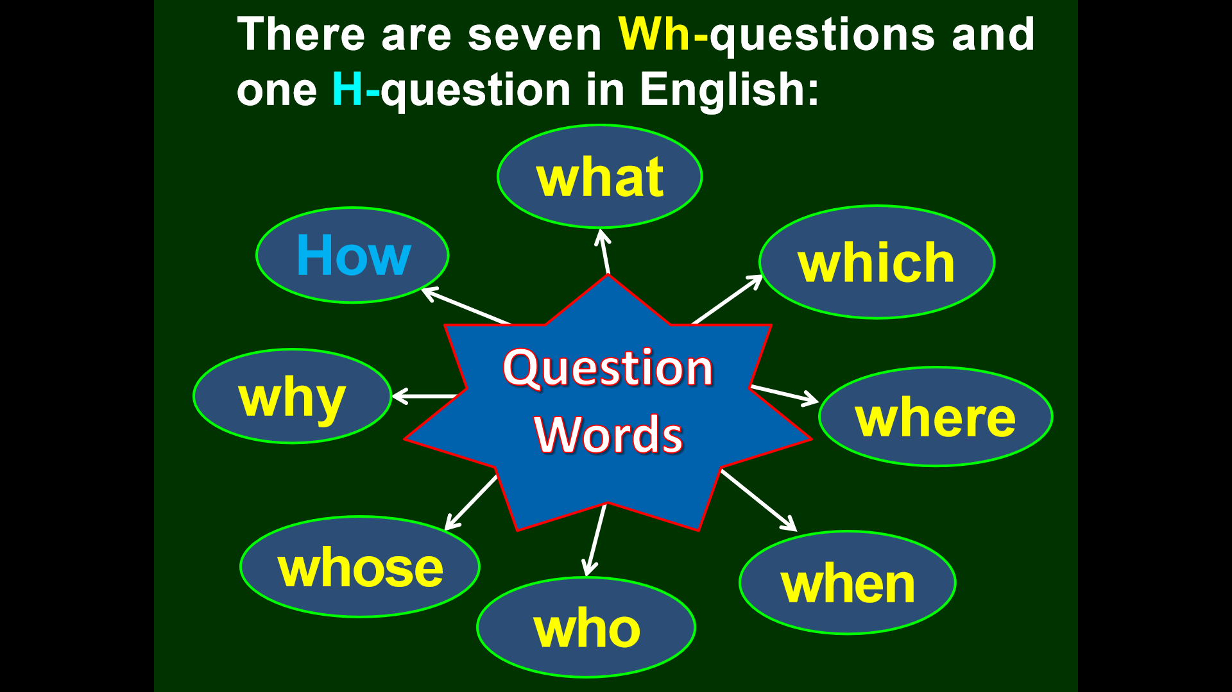

Slide 29
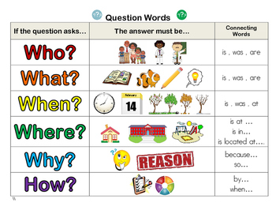
person
(người)
things (sự vật)
time
(thời gian)
place
(địa điểm)
reason
(lý do)
manner
(cách thức/như thế nào)

Slide 30
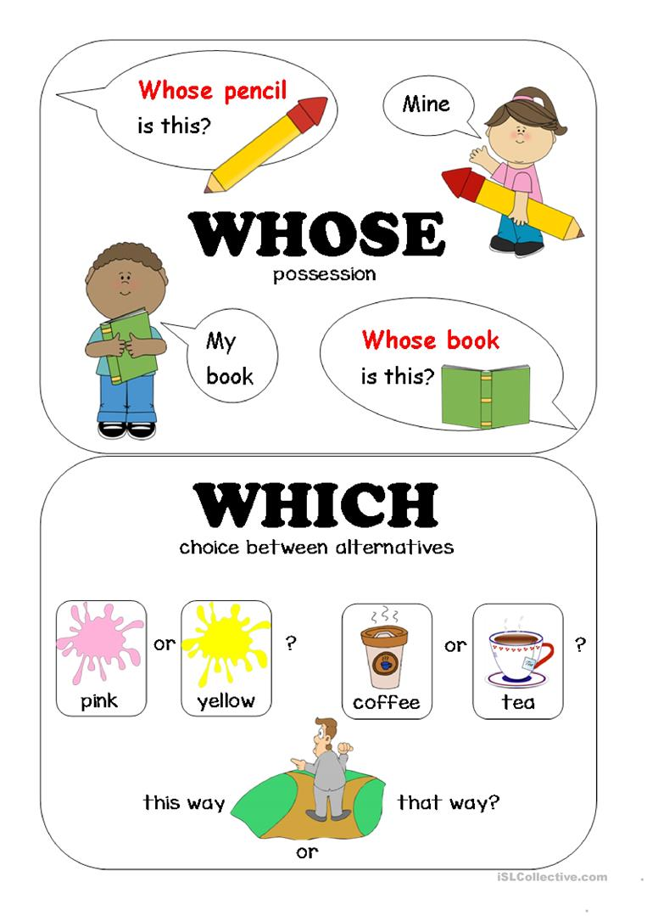
possession (sở hữu)
choice (sự lựa chọn)

Slide 31
HOW TO MAKE A QUESTION
1. Tobe:
Wh/H am/is/are/was/were + S ….?
2. Verbs:
+ Present simple: Wh/H - do/does + S + V ?
+ Past simple : WH/ H - did + S + V?
+ Present perfect: Wh/ H - have/has + S + Ved/V3 ?
+ Present continuous : WH/ H - am/is/are + S + Ving ?
+ Past continuous: WH/H - was/ were + S + VIng ?
+ Future simple : Wh/H - will/ can/should …+ S + V ?

Slide 32
III. Practice

Slide 33
I. Select the correct Wh question word:
1. ___ is your name?
What / Where
When / Who
2. ___ is your favorite actress?
What / Why
When / Who
3. ___ are you from?
What / Where
When / Who
4. ___ is your birthday?
Whose / Where
When / Who
5. ___ color is your new car?
What / How
Where / Whose
6. ___ old are you?
What / How
Which / Whose
7. ___ books are these?
Why / How
Where / Whose
8. ___ did you quit your job?
Who / Which
Why / Whose
9. ___ are you going to America?
Who / What
When / Which
10. ___ aren't you going to Peter's party?
What / How
Where / Why

Slide 34
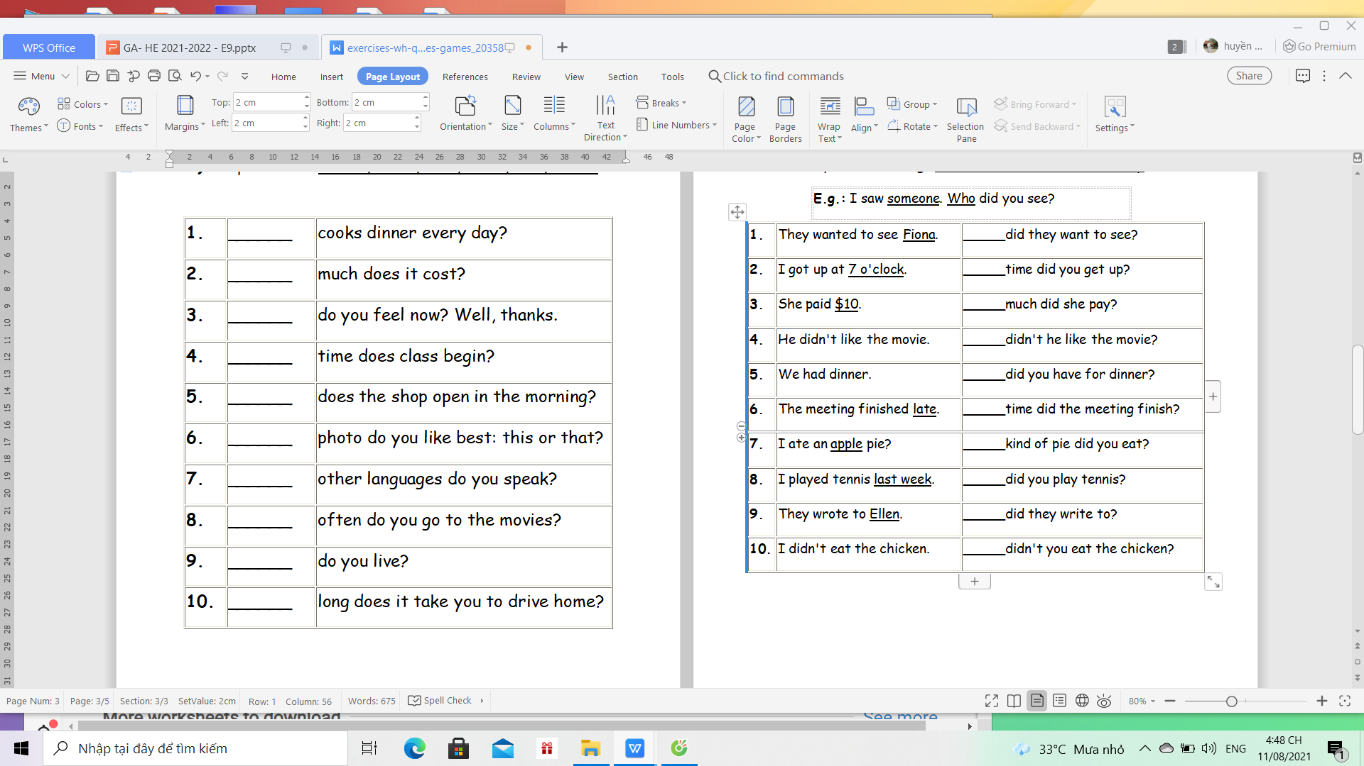
II. Fill the question -words : who, which, where, when, whose, what, why, how
Who
How
1. | ______ | cooks dinner every day?
2. | ______ | much does it cost?
3. | ______ | do you feel now? Well, thanks.
4. | ______ | time does class begin?
5. | ______ | does the shop open in the morning?
6. | ______ | photo do you like best: this or that?
7. | ______ | other languages do you speak?
8. | ______ | often do you go to the movies?
9. | ______ | do you live?
10. | ______ | long does it take you to drive home?
How
What
What time
Which
What
How
Where
How

Slide 35
III. Make the question for the underlined parts. ( Đặt câu hỏi cho bộ phận gạch chân)
1. The dictionary is 200,000 dong.
...............................................................................................................................................
2. I made it from a piece of wood.
................................................................................................................................................
3. Mary's birthday is on March 24th .
................................................................................................................................................
4. It’s about 1,500 km from Hue to Ho Chi Minh City.
................................................................................................................................................
5. The bank is opposite the restaurant.
................................................................................................................................................
6. The dress looks very nice.
................................................................................................................................................
7. I have just met her for a minute
How much is the dictionary ?
What did you make it from ?
When is Mary's birthday?
How far is it from Hue to HCM city ?
Where is the bank ?
How does the dress look ?
Who have you met for a minute?

Slide 36
THE ARTICLES : A/AN/THE
a/an =1
- Countable singular Noun ( danh từ đếm được số ít)
+ a book ,
+ an ( u,e,o,a,i) eg: an apple
- Unidentified Noun ( danh từ không xác định cụ thể đối tượng là ai , là cái gì )
+ a dog, a book, an animal , a teacher , an engineer .........
- Talk about a new thing (mới được đề cập đến lần đầu tiên )
+ I have a new dress
- Describe a person/ something ( miêu tả ai đó , thứ gì đó)
+ She is a beautiful girl

Slide 37
The
- Singular / Plural Noun ( Danh từ số it/ số nhiều)
+ the book / the books
- Identified Noun : ( đã được xác định rõ là ai, là cái gì , được đề cập lần 2 )
+ I have a new dress . The dress is very beautiful.
- The only Noun ( là duy nhất, độc nhất)
+ the Sun, the Earth, the King
- Superlative ( So sánh nhất)
+ She is the most clever in the class
- Before a name of ( river, sea , museum, hotel and newspaper, musical instrument)
+ the Nile , the Hilton hotel , the New York Times , the piano.............................

Slide 38
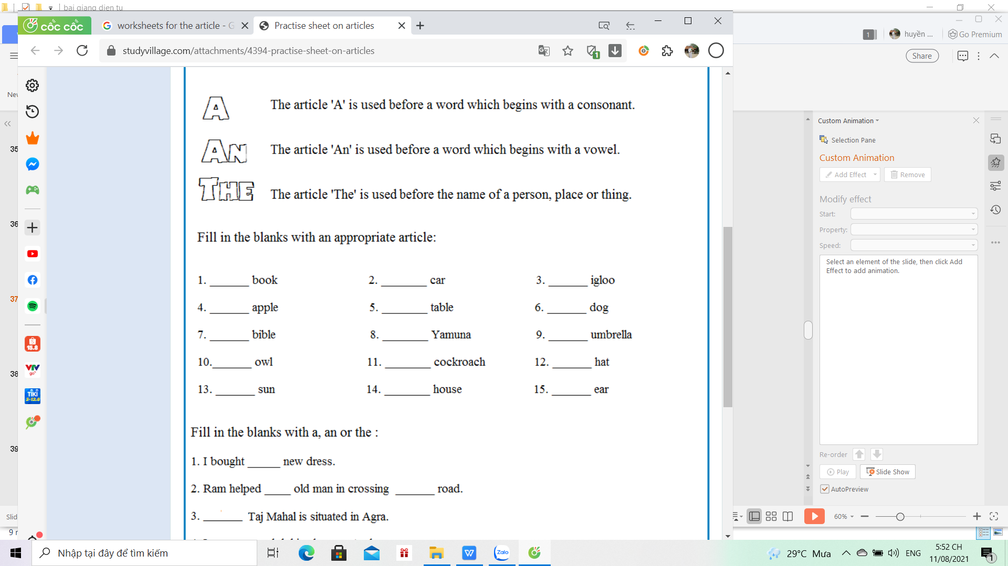
a , an , the
a
a
an
an
a
a
the
the
an
an
a
a
the
a
an

Slide 39
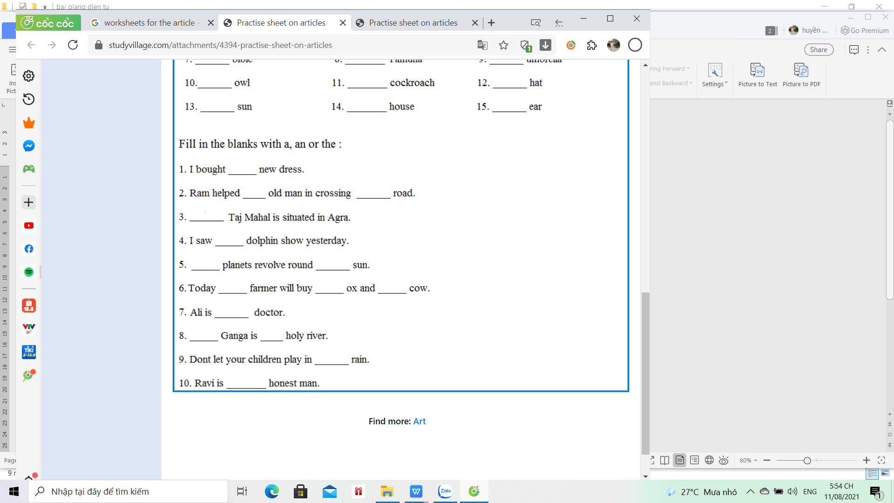
a
an
the
The
a
The
The
The
an
a
a
The
a
The
an

Slide 40

UNIT 4: OUR CUSTOM AND TRADITION
customs
traditions
They have their own ways of life, and ______ and ________

Slide 41
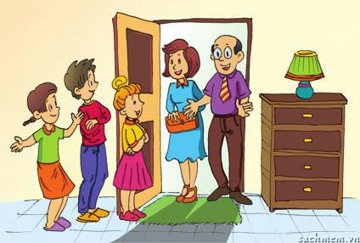
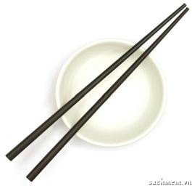
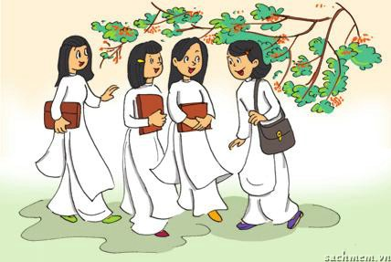
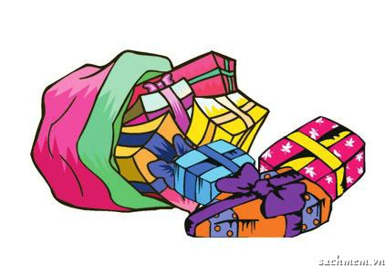
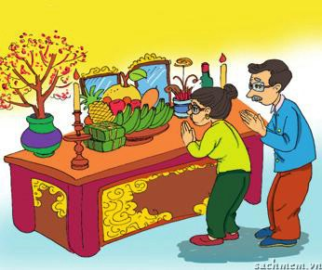
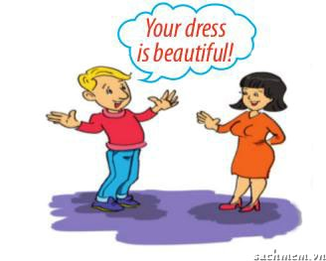
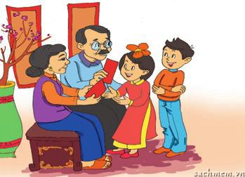
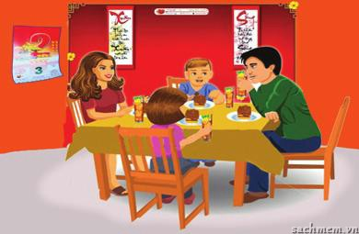
2a(p.39). Match the pictures with the customs and traditions.
1. | smiling to accept a compliment
2. | worshipping ancestors
3. | wrapping gifts in colourful paper
4. | having lunch together on the second day of Tet
5. | placing the chopsticks on top of the rice bowl when finishing a meal
6. | children in the family standing in a row to greet guests
7. | wearing ao dai on special occasions
8. | giving children lucky money at Tet
g.
c.
a.
e.
f.
h.
b.
f.
e.
c.
a.
g.
b.
d.
d.
h.

Slide 42
II. GRAMMAR

Slide 43
1. Should/ shouldn't - Have to / don't have to
- to give an advice for somebody
to express external obligation or necessity.( ai đó đưa quyết định về việc bạn phải làm)
Form:
+ S + have/has to V(infinitive)
-) S+ don't /doesn't have to V
( không cần thiết phải làm )
?) Do/ Does + S + have to V?
Note:
must not= mustn't + V
( không bắt buộc phải làm)
S + should/ shouldn't + V(infinitive)
eg: 1. You ________ respect old people.
2. According to tradition,
you _____________
sweep the floor on the first day of Tet.
should
shouldn't

Slide 44
1.Complete the sentences with should or shouldn’t.
(Hoàn thành các câu với should hoặc shouldn’t)
1.You __________ respect old people.
2.According to tradition, you __________ sweep the floor on the first day of Tet.
3.Children __________ take things from adults with both hands.
4.You __________ wear shorts when going to the pagoda.
5.You__________ bring a gift when you visit someone’s house.
6.Your sister is chewing and taking at the same time. You__________ do that .It’s not very polite.

Slide 45
2. Complete the sentences with have to
(Hoàn thành các câu với hình thức đúng của have to )
1.My mother says that I __________ be home by 9 p.m.
2.We __________ go now because our dad is waiting for us.
3.She __________ wear that costume because it’s the family tradition.
4.In the past, men __________ wear Ao Dai, but today they __________ wear it.
5.Before leaving the dinner table, __________ your son __________ ask for permission?
6. We__________ go to school today because it was raining heavily.

Slide 46
REVISION UNIT 5

Slide 47
I. VOCABULARY

Slide 48
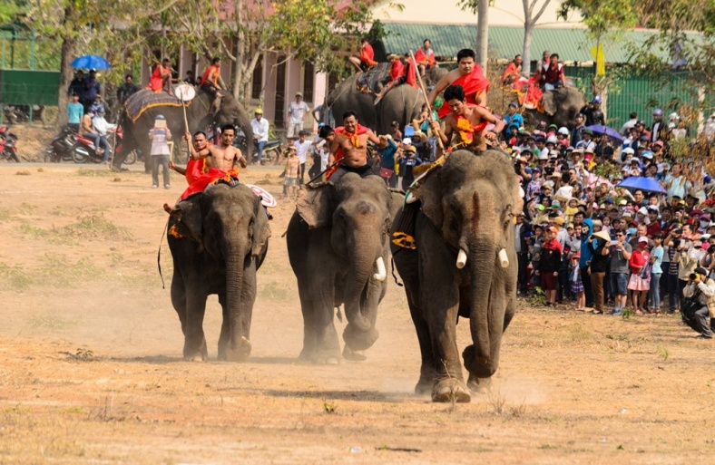
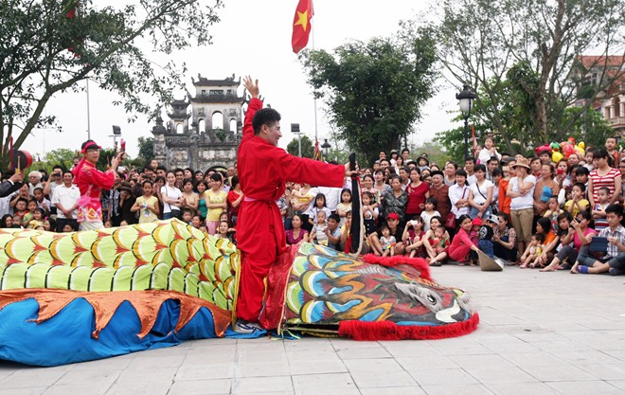
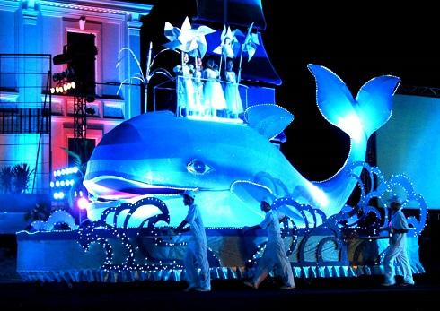
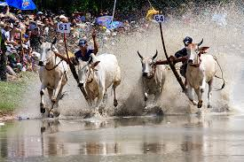
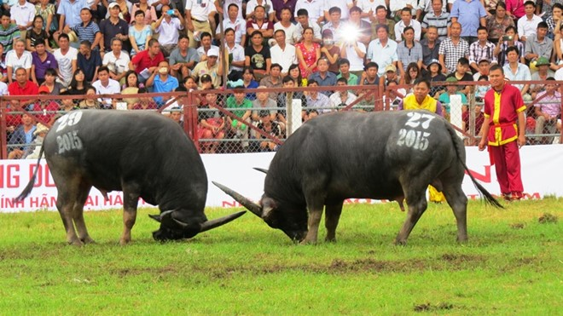
*Match the words with the pictures of festivals.
Do Son buffalo- fighting festival
Elephant race festival
Festivals
Cow racing festival
Le Mat snake festival
Whale festival
1.
2.
3.
4.
5.

Slide 49

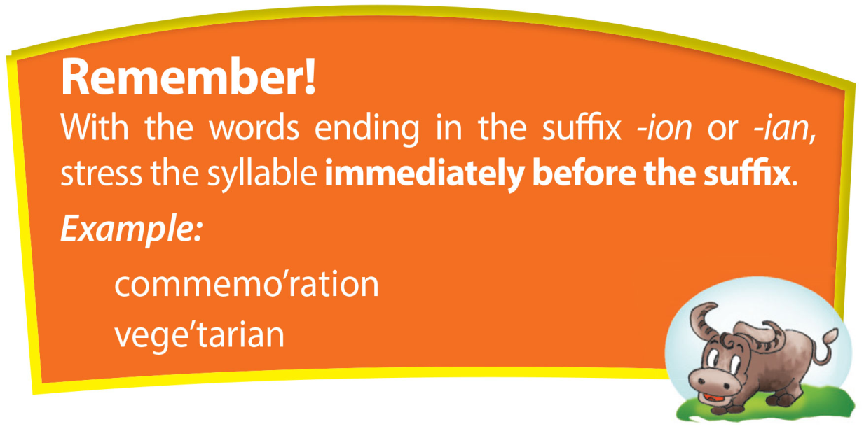
ii. pronunciation
compe’tition commemo’ration pro’cession presser’vation con’fusion ma’gician
Mu’sician vege’tarian com’panion

Slide 50
How to mark(') stress of the word.
- Đánh trọng âm từ hay còn gọi là đi tìm âm tiết nổi bật của từ:
Eg: com pe t'i tion
(trọng âm từ)
- Muốn xác định được trọng âm từ , :
+ Ta đếm âm tiết của từ ( dựa vào nguyên âm u,e,o,a,i)
com pe t'i tion ( 4 âm tiết)
1 2 3 4
+ Dựa vào quy tắc : đuôi “ion” và “ ian” đánh trọng âm vào âm tiết trước nó
com pe t'i tion ( 4 âm tiết)
1 2 3 4
mu 'si cian
1 2 3

Slide 51
Mark(') stress of the word
competition
commemoration
procession
preservation
confusion
magician
musician
vegetarian
companion

Slide 52
III. GRAMMAR

Slide 53
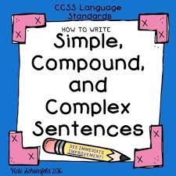

Slide 54
1. Simple sentences (Câu đơn) and compound sentencee ( Câu ghép)
SIMPLE= 1 clause
A simple sentence consists of a single independent clause.
EG: Grandma goes to church alone.
COMPOUND= 2 clauses
A compound sentence consists of two independent clauses.
EG: I like tea , and I like coffee.
S
V
S1 V1 01
S2 V2 02
( FANBOYS)
;however, ; therefore,
nevertheless; moreover
F: For, A: and, N: nor, B: but,
O: or, Y: yet, S: so

Slide 55
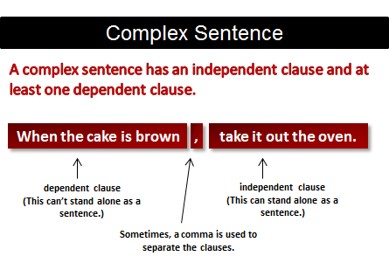
2. Complex sentence
mệnh đề độc lập
mệnh đề phụ thuộc
mệnh đề phụ thuộc
mệnh đề độc lập

Slide 56
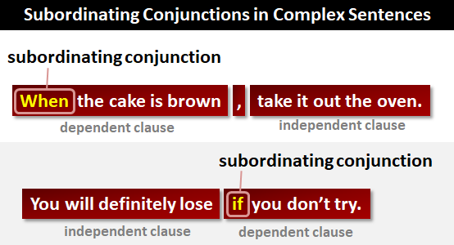
từ nối phụ
mệnh đề phụ thuộc

Slide 57
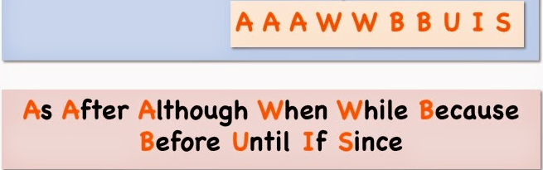
SUBORNATING CONJUNCTIONS

Slide 58
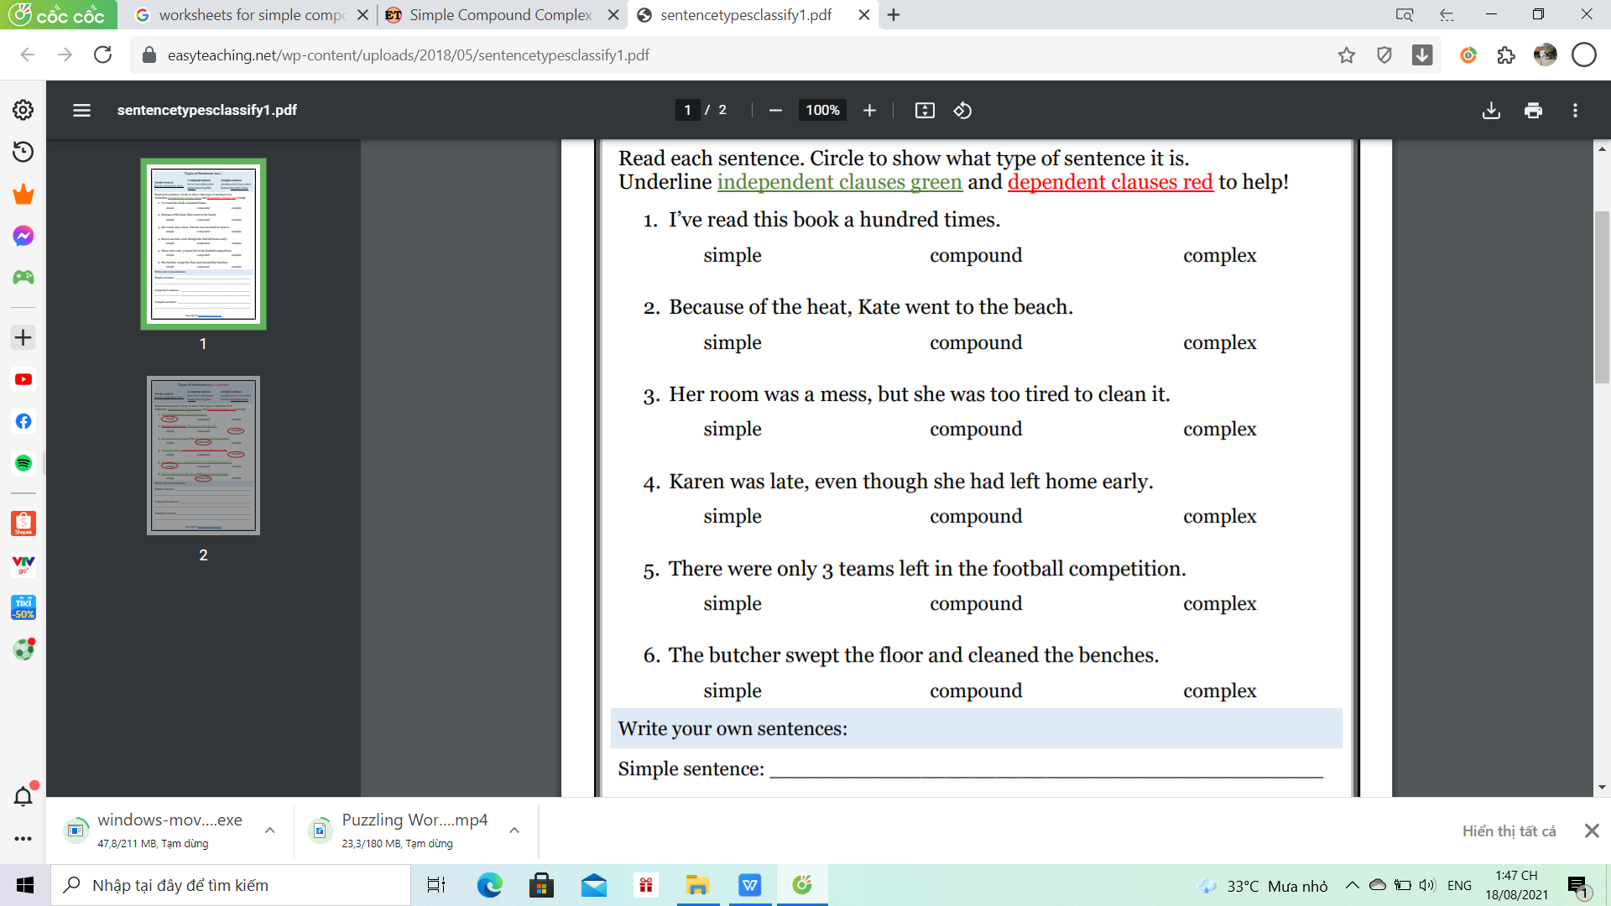
* Practice: EX1: Circle Simple , Compound and Complex

Slide 59
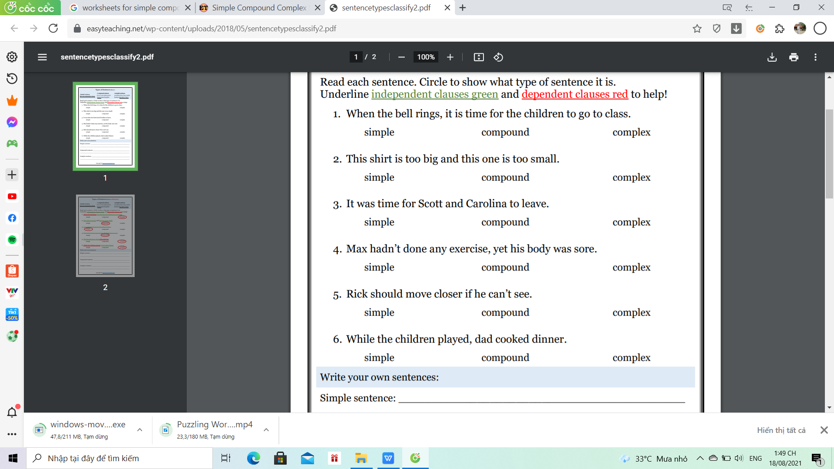

Slide 60
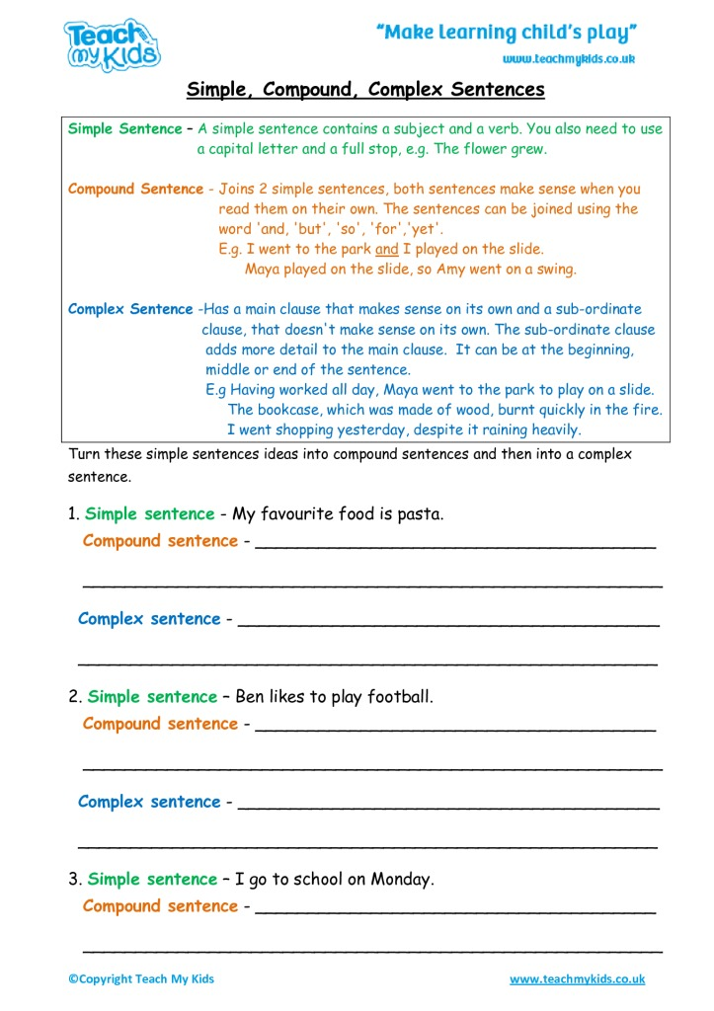
Ex2: Turn these sentences ideas into compound and complex sentence

Slide 61
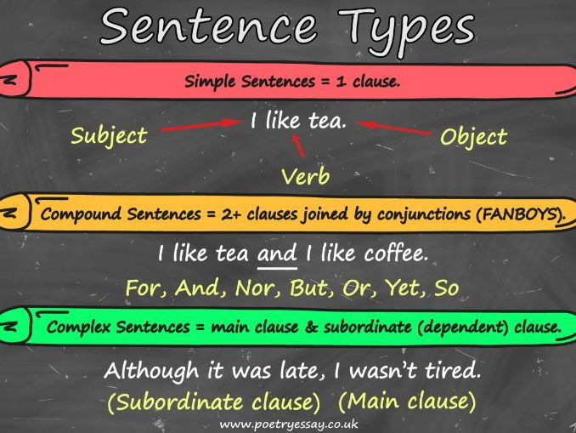

Slide 62
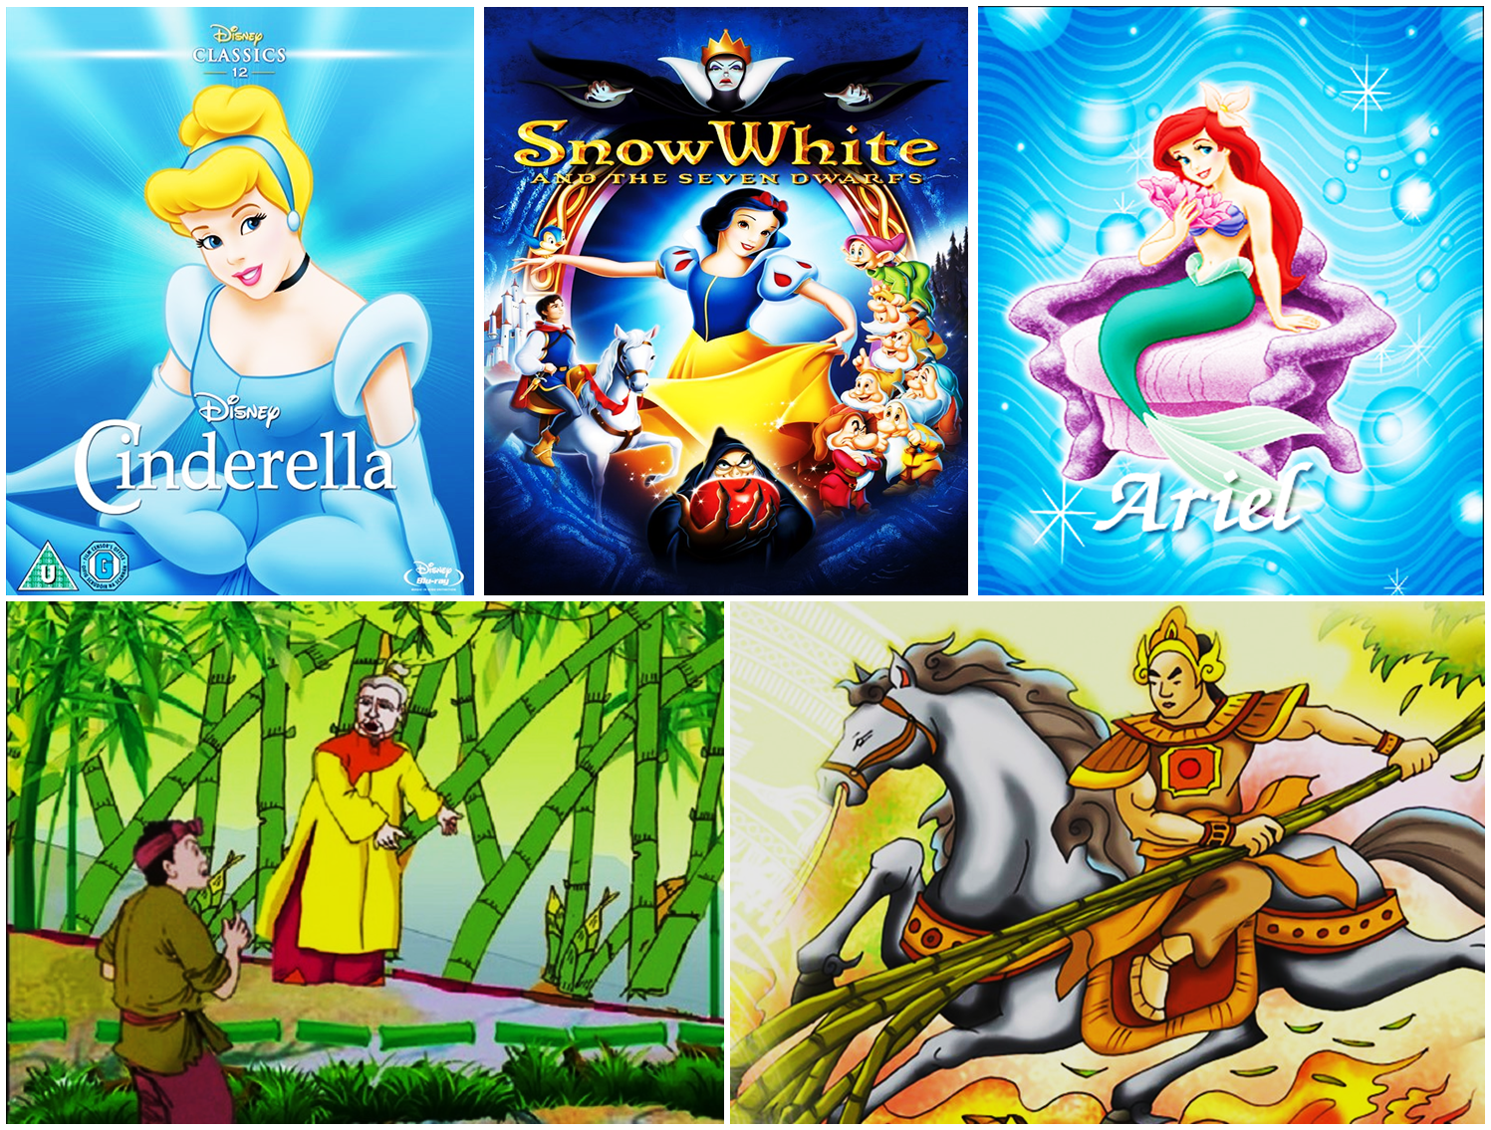
Warm up
FOLK TALES

Slide 63



REVISION
UNIT 6
FOLK TALES

Slide 64
I. VOCABULARY

Slide 65
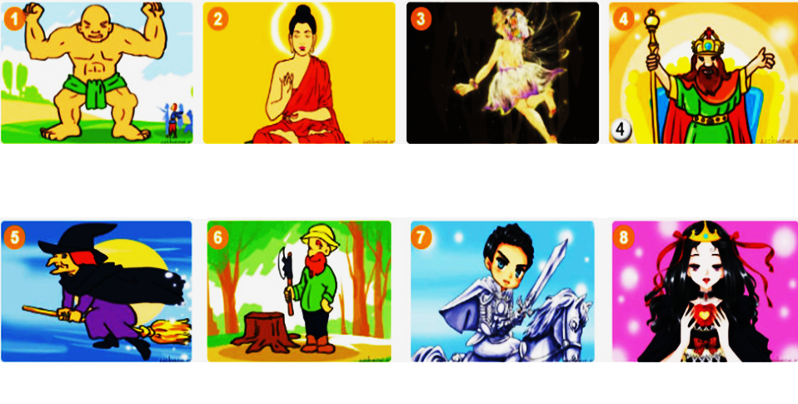
1. These are popular characters in folk tales. Match the characters with the pictures. Can you add more?
A. woodcutter
B. emperor
C. Buddha
D. knight
E. fairy
F. princess
G. giant
H. witch

Slide 66
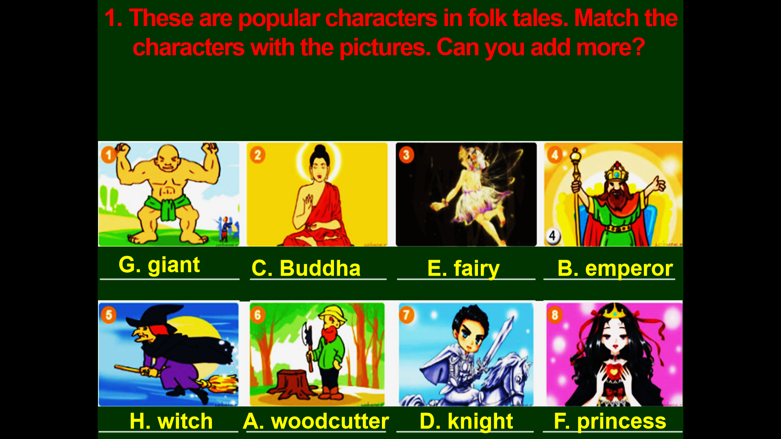
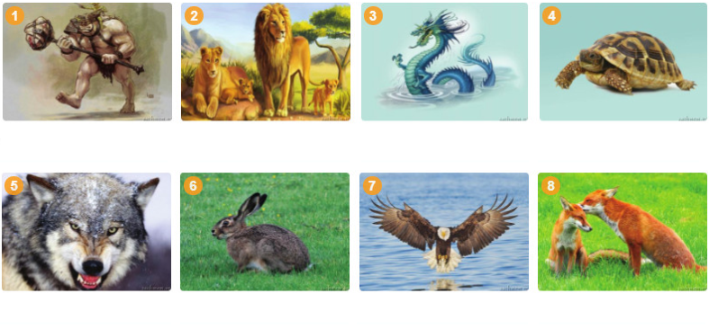
2. These creatures are popular characters in folk tales. Match the creatures with the pictures. Can you add more?
A. dragon
B. wolf
C. hare
D. fox
E. tortoise
F. lion
G. ogre
H. eagle

Slide 67
2. These creatures are popular characters in folk tales. Match the creatures with the pictures. Can you add more?
A. dragon
B. wolf
C. hare
D. fox
E. tortoise
F. lion
G. ogre
H. eagle

Slide 68


Slide 69
II. GRAMMAR

Slide 70

1. Exclaimatory sentence
useful books
they
are
beautiful weather
it
is
Singular Noun: What a/an ADJ N + S V !
Plural/ Uncountable Noun: What adj N + S V !

Slide 71
Practice: Make exclamatory sentences.
1. handsome / man
ome man (he is)!
2. interesting / game
Wresting game (it is)!
3. good / news
d news (it is)!
4. lovely / dogs
y dogs (they are)!
5. brave / women women (they are)!

Slide 72


Ex2: At 3p.m yesterday the tortoise was running ahead of the hare.
2. PAST CONTINUOUS
Ex1: Yesterday I (see) a hare and a tortoise.
saw
V₂
Form: S + was/ were + Ving
Past continuous (quá khứ tiếp diễn)
Usage: 1. We use the past continuous to describe an action that was in progress at a stated time in the past. (diễn tả 1 hành động diễn ra tại 1 thời điểm xác định trong quá khứ)

Slide 73


a fairy appeared
- When the boy was crying, ,
- A fairy appeared
while the boy was crying
S + was/ were + Ving , S + V_{2/ed}
(quá khứ tiếp diễn)
(quá khứ đơn)
(hành động đang diễn ra
trong quá khứ)
(hành động xen vào)
(when / while )

Slide 74

a. Form :
was not (wasn't
were not (weren't )

Slide 75
b. Usage
+ Diễn tả 1 hành động diễn ra tại 1 thời điểm xác định trong quá khứ;
Eg: At 3p.m yesterday the tortoise was running ahead of the hare.
+ Diễn tả 1 hành động đang diễn ra , có một hành động khác xen vào .
When the boy was crying , a fairy appeared
S + was/ were + Ving , S + V_{2/ed}
+ Hai hành động xảy ra song song cùng 1 lúc trong quá khứ
My mother was cooking while my father was reading newspaper.
S + was/ were + Ving S + was/ were + Ving

Slide 76
c. Signal words
at + giờ + thời gian trong quá khứ (at 12 o’clock last night,…)
- at this time + thời gian trong quá khứ. (at this time two weeks ago, …)
- at that moment
+ Trong câu có “when/while” khi diễn tả một hành động đang xảy ra và một hành động khác xen vào.

Slide 77
Practice:
https://www.liveworksheets.com/worksheets/en/English_as_a_Second_Language_(ESL)/Past_simple_and_past_continuous/Past_Simple_or_Past_Continuous_ca2640dp
https://www.baamboozle.com/game/304990 ( Game - past continuous)
https://www.baamboozle.com/game/40902 ( game - past - past continuous)
( Gửi link cho học sinh làm , hoặc chia sẻ màn hình làm trực tiếp.

Slide 78
https://www.liveworksheets.com/worksheets/en/English_as_a_Second_Language_(ESL)/Past_simple_and_past_continuous
HOMEWORK

Slide 79
REVISION UNIT 7,8,9 GRADE 8

Slide 80

English 8
UNIT 7 . POLLUTION

Slide 81








2. There are different types of pollution. Write each type
under a picture:
b. noise
pollution
c. visual
pollution
d. thermal
pollution
a. radioactive
pollution
e. water
pollution
f. land/ soil
pollution
g. light
pollution
h. air
pollution

Slide 82

1. CONDITIONAL SENTENCE TYPE 1
Use: Chỉ sự việc, hành động có thể xảy ra ở hiện tại hoặc trong tương lai. (Câu điều kiện có thực)
Form:
If clause | Main clause
If + S + ......................... | S + ..................................... + V (bare-inf)
V/ Vs/es
will / can/ may /might
I /you/we/they + V
He/She/It + Vs/es

Slide 83


Slide 84
1. CONDITIONAL SENTENCE TYPE 2
Use: Chỉ sự việc, hành động không thể xảy ra ở hiện tại hoặc tương lai, điều kiện chỉ là một giả thiết, một ước muốn trái ngược với thực tế ở hiện tại (Câu điều kiện không có thực ở hiện tại)
Form:
If clause | Main clause
If + S + ......................... | S + ..................................... + V (bare-inf)
V2/Ved
didn't V
would/ could/
PAST SIMPLE

Slide 85
NOTE:
Note: Trong câu điều kiện loại 2 thì động từ to be “were” thường được dùng với tất cả các chủ ngữ. Tuy nhiên, “was” vẫn có thể được sử dụng với chủ ngữ I, He, She, It.
eg: If I / He/ She/ It was/ were ............

Slide 86
COMPLETE THE SENTENCES USING CONDITIONAL SENTENCE TYPE II.
1. If I (come) ................ home earlier, I (prepare) ...................... dinner.
2. If we (live) ......................in Hanoi, my boyfriend (visit) ............................. us.
3. If Richard (be) ............ older, he (play) .............................in our football team.
4. If Mary (study) .....................harder, she (be) ................... better at school.
6. If they (have) ................enough money, they (buy) ............................. a new car.
7. If you (do) ..................a paper round, you (earn) .................. a little extra money.
8. If Minh (get) .......... more money, he (ask) ............................. Lam out for dinner.
9. If we (win) .............. the lottery, we (fly) ............................. to London.
10. If I ( be) ...........you , I ( not buy) ...............that flat.

Slide 87
I. Choose the letter A, B, C, D to indicate the correct answer to each of the following questions.
Question 1. If I ________, I would express my feelings.
A. were asked B. would ask C. had been asked D. asked.
Question 2. If the weather ________ nice, we will go camping tomorrow.
A. were B. is C. had been D. will be
Question 3. Will you be angry if I ________ your pocket dictionary?
A. stole B. have stolen C. were to steal D. steal
Question 4. John would be taking a great risk if he ________ his money in that company.
A. would invest B. invested C. had invested D. invests
Question 5. If the wall weren’t so high, he ________ it up to take his ball down.
A. climbed B. could climb C. is climbing D. climbs
Question 6. If I ________ her phone number, I would phone her.
A. had known B. would know C. know D. knew
Question 7. If he ________ the truth, the police wouldn’t arrest him.
A. tells B. told C. had told D. would tell
Question 8. If you press that button what ________?
A. would happen B. would have happened C. will happen D. happen

Slide 88






GAME
What are the names of these countries?
The USA
The United Kingdom
Singapore
1................................
2..........................................
3..................................
Australia
Canada
New Zealand
4.......................................
5.........................................
6..................................

Slide 89


Unit 8:
ENGLISH SPEAKING COUNTRIES

Slide 90
I/ Grammar : Present tenses
present simple | present progressive | present perfect
- Diễn tả những sự việc thường xuyên xảy ra , một thói quen hàng ngày - Diễn tả một chân lý , hiện tượng tự nhiên - KHi nói đến lịch trình , chương trình (phương tiện, trường học, chiếu phim...) | - Diễn tả sự việc đang diễn ra tại thời điểm nói . - DIễn tả sự việc tạm thời - Diễn tả tương lai có lên kế hoawchj sẵn . | - Diễn tả một sự việc vừa mới hoàn thành , Diễn tả 1 sự việc kéo dài trong quá khứ đến hiện tại và đến tương lai.
Form: + )S + V / Vs/es _) S + don't / doesn't + V ?) Do/ Does + S + V ? | Form: +) S am/is/are + Ving ? -) S amnot/ isnot/ arenot + Ving -) Is/ Are + S + Ving ? | Form: +) S has/ have + Vpii -) S hasn't / haven't + V pii ?) Has / have + S + V pii ?
Signal words: always , often, sometimes, usually, rarely, once /twice a week, every day/week/month.... | - now, at the moment, at present, today, right now......., Look! | - for, since, yet , already, so far, just recently ,

Slide 91
VII. Complete the sentences with the correct form of the verbs (present simple, present continuous, or present perfect).
1. __________ (you/ talk) about the upcoming journey? Can I join?
2. Recently, the United States__________ (alter) the whole of their immigration laws.
3. Either kangaroo or Sydney Opera House__________ (symbolize) Australia.
4. Look at the London Eye! The wheel__________ (appear) motionless, but it__________ (rotate) slowly.
5. Look! The concert__________ (start) at 7 P.M. and__________ (end) at 9 P.M.
6. Canada__________ (provide) fish, furs, and other natural resources to the world since the 15th century.
7. We’ve already booked our holiday. We__________ (go) to Scotland in July.
8. About 375 million people__________ (speak) English as their first language.
9. To preserve natural habitat, the government__________ (establish) six national parks so far.
10. Excuse me, what time__________ (the last train to Dublin/ leave)?

Slide 92


Pronunciation
Stress in words ending in –ese and –ee
-ese | -ee
1. Cantonese | 5. employee
2. Taiwanese | 6. adoptee
3. Japanese | 7. addressee
4. Portuguese | 8. interviewee

Slide 93

Revision Unit 9:
NATURAL DISASTERS

Slide 94


Slide 95


Slide 96


Slide 97
HOW TO CHANGE PASSIVE VOICE ?
ACTIVE: S1 V 0(S2)
S2(0)
TOBE + Ved/ P2
by 0 (s1)
PASSIVE VOICE: S + Tobe + Ved/ P2 by 0

Slide 98
Practice : Ex1 - Rewrite the sentences in passive voice.
Question 1. I clean the floor every day.
Question 2. My mother bought this dress this morning.
Question 3. She has already done her report .
Question 4. They will send him abroad to study.
Question 5. She is cleaning her room now.
Question 6. Someone was following him .

Slide 99
EX2: Choose the letter A, B, C, D to indicate the correct answer to each of the following questions.
Question 1. This house _________ in 1990 by my grandfather.
A. is built B. was built C. built D. has built
Question 2. My sister is going _________ this house.
A. sold B. sell C. to be sold D. to sell
Question 3. There’s a man behind us. I think we are _________.
A. being followed B. be followed C. followed D. following
Question 4. Over 1000 new houses _________ every year. Last year, 1200 new houses _________.
A. were built/ were built B. are built/ were built
C. are building / were built D. were built/ were being built
Question 5. The next exam _________ in May.
A. will hold B. will be held C. will be holding D. will have held
Question 6. English is _________ all over the world.
A. spoken B. speak C. speaks D. to speak

Slide 100
II. Choose the letter A, B, C, or D to indicate the sentence that is closest in meaning to each of the following questions.
Question 11. We should send their complaints to the boss.
A. Complaints should sent to the boss.
B. Complaints should be sent to the boss,
C. Their complaints should be sent to the boss.
D. Their complaints to the boss should be sent.
Question 12. They will give you a lot of questions at the interview.
A. You will be given a lot of questions at the interview.
B. You will given a lot of questions at the interview.
C. A lot of questions will be given you at the interview.
D. A lot of questions will be given at the interview.
Question 13. Nobody told me that Tim was ill.
A. I was told that Tim wasn’t ill.
B. I wasn’t told that Tim was ill.
C. Tim wasn’t told to be ill.
D. Tim was told not to be ill.
Question 14. We will send you the results soon.
A. You will be sent to the results soon.
B. You will send the results soon.
C. The results will be sent you soon.
D. The results will be sent to you soon.
Question 15. My sister can sing English songs well.
A. My sister can sing English songs better than me.
B. English songs can are sung well by my sister.
C. English songs can be sung well by my sister.
D. English songs can sung well by my sister.

Slide 101


Slide 102


Past perfect
Past simple

Slide 103

The differences between Past Perfect and Past simple
2001
2004
had + Ved/Vp2
Ved /V2

Slide 104

1. PAST PERFECT
A. FORM:

Slide 105
1. PAST PERFECT
b. Usage
- An action finished before another past action in the past
Eg: Gagarin had flown into space eight years before
before Amstrong walked on the Moon.
after
- An action that happened before a specific time in the past.
Eg: I had done my homework before last night.
c. Signals :
After, before, when, as, once
Ex: When I got to the station,
V2
the train had already left.
had Ved/ V3

