Slide 1

WELCOME TO OURCLASS

Slide 2
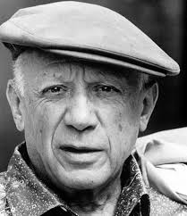

GUESSING GAME
WHO IS HE?
He’s a painter.
He is from Spain.
This is the potrait of him.
PICASSO

Slide 3

UNIT 4: MUSIC AND ARTS
PERIOD: 33
LESSON 6: SKILLS 2

Slide 4
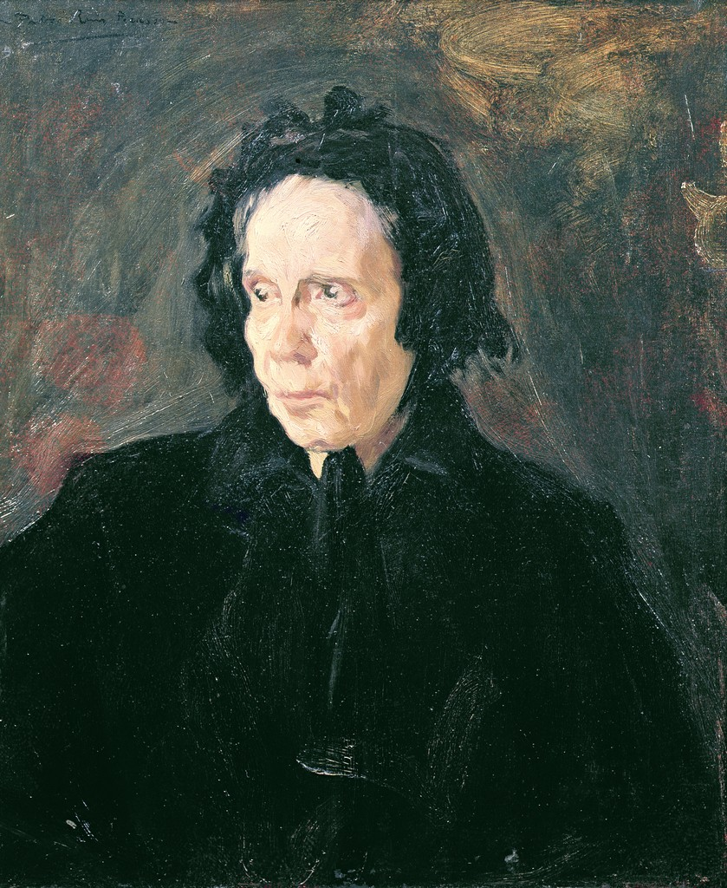
This is the first picture of picasso
Portrait of aunt pepa is drawn in 1896

Slide 5
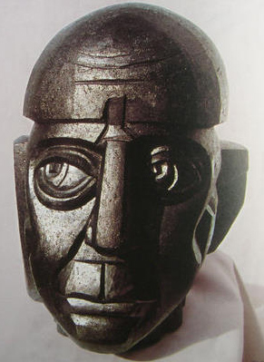
I. VOCABULARY
- sculpture (n)
= tác phẩm điêu khắc
- training/ education( n)
= đào tạo
- produce (v)
= sản xuất, chế tạo
- enormous (adj. )
= a lot of

Slide 6

ii. listening
1. Listen to the passage about Picasso and circle the words you hear.(Ex. 1/p.45)
1. artists
2. training
3. picture
4. portrait
5. music
6. paintings

Slide 7
E1. Read the passage, and then answer the questions.
There are many activities after school hours in Lan’s school, so she and her classmate can take part in them. Lan and Mai join the school theater group and they are also the members of the stamp collector’s club. They are rehearsing a play for the Teacher’s Day. Hung and Tuan are members of the school sport club. They play for the school football team, Ha and Thanh are the members of the school art club, and they want to be good artist one day in the future.
1.Which of them joins the school theater group?
2.What are they doing now?
3.Who are the members of the stamp collector’s club
4Who plays for the school football team?
5.Who are the members of the school art club?
1. Lan and and Mai join the school theater group.
2. They are rehearsing a play for the Teacher’s Day.
3. Lan and Mai are the members of the stamp collector’s club.
4. Hung and Tuan play for the school football team.
5. Ha and Thanh are the members of the school art club

Slide 8


2. Listen to the passage again and choose the correct answers. (Ex. 2/p.45)
1. When was Picasso born?
t
A. In 1881
f
B. In 1896
f
C. In 1973

Slide 9
2. Listen to the passage again and choose the correct answers. (Ex. 2/p.45)
2. Picasso received artist training from his father at ______
f
A. thirteen
t
B. seven
f
C. thirty

Slide 10
2. Listen to the passage again and choose the correct answers. (Ex. 2/p.45)
3. How many works of art did Picasso produce?
t
A. 50,000
f
B. 1,885
f
C. 1,973

Slide 11
2. Listen to the passage again and choose the correct answers. (Ex. 2/p.45)
4. Where did Picasso died?
f
A. In Malaga
f
B. In Barcelona
t
C. In Mougins

Slide 12
ii. listening
3. Listen to the passage one more time. As a class, discuss how the listening is organized
( according to a timeline, the order of important events, or another way)(Ex. 3/p.45)
Timeline
1. 1881
2. 1888
3. 1894
4. 1896
5. 1973
EVENTS
was born in Malaga , Spain.
received formal artistic training from his father.
was admitted to a School of Fine Art in Barcelona.
completed “ Portrait of Aunt Pepa “.
died in Mougins , France

Slide 13
E1. Read the passage, and then answer the questions.
There are many activities after school hours in Lan’s school, so she and her classmate can take part in them. Lan and Mai join the school theater group and they are also the members of the stamp collector’s club. They are rehearsing a play for the Teacher’s Day. Hung and Tuan are members of the school sport club. They play for the school football team, Ha and Thanh are the members of the school art club, and they want to be good artist one day in the future.
1.Which of them joins the school theater group?
2.What are they doing now?
3.Who are the members of the stamp collector’s club
4Who plays for the school football team?
5.Who are the members of the school art club?
1. Lan and and Mai join the school theater group.
2. They are rehearsing a play for the Teacher’s Day.
3. Lan and Mai are the members of the stamp collector’s club.
4. Hung and Tuan play for the school football team.
5. Ha and Thanh are the members of the school art club

Slide 14
E2.Read the text about an artist. Choose the correct answer: A, B, or C.
You can’t buy a drawing by Julian Beever and you can’t see his work in a gallery or museum. Julian makes his amazing pictures on the pavements of city streets. People have called him “the Pavement Picasso” and perhaps you have seen his pictures on the Internet.
Julian has made hundreds of pieces of “pavement art” in different countries - in many parts of Europe and also in the USA, Australia, Japan, Argentina, and Brazil.
His drawings can take three or four days to finish. But because he draws with chalk, the drawings only stay for a short time. When people walk on them or when it rains, they quickly disappear. For Julian, this isn’t a problem. The drawings survive in the photos he has taken, and this is the most important thing for him.
Julian’s fame hasn’t come from experts in the art world, but from the Internet. “The reason why my work has become well known is because people like it and they’ve sent it to each other on the Internet,” he says. “So I know that what I do is popular.”
Julian Beever is from Leicestershire in England, but he now lives in Belgium.
1. Julian Beever makes drawings .
A. outside B. on his computer C. for exhibitions in a gallery
2.He has worked .
A. in a few cities B. in lots of countries C. with hundreds of people
3.His pictures .
A. are easy to draw B. look good when it rains C. don’t stay for a long time
4. Lots of people know Julian’s art because .
A. they know a lot about art B. he has sent photos to them C. they have seen it on the net
5. Julian Beever .
A. hasn’t lived in Britain B. hasn’t tried to be a star in the art world C. isn’t very interested in photos
1. A 2. B 3. C 4. C 5. B

Slide 15

iii. writing
Informal letter of invitation.
Writing tip
Would you like + to……?
How about + V-ing ………………?
What about + V-ing........................ ?
Time: Time to meet :
Place : Place to meet

Slide 16
1. Read the following letter and choose the correct answer.(Ex. 4/p.45)
1. This letter is from Duong to _____.
A. a friend
B. a teacher
C. an old man

Slide 17
1. Read the following letter and choose the correct answer.(Ex. 4/p.45)
2. Duong write this letter to____
A. give an order
C. complain about something
B. make an invitation

Slide 18
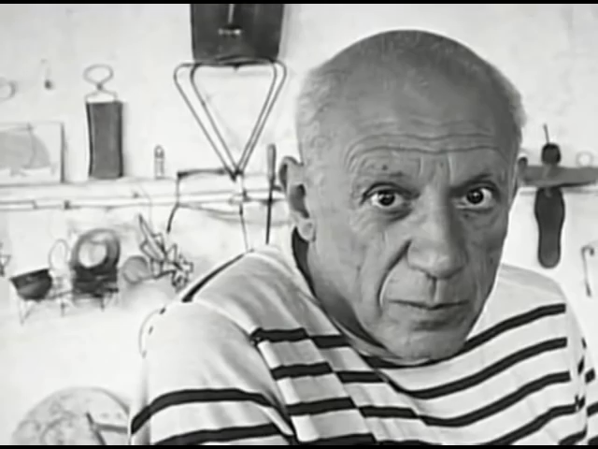
A VIDEO OF PICASSO

Slide 19
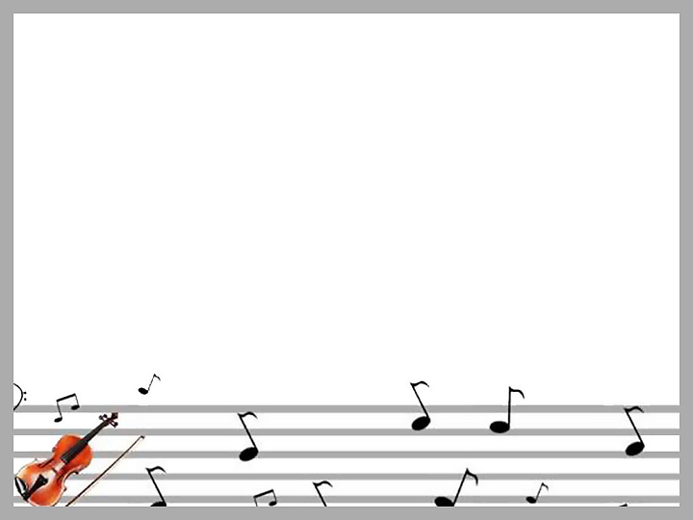
iv. At home
Learn new words by heart.
Do exercise 5 /P.45 in textbook.
Prepare LOOKING BACK AND PROJECT.

Slide 20

THANKS FOR YOUR ATTENTION

Slide 21
Hi Nam,
How are you? Are you busy this Saturday?
Well, there is an Exhibition of Modem Art in Arts Centre now. It is the great exhibition of this year. How about going there this Saturday morning? The exhibition often opens at 9:00, so let’s meet at the gate at 8:15 and we will go to the KFC store nearby to have breakfast and then we come back the centre.
Write to me soon. I’m sure that it will be fun
Cheers,
Lan

