Slide 1

Period 33: Unit 4: Our customs and traditions
Lesson 7: Looking back + project

Slide 2

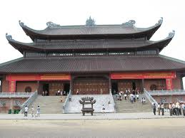
VOCABULARY 1. Complete the sentences with the words from the box. Cutlery generations wrap worshipping host respect
respect
We should ………………………. our customs and traditions.
A lot of countries in the world have the tradition of …………….. their ancestors.
You shouldn’t …………………. a gift in black or white paper.
In a lot of countries, the ………………... usually invites everybody to start eating.
In Viet Nam, the …………………… We mostly use is chopsticks.
For ………………., many family has visited this pagoda
worshipping
wrap
host
cutlery
generations

Slide 3

2. Write sentences with the following expressions
There’s a tradition that
according to tradition
follow the tradition of
break with tradition by
have the custom of
1. …………………………………………………………………………………………
2……………………………………………………………………………………………
3. …………………………………………………………………………………………
4. …………………………………………………………………………………………
5. …………………………………………………………………………………………..

Slide 4

Suggestions
There is a tradition in our countries of having fireworks on New year’s Eve.
2. According to tradition, we have fireworks on New year’s Eve.
3. Following the tradition of having fireworks on new year’s Eve.
4. My neighborhood broke with tradition by not having five crackers on New year’s Eve.
5. In the first day, people have the customs of going to the pagoda.

Slide 5

Grammar: Modal verbs
*Have to
S(I,you,we,they)+ have to + V(infinitive)
S(he,she,it)+ has to +V(infinitive)
*Should
(+) S + should + V(infinitive)
(-) S + shouldn’t + V(infinitive)

Slide 6

4. Complete the sentences, using should or shouldn’t and a verb from the box. Use break wait touch follow
should wait
In Viet Nam you …………………… for the eldest person to sit before you sit down.
2. In Viet Nam you ………………………........ Only the first name to address people older than you.
3. You ……………………...... your promise to the children.
4. If you are Vietnamese, you ……………………… your customs and traditions.
5. You ………………………..... another person’s head because it’s disrespectful.
shouldn’t use
shouldn’t break
should follow
shouldn’t touch

Slide 7
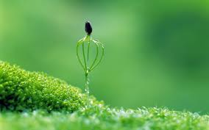
5. Underline one mistake in each of the following sentences. Correct it.
1. When you visit a temple in Thailand, you has to follow some important customs.
2. People should wear short shorts and tank tops. This is disrespectful.
3. People can wear sandals, but these have to has a strap around the back.
4. People should to lower their voice inside the temple.
5. Women have a voice touching monks.

Slide 8
5. Underline one mistake in each of the following sentences. Correct it.
When you visit a temple in Thailand, you has to follow some important customs.
2. People should wear short shorts and tank tops. This is disrespectful.
3. People can wear sandals, but these have to has a strap around the back.
4. People should to lower their voice inside the temple.
5. Women have avoid touching monks.
-> have to
-> shouldn’t
->have to have
-> should
->have to avoid

Slide 9

Communication 6. Game: WHAT SHOULD I DO?
In small groups, take turn to choose one of these scenarios for each other. Once
everyone has had a turn at answering, vote for. the person who gave the best advice.
I’ ve been invited to dinner with a British family.
I’m going to Japan to stay with my Japanese friend
I’m going to visit a pagoda in Viet Nam.
I’m going to visit a temple in Thailand.
I want to join in Tet celebrations.

Slide 10

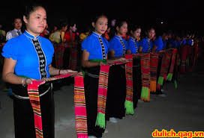
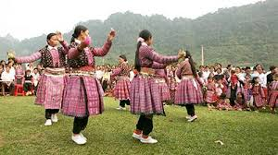
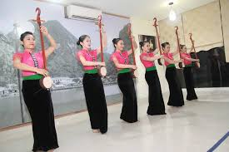
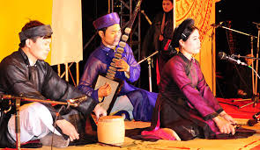
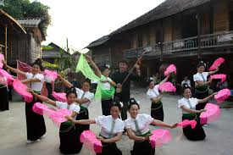
Project
Customs and traditions: How they have changed

Slide 11
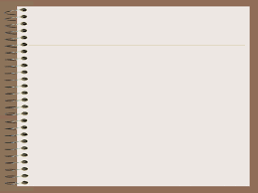
Homework
- Do again all exercises
- Do exercise : E.writing in page 35 in workbook
- Prepare unit 5: getting started

