Slide 2

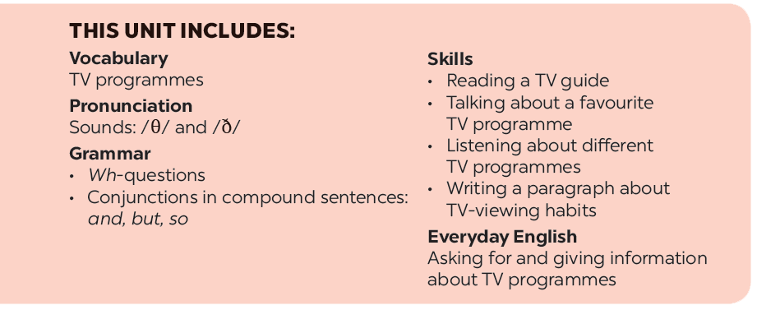

Slide 3






Listening
Writing
Listen and tick () the correct channel for each programme.
Read the questions and circle the right answers for yourself.
Listen again and tick () T (True) or F (False).
Write a paragraph of about 50 words about your TV-viewing habits. Use your answers in 3.

Slide 4
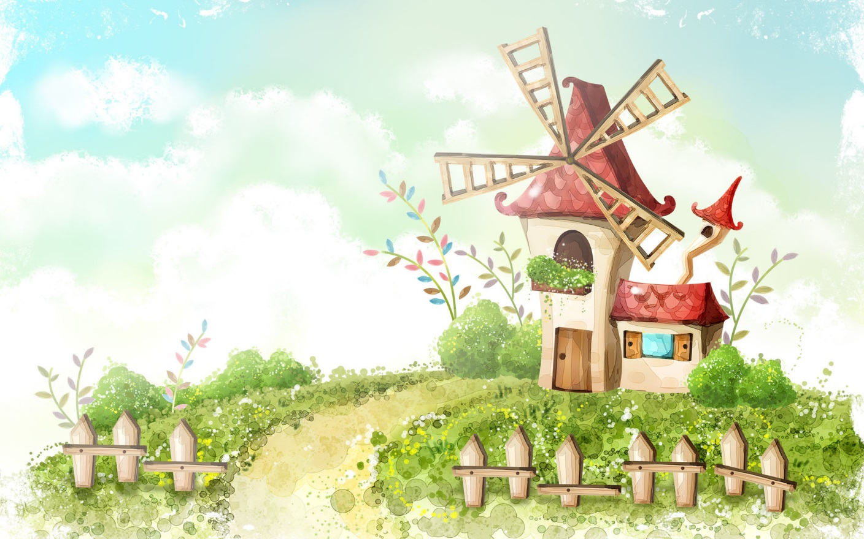
Saturday,January 22nd 2022
Unit 7: Television
Lesson 6: Skills 2p.13

Slide 5
Listening

Slide 6



Listen and tick () the correct channel for each programme.
PROGRAMMES | CHANNEL 1 | CHANNEL 2 | CHANNEL 3
Green Summer
My Childhood
Harry Potter
English and Fun




Audio script

Slide 7
AUDIO SCRIPT
Here are some interesting TV programmes for you. Green Summer, a music programme, is on channel 1. It starts at eight o’clock. My Childhood is on Channel 2. It’s the story of a country boy and his dog Billy. On channel 3, you will watch Harry Potter at 8.30. Children all over the world love this film. If you like to learn English, you can go to English and Fun on channel 1. It’s at nine o’clock. We hope you can choose a programme for yourself. Enjoy and have a great time.

Slide 8

Listen again and tick () T (True) or F (False).
 | T | F
1. Green Summer is a music programme.
2. My Childhood is the story of a girl and her dog.
3. Children love Harry Potter.
4. English and Fun is at five o’clock.




Audio script

Slide 9
AUDIO SCRIPT
Here are some interesting TV programmes for you. Green Summer, a music programme, is on channel 1. It starts at eight o’clock. My Childhood is on Channel 2. It’s the story of a country boy and his dog Billy. On channel 3, you will watch Harry Potter at 8.30. Children all over the world love this film. If you like to learn English, you can go to English and Fun on channel 1. It’s at nine o’clock. We hope you can choose a programme for yourself. Enjoy and have a great time.

Slide 10
Writing

Slide 11

Read the questions and circle the right answers for yourself.
1.
How much do you like watching TV?
A.
A lot.
B.
So so.
C.
Not much.
2.
How many hours a day do you watch TV?
A.
1 hour.
B.
2 -3 hours.
C.
Less than one hour.
3.
When do you watch TV the most?
B.
C.
In the evening
A.
In the morning
In the afternoon
4.
Do you watch TV when you are eating?
A.
Always.
B.
Sometimes.
C.
Never.
5.
What TV programme do you watch the most?
A.
Cartoons.
B.
Sports.
C.
Science.

Slide 12

Write a paragraph of about 50 words about your TV-viewing habits. Use your answers in 3.

Slide 13
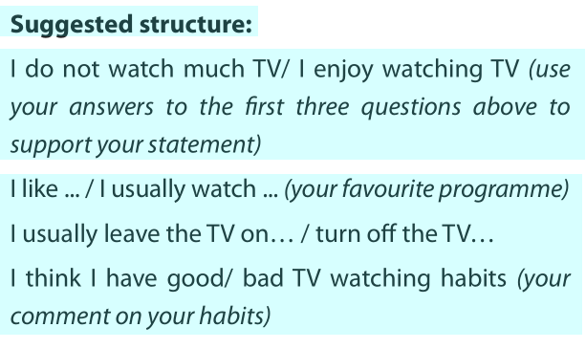
2. Write a short description

Slide 14
Suggested writing:
I do not watch much TV. I only spend one or two hours a day watching TV. I spend most of my free time on outdoor activities. I usually watch the VTV news on VTV 1 channel. I usually turn off the TV when I do not watch it. I think I have good TV watching habits.

Slide 15
Home Assignments
Review vocabulary
Do EX in part E p.7-8 in WB

Slide 16







